Slide 1
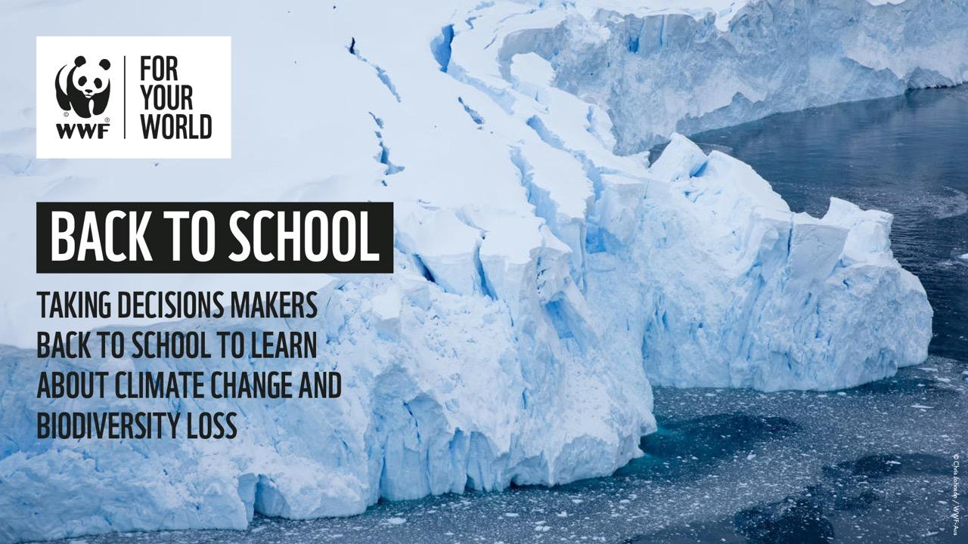
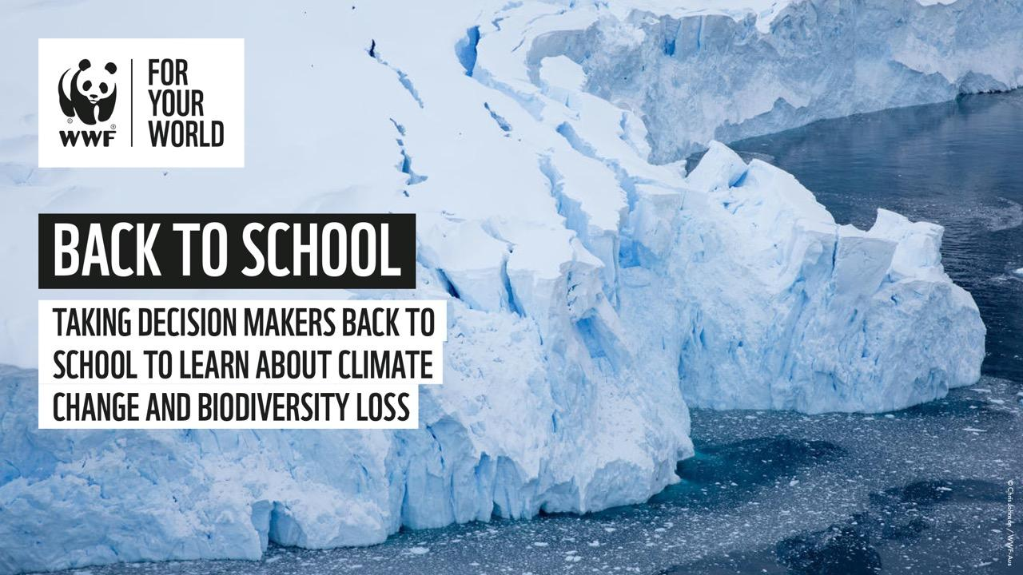

Slide 2
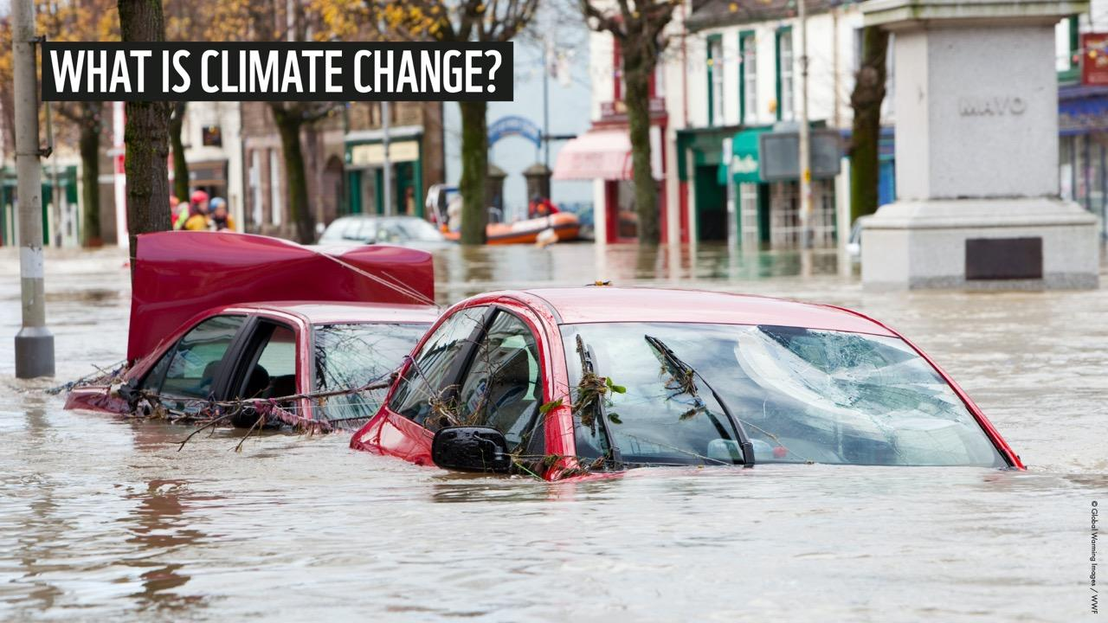
Notes:
Ask the audience: have you heard of climate change? What do you think it is?
Take some responses from the students
Explain that climate change (sometimes called global warming) is the process of our planet heating up.
Scientists are very worried about the way the climate is changing now on our planet, and the way it is predicted to change in the future. Our planet has warmed by an average of 1°C in the last century. It is going to continue to heat up, as we emit more greenhouse gases, and if things don’t change, it could increase by a lot more than that.
1°C might sound small but this is already having a big impact, making weather around the world more extreme and less predictable. Any rise will make storms, floods, droughts and wildfires even more severe, and more frequent; a rise of 2°C would make it 10 times more likely that the Arctic would be sea-ice free in the summers, than a rise of 1.5º.
This increase is due largely to increased levels of carbon dioxide – and other greenhouse gases - in our atmosphere, produced by the use of fossil fuels (coal, oil and gas), and has been worsened by the cutting down of forests that naturally absorb carbon dioxide.

Slide 3
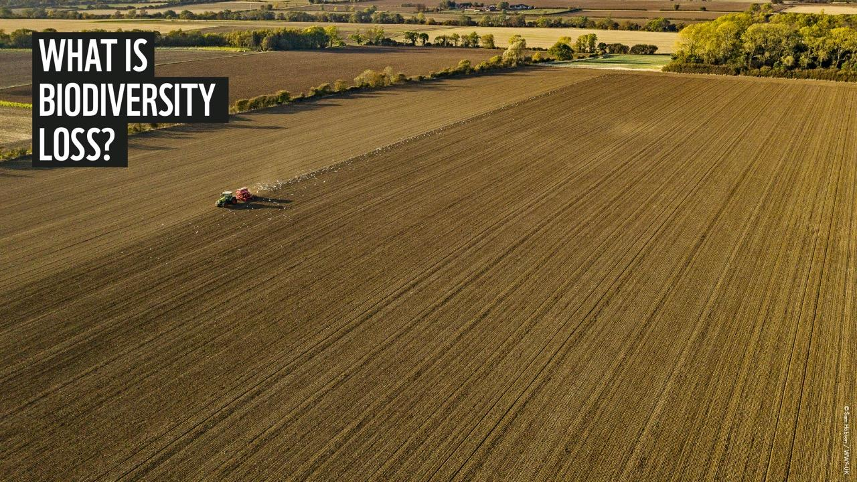
Notes:
Ask the audience: Have you heard of biodiversity? What do you think it means?
Take some suggested responses
What is biodiversity?
Biodiversity is the variety and variability of life on our planet.
The Earth’s natural assets are made up of plants, animals, land, water, the atmosphere AND humans!
Biodiversity is the link between all organisms on earth, binding each into an interdependant ecosystem, in which all species have their role.
Biodiversity underpins the health of the planet and has a direct impact on all our lives. It is the resource upon which families, communities, nations and future generations depend.
What is biodiversity loss?
Plummeting numbers of mammals, reptiles, amphibians, birds and fish around the world are an urgent sign that nature needs life support.
The Living Planet Report 2018 shows that wildlife populations have declined by over half in less than 50 years.
Humans have only been around for 200,000 years, a tiny blip in the 4.5 billion years of our planet’s history. Yet we have had a greater impact on the Earth than any other species. All over the world, we are cutting down forests, using too much water from rivers, choking our oceans with plastic and pushing many animals to extinction.
And the picture isn’t any different at home. Here in the UK, over 1,000 species are at risk of extinction. From our iconic hedgehogs to our bees and butterflies, our nature needs life support.
For both people and wildlife to thrive, now and in the future, we need a healthy planet, with a rich variety of plants and animals and vibrant ecosystems.

Slide 4
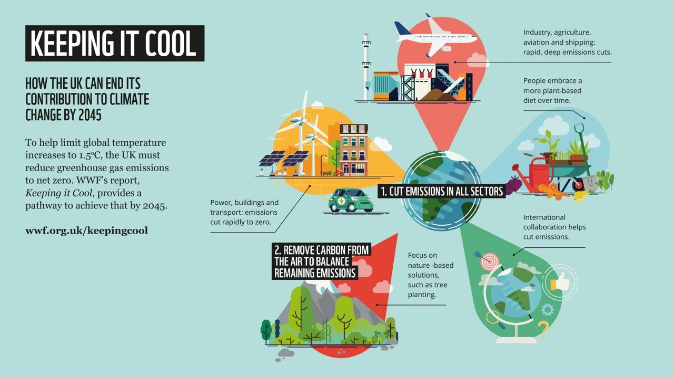
Notes:
Ask the audience:
Who are the decision makers that can have a real influence on these issues?
How can we influence decision makers?
Take some suggestions
Explain that the biggest barrier to stopping biodiversity loss and climate change is the failure of politicians and big business to act.
In order to stop climate change and biodiversity loss we need decision makers to take responsibility, and take urgent action to:
Make climate and nature action a priority across all parts of government.
End support for fossil fuels, including no more subsidies for oil and gas, stopping fracking and halting airport expansion.
Invest in the clean economy, including renewables, electric vehicles and carbon neutral homes, creating jobs of the future.
Restore the environment at home and abroad, so nature can fight back against climate change, and wildlife and people thrive.
Commit to net zero greenhouse gas emissions by 2045.

Slide 5
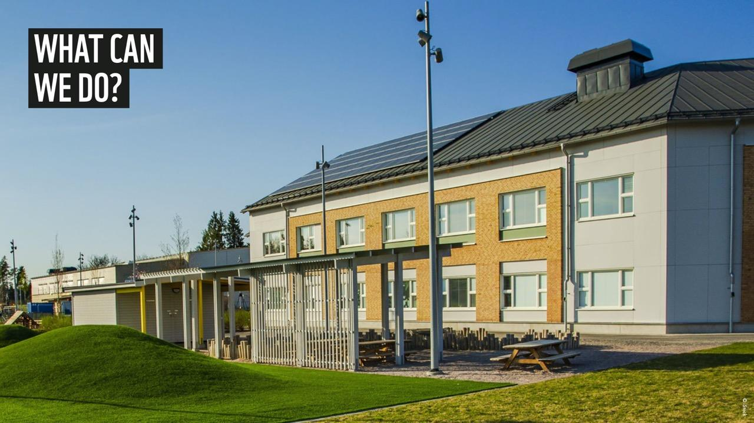
Notes:
To stop climate change and biodiversity loss we need real change, all over the world.
Everyone – governments, businesses, communities and individuals – have a part to play in coming up with this new plan – a global deal for nature.
You can help by:
campaigning to end deforestation and fix our food system
advocating to stop fossil fuel emissions by 2050
taking action to end plastic pollution
supporting our local wildlife by calling on MPs to restore UK nature.

Slide 6
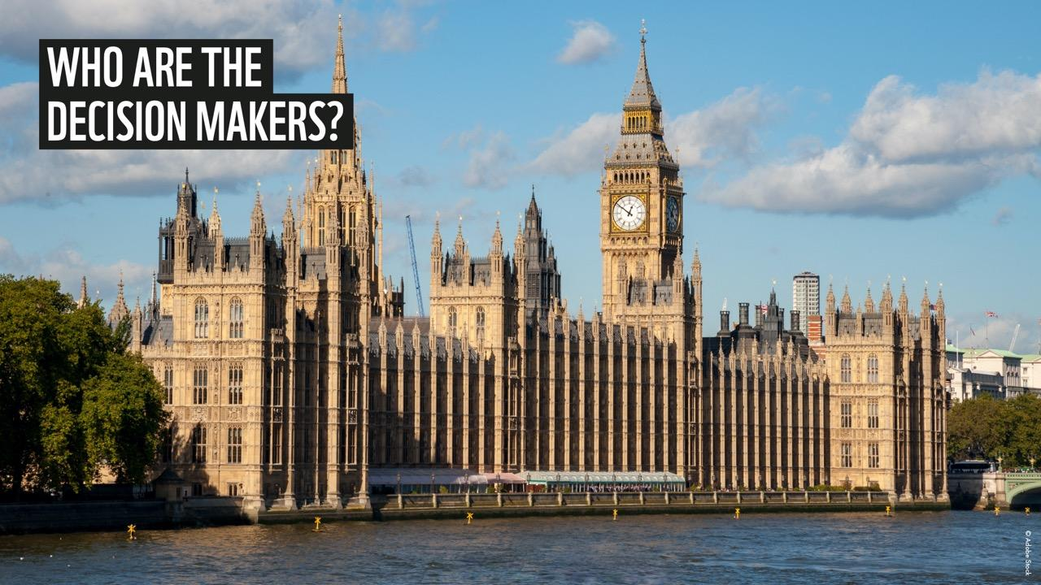
Notes:
Ask the audience: who are the decision makers in the UK?
Prompt for: MPs (and MSPs and AMs), heads of big businesses, the EU and the UN
Ask the audience: do you know what an MP is?
Take some suggestions
MPs are politicians. MP means Member of Parliament. A member of parliament is the representative of the voters to a parliament. One MP is elected to the House of Commons by each of the UK’s constituencies.
MPs’ responsibilities include participating in debates, voting on new laws and making decisions about key issues.
MPs can help their constituents by advising on problems, representing the concerns of their constituents in Parliament and acting as a figurehead for the local area.
MPs are elected to represent their local community in the UK Parliament (Houses of Parliament), to ensure that their views are taken into account when discussing national policies and the passing of laws.
MPs not only represent their local communities but also their political party of which they are a member. The party with the largest number of MPs elected to Parliament forms the Government.
What about big businesses?
Business and industry are responsible for a large proportion of global emissions and landscape transformation.
Business leaders across a wide range of industries have a key role in implementing technologies and innovations to restore nature and address climate change.
Businesses can lead by example by setting targets to lower emissions and impacts on nature and the environment, providing environmental education opportunities, using sustainable materials to make their products and so on.
For example - the renewable energy sector is growing rapidly and competing with fossil fuels.
This helps to shield the world from the worst climate risks while improving health, boosting our economies and creating jobs. Another example can be sustainable farming and fishing, where nature’s recovery can not only help wildlife to thrive but also bring benefits for people and their businesses, by providing better yields (more pollination, healthier soils and seas, greater fish stocks and variety, etc.).

Slide 7
Notes:
Ask for a show of hands:
Who knows who their MP is?
Has anyone written to or met their MP? (If any students raise their hands, ask what they wrote to their MP about and if they got a reply)
By writing to your MP, you can help them to understand which issues are important to you, and what you would like them to do about it.
For example, you can ask them to support a campaign you feel strongly about. If enough people write to their MP about a particular issue they might discuss it in the House of Commons and this can help the campaign gain attention. If an issue gains lots of attention in the media and amongst the public, this puts pressure on politicians to actually do something about it.
You can also write to your MP to ask them to speak at or attend an event.
Lots of MPs like to visit schools, to see what students are doing and learn about the issues young people care about.
MPs represent their constituents (the people that live in their area), so they need to know what you care about. By talking to your MP you can put pressure on them to take actions on the things that are important to you.
You can find out who the MPs for your school catchment area are here www.theyworkforyou.com/
Find out more about what your MP can do for you here www.parliament.uk/about/mps-and-lords/members/what/
You can influence big businesses by:
Lobbying them to make changes (e.g. by writing to them or contacting them on social media)
Making sure you buy your products and services from businesses that are doing good for the environment

Slide 8
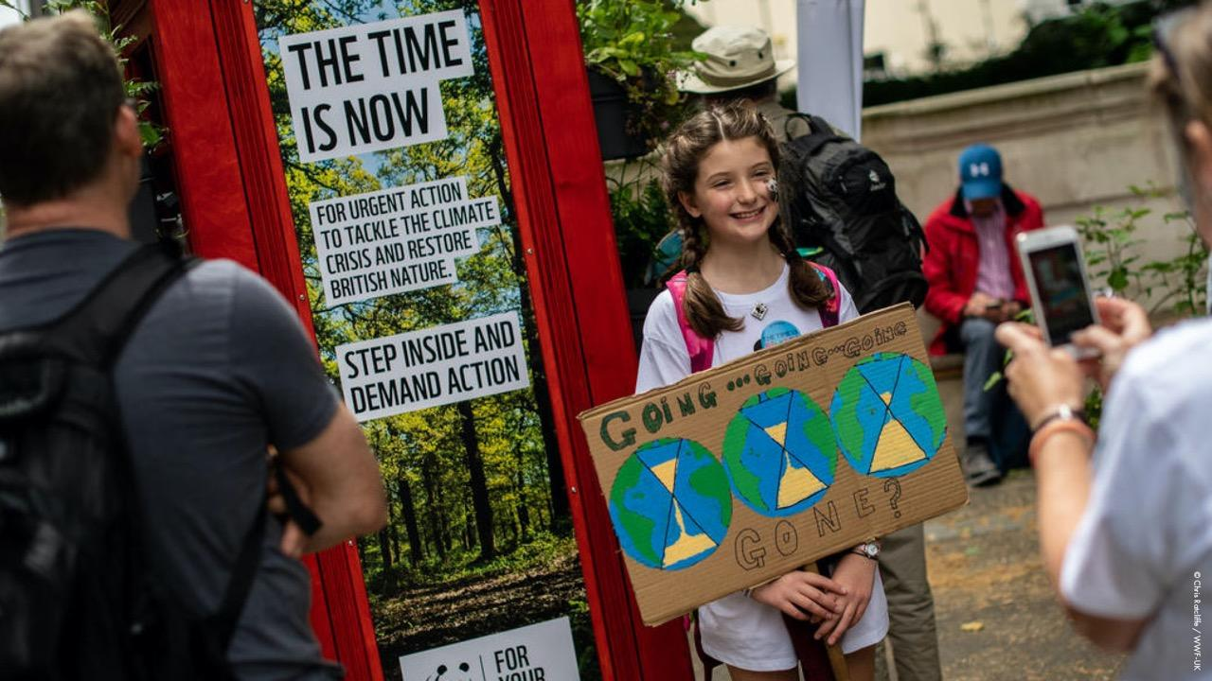
Notes:
Take a show of hands:
Did anyone hear about the Global Climate Strike for Future on 15 March 2019?
Many young people today are very concerned about climate change.
On 15 March 2019, school strikes, urging adults to take responsibility and stop climate change, began taking place in over 2000 cities worldwide.
Approximately 1.4 million pupils from around 130 countries around the world participated in the events.
You might have also seen the latest protest from Extinction Rebellion? It’s a movement made up of people from all walks of life, from under 18 to over 80 year olds.
Ask the audience: has anyone heard about anything else young people are doing to fight climate change?
Take some responses

Slide 9
Notes:
Ask the audience for a show of hands: Who has heard of Greta Thunberg? Has anyone seen her in the news? Who is she?
Greta Thunberg is a 16-year-old Swedish climate change activist.
When she was 15 she started protesting outside the Swedish parliament, to put pressure on them to take immediate action on climate change.
She has been in the news a lot recently and she started the school strike for climate movement in November 2018.
In March 2019 she was nominated for the Nobel Peace Prize.
If you have time you can show the short video of Greta talking to MPs.
‘Our future was sold’ www.youtube.com/watch?time_continue=16&v=FwY06xE24Es
Despite being only 16, Greta has become very influential and has been invited to speak in front of many different worldwide decision makers.
In November 2018 she spoke at TEDxStockholm
In December 2018 she addressed the COP24 United Nations climate change summit
In January 2019 she spoke to a panel at the the World Economic Forum
In February 2019, she spoke at a conference of the European Economic and Social Committee
In April 2019 she spoke at a meeting at the European Parliament with MEP's and EU officials
ASK THE AUDIENCE:
Why do you think people are listening to Greta?
Do you think it is important for young people’s voices to be heard? Why?

Slide 10
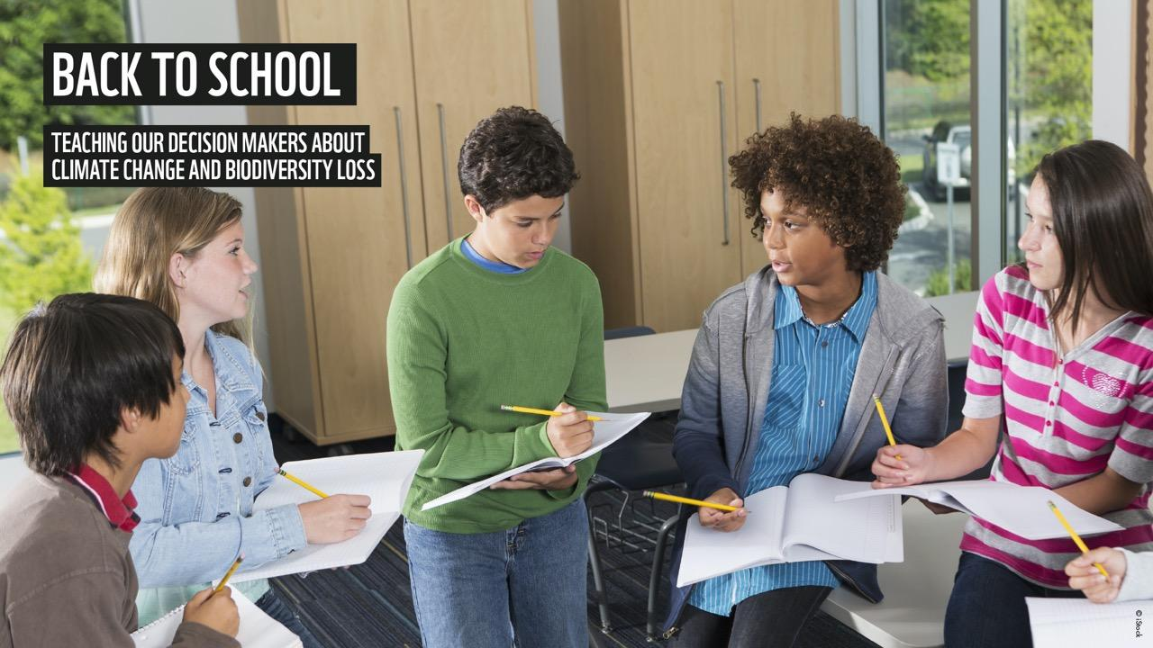
Notes:
Our school is taking part in the ‘Back to School’ project.
A role reversal is needed for the survival of the planet, with young people doing a lesson ‘take-over’ and becoming the teachers. We need to send MPs ‘Back to School’, so that they can explore how climate change can be tackled and nature restored, responding to inputs and challenges from you – young people – about how it might impact your future.
This project gives you the opportunity to take action on climate change and biodiversity loss within the school setting.
Tell students how they can get involved in your school.
e.g.
Come to a workshop on DATE AND PLACE
Join the Green Team by asking TEACHER NAME
See me after the assembly to get a campaigning pack

Slide 11
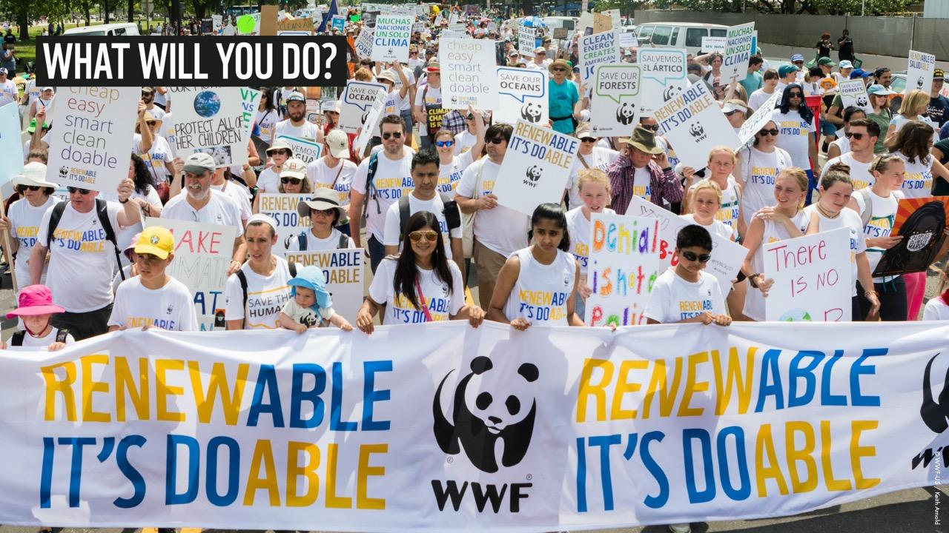
Notes:
Ask the students to share ideas about what they could do to protect the things that are important to them.
Take some suggestions
Add some more suggestions to those of the students - focusing on those bigger than individual action.
e.g.
Write to your MP asking them to visit the school or support your environmental campaign
Ask the local paper to visit the school or publish something about your campaign
Make a video about climate change and/or our impacts on nature. It can also include positive things to improve the environment
Hold an outreach event to educate the local community about the environment
Ask a local radio station if they can interview you and your friends about your campaign
Write to local or national businesses to ask them what they are doing and encourage them to do more to help the environment
Make changes at home or at school to be more environmentally friendly.

Slide 12
Notes:
https://www.wwf.org.uk/get-involved/schools/resources/back-to-school

Slide 13
