Slide 1
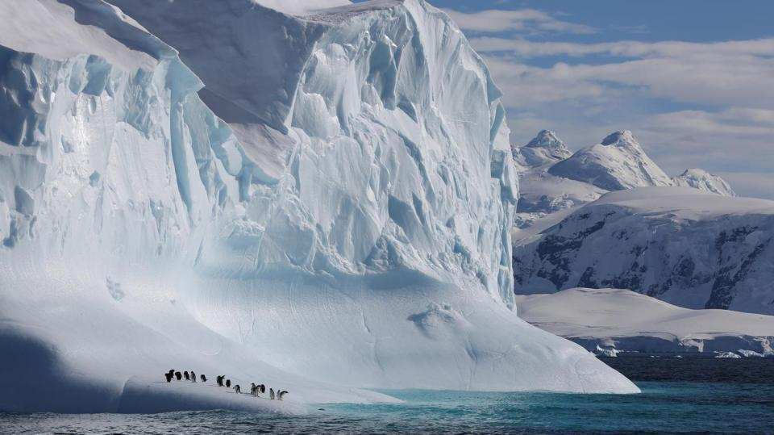
Our frozen worlds
Notes:
Our life on earth depends on the coldest places on our planet – the icy worlds of the Arctic and Antarctica.

Slide 2
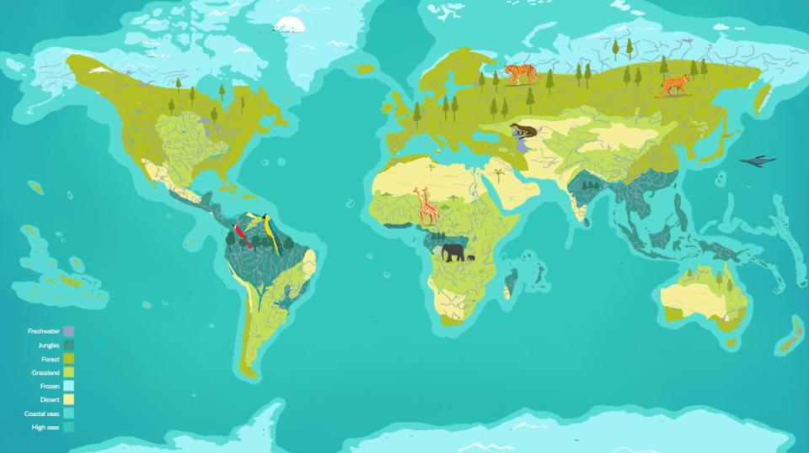
Arctic
Antarctica
Where in the world?
Notes:
The Arctic region is the northernmost region of the planet, consisting of the Arctic Ocean and parts of Russia, Greenland, Canada, USA, Norway, Iceland, Sweden and Finland that lie above the ‘Arctic Circle’.
At the other end of the earth, Antarctica is the world’s highest, driest, windiest and coldest continent. It is bigger than Europe and is so dry that it’s classified as a desert.

Slide 3
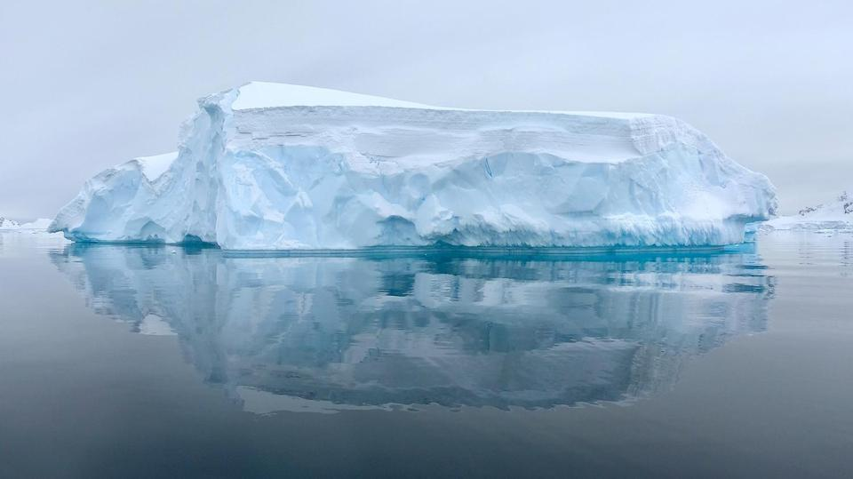
Our frozen worlds
Notes:
Click to watch illustrative biome tour of our frozen worlds: https://www.ourplanet.com/en/video/biome-tour-of-our-frozen-worlds

Slide 4
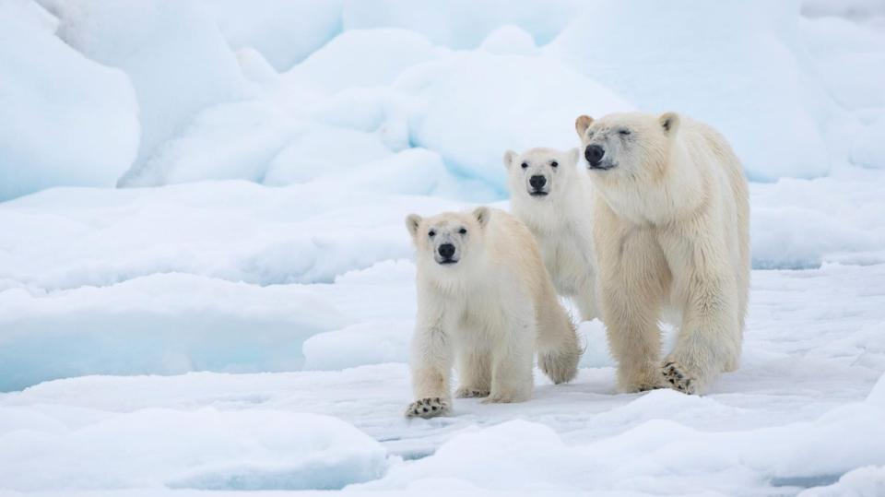
The Arctic
Notes:
About 4 million people live in the Arctic region, and the Arctic sea ice supports a wide range of animal species, from microscopic algae to the world’s largest land carnivore, the polar bear.

Slide 5
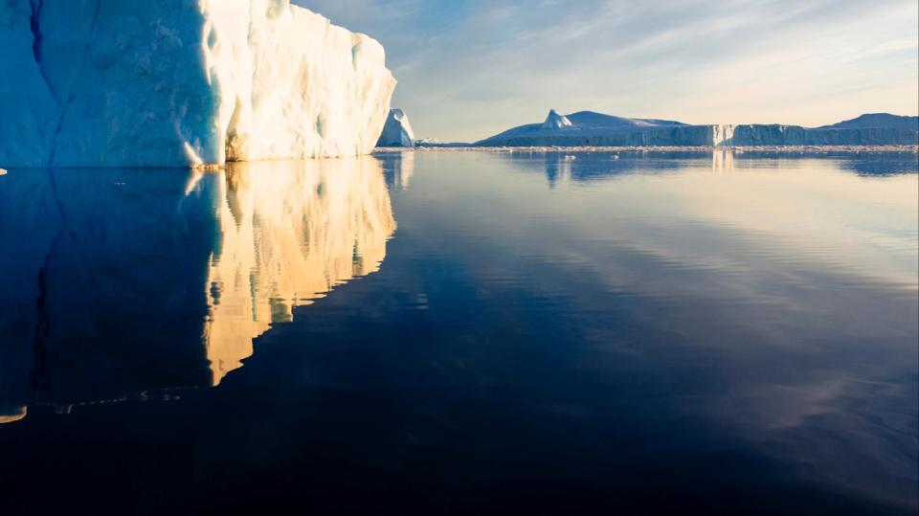
Krill
Antarctica
Notes:
The freezing Southern Ocean surrounding Antarctica is teeming with life. The waters are full of nutrients, which feed plankton at the bottom of the food chain. Plankton is a vital source of food for krill, tiny shrimp-like creatures, which are then eaten by penguins, seals, seabirds and whales.

Slide 6
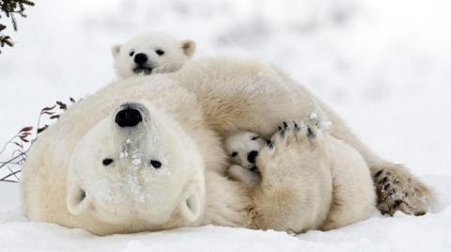
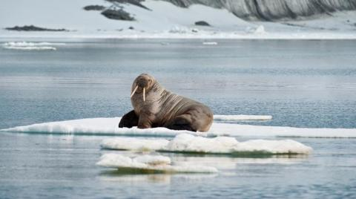
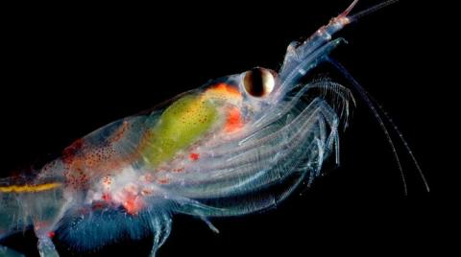
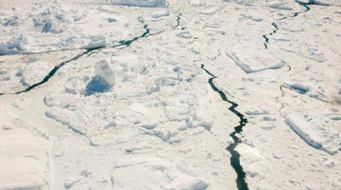
Why does ice matter?
Notes:
The ice provides a platform on which much life in the polar regions depends. Polar bears need the sea ice to hunt for seals. If the ice connected to land forms later and melts earlier in the year, the bears have less time to hunt and it becomes harder for females to build up the fat stores they need to nurse their cubs.
Walruses can’t climb out of the sea onto thin ice, and caribou risk falling through it as they cross between islands and headlands.
Antarctic krill are a vital source of food for ocean species worldwide and depend on the shelter and food under sea ice to nurture their young.
Ice in the polar regions reflects sunlight back into space and helps cool our planet.

Slide 7
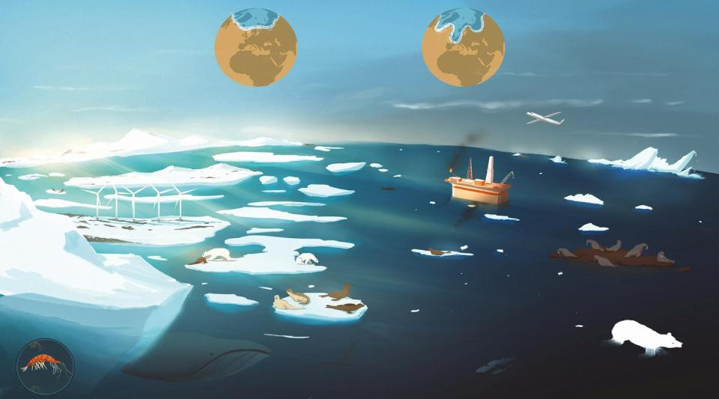
The polar jet stream
is a circle of fast-moving air currents created by the difference in temperature between the cold Arctic and warmer areas further south.
Warmer Arctic temperatures weaken the polar jet stream, changing its shape and causing extreme weather further south.
Burning
fossil fuels releases carbon into the atmosphere, causing global warming that leads to loss of
sea ice.
As sea ice disappears, predators such as walruses and polar bears have to swim long distances from land to find
food.
Loss of sea ice reduces krill populations, meaning less food for many species.
What’s the problem?
Notes:
Globally, sea ice is diminishing faster than ever before, with terrible consequences for wildlife.
Burning fossil fuels such as coal, oil, and natural gas releases carbon dioxide into the earth’s atmosphere. This causes global warming and melting ice.
Loss of ice from the poles is causing weather systems to change because the Arctic and parts of Antarctica are warming faster than the rest of our planet. We are already seeing more droughts and flooding around the world. Also, when ice melts it cause sea levels to rise so that millions of people and lots of wildlife could see their homes disappear below the waves.

Slide 8
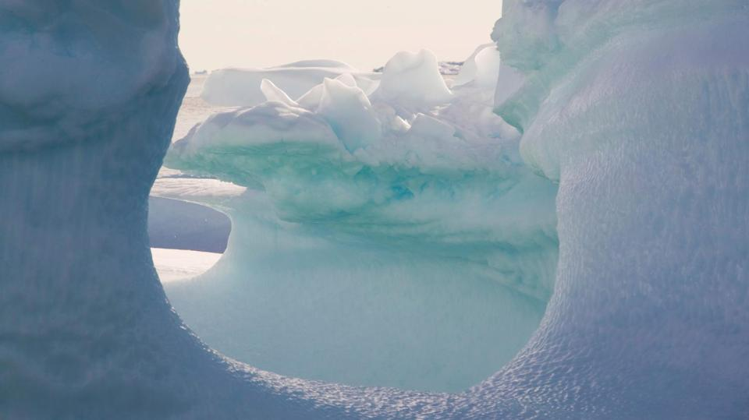
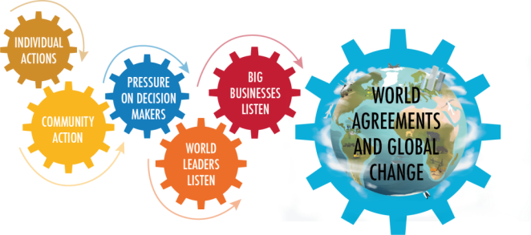
Global change
Replace fossil fuels with renewable sources of energy
Individual actions
Save energy
Reuse, repair, recycle, share and borrow
Eat more plants and cut down on meat
Walk and cycle rather than drive
Hold businesses to account
Ask politicians to support renewable energy and make restrictions on emissions
What can we do?
Notes:
We can all play a role in creating a more sustainable future through our own actions.
Phasing out fossil fuels and replacing them with renewables will not only slow the warming of the planet and the acidification of the ocean, but it will also lead to clean air for all of us.

Slide 9
#OurPlanet
www.ourplanet.com
Notes:
Visit www.ourplanet.com for more information, classroom resources and a wealth of free videos.

