Slide 1
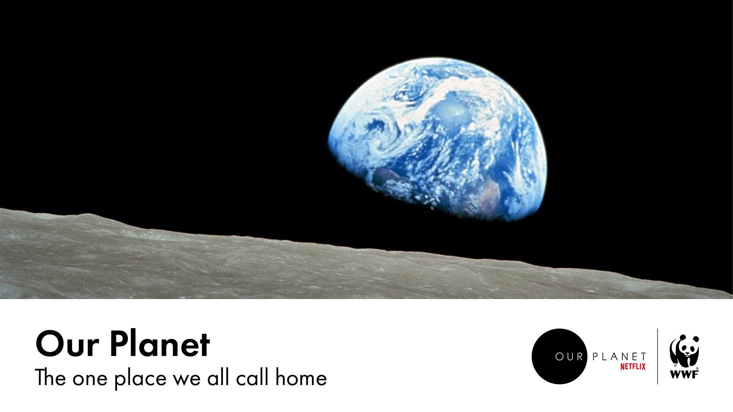
Notes:
‘Our Planet, the one place we call home’ is based on the WWF/Netflix Original documentary series, which aims to help us understand what we all need to do in order to ensure a future for our planet in which people and nature thrive.
This photograph, ‘Earthrise’, was taken by astronaut William Anders on 24 December 1968, during the Apollo 8 mission. In your view, what makes this photograph of our planet so significant in the way we view our home?
Seeing Earth from space changed people’s perception of the planet we live on. We can see not only how beautiful it is, but how interconnected it is.
[Photo credit Earthrise photo by Bill Anders / NASA. Processing by Jim Weigang]

Slide 2
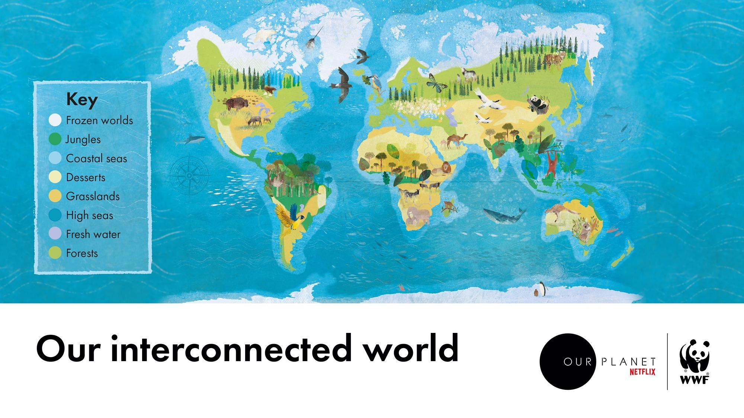

Notes:
Our planet is one interconnected system of different environments, called biomes. Each biome harbours communities of animal and plant species that have adapted to the conditions there in order to survive.
The biomes that make up our planet might seem to be completely different and separate worlds, but, in fact, they are closely linked. From the high seas to the shallow waters around our coastlines, the forests and jungles to grasslands and deserts, freshwater environments to the ice worlds, an astonishing diversity of life on Earth depends on these global connections.
Video (3mins 42s): ourplanet.com/biomes

Slide 3
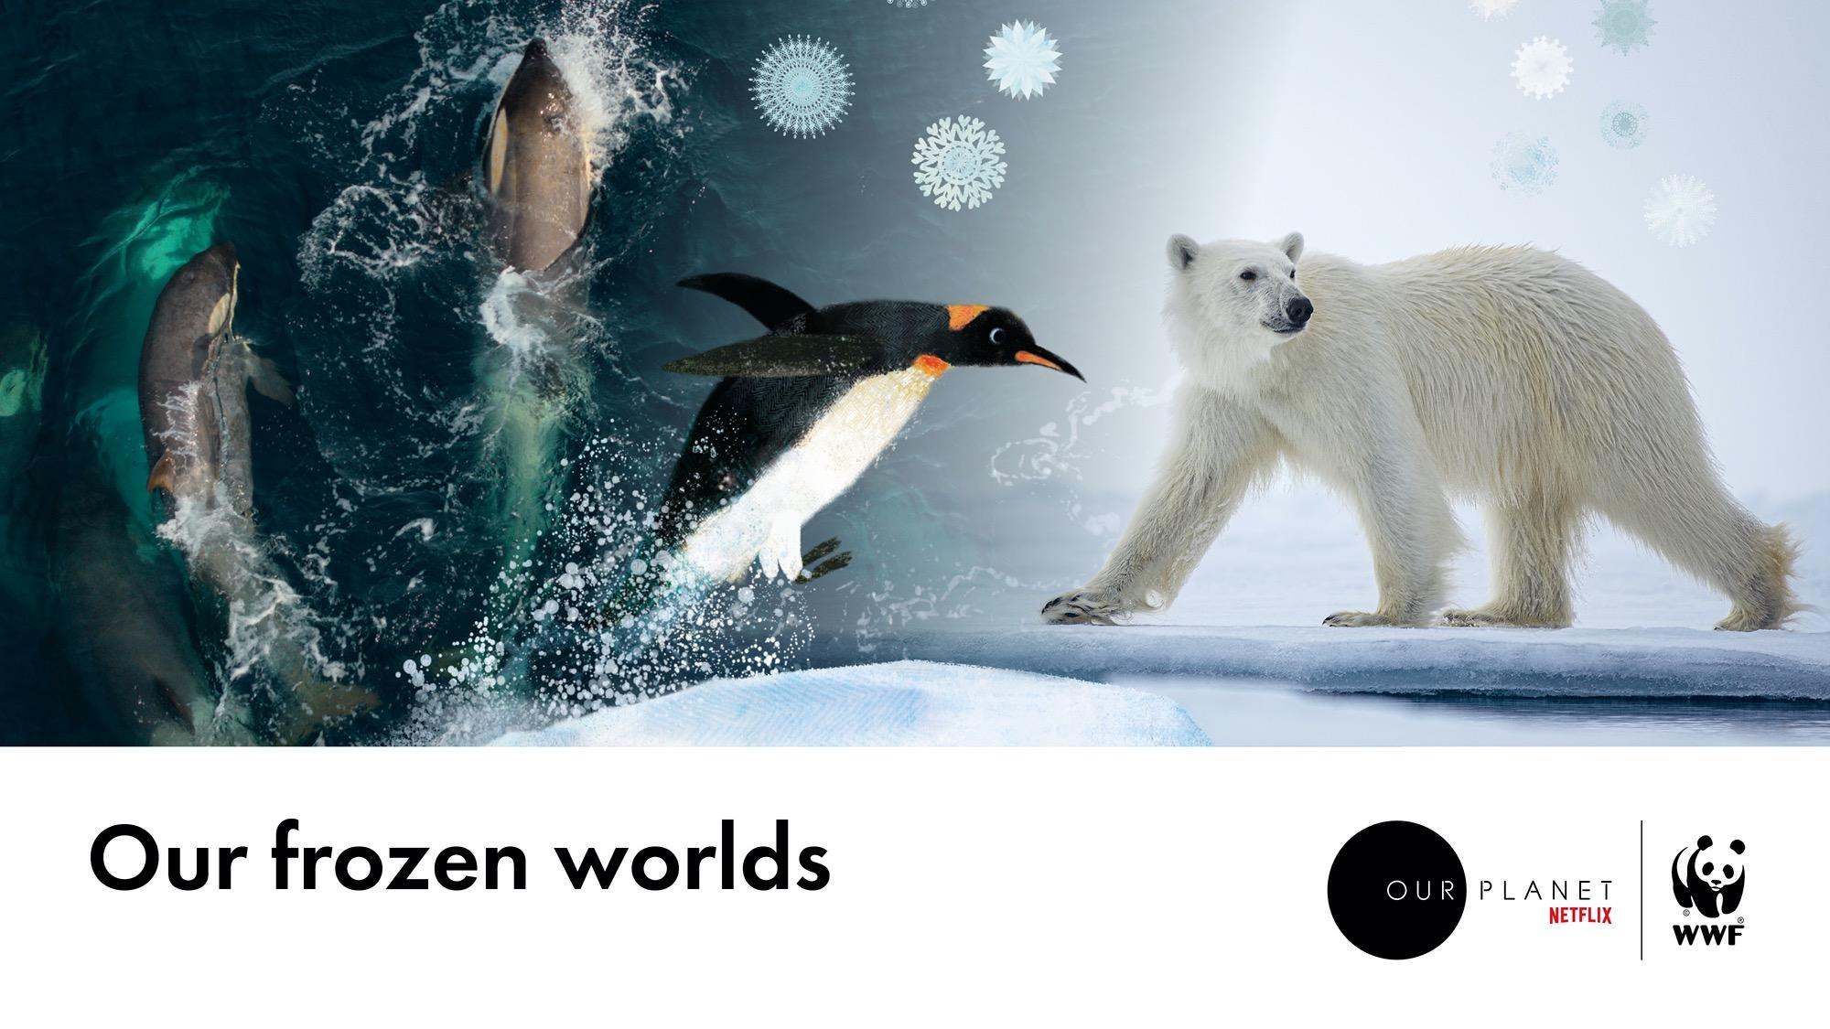
Notes:
Life on Earth depends on the coldest places on our planet – the icy worlds of the Arctic and Antarctica.
In the Arctic, sea ice supports a wide range of species, from microscopic algae to larger animals such as walruses, narwhals and polar bears, which rely on ice to hunt, rest and breed.
The Antarctic waters are full of nutrients that feed plankton, which makes up the bottom of the food chain. Plankton is eaten by tiny shrimp-like creatures called krill, which in turn are eaten by seals, penguins, seabirds and whales.
Our planet poles act as an air conditioning system reflecting sunlight away from the planet to keep it cool. They also contain huge amounts of water locked up as ice.
The poles might seem like a world away, but they affect all our lives. It’s essential they stay frozen to lock in water that would otherwise cause sea levels to rise, as well as to reflect the sun’s rays back into space to keep our planet from warming up.
[Photo credits. Polar bear © David Reid. Orca – screengrab © Netflix]
Option - screen the biome tour video at: https://www.ourplanet.com/en/video/biome-tour-of-our-frozen-worlds

Slide 4
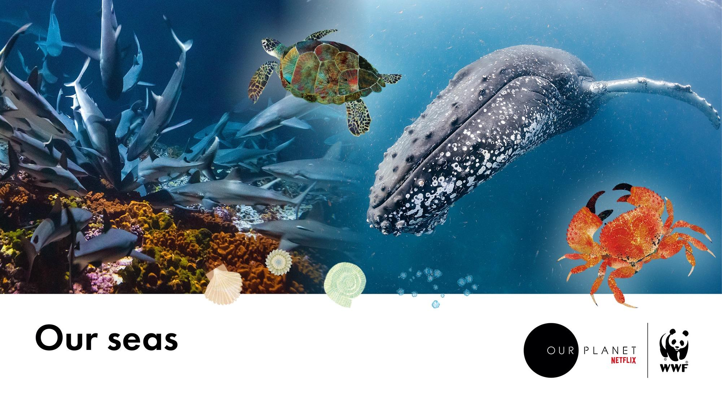
Notes:
Oceans cover 70 per cent of our planet and provide a huge amount of space for wildlife to thrive.
The waters around our coasts are home to 90 per cent of all marine creatures. Sunlight reaches the seafloor allowing plants to grow. These provide food for lots of different species and a safe place for fish to breed and raise their young.
Far beyond the shallow coastal waters, the high seas cover half of our planet, supporting life from the deepest ocean floor to the surface. Whales and big fish stir up microscopic nutrients to support the marine food chain. Seabirds soar above and dive into the water for food.
In the surface waters warmed by the sun, tiny plants called phytoplankton are constantly absorbing carbon from the atmosphere, producing half of the oxygen in the air that we breathe.
When the sun heats the surface of oceans, water evaporate to form huge clouds and then falls as freshwater on the landscapes around our planet.
[Photo credits. Humpback whale – © Steve Benjamin. Grey reef sharks © Gisle Sverdrup]
Option- screen the biome tour video at: https://www.ourplanet.com/en/video/biome-tour-of-our-coastal-seas

Slide 5
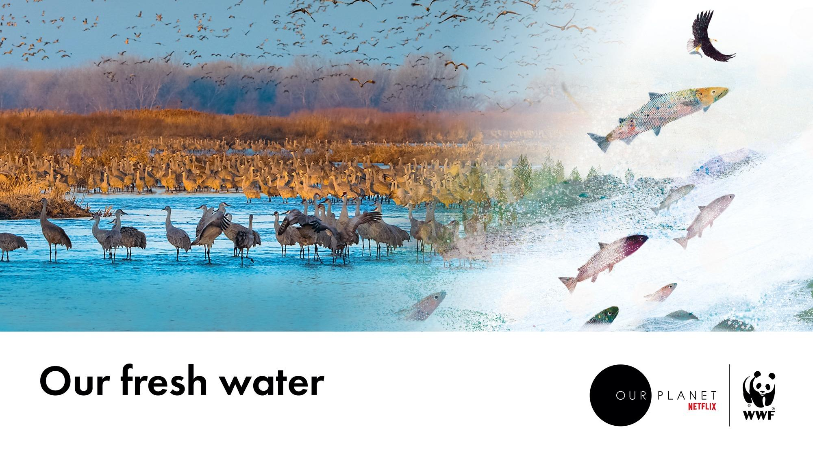

Notes:
Without fresh water, life on Earth wouldn’t exist. Every animal and plant depends on it – including us! Yet fresh water adds up to less that 3 per cent of the total water on Earth. The rest is salt water in the seas and oceans.
Fresh water habitats, such as rivers and streams, lakes, ponds and wetlands, are home to more than 10 per cent of all the world’s known animals, from dragonflies and kingfishers to ospreys and bears. Freshwater systems also transport water and nutrients throughout the landscape.
We need to keep our freshwater systems clean and rethink how we capture, divert and store fresh water, whether it’s to supply towns and cities, industry or farms, so that we are working with nature.
[Photo credit. Screengrab © Netflix]
Option - screen the biome tour video at: https://www.ourplanet.com/en/video/biome-tour-of-our-freshwater

Slide 6
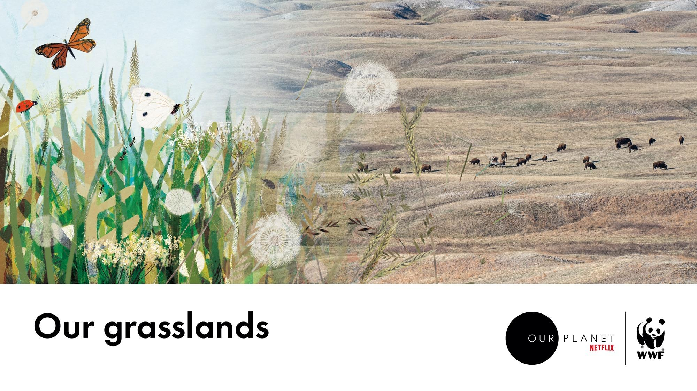
Notes:
Rainfall plays an important role in sustaining grasslands.
Huge herds of grazing animals such as caribou, antelope and zebra, move across these landscape to follow the rain, so they can get freshwater and food.
These animals stimulate new growth with their trampling feet, keep trees and shrubs from taking over and provide food for predators.
[Photo credit. Bison ]
Option - screen the biome tour video at: https://www.ourplanet.com/en/video/biome-tour-of-our-grasslands

Slide 7
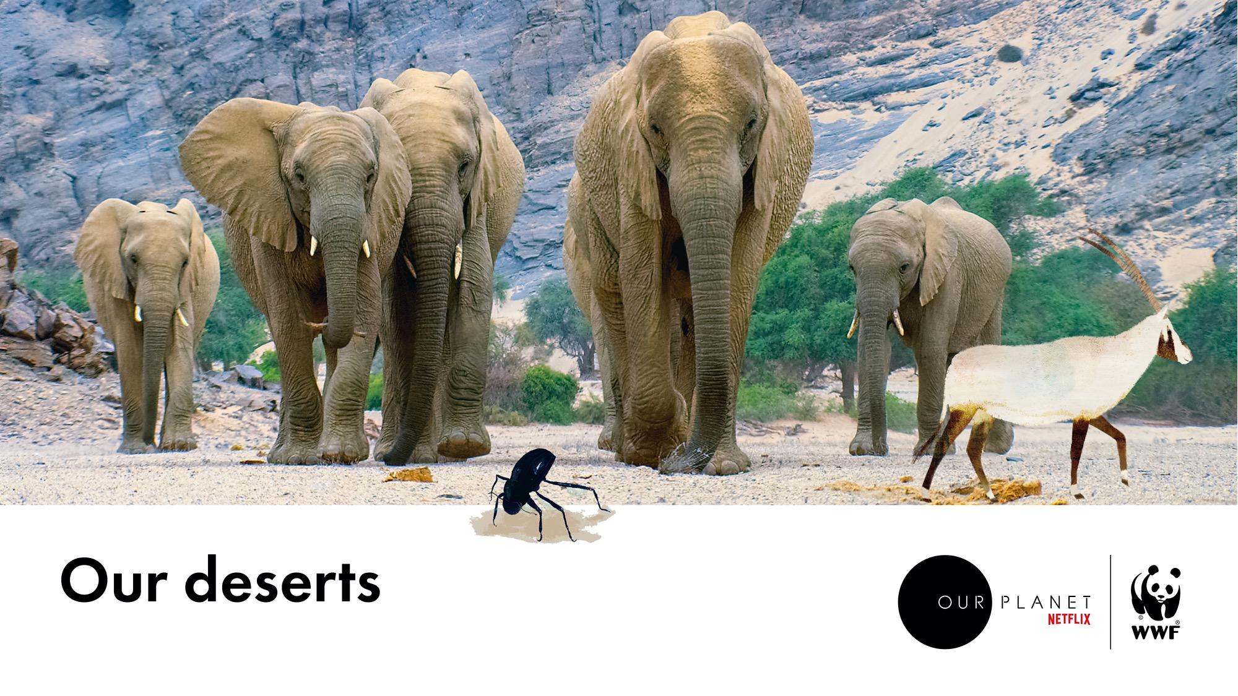
Notes:
Overgrazing and intensive farming can lead to some grasslands becoming deserts.
A fifth of the land on our planet is desert. In this harsh landscape where rainfall is extremely low, plants and animals have adapted to survive with very little water, from beetles and snakes to camels and lizards.
Did you know that desert storms play an important role for other biomes? They provide minerals that help distant rainforests to grow. Several hundred million tonnes of phosphorus-rich dust are blown from the Sahara desert across the Atlantic Ocean each year. Much of it lands over the Amazon basin, providing nutrients for plant life.
[Photo credit. Desert elephant family]

Slide 8
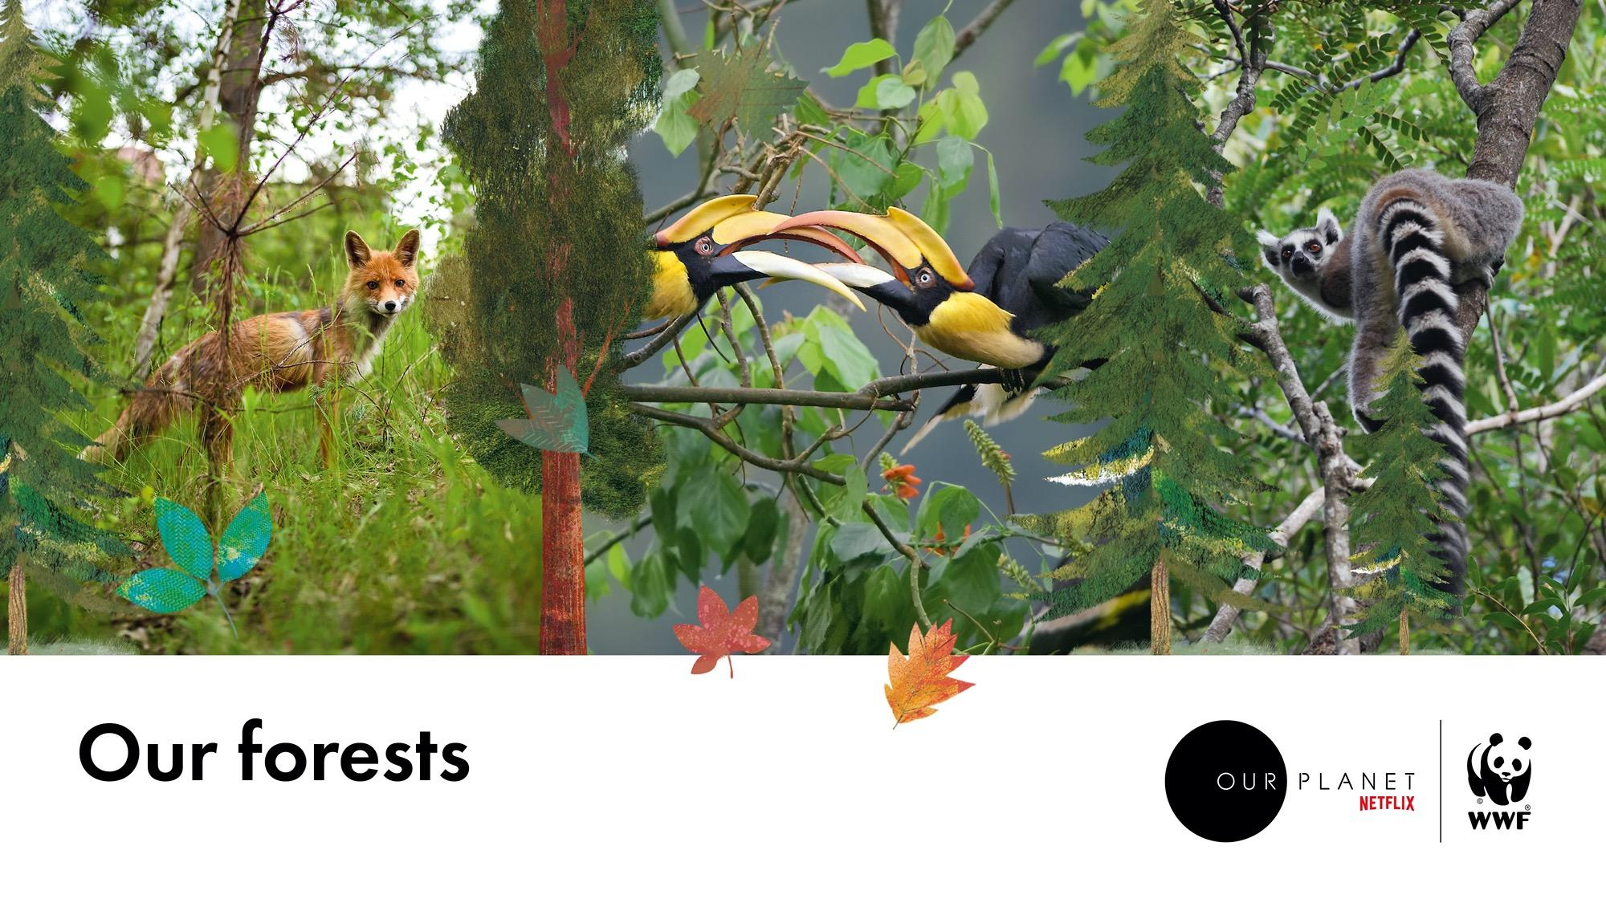
Notes:
Forests cover almost a third of all the Earth’s land area and are home to half the planet’s land-living species.
Forests are the lungs of our planet and are key to our climate. They capture the sun’s energy and release water and oxygen in this process.
From coniferous forests spreading across continents south of the Arctic to the warm, steamy rainforests close to the equator, each forest contains a delicate balance of trees and other plants, animals, fungi and bacteria.
[Photo credits. Fox © Kieran ODonovan. Great hornbills screengrab © Netflix. Ring-tailed lemur © ]
Option- screen the biome tour video at: https://www.ourplanet.com/en/video/biome-tour-of-our-forests

Slide 9
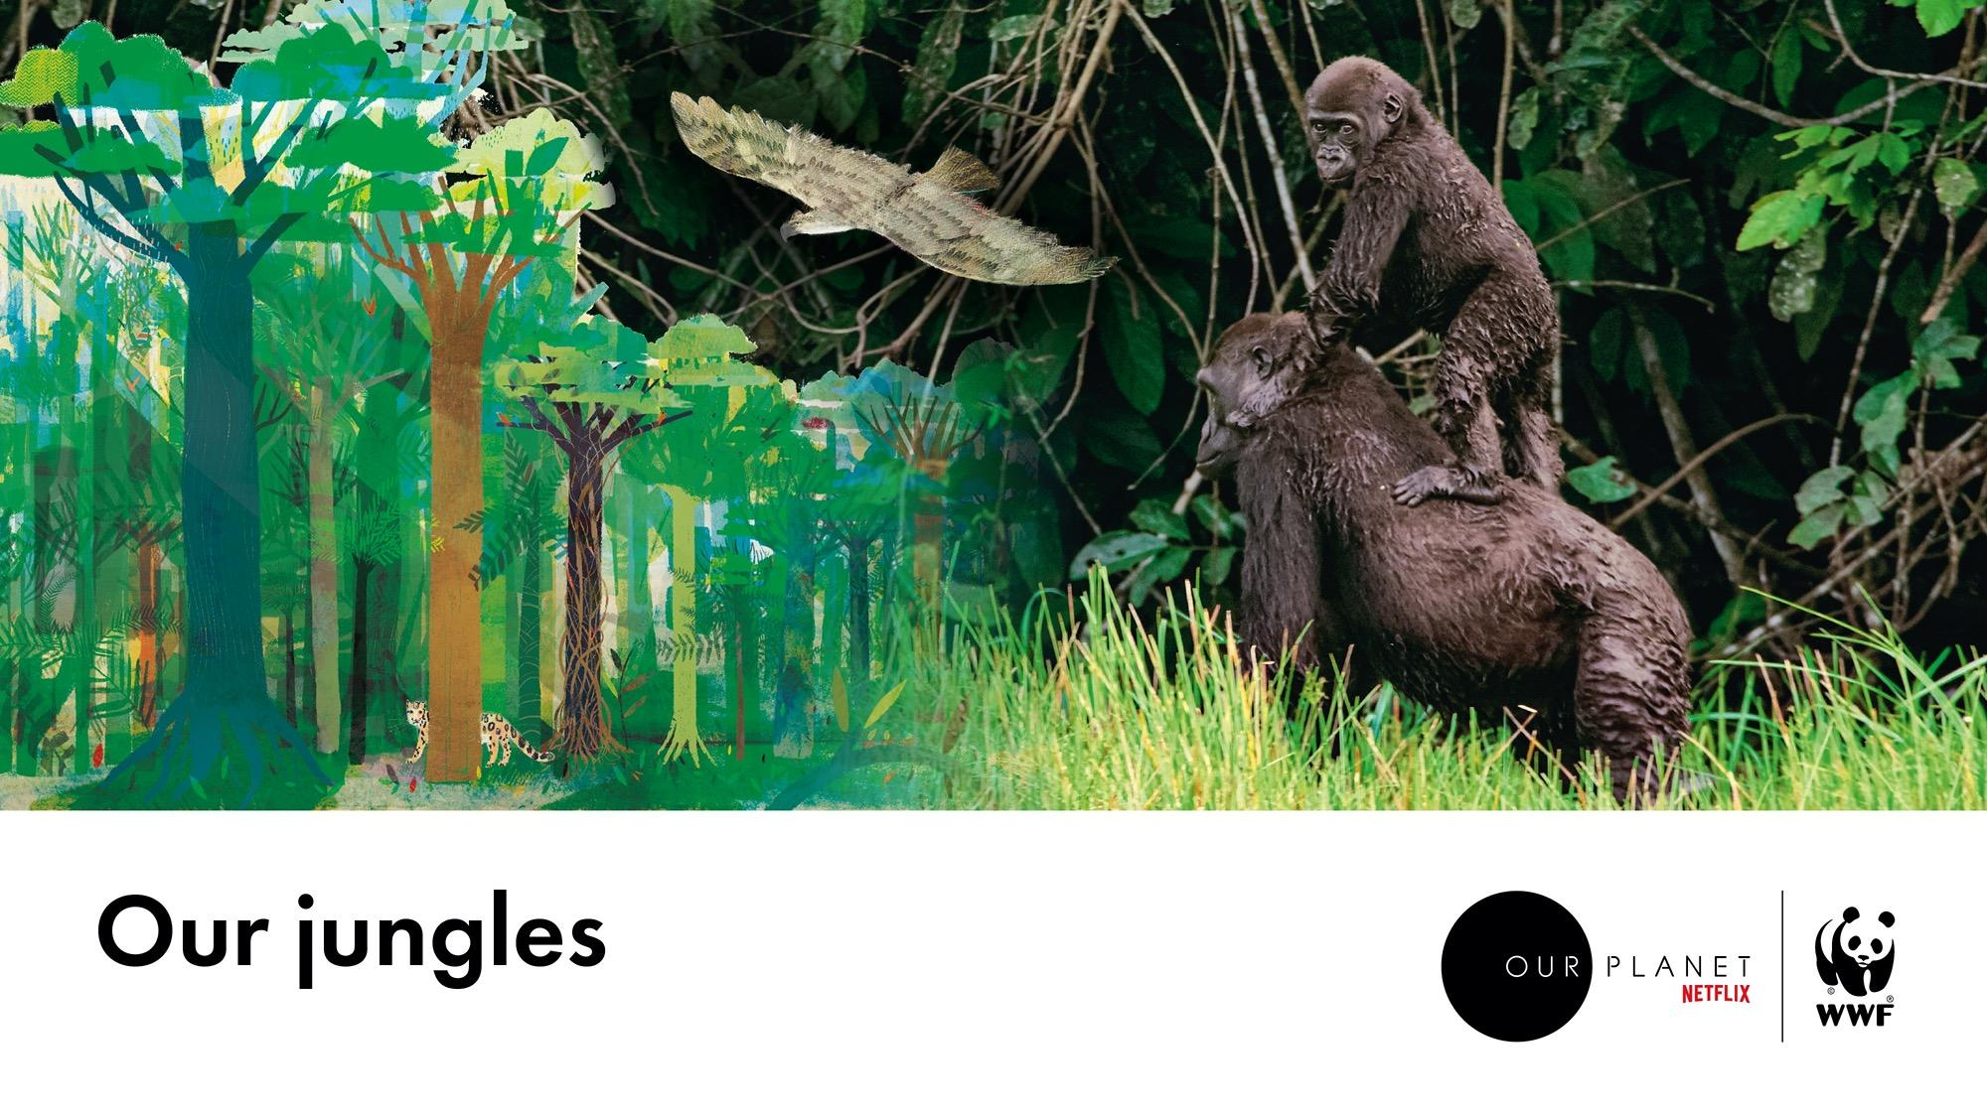
Notes:
Rainforests are the oldest and most diverse ecosystems on Earth and are home to a staggering range of species, many still undiscovered.
Like all forests, they play a vital role in the health of our planet and help to control our climate by absorbing huge amounts of carbon from the atmosphere. They also soak up vast amounts of water. When this evaporates back into the atmosphere, it’s often carried to drier regions that need it most.
Yet their future is far from safe. Rainforests are cut down for timber or to make way for roads, housing or farming, especially palm oil plantations.
[Photo credits. Lowland gorilla © ]
Option - screen the biome tour video at: https://www.ourplanet.com/en/video/biome-tour-of-our-jungles

Slide 10
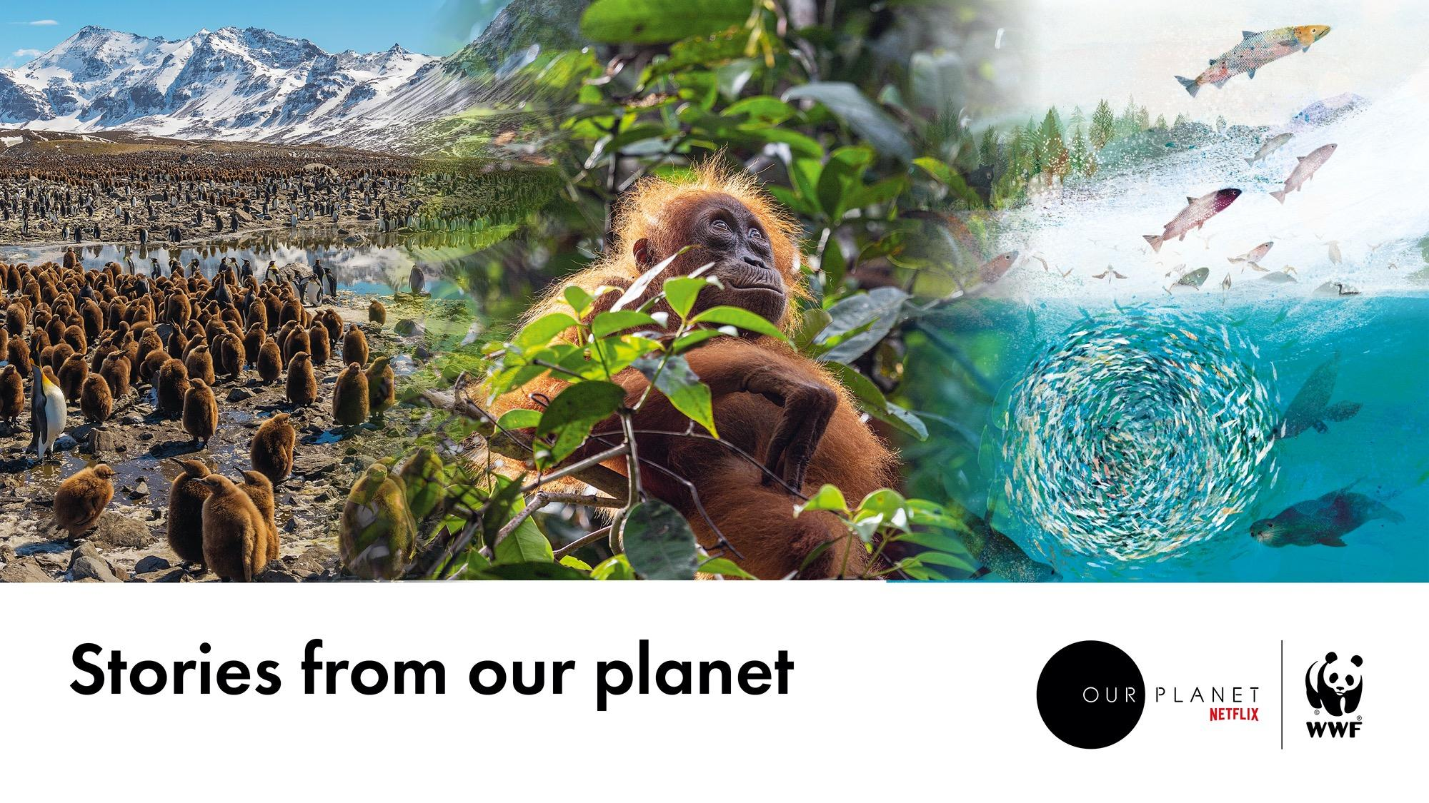
Notes:
Within each biome, there are so many more thrilling stories to tell and connections to explore. Each biome contains a close-working community of species dependent on one another.
Some of these tales are about animals living in the harshest places on Earth, lashed by ferocious, freezing blizzards, with very little to eat.
Others are about creatures such as orang-utans clambering around in tropical rainforests, learning from their mothers where to find trees that give the best fruit, or how to use a stick to pick out insects from their hiding places.
Some are travel stories – how salmon, having spent the early years of their lives feeding in the ocean, manage to find the mouth of the exact river in which they were hatched to lay their own eggs.
There are stories of hunting techniques, with armies of seabirds and marine creatures searching for the same food, by air and by sea.
“Be prepared to add your own, because you will be among the next characters who can, if they wish, tell the most extraordinary story of all – how human beings in the 21st century came to their senses and started to protect Planet Earth and all the other wonderful forms of life with which we share it.”
David Attenborough
[Photo credits. King penguins © Oliver Scholey. Young orangutan © Huw Cordey ]

Slide 11
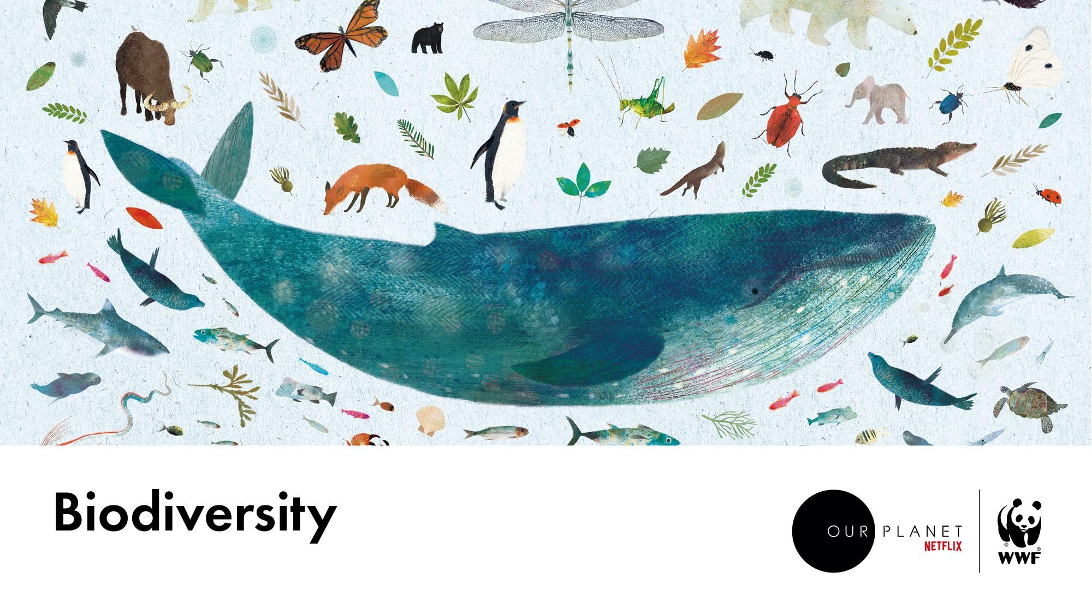
Notes:
Biodiversity means the variety of all life on Earth – thousands of different habitats, millions of different species and billions of individual animals.
All the different pieces in the big jigsaw of life on our planet play a part in keeping it healthy and strong. The more biodiversity, the more secure all life on Earth is – including us.
Biodiversity equals stability. Stability relies on such connections between and within different biomes.
Video (3mins): https://www.ourplanet.com/en/video/what-is-biodiversity/

Slide 12
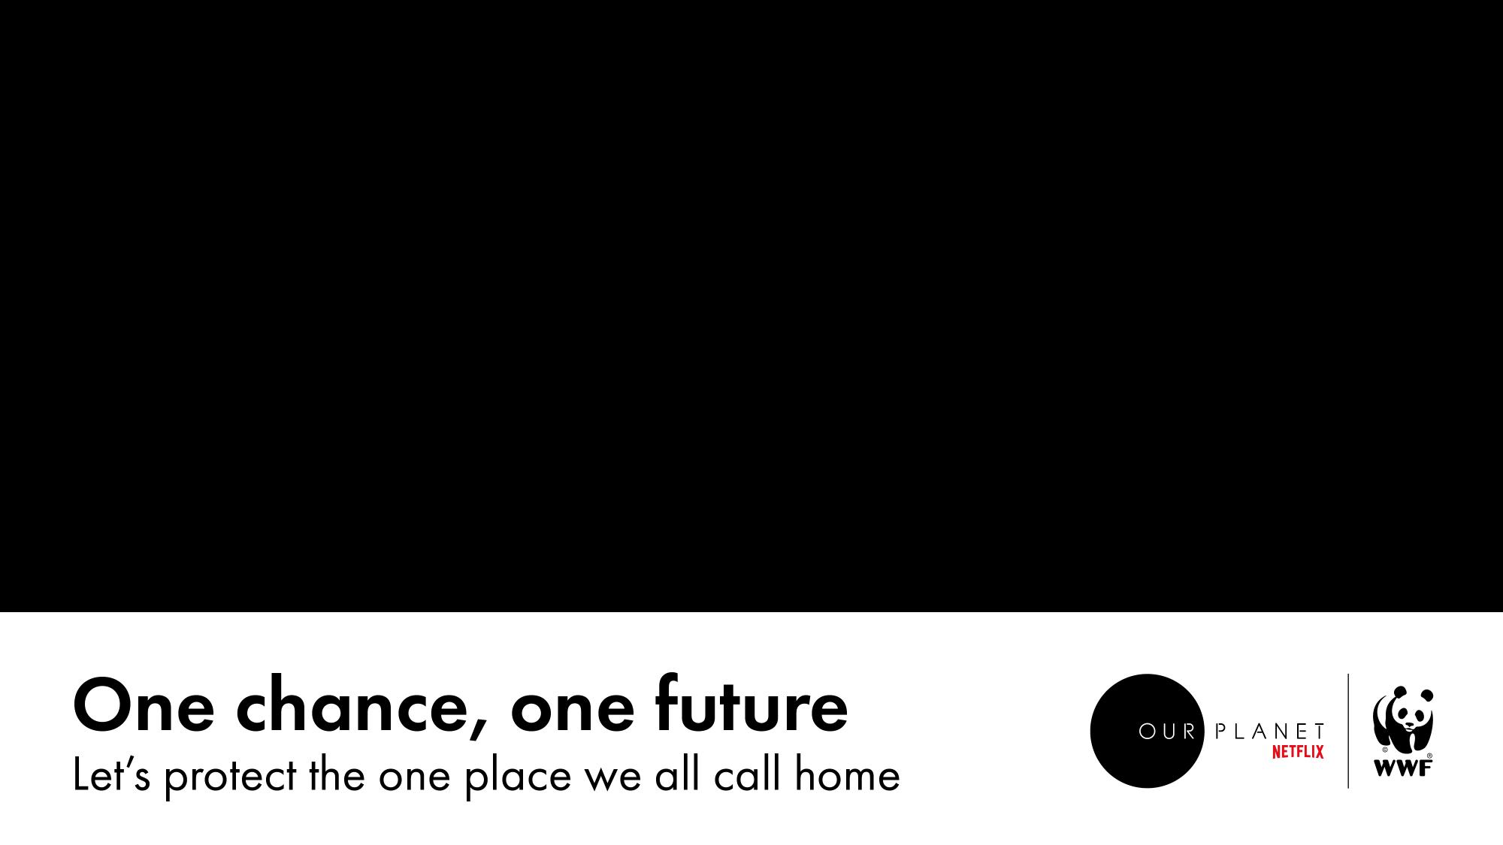
Notes:
Our planet is our home. It provides us with food, water and shelter, and has allowed us to grow as a species over 200,000 years.
We have arrived at a moment where we must rethink our relationship with the Earth. Why? Because we have changed it so much for the first time in our planet’s history, the global connections that all living things rely on are breaking. If our world is to remain healthy, stable and productive, then all seven biomes must function properly. Harming just one habitat has global consequences and affects us all.
And we can all play a role in creating a future in which people and nature can thrive.
[Show the film]
https://www.ourplanet.com/en/video/how-to-save-our-planet

Slide 13


