Slide 1
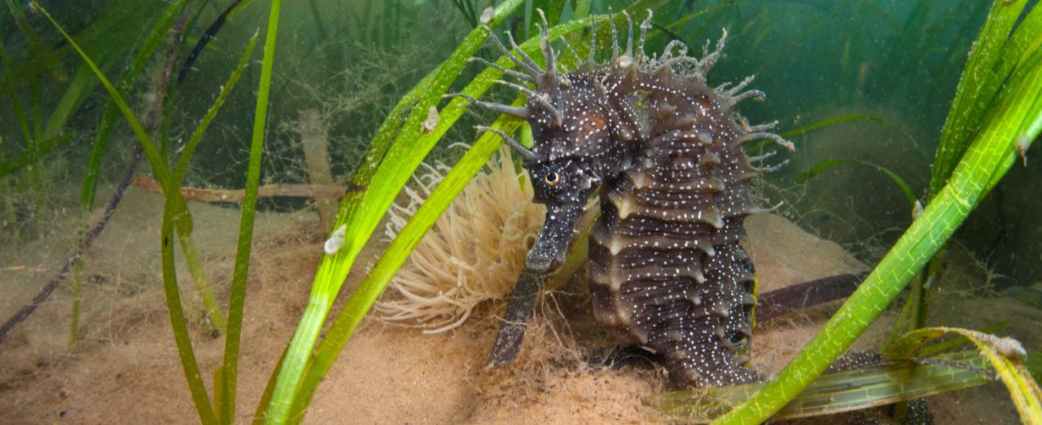
SEAGRSS
Seagrass, the wonder plant
Restoring our oceans
Notes:
Find out about WWF’s Seagrass Project.
Covering about 70% of the earth’s surface, our oceans supply half the oxygen we breathe and provide food and livelihoods for more than a billion people. They are also home to a wondrous array of wild species, from tiny plankton to huge whales.
Copyright credits
Seahorse © naturepl.com / Alex Mustard / WWF

Slide 2
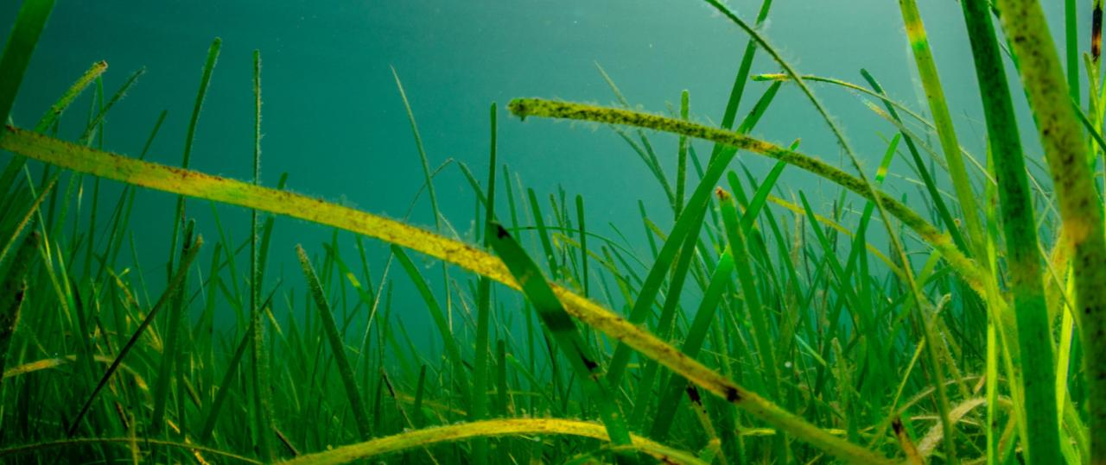
What is seagrass?
Notes:
Seagrass is a wonder-plant that lives in shallow, sheltered areas along our coast. It is vital to the health of our seas and can help address environmental problems.
Copyright Credit:
© Lewis Jefferies / WWF-UK

Slide 3
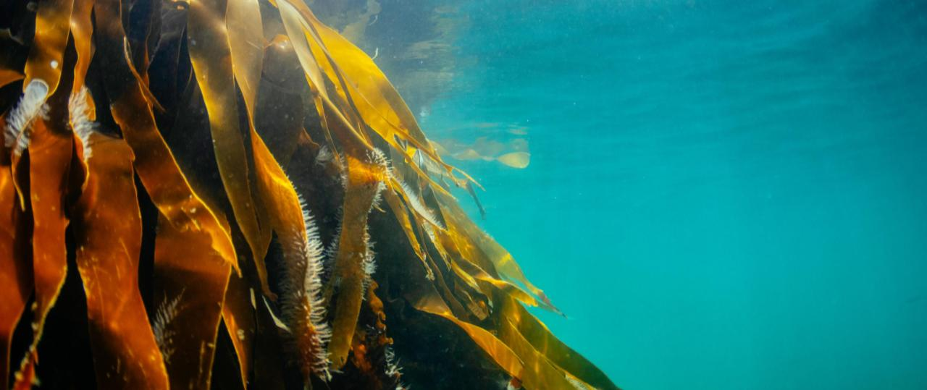
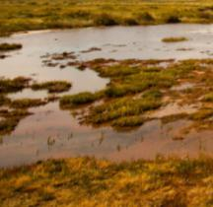
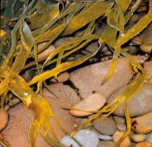
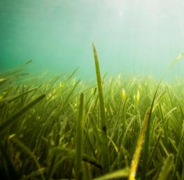
Kelp
Saltmarsh
Seagrass
Coastal seas
The coastal seas are made up of many different ecosystems.
Notes:
Here sunlight reaches the sea floor, so plants can grow.
Although they make up only 10 per cent of the ocean, these shallow waters of coastal seas (within 230 km of land) are home to 90 per cent of all marine species.
The coastal seas are made up of many different ecosystems including coral reefs and mangrove forests. Closer to home, you may have seen saltmarshes, kelp and fields of underwater sea grasses.
Copyright credits
Main picture © Lewis Jefferies / WWF-UK
Kelp © Fritz Pölking / WWF
Saltmarsh © Global Warming Images / WWF
Seagrass © Lauren Simmonds / WWF-UK

Slide 4
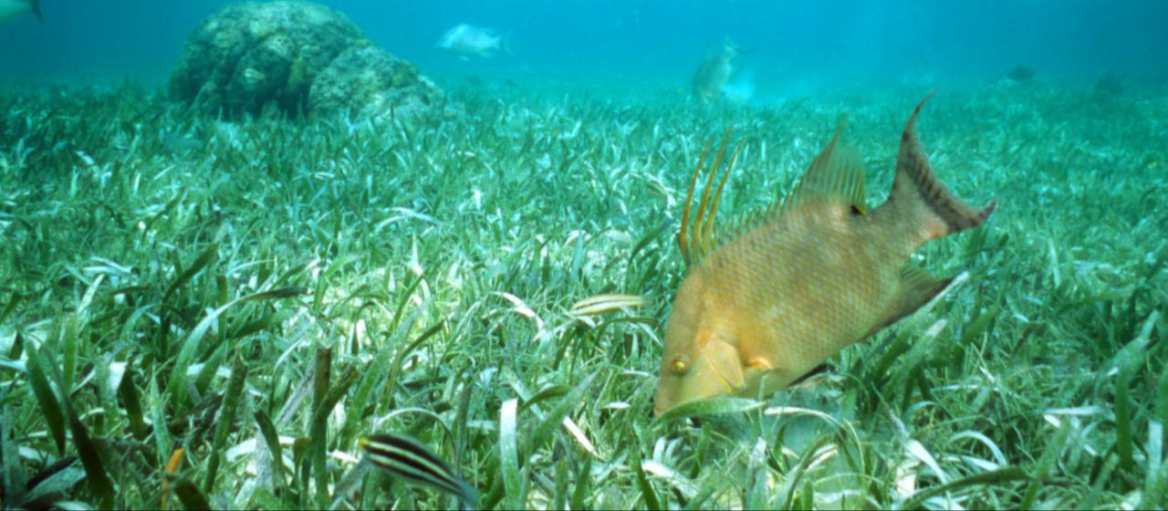
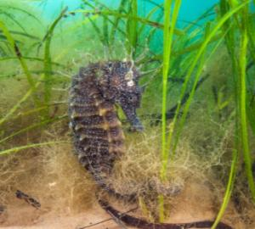
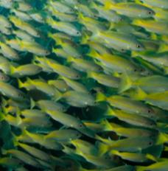
Seagrass is an important nursery habitat for young fish and invertebrates
..and endangered species such as seahorses.
A nursery
for wildlife
Notes:
Seagrass is vital for marine life, they form an important nursery habitat for several species of juvenile fishes and invertebrates including endangered wildlife such as seahorses
These then move to other habitats as they mature. These include many of the fish we eat, including cod, plaice and pollock and snappers and emperors in tropical waters.
Copyright Credit:
Seahorse © naturepl.com / Alex Mustard / WWF
Fish (Bigeye Snappers) © Jürgen Freund / WWF
Seagrass and fish © Anthony B. Rath / WWF

Slide 5
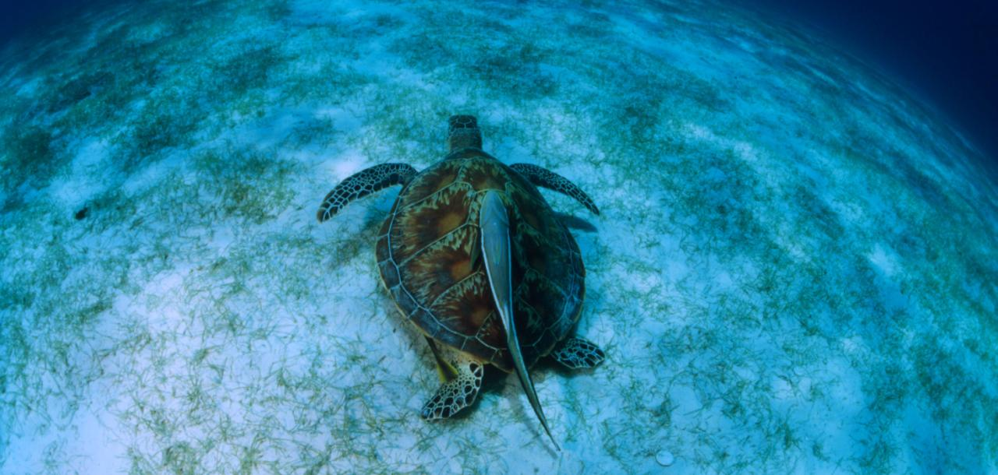
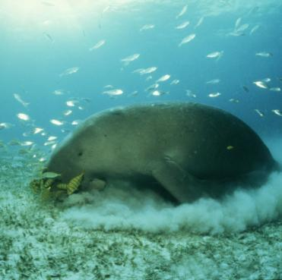
Who am I?
Food and habitat
for wildlife
Notes:
Seagrass meadows are an important feeding ground for herbivorous grazers, like green turtles seen here and manatees, and for foraging omnivores that may feed on invertebrates and other animals that live amongst the plants.
Several species of coral reef fishes forage in seagrass meadows during the night and return to the protection of the reefs during the day.
It provides a home for this rather unusual species which is seen here grazing on seagrass. Can you guess what it is?
An elephant seal
A beluga whale
A dugong
Copyright
Turtle © Jürgen Freund / WWF
Dugong © Jürgen Freund / WWF

Slide 6
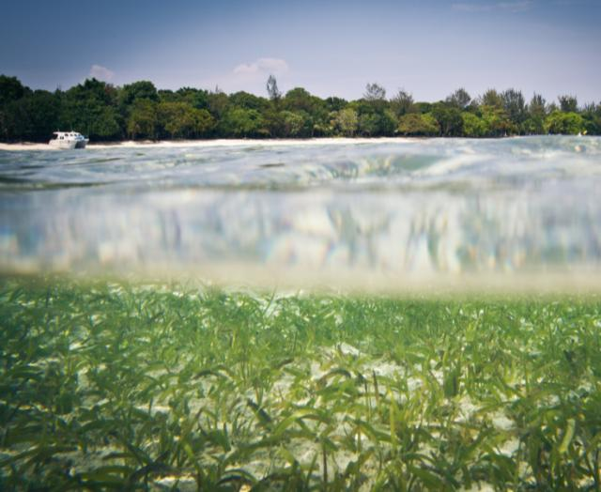
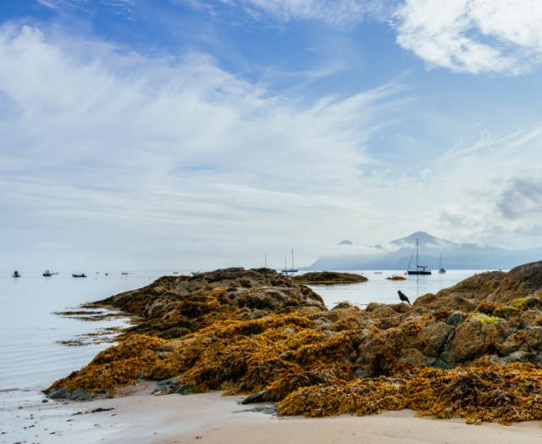
It provides us with oxygen to breath
It creates clearer water
It protects the coastline
It removes pollution from water at the coast
Other benefits of seagrass
Notes:
From the film we watched earlier, can you remember any of the other benefits of seagrass?
It creates clearer water
It removes pollution from water at the coast
It protects the coastline
It provides us with oxygen to breath
Copyright Credit:
Clear water © WWF-Malaysia / Mazidi Abd Ghani
Coastline © Lewis Jefferies / WWF-UK

Slide 7
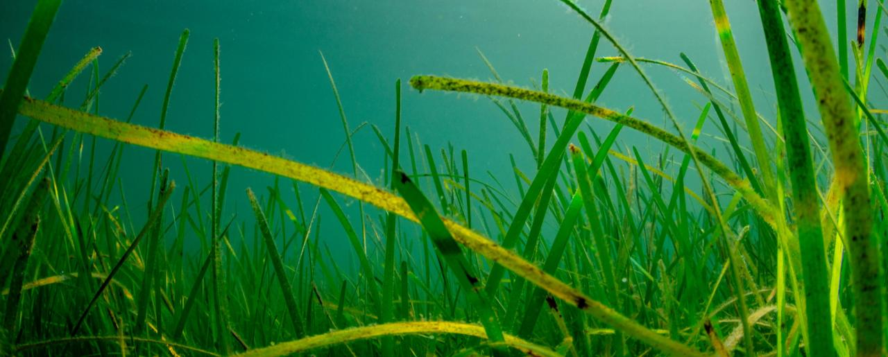
Seagrass captures carbon up to 35 times faster than tropical rainforests
It absorbs 10% of the ocean’s carbon each year.
An area of seagrass the size of a football pitch can support over 50,000 fish and over 700,000 invertebrates.
In the UK, up to 92% of our seagrass has disappeared in the last century.
Seagrass in numbers
Notes:
Seagrass in numbers
Our climate is warming up and we know why. We release carbon dioxide into the atmosphere by burning fossil fuels for energy, farming, and destroying forests. These carbon emissions are causing the greenhouse effect, trapping heat and making the Earth warmer, faster than could happen naturally.
Seagrass captures carbon up to 35 times faster than tropical rainforests and, even though it only covers 0.2% of the seafloor, it absorbs 10% of the ocean’s carbon each year, making it an incredible tool in the fight against climate change.
Copyright Credit:
© Lewis Jefferies / WWF-UK

Slide 8
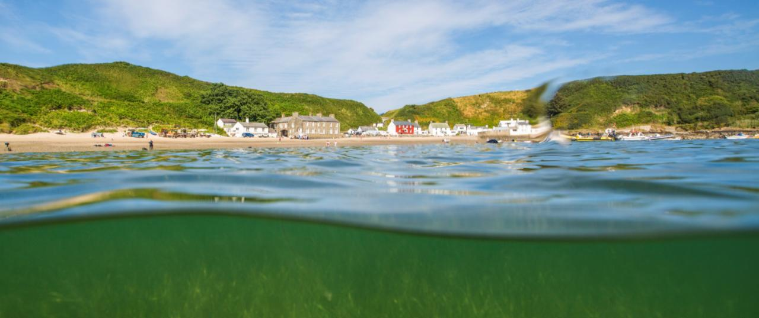
Pollution
Run off from the land can be harmful to marine plants and animals
Coastal towns and tourism
Unsustainable development at coasts and mass tourism can be a problem for seagrass
Destruction
Anchors, boat propellers and bad fishing practises all have an impact
What’s the problem?
Notes:
Why have we lost up to 92% of our seagrass in the last century?
Pollution Run off from the land can be harmful to marine plants and animals
Destruction Anchors, boat propellers and bad fishing practises all have an impact
Coastal towns and tourism
Warming global temperatures make the seas more acidic, harming habitats on which many animals depend for food and shelter
Copyright Credit:
© Lewis Jefferies / WWF-UK

Slide 9
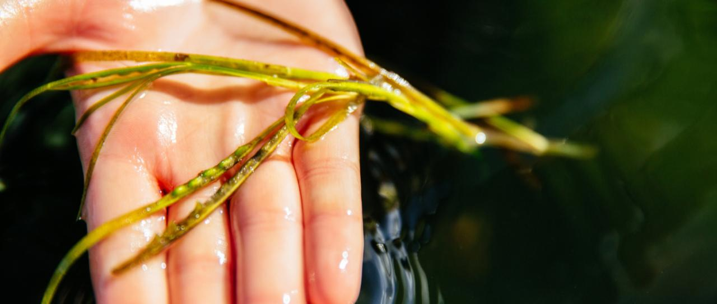
One million seeds have been collected by volunteers.
Seagrass Ocean Rescue
Notes:
We’re working with Sky Ocean Rescue and Swansea University to bring these incredible underwater meadows back to life, by launching the biggest seagrass restoration project ever undertaken in the UK.
One million seagrass seeds have been collected this summer from various sites around the country by a team of volunteers.
Copyright Credit:
© Greg Armfield

Slide 10
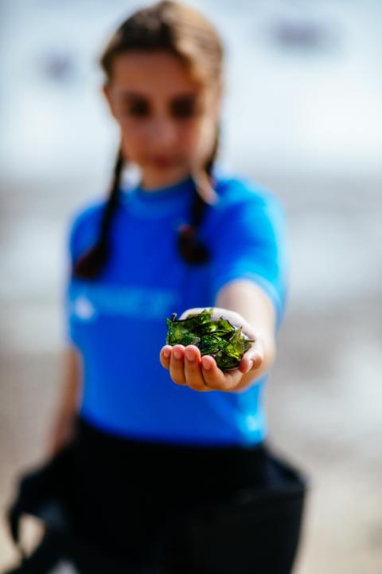
WWF needs you
Do you want to be involved in a real world conservation project in your school?
The prepped seeds will be placed in 20,000 tiny hessian bags before they are planted in South Wales
The work that needs to go into getting everything ready for planting is huge, so we are hoping that you’ll be able to lend a helping hand.
If you’d like to help us with the next stage of this fantastic project, please email us at schools@wwf.org.uk to find out more.
Notes:
Your school has the opportunity to take part in real world conservation.
The prepped seeds will be placed in 20,000 tiny hessian bags before they are planted in north Wales
The work that needs to go into getting everything ready for planting is huge, so we are hoping that you’ll be able to lend a helping hand.
If you’d like to help us with the next stage of this fantastic project, please email us at schools@wwf.org.uk to find out more.
Copyright Credit:
© Greg Armfield

Slide 11
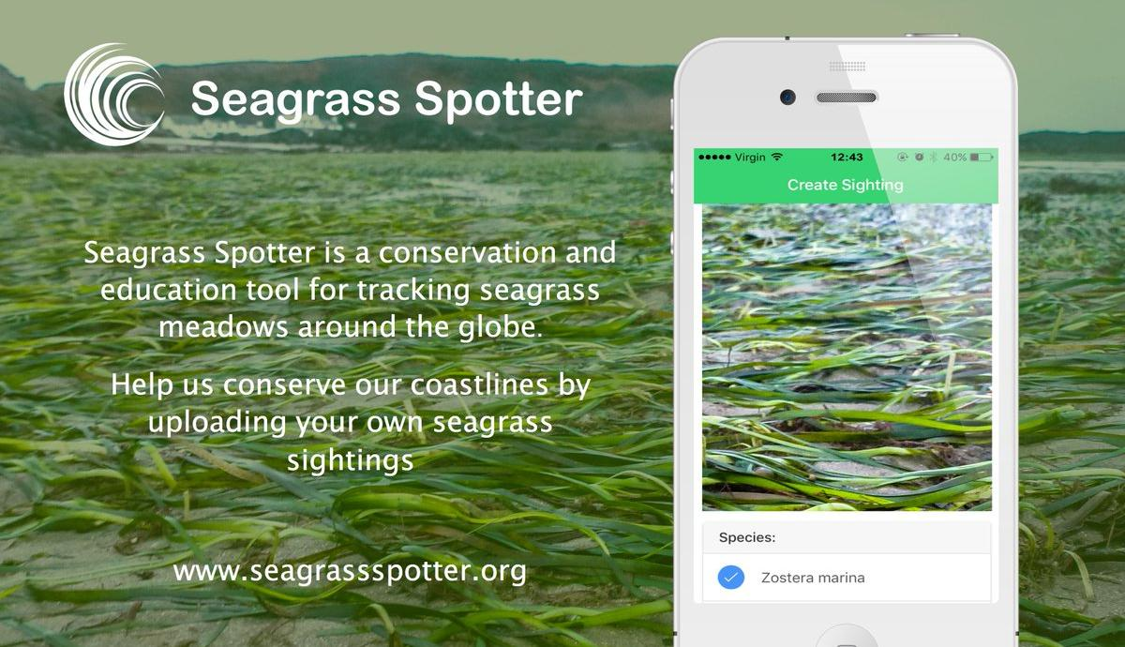
You can also get involved in real world conservation through Seagrass Spotter.
Go to www.seagrassspotter.org to find out more.
Seagrass spotter

Slide 12
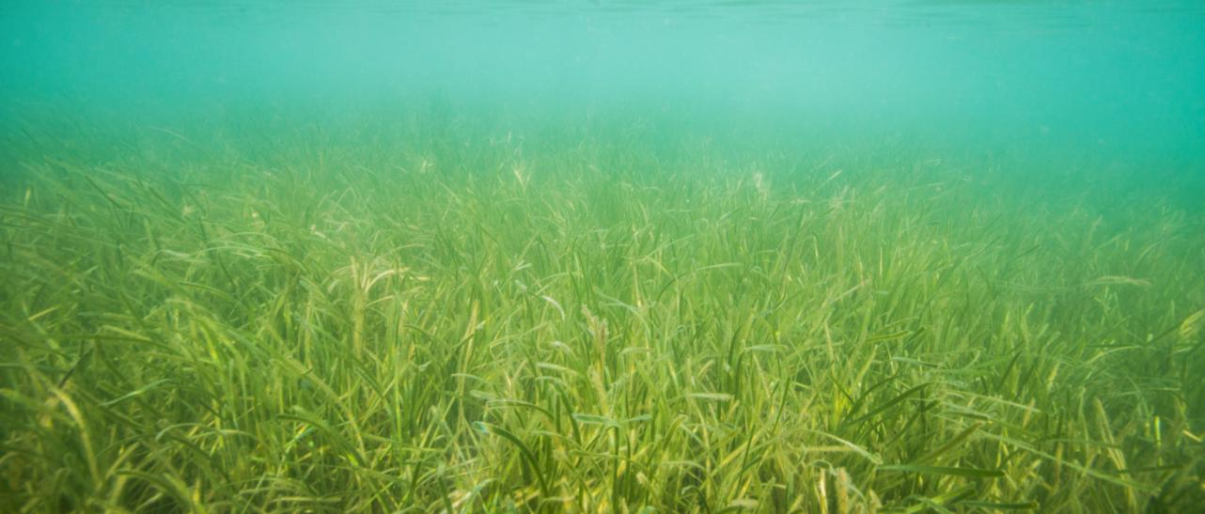
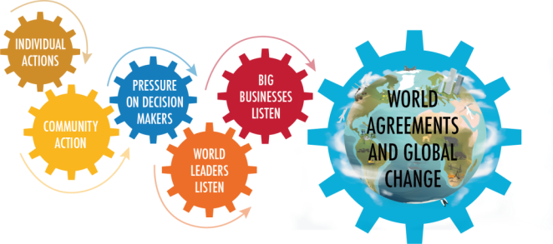
Big businesses
Just like WWF Sky think it is really important to protect our planet
They think everyone should do their part, including big businesses
Individual actions
What do you think you can do?
We can all do our bit
Notes:
We can all play a role in creating a more sustainable future through our own actions.
Big businesses
Just like WWF Sky think it is really important to protect our planet
They think everyone should do their part, including big businesses
That’s why they are supporting WWF with donations so that we can carry out this important work
Individual actions
Individuals can get involved with www.SeagrassSpotter.org and help us by recording spottings of seagrass!
By not flushing nasties down the toilet and drain we can all do out bit to help with water quality
Don’t use pesticides, herbicides and chemical fertilizer as these can end up in our water system
People on boats need to make sure they tie up to moorings and don’t drop an anchor on the precious seagrass.
Global change
If projects like this happened globally, it would be amazing for our planet
We’re calling on our government to help the UK lead the way.
Copyright Credit:
© Lauren Simmonds / WWF-UK

Slide 13
Let’s protect
our coastal seas
Notes:
Let’s protect our coastal seas and the wildlife that lives there.

Slide 14
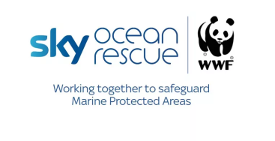
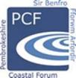
Funded by
In partnership with
schools@wwf.org.uk #Seagrassoceanrescue www.wwf.org.uk

