Slide 1
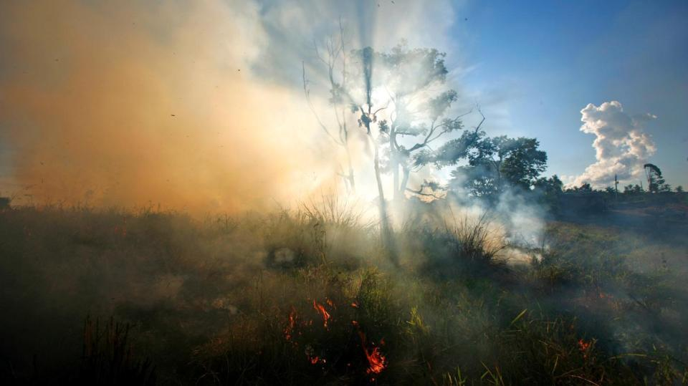
Amazon forest fires
Notes:
Please note: This topical resource is adapted from the Our Planet UK classroom biome presentations. For the full resource and to explore five more stunning biomes please go to www.wwf.org.uk/get-involved/schools/our-planet.

Slide 2
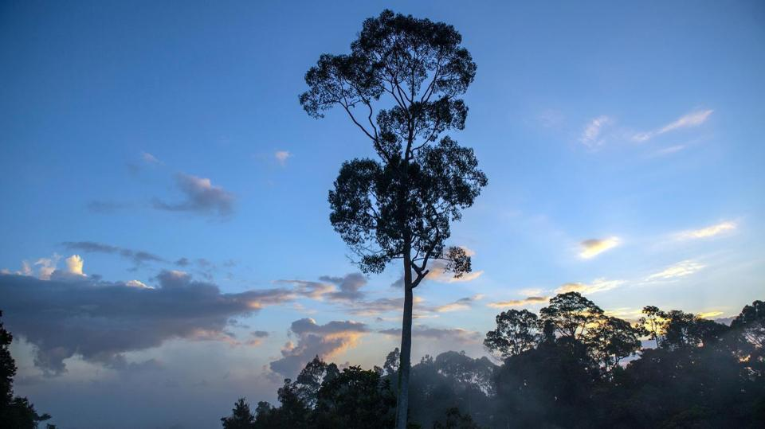
Let’s explore
our tropical rainforests
Notes:
Forests cover almost one third of our planet’s land surface and are home to over half of the species found on land.
About 300 million people live in forests and over one billion people depend on them for their livelihood.
The forests with the most plentiful and diverse wildlife are tropical rainforests. These forests grow near the equator, where it is hot and humid all year round.
Let’s explore our tropical rainforests. View our short video at: https://www.ourplanet.com/en/video/biome-tour-of-our-jungles/

Slide 3
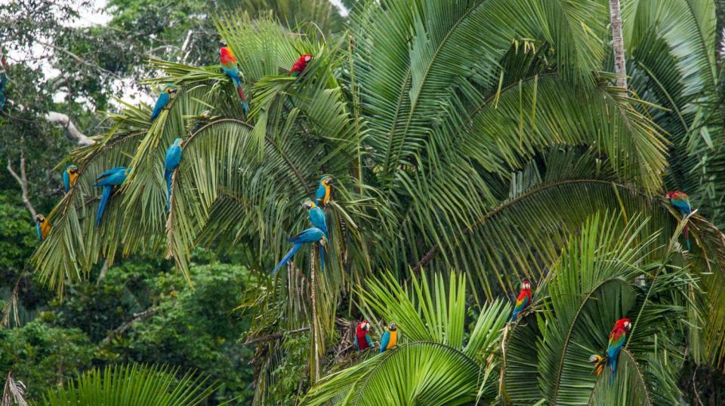
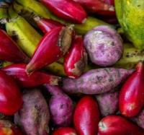
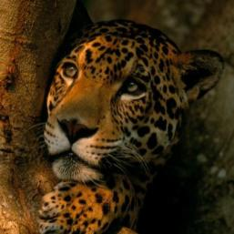
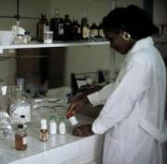
Food
Wildlife
Medicine
The Amazon
is the biggest tropical rainforest in the world
Notes:
The largest tropical rainforest in the world is the Amazon rainforest .
Despite only covering arounds 1% of the planet’s surface, the Amazon is home to 10% of all the wildlife we know about.
The Amazon provides us with many resources, including food, paper, timber, medicines, and even the air we breathe.

Slide 4
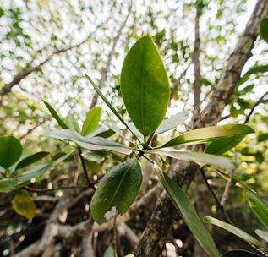
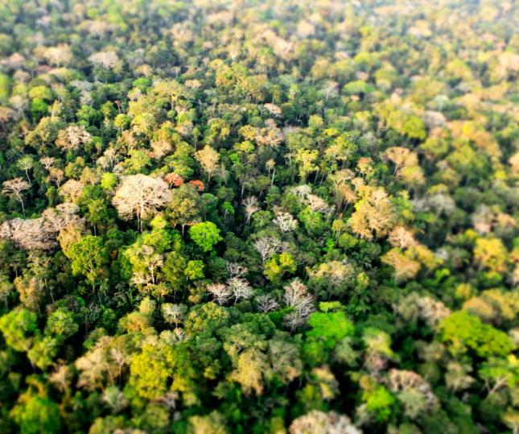
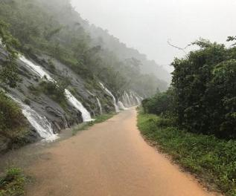
Forests are the lungs of our planet, they soak up carbon dioxide and other greenhouse gases that cause climate change.
The Amazon is a key ally in fighting the climate crisis.
The trees in the Amazon contain up to 140 billion tonnes of carbon. That’s the equivalent of what humans produce in 100 years!
Oxygen
Rainfall
The Amazon
is important
Notes:
Forests also play an important role filtering, storing and distributing freshwater. Over three quarters of the freshwater humans can access comes from forests.
Forests are the lungs of our planet and soak up carbon dioxide and other greenhouse gases that cause climate change.
The Amazon is the world’s largest rainforest and a key ally in fighting the climate crisis. It’s meant to absorb carbon, not produce it. The trees in the Amazon contain up to 140 billion tonnes of carbon. That’s the equivalent of what humans produce in 100 years. Put simply, there’s no way we can fight the climate crisis without stopping the destruction of our forests.

Slide 5
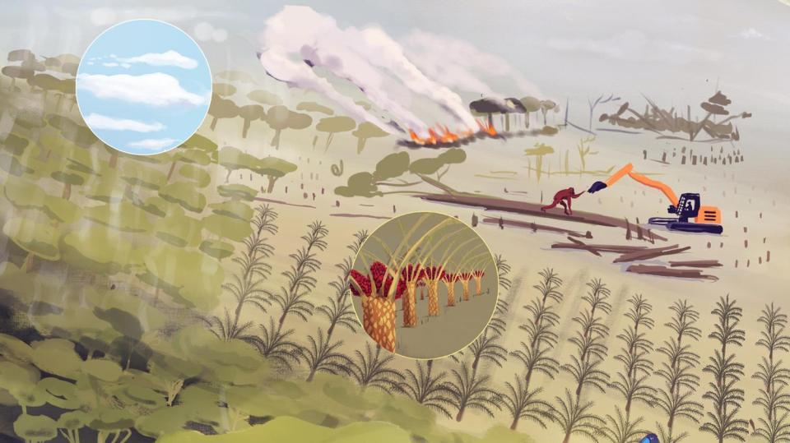
In many parts of the world, illegal logging is leading to loss of forests.
Forests are cleared for agriculture through fires, but not normally this much! The current dry season means the fires are spreading quickly.
The cleared land is often used to grow food for animals.
What’s the problem?
Notes:
Forests are under threat.
In the Amazon basin, an area of rainforest around the size of 3 football pitches is being cut down every minute
Building roads, railways, electric pylons and pipelines lead to fragmentation of forests, having an impact on wildlife.
Wood is still used by more than a quarter of the world’s people for cooking and heating.
Forests are illegally cleared for agriculture through fires, but not normally this much! More illegal fires are being started and the current dry season means the fires are spreading quickly.

Slide 6
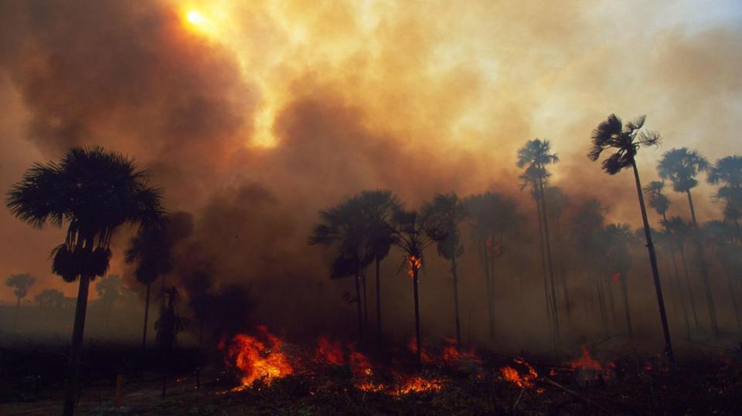
Almost 73,000 fires have been recorded in Brazil already this year – 85% more fires than were seen in the whole of 2018!
Right now
the Amazon is burning
Notes:
Almost 73,000 fires have been recorded in Brazil already this year – 85% more fires than were seen in the whole of 2018. Land is cleared and prepared for agriculture through fires, but not normally at this intensity. The current dry season also contributes to the rapid spread of these fires. We've seen a massive increase in the number of fires in 2019, and half of these have been in the last 20 days!
It's devastating to see this precious place burning.

Slide 7
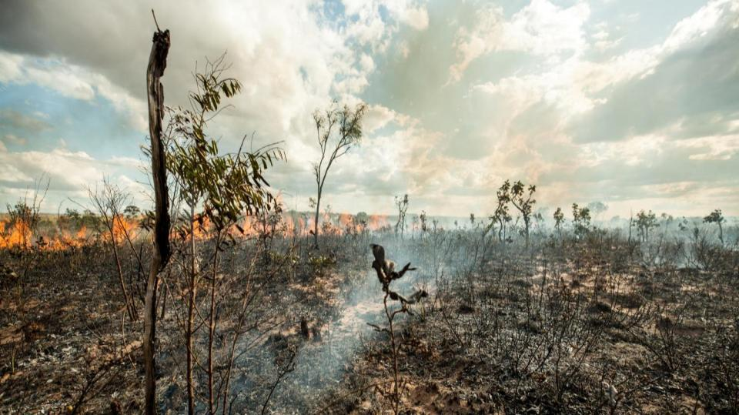
Forests are resilient.
Notes:
Can the Amazon regrow and recover?
We absolutely need to encourage forest restoration and we know that nature can bounce back when given a chance. The good news is that forests are naturally resilient and areas cleared of tree cover can spring back to life after forest fires if given a chance. We must stop the destruction of this rainforest now before it too late and protect what we have.

Slide 8
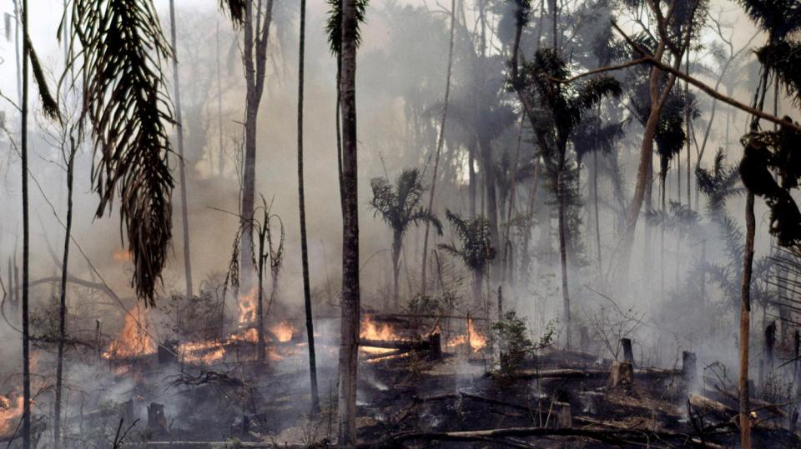
5 things you can do to help:
Show your outrage - get social!
Learn about the crisis – the more you know, the more you care
Sign the petition – tell leaders that this is important
Fundraise – how could your school raise money?
Be part of the change – what individual actions can you take?
5 ways we can help
Notes:
5 things you can do to help:
1. Show your outrage - Share it on social media. Talk to your friends and family about it. It’s up to all of us to make this socially, economically and politically unacceptable, and to help stop it happening again in the future.
The more voices we have, the louder our call for urgent action. Keep sharing updates, tag influencers, demand a rallying cry.
2. Learn about the forest - The more you learn about the crisis that’s happening, the more you can help.
3. Sign the petition - Tell leaders that you care by signing the petition: www.wwf.org.uk/save-the-amazon
4. Fundraise - With the money raised, our Amazon teams along with local organisations will carry out urgent work on the ground.
5. Be part of the change – Go to the next slide to find out individual actions you and your pupils can take to be part of the change.

Slide 9
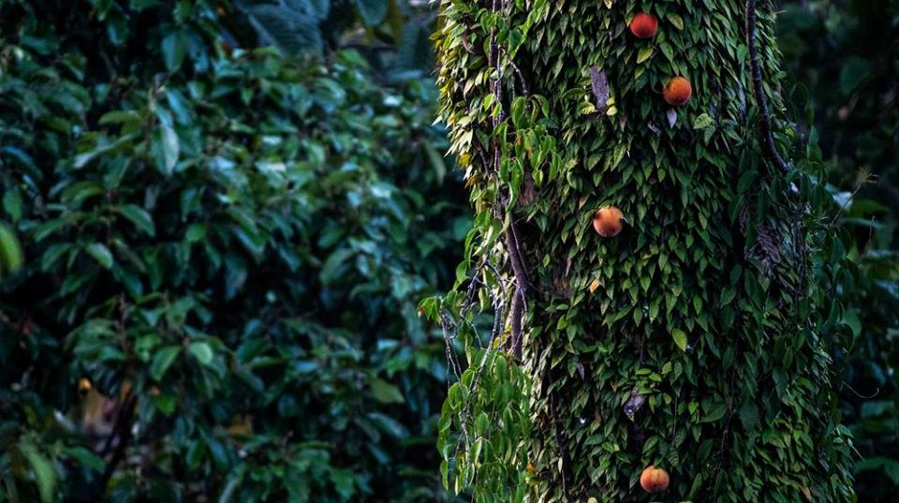
Global change
Allow areas that have lost tree cover to regrow
Carefully manage existing and newly planted forests
Individual actions
Think carefully about how we use products made from wood
Buy reused or recycled materials when possible
Buy products that come from a well managed forest (with an FSC label)
Hold businesses to account
Ask politicians to protect forests
What else
can we do to help forests?
Notes:
We can all play a role in creating a more sustainable future through our own actions.
Individual actions
Think carefully about how we use products made from wood
Buy reused or recycled materials when possible
Buy products that come from a well managed forest (with an FSC label)
Hold businesses to account
Ask politicians to protect forests

Slide 10
#OurPlanet
www.ourplanet.com

