Slide 1
Living Planet Report 2020
Notes:
The presentation consists of slides
Lesson: Exploring the LPR
Activity 1: Freshwater debate: Dams
Activity 2: Create your own LPR
Students don’t need to have read the LPR for Youth, but it is preferred. These notes will refer to pages in the LPR for Youth for extra support. See teacher resource for more details and worksheets.

Slide 2
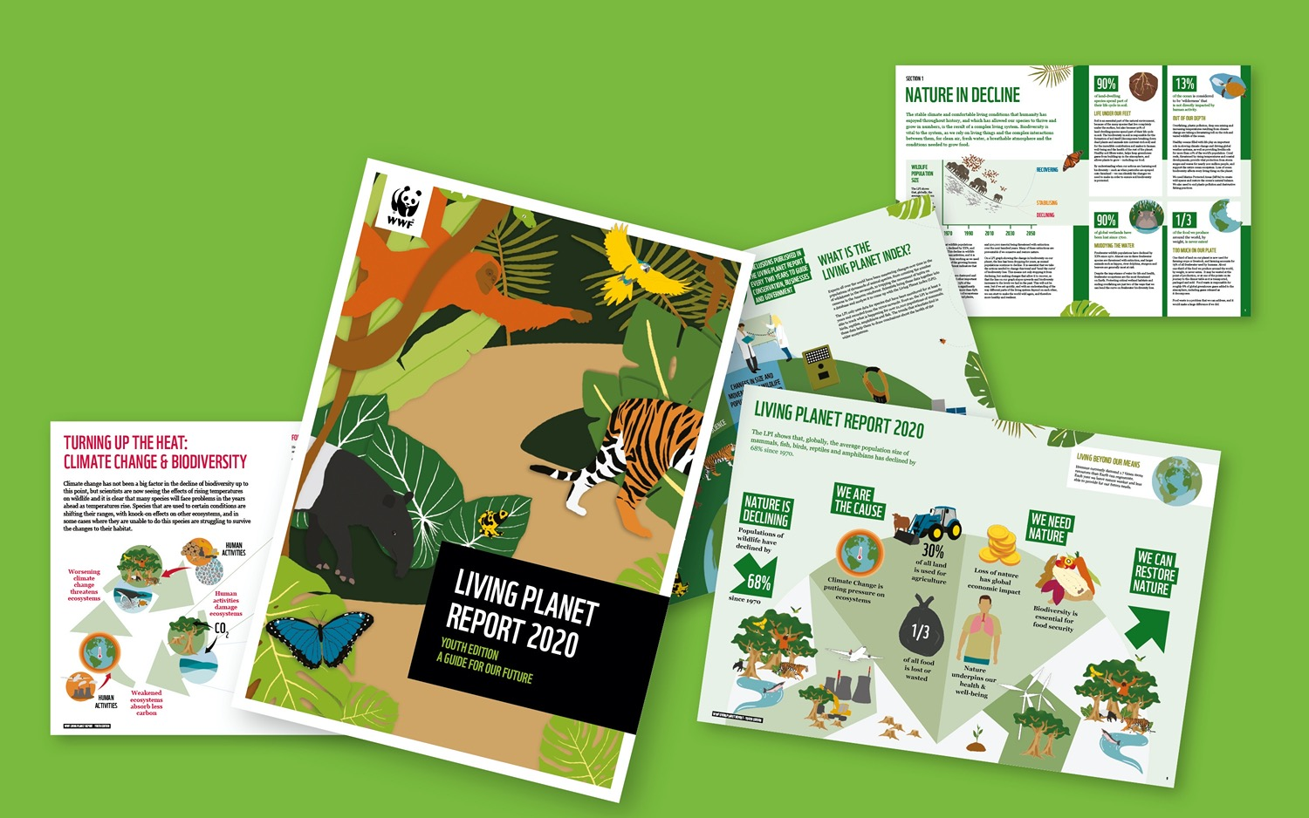
What is the Living Planet Report (LPR)?
It is a health-check for the planet which takes place every two years.
2
Notes:
The Living Planet Report (LPR) is produced every two years by WWF, with input from leading experts and other organisations.
It is a health-check for the planet, showing how the natural world is doing, what threats it faces and what this means for us humans.
The conclusions and recommendations in the LPR are based on an analysis of many measures of biodiversity, one of the biggest being the Living Planet Index (LPI).

Slide 3
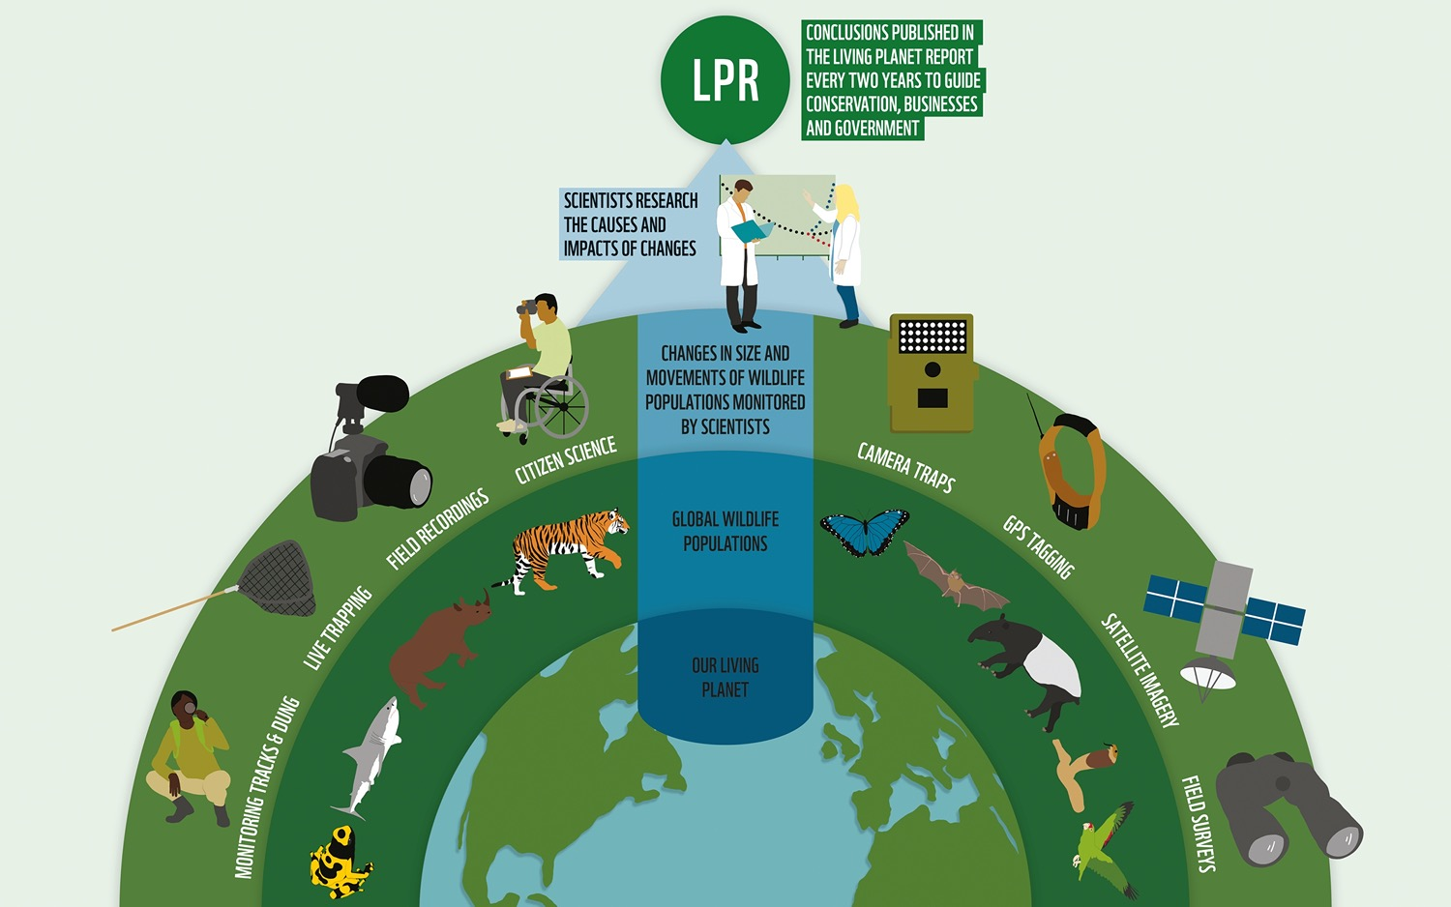
What is the Living
Planet Index (LPI)?
3
Notes:
Experts all over the world have been measuring changes over time in the populations of thousands of animal species.
Scientists bring this data together into a database and analyse it to come up with the Living Planet Index (LPI).
The LPI only uses data for species that have been monitored for at least 2 years and recorded from the 1970s onwards.
Even so, the LPI is currently able to track what is happening for over 21,000 populations of mammals, birds, reptiles, amphibians and fish. The trends that scientists find in
these data help them to draw conclusions about the health of the wider ecosystems.

Slide 4
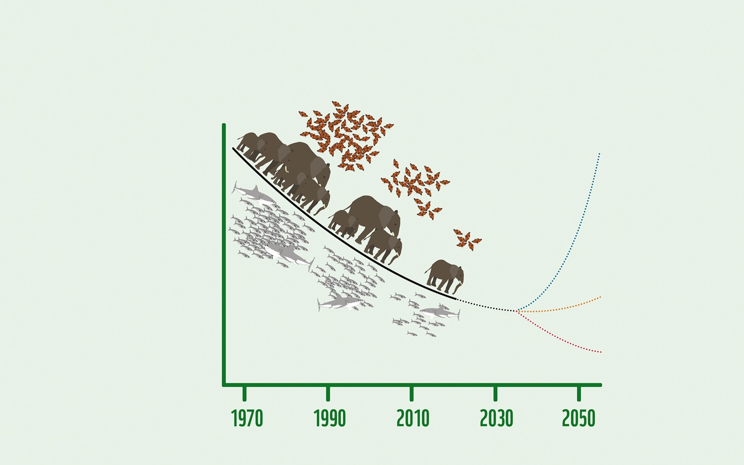
What is the LPI telling us?: Nature is in decline
Wildlife
population size
Recovering
The LPI shows that, globally, the average population sizes of mammals, fish, birds, reptiles and amphibians have declined by 68% since 1970.
Stabilising
Declining
4
Notes:
Ask students: What does this graph show?
Answer: The LPI shows that, globally, the average population size of mammals, fish, birds, reptiles and amphibians has declined by 68%
since 1970.
Example statistics on page 5 can help show what is happening.
Ask students why they think this is happening? What could be the causes? This could be in groups, or as a class. Write them down as a reminder (flip chart paper for example) so solutions can be explored.

Slide 5
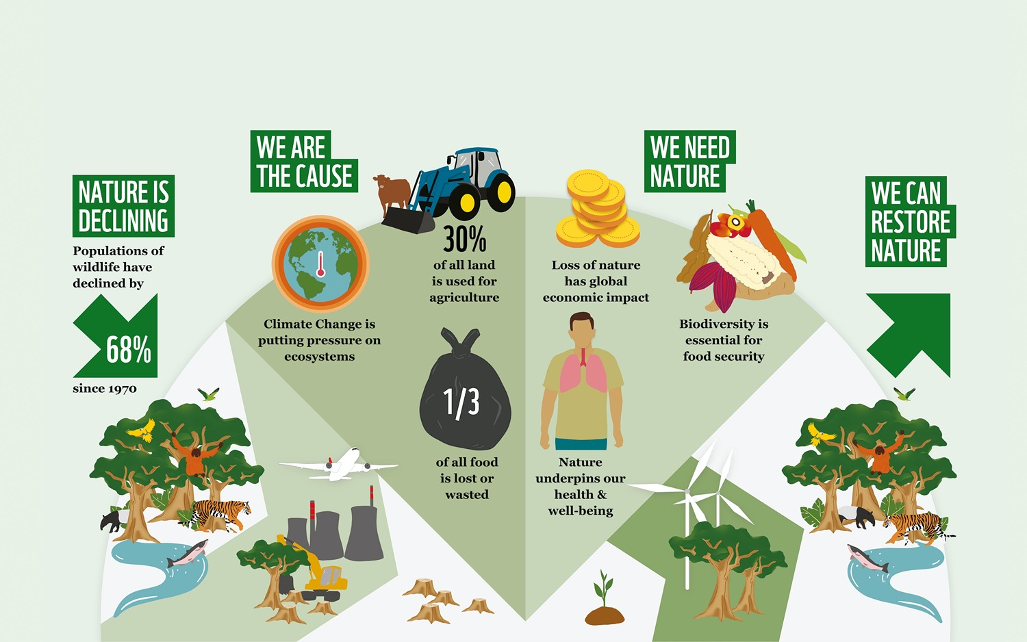
What is the LPR telling us?
5
Notes:
Explore the diagram from left to right. Were example in the section ‘We are the cause’ picked up by students in the last slide?

Slide 6
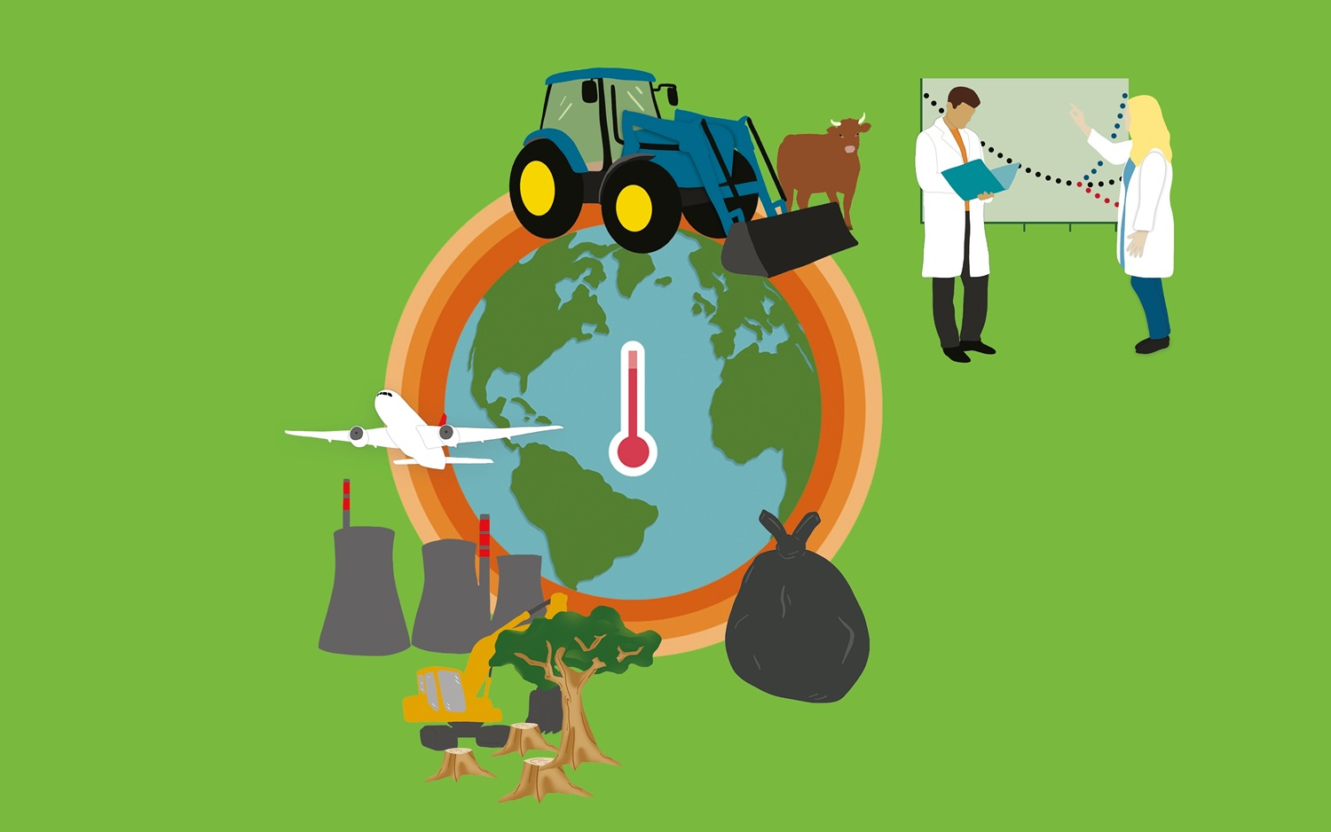
What can we do?
The way humans live on the planet is unsustainable, and we need to rethink our relationship with the planet and find the balance that will allow us and the rest of nature to survive.
Scientists show the impact certain human activities are having on our planet. When we know an activity is damaging the natural world we need to…
… stop doing it altogether,
… do the thing less,
… find new ways to do the same thing.
6
Notes:
Activity: In groups, take one of the 3 statements and come up with action that fit into that statement that could help us live sustainably and protect nature. Discuss ideas as a class.
Three specific solutions from scientists can be found on page 7. If any group struggles, then these can act as prompts.
Can students make this into an action plan?

Slide 7
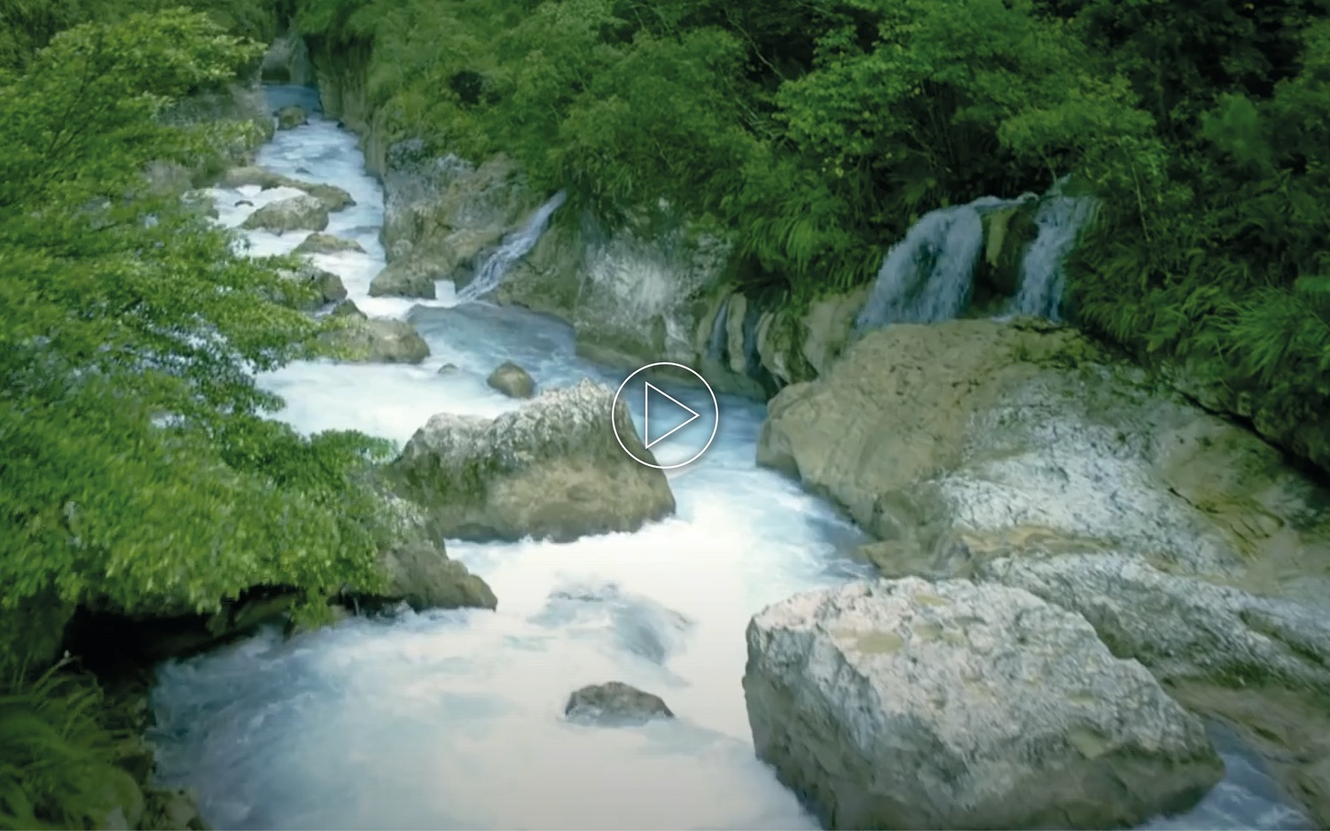
Activity one: Freshwater
7
Notes:
Play video. More resources can be found on page 5 of the teacher resource.

Slide 8
Case study: Brookham dam
Brookham is a small town next to the Pebblebank River. It is famous for its delicious crayfish and many tourists visit each year to sample the fresh fish. There is also a large wetland reserve which provides a home to species such as otter, kingfisher and water vole. A large dam was built near the town ten years ago and planning permission has been approved for another dam to be added just outside of Brookham near the area’s wetland reserve.
8
Notes:
Ask students:
1. Which stakeholders do you think should be involved in the debate?
2. Who will oppose or support the new dam?
Use the teacher resource for more prompts and ideas. The stakeholder cards n Appendix II can be given out or students can create their own.
Debate: See teacher resource for instructions and prompts.

Slide 9
Case study: Brookham dam
1
Withdraw planning permission for the second dam and keep the first dam
3
Build the second dam and keep the first dam
2
Withdraw planning permission for the second dam and remove the first dam
4
Build the second dam and remove the first dam
9
Notes:
Ask the class to vote on the outcome based on the arguments.
See teacher resource for plenary notes if time.

Slide 10
Activity two:
Create your own LPR
10
Notes:
Remind students of the purpose of the LPR. Ask students to write down 5 or more steps that they will take to produce a Living Planet Report for their local area. Ask for answers and discuss. The next slide will map out a suggested process.

Slide 11
Planning your LPR
A suggested process includes:
Mapping out the area
Recording biodiversity using different tools
Analysing your data
Planning the report
Writing
Editing
Designing or displaying the report in a visually interesting way
Distributing the report
11
Notes:
Individually or in groups, students should use the LPR planning sheet (Appendix III) to write down their plan for creating their own report.
Ask students to peer assess each other’s plans: see if they have missed out anything important and how they might work together to find solutions to some of the challenges they may face.
See the teacher resource for resource links and full activity details.

