Slide 1
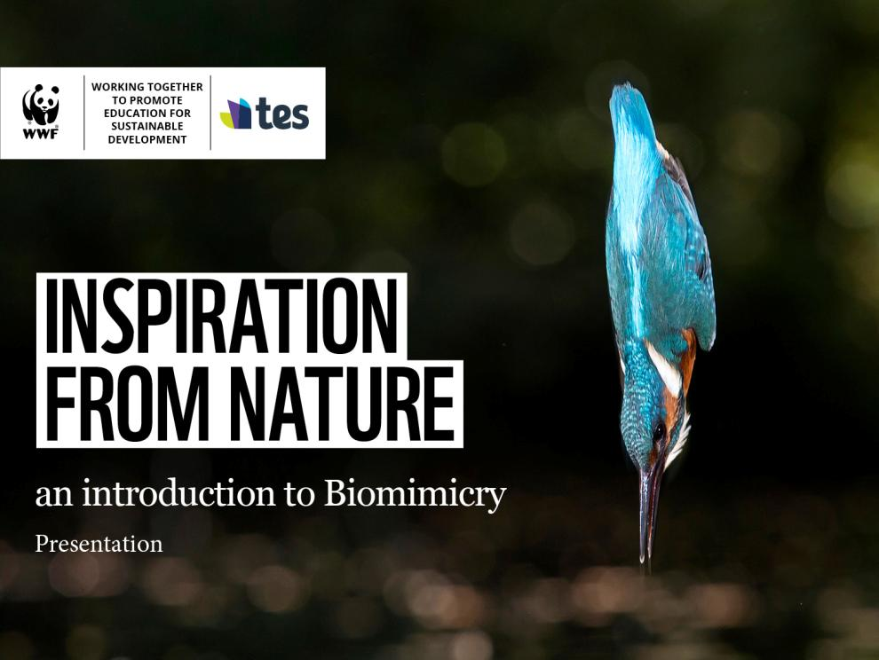
INSPIRATION FROM NATURE
Notes:
Animals and plants build amazing constructions, create incredible substances and develop body shapes that allow them to glide smoothly through air and water. They use and reuse materials without creating any waste. What can we learn from nature?
© Global Warming Images / WWF

Slide 2

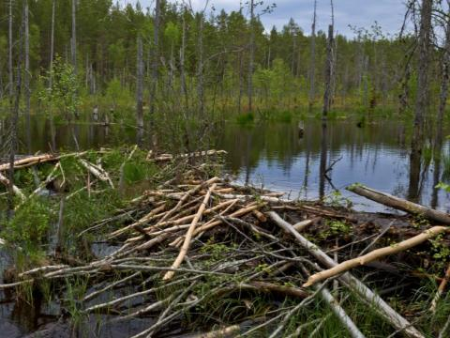
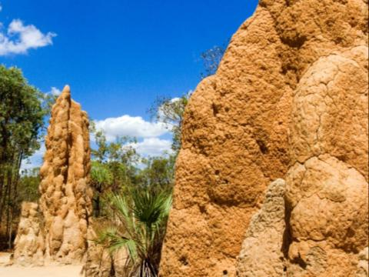
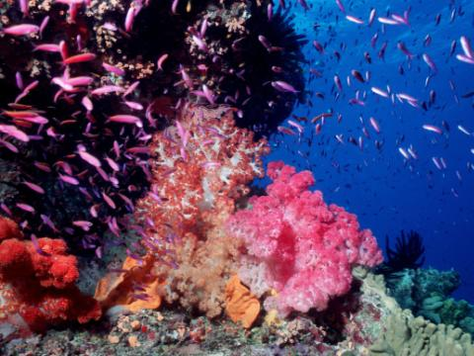
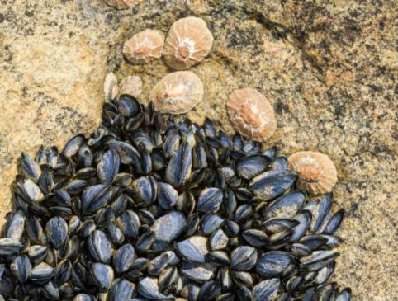
Notes:
Here are some examples of the amazing shapes and functions found in nature. Beavers cut down trees with their strong teeth to build dams across rivers. Termites create a natural ventilation system to cool themselves. Mussels manage to cling on to rocks despite being pounded by waves, tides and currents. Coral reefs create limestone structures.
Mussels © Peter Chadwick
Termite mounds © Wim van Passel / WWF
Coral reef © naturepl.com / Doug Perrine / WWF
Dammed beaver dam in a marsh © Ola Jennersten

Slide 3
Biomimicry =
to imitate life or nature
Notes:
Biomimicry means to imitate life or nature. Let’s have a look at some incredible designs inspired by nature.

Slide 4
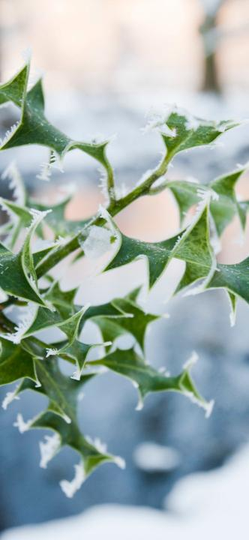
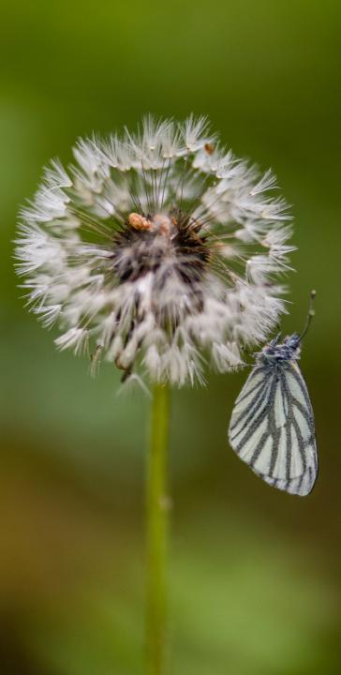
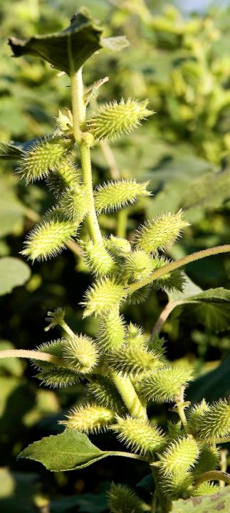
Notes:
Ask two pupils to come to the front of the class and play throw and catch with a Velcro pad and tennis ball.
Which of these plants do you think inspired Velcro? The holly leaf, the dandelion or the cocklebur?
Holly leaf © Global Warming Images / WWF
Dandelion © Ola Jennersten / WWF-Sweden
Cocklebur © Michael Gunther

Slide 5
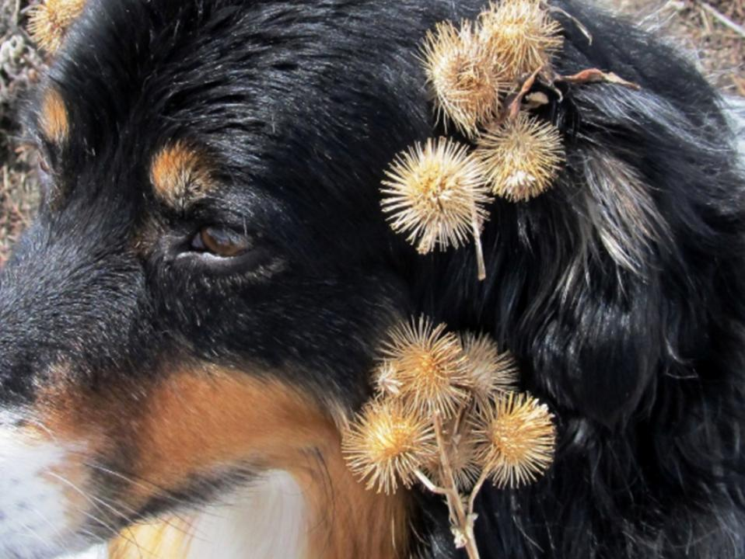
Notes:
The answer is the cocklebur. In the 1940s, the Swiss engineer George de Mestral noticed sticky burrs clinging to his dog’s fur. He took a closer look and discovered that the burrs were covered in tiny hooks. This inspired his famous invention – Velcro.
Cockleburrs on a dog / © Celestine Duncan Techline News.com

Slide 6
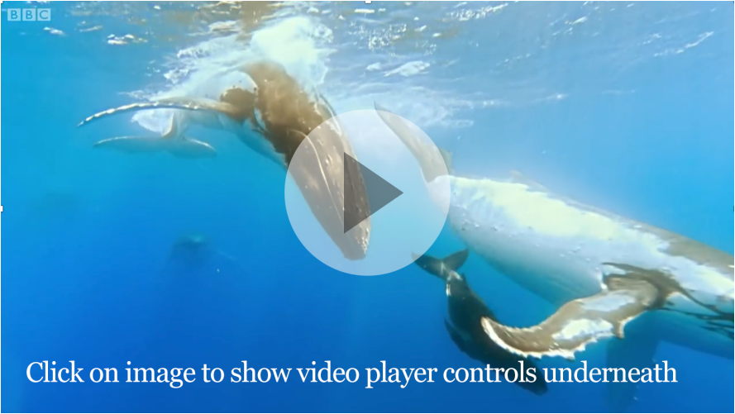
Watch
You can also view online at youtu.be/o767PuYbEXg
Notes:
What invention might have been inspired by these magnificent creatures?
Humpbacks are mainly black or grey with white undersides to their flukes, flippers and bellies. They are around 15m long. Humpback whales are very heavy, weighing around 36,000kg, yet they swim, jump and dive gracefully. One of the most noticeable characteristics of humpback whales are their long flippers.
Show the film to pupils.
Can you see the small bumps along the edge of the humpback whale’s flippers? These make water flow over the flippers more smoothly, reducing drag and so helping this giant mammal glide through the ocean.
youtu.be/o767PuYbEXg

Slide 7
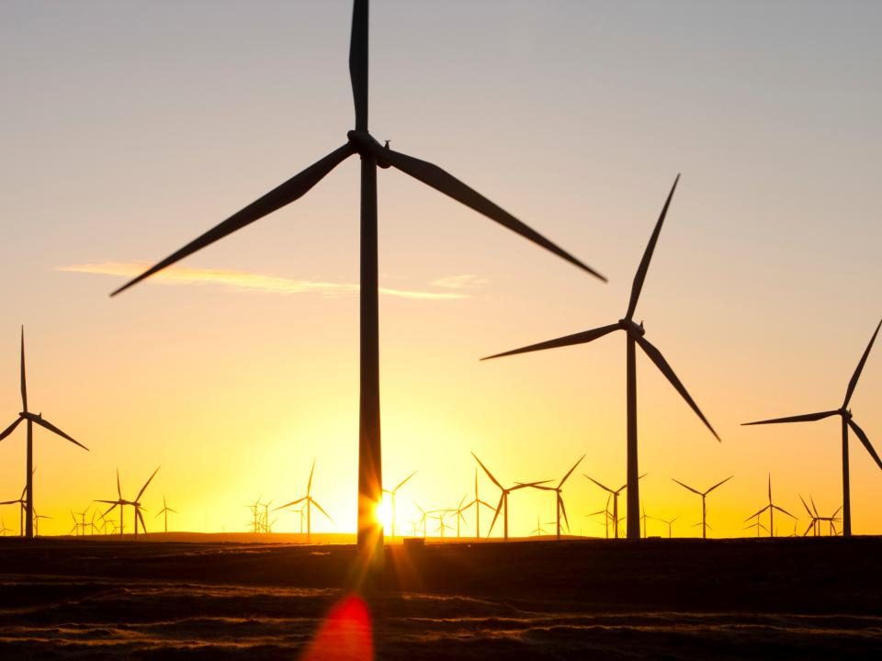
Notes:
This design of wind turbine often stalls when there is a change in wind speed.
© Global Warming Images / WWF

Slide 8
Notes:
Inspired by the graceful humpback whale, scientists have designed wind turbines with bumpy blades, to help them run more smoothly and to capture more energy from the wind.
© Whalepower

Slide 9
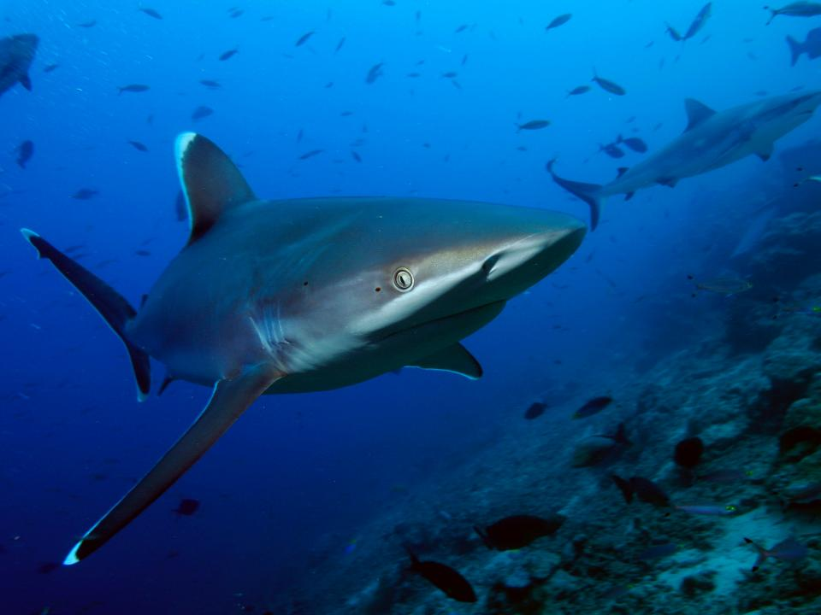
Notes:
Sharks have been around before dinosaurs, so no wonder they have a few things to teach us!
© Brent Stirton / Getty images

Slide 10
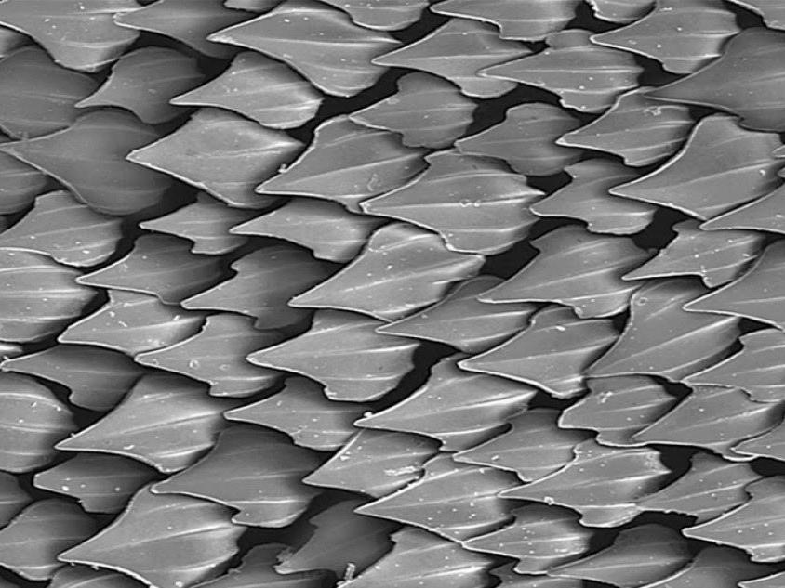
Notes:
This is a close-up of a shark skin. The tiny scales or teeth are shaped so that water is pushed down the shark more efficiently and with less drag.
© Oceanographic Museum of Monaco

Slide 11
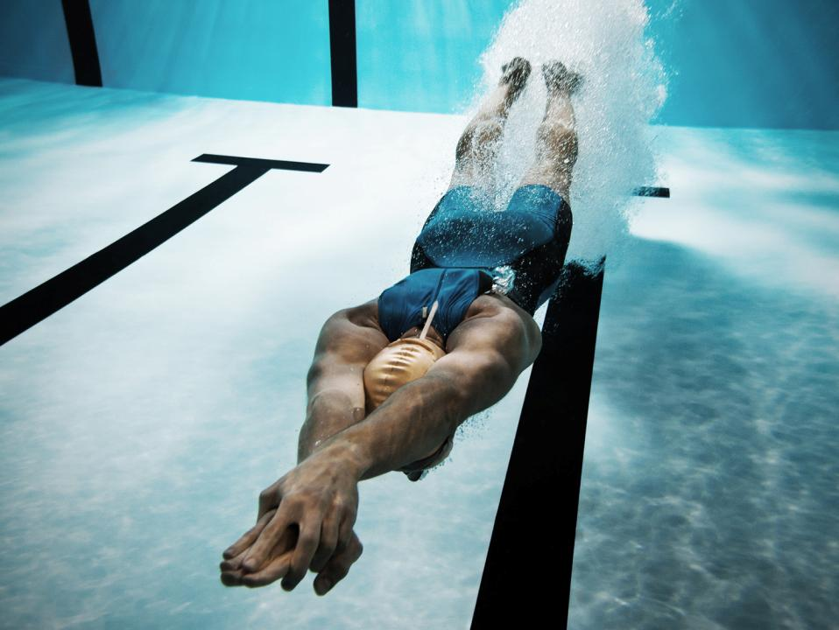
Notes:
The texture of a shark skin has been copied to create extremely streamlined swimming gear.
© iStock

Slide 12
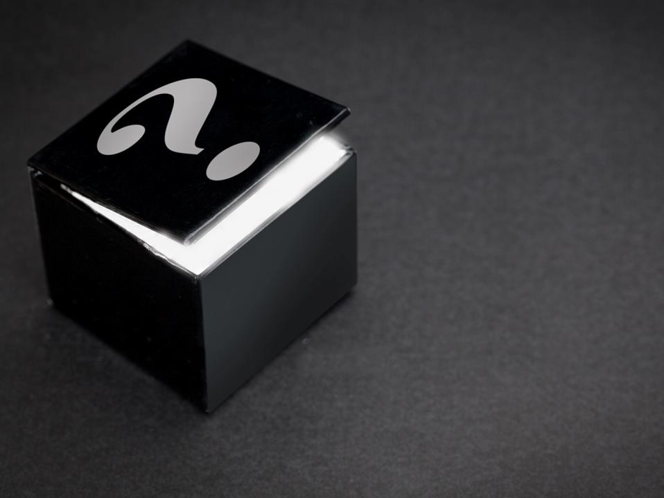
Mystery box 1
Notes:
Mystery box 1 and pinecone. Ask a pupil to guess what is in the box. Pinecones have inspired the invention of breathable fabric for sport clothing, as they open and close depending on the humidity in the air.

Slide 13
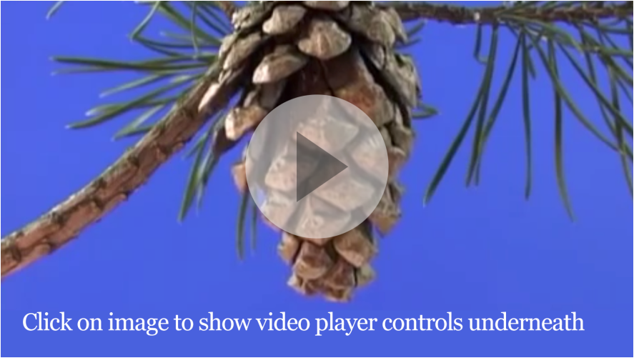
Watch
You can also view online at youtu.be/KUhubDdGRuo
Notes:
Film of the pine cone opening.
Ask another pupil to put on a running vest and to run on the spot while we show the film.
How are these two things connected?
The development of a new type of breathable fabric has been inspired by pinecones. In damp weather, the scales of pinecones close tightly to protect the seeds inside. When the weather is warm and dry, they open to release their seeds. The fabric adapts to changing humidity just like a pinecone in nature.
youtu.be/KUhubDdGRuo

Slide 14
Mystery box 2
Notes:
Mystery box 2 and an environmentally friendly lizard toy, made of fabric or wood. Ask a pupil to put their hand in the box and describe to the class what’s inside.

Slide 15
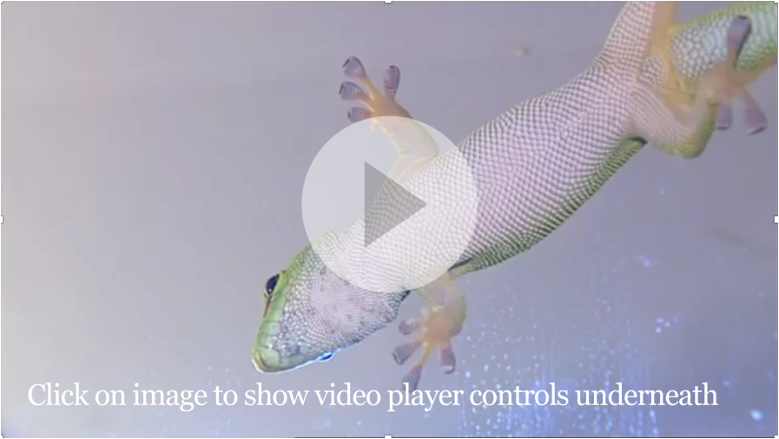
Watch
You can also view online at youtu.be/uEYcY7WfDTY?t=6s
Notes:
Show the film of the Gecko walking up a wall.
youtu.be/uEYcY7WfDTY?t=6s
START at 00.00.06.320 and END at 00.00.28.160
© Deutsche Welle

Slide 16
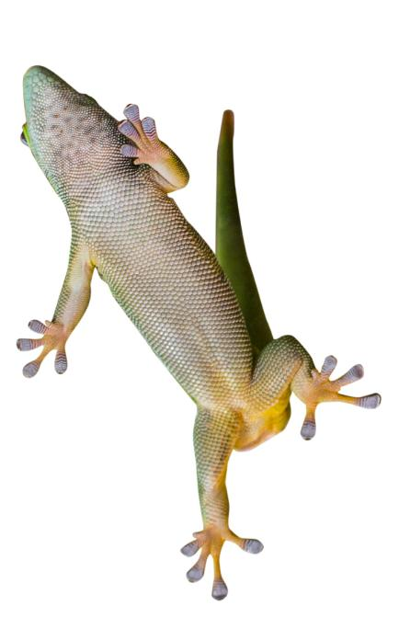
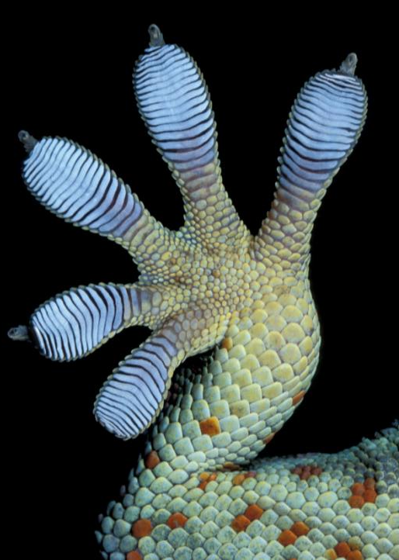
Notes:
You may think a gecko’s feet are sticky but actually they’re not. The toes of the gecko are covered in elastic hairs which are then split into nano hairs called spatulae. These hairs are so small they can bond with the atoms on the wall, allowing geckos to walk up walls and across the ceiling.
Scientists have developed a new super-strong adhesive based on the feet of the gecko.
Gecko foot © Ingo Arndt
Gecko © iStock

Slide 17
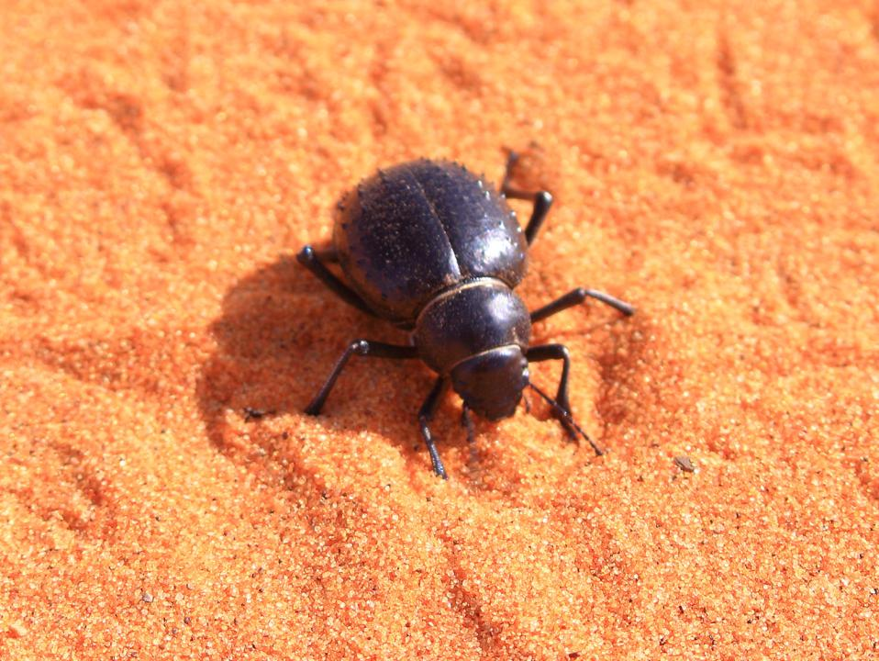
17
Notes:
Ask pupils if they can guess what amazing invention could have been inspired by a tiny beetle that lives in the desert?
© Martin Harvey / WWF

Slide 18
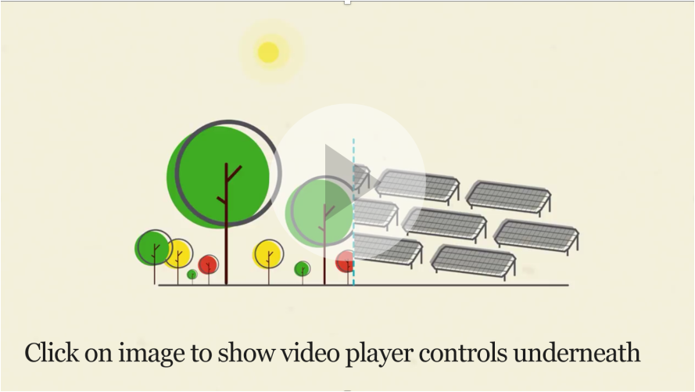
Watch
You can also view online at youtu.be/TmyfqjXOf7M
Notes:
Explanation by Janine Benyus, co-founder of the Biomimicry Institute.
youtu.be/TmyfqjXOf7M
© Wired

Slide 19
How does nature work?
Nature uses renewable energy
Nature reuses and recycles everything
Nature uses local materials
Notes:
What can we learn from nature in the way we make, use and dispose of our stuff? In nature, materials are used and reused in an endless loop and there is no waste.

Slide 20
