Slide 1
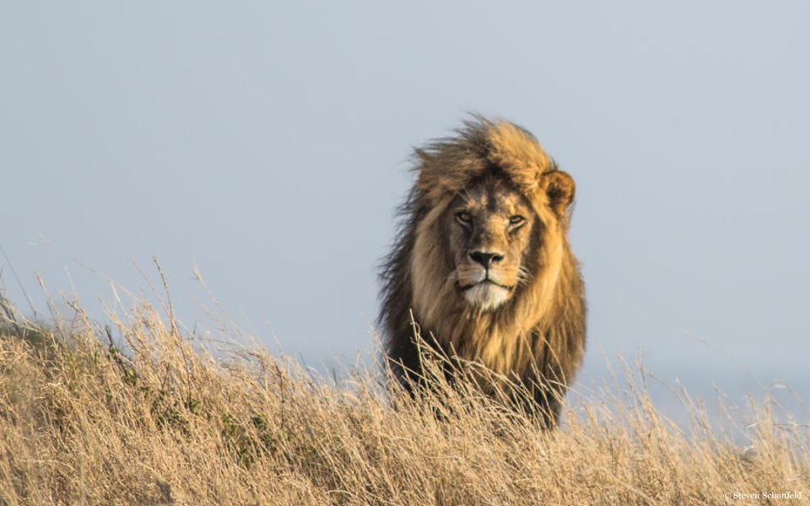
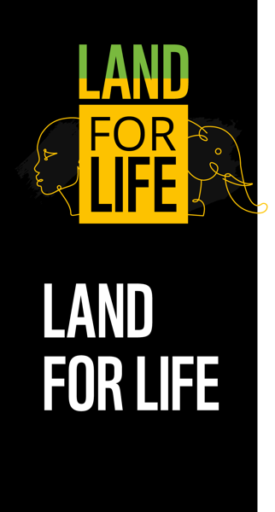
Notes:
The presentation consists of slides
- Lesson: Land for Life – overview of geography, ecosystems, threats and conservation projects in southern Kenya and northern Tanzania
- Activity 1: Living Connections (suggested time 10 minutes)
- Activity 2: Conservation Solutions (suggested time 30 minutes)
See Teacher Guide for more information and notes on how to run activities.

Slide 2
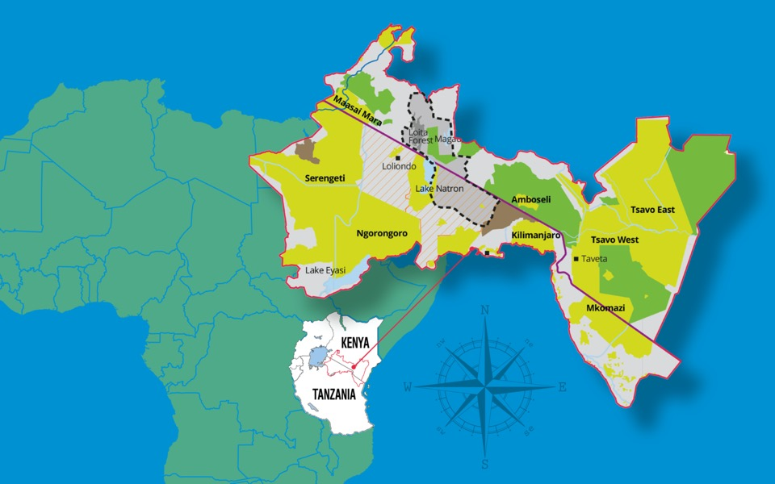
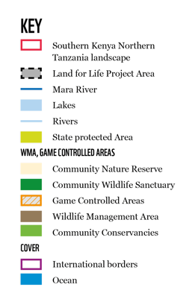
Where in the World?
1
Notes:
Can pupils recognise the African continent?
Can they use simple 8-point compass directions to describe the position of Kenya and Tanzania in relation to Africa?
Kenya and Tanzania are two countries in East Africa.
The border between these two countries stretches from Lake Victoria to the Indian Ocean.
This border area includes important wildlife areas such as the Maasai Mara National Reserve and Serengeti National Park. It also includes volcanoes such as Kilimanjaro – the tallest mountain in the whole of Africa.
Fun fact: Mount Kilimanjaro is the tallest free standing mountain (not part of a mountain chain) on Earth!
Optional task: Can pupils use an atlas to find Kenya and Tanzania?
Can pupils use map key/atlas to work out where and what some of the important geographical features are? Lake Victoria, Mara River, Serengeti National Park, Nairobi, Kilimanjaro

Slide 3
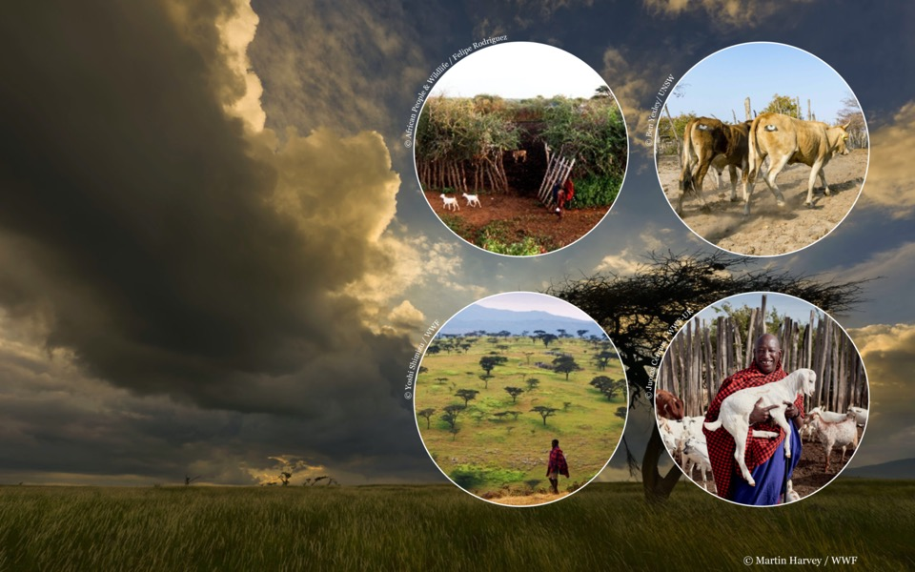
People and Resources
14 million people live in Southern Kenya and Northern Tanzania.
The landscape supports local livelihoods. It provides water and materials for shelter, land for livestock animals, fencing, fuel, food and traditional medicines.
2
Notes:
The landscape supports local livelihoods and provides many important resources.
Discuss the natural resources humans need to live.
Around 14 million people live in this region and this number is increasing.
5 million Kenyans depend on the Mau Forest for their daily needs including water, food, shelter, clothing, firewood and grazing areas for their livestock animals. The Mau Forest is the source of 12 rivers including the Mara River.
The Mara river is the lifeblood of the region. It provides water for wildlife and farming.
Wildlife tourism provides around 3 million jobs for people in this region and a vital income for the area.
Discuss potential impact of COVID-19 on wildlife tourism jobs

Slide 4
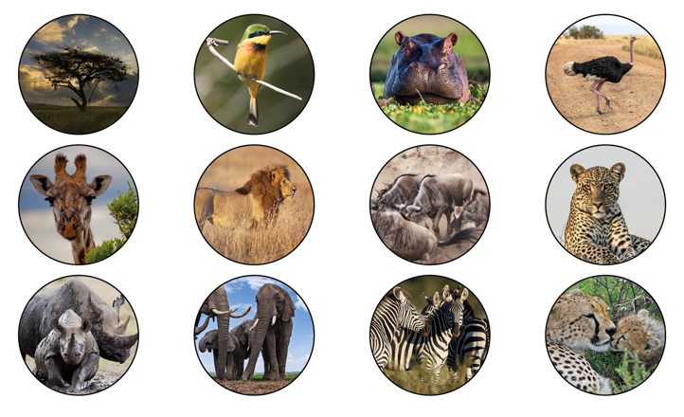
Wildlife
Maasai Mara has 100 species of mammal and 570 species of bird
Tsavo National Park has the largest population of elephants in Kenya
The Serengeti is home to the largest land mammal migration on Earth!
Fun Fact: African elephants' ears are shaped a bit like the African continent, and Asian elephants have ears shaped more like India!
3
Notes:
The boundary region between Kenya and Tanzania is extremely important for wildlife. Well known plants and animals from this region include lions, leopards, elephants, cheetah, hippopotamus, zebra, giraffe, wildebeest, ostrich, rhino, Thomson’s gazelle and the acacia tree.
The largest land mammal migration in the world occurs in the Mara region every year. Around 1.3 million wildebeest and 200,000 zebras travel up from the Serengeti plains to feed on the lush grass that springs up after the rainy season.
Fun fact: you can tell African and Asian elephants apart easily in photos because African elephants have ears shaped roughly like the African continent, and Asian elephants have ears shaped more like the Indian subcontinent!

Slide 5
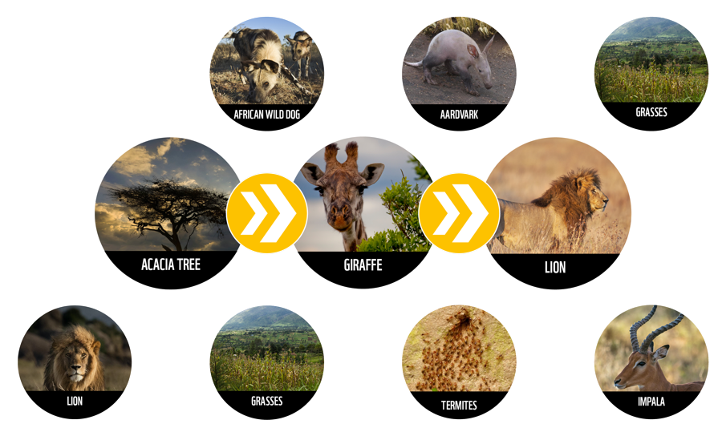
Food Chains
4
Notes:
Discuss different parts of a food chain (producer, consumer KS2, direction of energy transfer and trophic levels for KS3).
Food chains show how energy from the sun is captured by plants and then transferred to animals. All food chains start with a producer, a plant or algae that can produce its own energy from sunlight (photosynthesis).
Producers are eaten by consumers, these animals must consume food in order to get energy, they cannot produce their own energy from sunlight.
There are thousands of different food chains in the southern Kenya northern Tanzania region.
Ask students to make their own food chain using the other plants and animals on the slide starting with the producer.

Slide 6
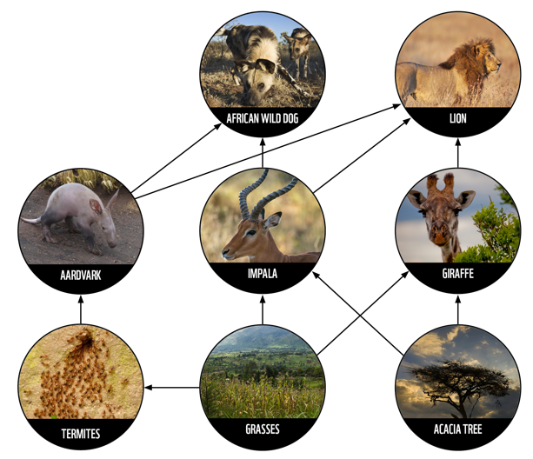
Food Webs
5
Notes:
In reality, food chains don’t just happen in isolation. For example, an acacia tree might be eaten by a giraffe, but it also might be eaten by elephants, zebras and lots of different insects. When we consider all of these other connections, we build up a food web.
Each food web is part of an ecosystem.

Slide 7
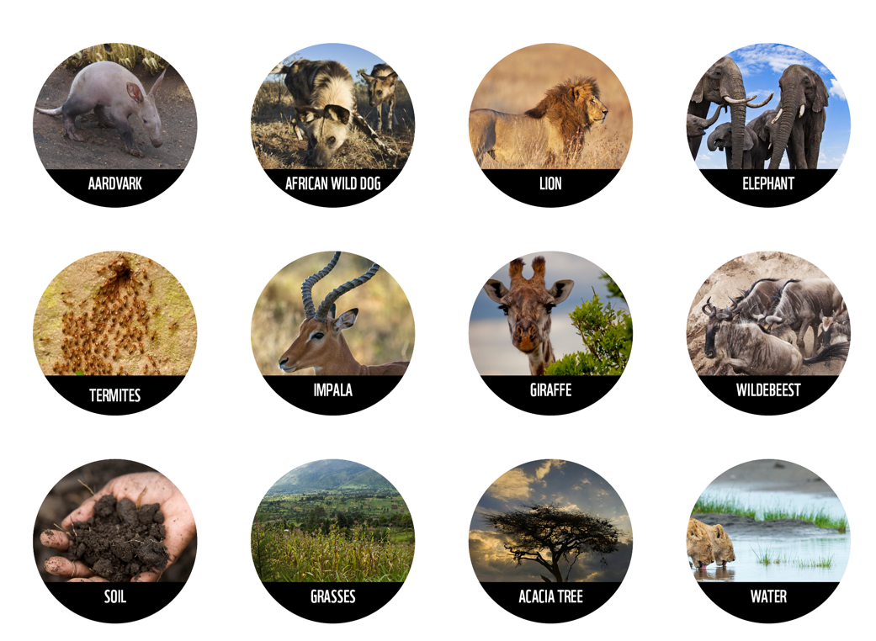
What is an
Ecosystem
Activity 1: Living Connections
Explore how living and non-living things are interdependent in an ecosystem
6
Notes:
An ecosystem is like a community made up of all of the living and non-living things in a habitat. This includes all of the plants, animals, and other living things but also non-living materials such as water, weather, rocks and soil.
An ecosystem’s health depends on all of its different parts working together. The connections are interdependent, they rely on each other.
Activity 1: Living Connections – Find instructions on how to run this activity in our Teacher Guide.

Slide 8
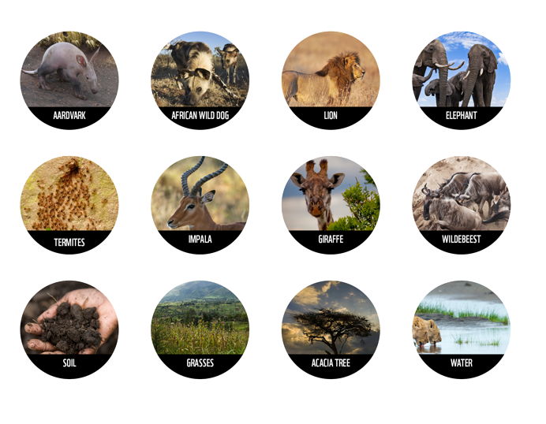
What is an
Ecosystem
Activity 1: Living Connections
Explore how living and non-living things are interdependent in an ecosystem
6
Notes:
An ecosystem is like a community made up of all of the living and non-living things in a habitat. This includes all of the plants, animals, and other living things but also non-living materials such as water, weather, rocks and soil.
An ecosystem’s health depends on all of its different parts working together. The connections are interdependent, they rely on each other.
Activity 1: Living Connections – Find instructions on how to run this activity in our Teacher Guide.
(Suggested time 10 minutes)

Slide 9
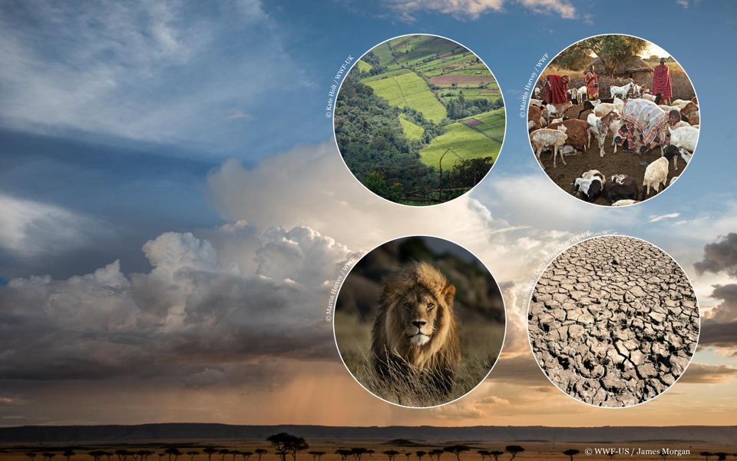
Landscape
Under Threat
Deforestation
Expanding human habitats
Human-wildlife conflict
Climate change
7
Notes:
The Maasai people have lived alongside wildlife in southern Kenya and northern Tanzania for many centuries, but their livelihoods and wildlife in this unique landscape are now under threat.
Poverty is high in the region. Many people have limited opportunities to make an income and often face food shortages. Because of this, people may resort to unsustainable activities, such as wildlife poaching, overgrazing by livestock or cutting down trees for fuelwood.
These activities damage grasslands, forests and freshwater habitats. This negatively impacts wildlife such as elephants, lions and wild dogs as they have less space to live.
As their natural habitats shrinks, wildlife are forced to come into closer contact with human communities. This can result in human-wildlife conflict and poses a danger to human life.
Local people’s livelihoods, including traditional Maasai livestock practices and opportunities such as eco-tourism are threatened by human-wildlife conflict and reducing habitat size.
Climate change is threatening the region. The average annual temperature in both Kenya and Tanzania has already increased by 1°C since 1960. Annual droughts are now the norm in Kenya, severely impacting food production and livestock mortality.

Slide 10
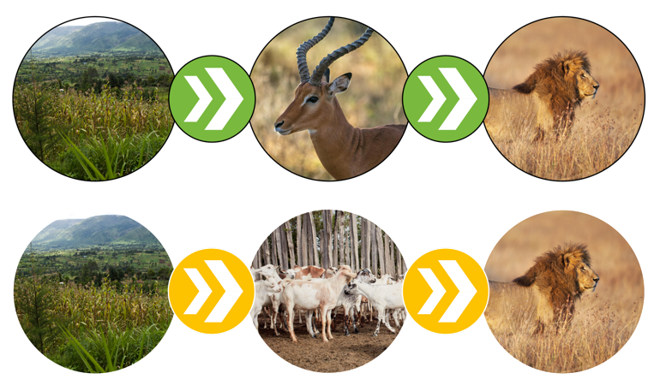
Human-Wildlife Conflict
Natural food chain
Human influenced food chain
8
Notes:
As human habitats expand, predators like lions, cheetahs and hyaenas have their habitats reduced. As there is less grassland to graze on, wild prey animals also decrease in number.
When their natural prey is scarce, lions may start to prey on livestock animals such as cows, sheep and goats as these animals can make an easier meal.
Livestock animals provide important income for local communities, so if they are killed by wildlife this can result in predators including lions being attacked in retaliation, such as through poisoning.
Optional role play activity: choose a student to represent a villager and another student to represent a lion.
What problems does the villager face when lions come into their community - people are scared, livestock can be eaten, people lose money, people can be injured.
What problems do the lions face when humans reduce their habitats? - lions lose place to live, lions lose their natural prey and have to find alternative option, lions are poisoned by humans

Slide 11
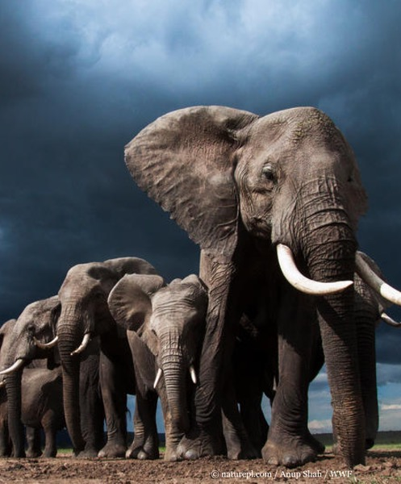
Human-Elephant Conflict
Activity 2: Conservation Solutions
Research a current conservation solution to prevent human-elephant conflict and present your findings to your class.
Remember to think about:
What will the cost be?
How long will it take? How long will the solution last?
Who needs to be involved?
Can you find any statistics?
Are there any additional benefits to the solution (income for community, increased biodiversity)?
How are these solutions sustainable?
Can you use any persuasive language?
9
Notes:
As habitats are reduced, elephants have smaller areas to roam and find food. This means that they often travel across farmland and eat crops.
Activity 2: Conservation Solutions - Find instructions on how to run this activity in our Teacher Guide
(Suggested time 30 minutes)
Research prompts: chilli pepper plants, bees, solar-powered electric fences

Slide 12
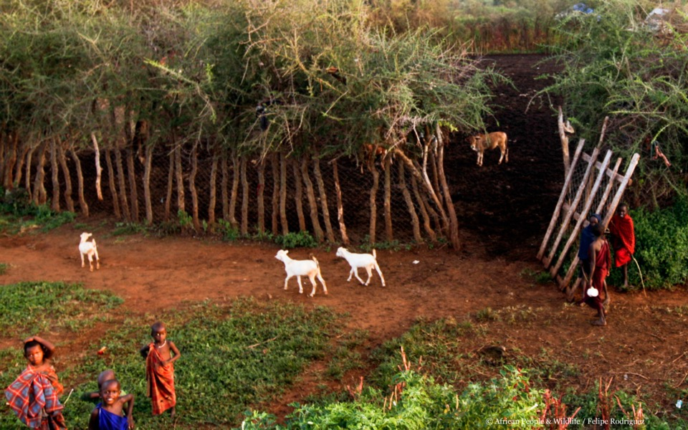
Conservation Solutions:
Living Walls
10
Notes:
Through the Land for Life project, WWF are collaborating with communities in southern Kenya and northern Tanzania to keep landscapes healthy and develop solutions for people and wildlife to coexist and thrive in a changing world.
‘Living Walls’ are circles of living African myrrh trees with chain fencing. They help protect livestock animals, such as cows, sheep and goats, by preventing attacks from predators such as lions.
Because the livestock animals are better protected, humans are less likely to kill lions in retaliation and lion populations are given a chance to recover.
Living plants are also used to make the fences so no trees need to be cut down – a ‘triple win’ for conservation!
(This project was developed by WWF’s partner African People & Wildlife)

Slide 13
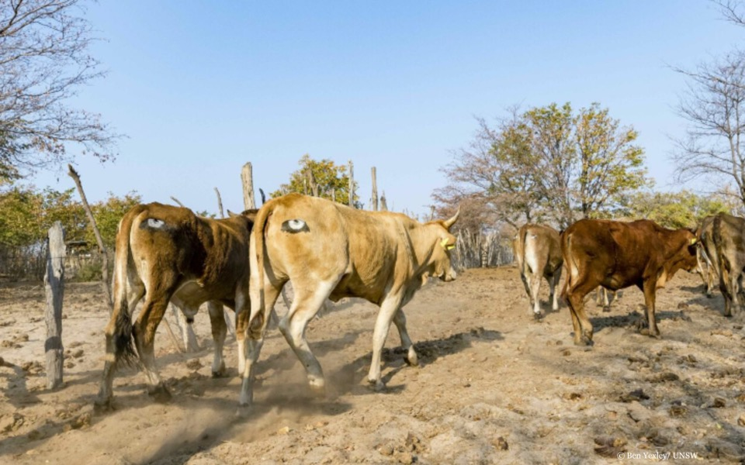
Conservation Solutions:
Eyes on Butts
11
Notes:
Painting eyes on the backsides of livestock animals with a foam stencil is a cost-effective method of keeping predators, such as lions, away. It makes lions think the animals are watching them from behind, so they are much less likely to try and attack.
(This project was developed by WWF’s partner Mara Predator Conservation Program)

Slide 14
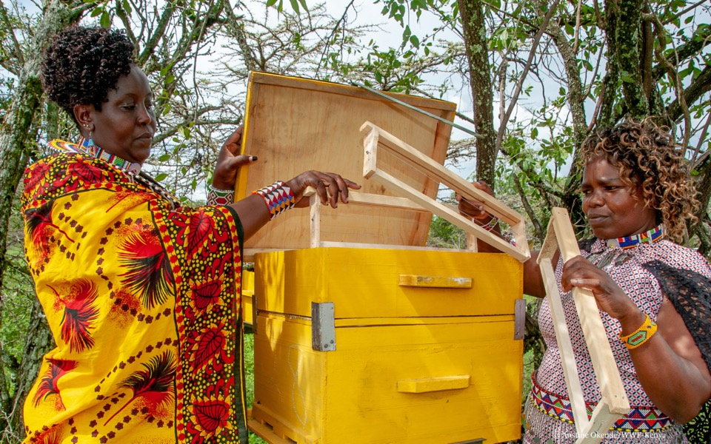
Conservation Solutions:
Bees
12
Notes:
A bee-keeping project supported by WWF-Kenya has provided 50 modern beehives to over 100 female members of the Oloisukut conservancy.
Money made from selling honey means that women have an additional source of income. This allows them to pay for things such as household items and children’s school fees.
If well managed, these beehives have a life span of 17 years.

Slide 15
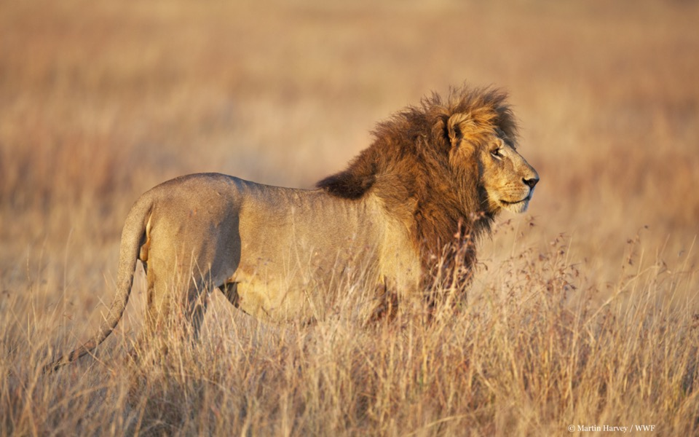
Conservation Solutions:
Phone Apps
13
Notes:
Some community wildlife rangers, use WhatsApp groups to share information on wildlife movements and poaching incidents. By sharing messages, voice recordings, images and locations with each other, teams can track lions and elephants across the landscape.
The shared information is used to help local communities avoid dangerous wildlife.
Ranger teams also use WhatsApp to consult with doctors on how best to treat community members who have been injured by lions, buffalo or elephants.​
(This project is supported by WWF’s partner SORALO)

Slide 16
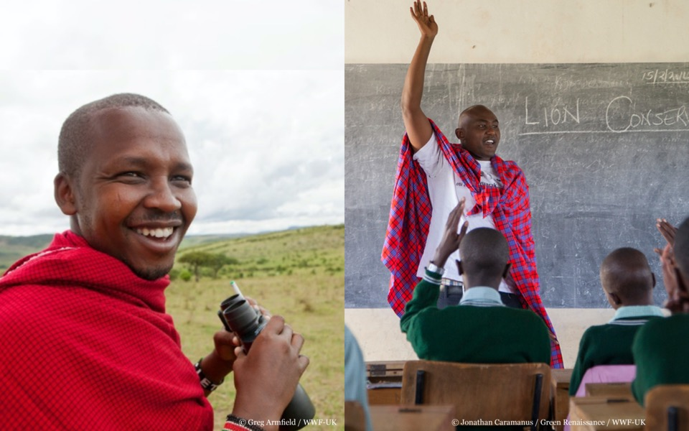
Conservation Heroes
David Leto
Elephant Project Officer for WWF-Kenya
Michael Kaelo
Community and Public Relations Manager for Mara Predator Conservation Programme
14
Notes:
Show David Leto WWF elephant officer video (1:30)
Link: https://www.youtube.com/watch?v=05gOs1wPiwE&feature=emb_logo&fbclid=IwAR3o9a2Ekp8GEPzda8mhy1vWk9c_vF1QY609UJiXoKxZrYxiIE2H4AMpea4
David Leto is an elephant project officer with WWF-Kenya. He works to try and reduce human-wildlife conflict between elephants and local Maasai communities.
David’s work helps to put satellite collars on elephants to monitor their movements. Learning about these movements can help people make decisions on how to protect elephants – and warn local people of their approach.
David has experienced the tragedy of human-elephant conflict first hand. His father was killed by an elephant when he was just 10 years old. In spite of this David decided to spend the rest of his life trying to protect elephants and to help people live in harmony with them.
Michael Kaelo is another conservation hero. He works to improve relationships between communities, their livestock and wildlife animals such as lions.
To do this Michael teaches children from local primary schools about lion conservation such as in Ole Seri in the Maasai Mara, works with Maasai cattle herders, and helps to strengthen livestock enclosures (known as bomas) which protect livestock animals from lions.

