Slide 1
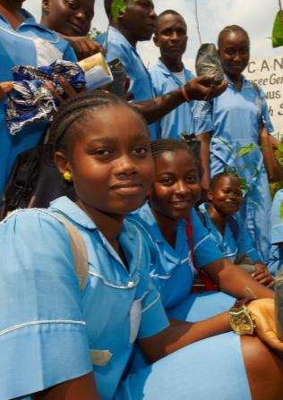
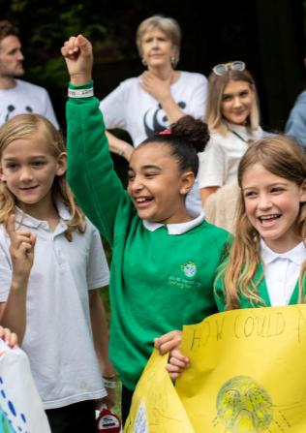
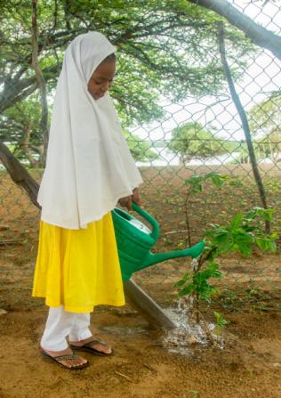
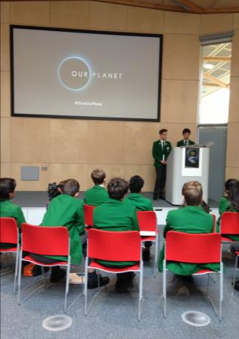
Our Climate Our Future School Climate Action Workshop
© Matt Larsen-Daw / WWF-UK
© Matt Larsen-Daw / WWF-UK
© Matt Larsen-Daw / WWF-UK
© Matt Larsen-Daw / WWF-UK

Slide 2
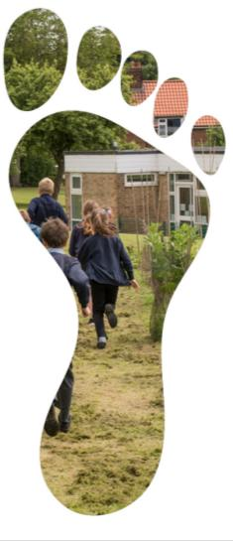
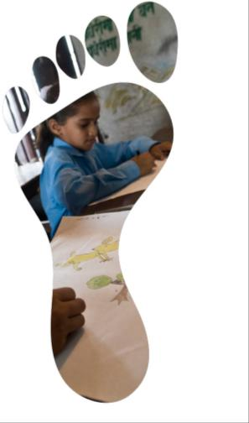
What makes up your school ‘footprint’?
Think about all of the ways that life in your school has an impact on the planet (good or bad).
Energy
Water
Waste
Resources
Transport
Food & Drink
Wildlife
Notes:
A footprint is often used to talk about impact on nature. You can think of it in terms of the mark you leave when you have stepped somewhere. If it is a light footprint then the land will repair very quickly (by the time you have made another footprint with your next step), but a deep footprint would still be there as you walked on – leading to a build up of damage. A ‘carbon footprint’ is the amount of carbon that ends up in the atmosphere as a result of someone’s lifestyle (the things they eat, the amount of electricity they use, the way they travel etc) or the running of a business or building. An ‘environmental footprint’ is a way of talking about the impact on nature in terms of how much land and water is used for the planet to be able to replace what is taken. The smaller our footprint, the more the planet is able to support us without being damaged.
For this exercise, think about all of the ways that your school uses resources that nature has to provide, or has an impact (good or bad) on nature.
Make a list of all the things you can think of (as one group, or with small groups working on each of the areas). This will help you identify changes you might make to lower the school footprint.
Choose two or three things that you feel have the biggest impact on the school’s footprint, and discuss changes that could be made or actions that could be taken to reduce the impact.
Energy: Powering lights, heating, air-con, computers and screens.
Impact: Electricity may be generated by carbon-producing fossil fuel power stations, and heating may use gas or oil which release carbon into the atmosphere when used.
Ideas: Source electricity that is created using renewable sources (so it does not contribute to a carbon footprint). Use LED or halogen light bulbs that use less electricity, and switch them off when not needed. Make the most of natural light. Switch off any electrical equipment when not in use. Avoid wasted heat in winter by keeping doors and windows closed and improving insulation, so that less energy is needed for heat.
Water: Flushing toilets, washing hands, watering plants in the school grounds
Impact: Freshwater is not unlimited, and if we use too much we may cause problems for freshwater ecosystems or for humans who don’t have the water they need.
Ideas: Install dual flushes to toilets so that the smallest possible amount of water is used. Collect rainwater to water plants – and maybe even to flush toilets. Only run taps for as long as needed.
Waste: Food waste, single use plastic, paper
Impact: When food or packaging is thrown away it has to go somewhere. Plastic that cannot biodegrade may end up polluting rivers or the sea and harming ecosystems. Food releases greenhouse gases as it rots and the energy used to produce it is wasted if it is not eaten.
Ideas: Start recycling in schools and ensure the whole community understands how to do it properly and why it is important. Make drinking water available for people to refill water bottles. Ban single use plastic on site. Start a compost heap for food waste. Try to use as little paper as possible and start monitoring how much is used to identify where it could be reduced.
Resources: Paper, pencils, pens, furniture
Impact: Stationery and furniture take energy to produce and deliver, and forests may be cut down to get wood to make products like paper and furniture.
Ideas: Create a school policy to only buy wood products and paper from responsibly managed forests, and to try to avoid plastic products that can’t be recycled.
Transport: Travel to and from school, school trips
Impact: Petrol-powered vehicles release greenhouse gases that cause climate change, and pollute the air around them making it less healthy for people. A bus carrying many people at once is better than lots of cars, and if people can cycle and walk to school then they are not having an impact on the planet.
Ideas: Walking and cycle clubs with reward chart. Bicycle parking at school. No idling zones outside school to make it safer for walkers/cyclists.
Food & Drink: Canteen, events, tuck shop
Impact: Food production is one of the biggest causes of climate change, due to the land and water used to grow crops and farm animals, the forest and grassland lost to clear land for this purpose, and the carbon that is put in the atmosphere as a result of food being transported around the world. Producing meat and dairy takes much more land and water, and causes more emissions, than producing plants with the same nutritional value.
Ideas: Ensure there is always a plant-based option and that students and staff are encouraged to try and reduce meat and dairy. Try to make it school policy to buy local if possible and to avoid unsustainable palm oil. Grow food in the school grounds to reduce food miles for the canteen.
Wildlife: School grounds
Impact: School grounds can support wildlife by providing habitat and food, but if space is not left for wildlife, or if it is managed in a way that harms wildlife, wildlife may be worse off.
Ideas: Plant trees or wildflowers. Leave areas of grass unmown to create pollinator habitats. Build bug hotels for the school grounds. Create a wildlife pond. Avoid use of pesticides or fertilisers. Make spaces in fences for wildlife or replace them with hedges that support wildlife and let it pass.

Slide 3
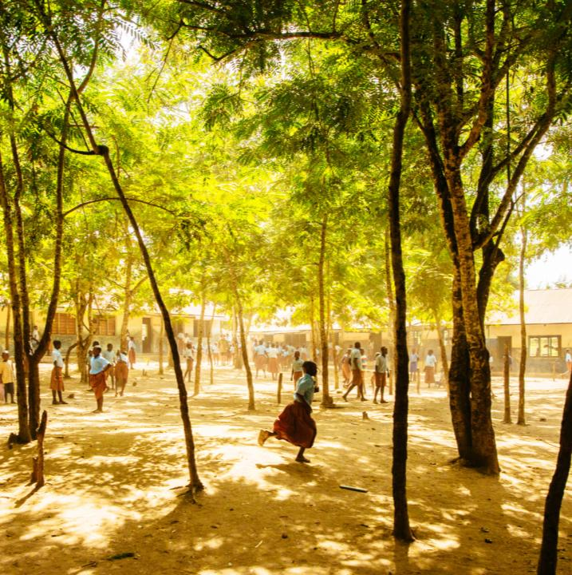
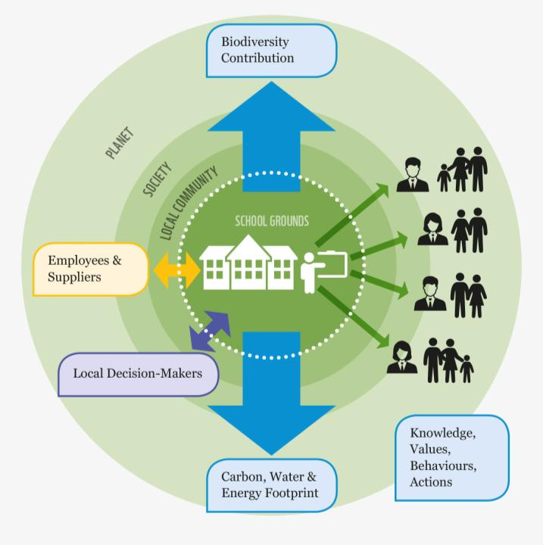
What happens in school doesn’t stay in school!
Taking action and making changes as a school can lead to changes across your community and beyond.
Can you think of ways that your school can help bring change?
Helping nature
Staff & businesses
Local decision-makers
Students change their community
Energy and water
Notes:
Group discussion – how can things that happen in school lead to change in the wider community? What already happens, and what could the school community do to bring wider change?
Click to reveal a diagram of school influence.
Energy & Water: A school uses electricity and water, and may buy products (stationery, food, furniture) that also has a ‘footprint’.

Slide 4
Focus Area: EG Food & Drink
Individual Action
Your #PromiseToThePlanet
School Action
Think about Campus / Curriculum / Culture / Community
Global Action
A promise you want world leaders to make

Slide 5
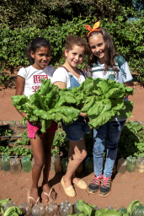
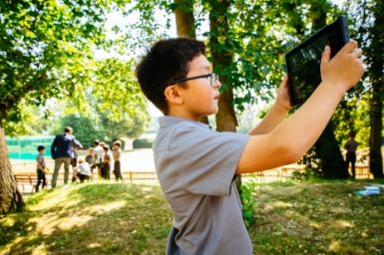
School #PromiseToThePlanet
Make a plan for school climate action
Take a whole school approach to sustainability by exploring changes across these four areas
Culture
How can the school encourage and support sustainability?
EG policies, displays, communications
Classroom
What can be changed about what is taught and how to help prepare students to be climate champions now and in the future?
Campus
What could the school do to lower its impact and help nature?
EG nature-friendly school grounds, solar panels
Community
How can the school create ripples of change across society?
EG Become a recycling hub,
hold events and exhibitions
For every idea, consider…
What is the change?
Why is it important?
Who needs to help make the change happen?
How will you reach them and persuade them to help?
When do you want to see the change made?
© Jaime Rojo / WWF-US
© Greg Armfield / WWF-UK
Notes:
Images
Left: Students of the Municipal School PA Sapiquá in Caceres, Brazil, showing their school garden, that is irrigated with rain water only and was built as part of a water conservation project.
Right: Students in St Andrews School, UK, conduct a biodiversity survey of their school grounds.

Slide 6
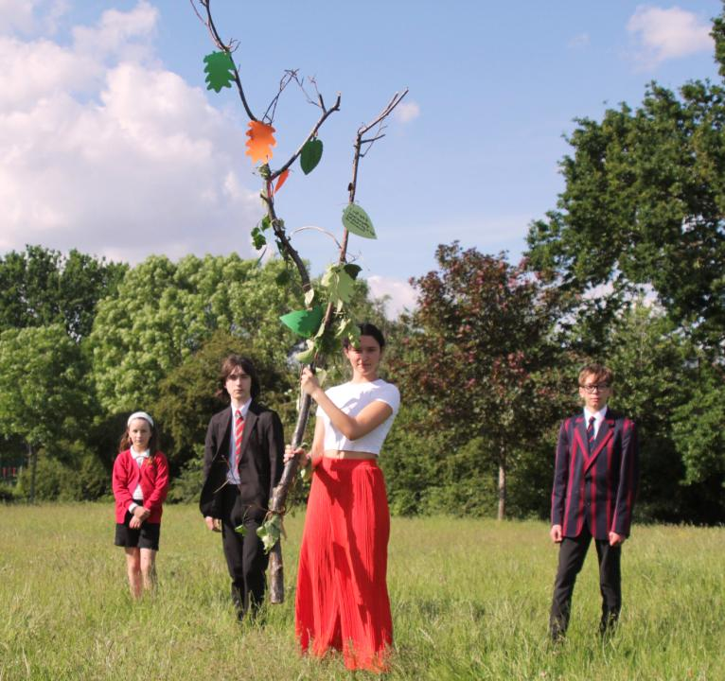
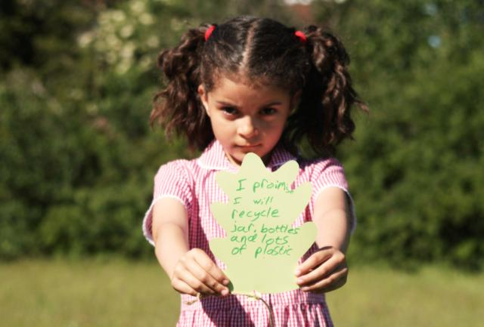
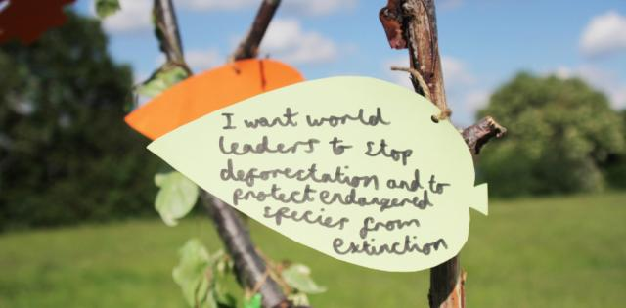
Join the Forest of Promises for COP26 – 5th November 2021
Make your leaf (or find a fallen leaf)
On one side write your #PromiseToThePlanet
On the other side write a promise you want world leaders to make
Display your leaves on a tree or display for your community to see
Share your promises with world leaders at COP26
Notes:
Schools around the world will form a Forest of Promises during COP26.
This will send a strong message to world leaders that the millions of young people in school today are prepared to be part of the solution to climate change, but need leaders to make strong promises and keep them. If we all work together we can be strong, and shape a sustainable future. It will take all of us, and it will need us to keep our promises now but also going forward into the future.

