Slide 1
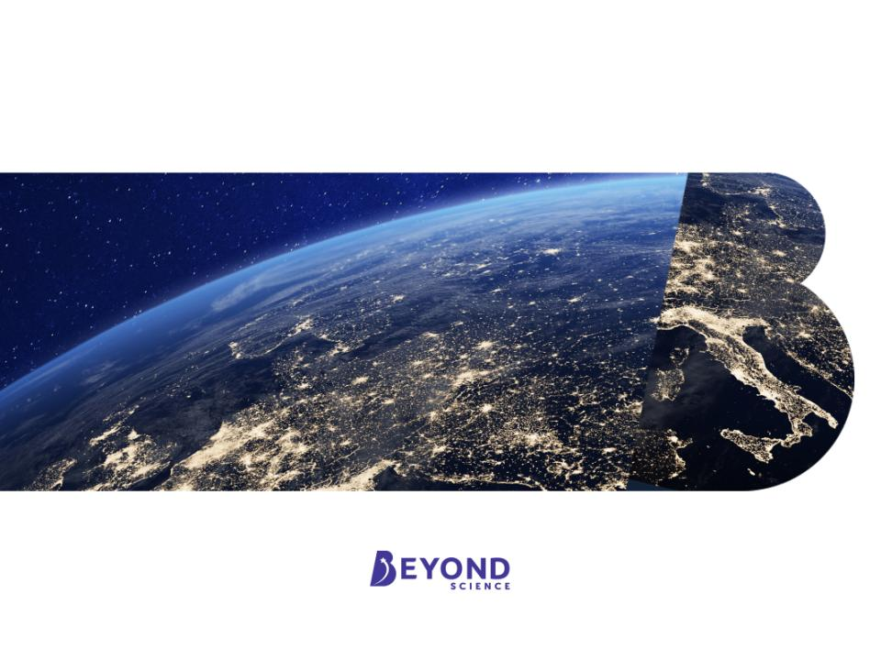
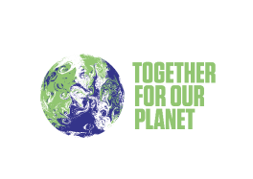
COP26
Our Climate, Our Future

Slide 2
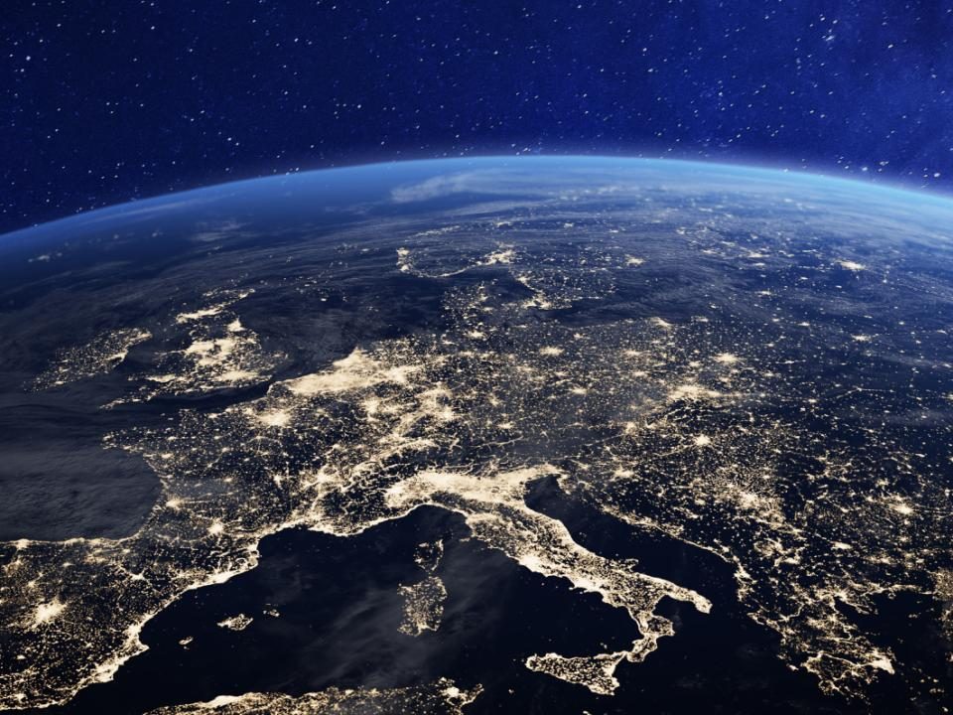
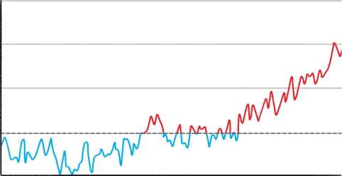

What Is Climate Change?
Climate change is a change in the average temperature and cycles of weather over a long period of time.
Since 1880, scientists have kept thermometer-based records of the global surface temperature.
What is happening to the global temperature?
The planet is becoming warmer; the climate is changing.
1.5
1.0
0.5
Temperature Anomaly (°C)
Data source: NASA's Goddard Institute for Space Studies (GISS)
0
-0.5
2008
1880
2016
1888
1896
1904
1912
1920
1928
1936
1944
1952
1960
1968
1976
1984
1992
2000
Year

Slide 3
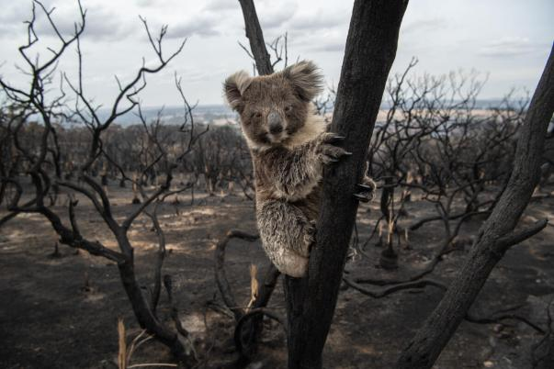
Why Is Climate Change a Problem?
Over millions of years, species become adapted to survive in the conditions in which they live. A stable climate supports this process and allows living things to thrive. If the climate changes quickly, organisms don’t have enough time to adapt to new conditions and may no longer be able to survive.
Bushfire Aftermath On Kangaroo Island by © Brad Fleet / Newspix licensed under CC BY

Slide 4
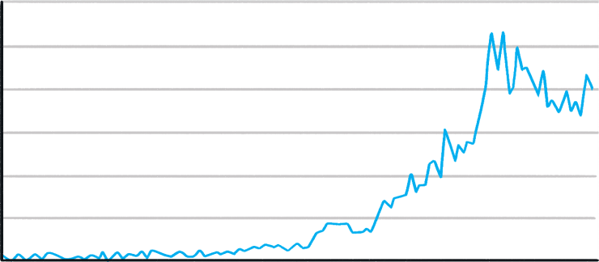
Why Is Climate Change a Problem?
Climate change disrupts weather patterns and causes extreme weather events to become more common. These include hurricane activity, droughts and floods.
As the global temperature has increased, so has the number of reported natural disasters.
600
500
400
Number of Reported Natural Disasters
Data source: EM-DAT International Disaster Database
300
200
100
0
1900
1920
1940
1960
1980
2000
2020
Year

Slide 5
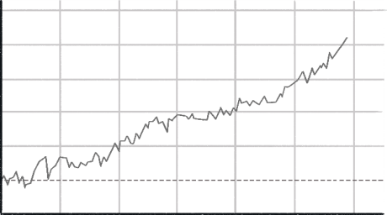
Why Is Climate Change a Problem?
Rising temperatures are causing sea levels to increase.
The rising water can cover coastal areas, destroying habitats and displacing whole populations from low-lying areas.
250
200
150
Sea Level Change (mm)
100
Data source: NASA (GISS)
50
0
-50
1900
1920
1940
1960
1980
2000
2020
Year
Rising sea levels are driven by two main processes:
Ice Melt: When the atmosphere and ocean get warmer, ice sheets and glaciers melt, resulting in the addition of fresh water to the ocean.
Thermal Expansion: As ocean water gets warmer, it expands, causing
sea levels to rise.

Slide 6
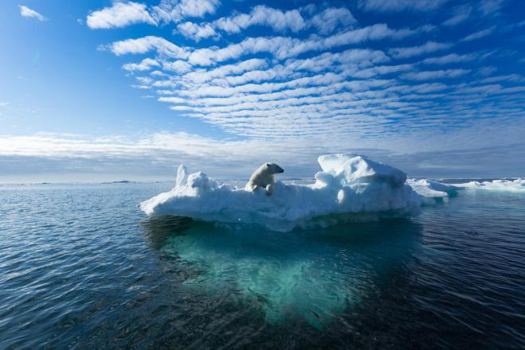
Why Is Climate Change a Problem?
The increase in global temperatures is causing a reduction in sea ice.
This causes problems for animals that depend on the ice to hunt, mate and sleep.
Untitled by © Shutterstock / Ritesh Chaudhary / WWF licensed under CC BY

Slide 7
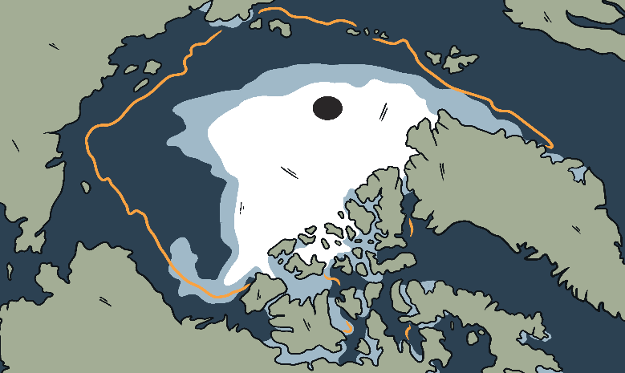
Why Is Climate Change a Problem?
The bright surface of the ice reflects 80% of the sunlight that hits it back into space. This keeps the polar regions cool and moderates the global climate.
When the area of sea ice is reduced, less sunlight is reflected back into space. This causes more ocean warming and reduces the sea ice even further.
This feedback drives faster climate change.
The orange line on the picture marks the average minimum sea ice coverage from 1981 to 2010. The white ice shows the minimum sea ice coverage in 2020.
The difference between the two exceeds one million miles.
Russia
Greenland
Alaska

Slide 8
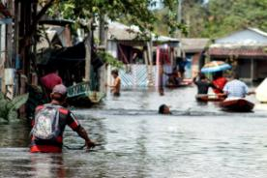
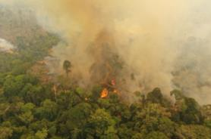
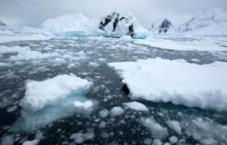
Why Is Climate Change a Problem?
No matter how fast we act, the global temperature is set to continue rising as a result of greenhouse gases that are already in the atmosphere. The problems that we are already experiencing are going to worsen.
Untitled by © Marcio James / WWF–Brazil licensed under CC BY
Untitled by © Marcio James / WWF–Brazil licensed under CC BY
Melting ice, Antarctica by © Wim van Passel / WWF licensed under CC BY
Acting quickly to keep the temperature rise to minimum is extremely important for humans and wildlife.
How much difference do you think a 0.5°C increase in global temperature can make?

Slide 9
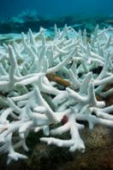
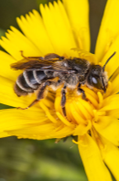
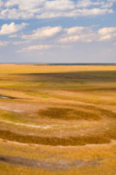

Why Is Climate Change a Problem?
Coral Bleaching
Species Loss
18
1.5°C
16
2°C
8
1.5
2
Temperature Rise (°C)
Bleached coral, Maldives by
© naturepl.com / Peter Scoones / WWF licensed under CC BY
Untitled by © Ola Jennersten
/ WWF-Sweden licensed under CC BY
Drought
Rise in Sea Level
410
million
56 cm
49
million
Million People Affected
1.5
2
1.5
2
Temperature Rise (°C)
Temperature Rise (°C)
1.5
2
Temperature Rise (°C)
Dried up fishing pans in Liuwa plain
National Park by © Jasper Doest / WWF licensed under CC BY
Climate change adaption Wadden sea by © Claudi Nir / WWF licensed under CC BY

Slide 10
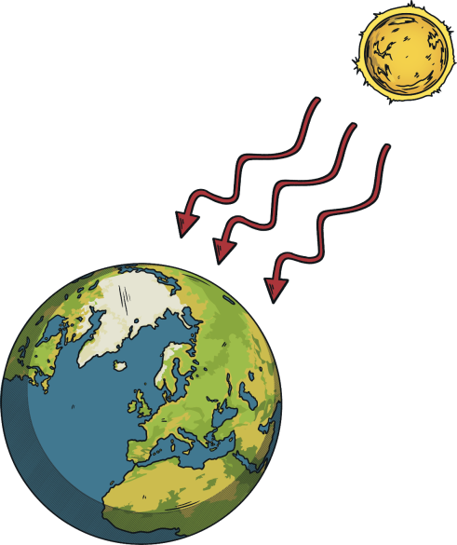
What Causes Climate Change?
Carbon dioxide (CO₂),
methane (CH₄) and water vapour (H₂O) are greenhouse gases that are found in the atmosphere.
Energy travels from the Sun
to the Earth as short wave radiation. It does not interact strongly with the greenhouse gas molecules so it reaches the Earth’s surface.
H₂O
CO₂
CH₄
CH₄
CO₂
CH₄
CO₂
H₂O
CH₄
CO₂

Slide 11
What Causes Climate Change?
The Earth’s surface emits
long wavelength radiation.
This does interact with the greenhouse gas molecules.
The greenhouse gas molecules absorb some of the energy, trapping it in the atmosphere.
This process keeps the Earth warm and is essential for life.
H₂O
CO₂
CH₄
CH₄
CO₂
CH₄
CO₂
H₂O
CH₄
CO₂

Slide 12
What Causes Climate Change?
The higher the proportion
of greenhouse gases in the atmosphere, the more radiation is absorbed.
This causes a rise in the temperature of the Earth and is known as the greenhouse effect.
This increase in temperature drives climate change.
CO₂
H₂O
CO₂
CO₂
CO₂
CO₂
CH₄
CH₄
CO₂
CH₄
CO₂
CO₂
CO₂
CO₂
CH₄
CH₄
CO₂
CO₂
CO₂
H₂O
CH₄
CO₂
CH₄
CO₂
CO₂
CO₂

Slide 13
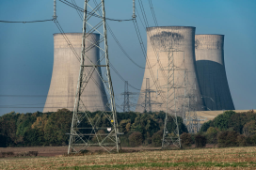
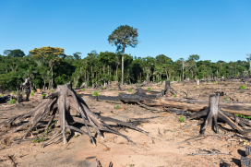
What Causes Climate Change?
Climate change can be caused gradually by natural processes or suddenly by large events, such as a massive meteorite strike or volcanic activity. However, the rapid climate change we are experiencing now is due to three main human activities:
Burning fossil fuels for heating and cooking, generating electricity and powering vehicles releases carbon dioxide into the atmosphere.
Deforestation (destruction of forests) releases carbon dioxide and reduces the number of trees able to capture carbon dioxide from the atmosphere.
Reduction of biodiversity creates an unstable ecosystem. Nature loss leads to ecosystems that are less able to capture carbon from the atmosphere and less resilient to rising temperatures.
Untitled by © Sam Hobson / WWF-UK licensed under CC BY
Deforestation for future agriculture plantation-Tahuamanu Province, heading to Centro Poblado de Alerta - Madre de Dios Region, Peru by © Nicolas Villaume / WWF-US licensed under CC BY

Slide 14
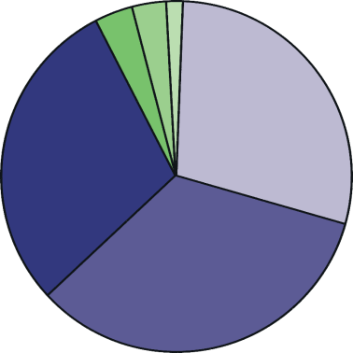
Who Causes Climate Change?
The 50 least developed countries are thought to have contributed 1% of the greenhouse gases that have caused global warming. The USA, the EU and China alone have contributed around 60%.
South America
Africa
Oceania
North America
Asia
Europe

Slide 15
Who Does Climate Change Affect?
In the long term, everyone will feel the effects of climate change. However, some people are currently more affected than others.
In most cases, the wealth of prosperous countries has come from activities which contribute to greenhouse gas emissions. This wealth allows these countries to protect themselves from the effects of climate change.
Poorer countries are less able to adapt to climate change and therefore suffer the most from its effects. They are also less able to develop because they need to focus on addressing the challenges caused by climate change.
The countries who have contributed the least to the climate crisis are the ones who are affected the most.
Is this fair?

Slide 16
Social Justice
Justice is the concept of fairness.
Social justice relates to fairness within a society.
The idea of social justice is that people should have equal access to wealth, health, opportunities and privileges within a society. All humans should have the right to a certain standard of living, including a healthy diet, access to clean water, shelter, clothing, education and healthcare.
The people most likely to be left behind by development are those that face inequalities.
Those that are most affected have intersecting inequalities. This means that they may face exclusion or discrimination because they fall into multiple disadvantaged groups, for example, Black women, disabled LGBTQ+ people or poor children.

Slide 17
Climate Justice
The impacts of climate change affect disadvantaged groups of people the most. The effect of climate change on these groups needs to be recognised and addressed.
Climate justice means looking at the climate crisis from the perspective of social justice. Solutions need to not only curb climate change; they need to protect and empower the most vulnerable groups of people too.
We have the responsibility to consider the most vulnerable when planning climate action. Remember, these groups of people contribute to climate change the least. This means putting the people and communities that are most vulnerable to the impact of climate change at the heart of development.
Climate solutions will not work if we do not address social justice issues. For example, if we do not address poverty, then unsustainable lifestyles will continue to damage ecosystems and we will fail to curb climate change.

Slide 18

Who Can Fix It?
Governments can make laws and policies that reduce the amount
of greenhouse gas emissions.
Businesses can change their processes to run more sustainably.
We can all make choices in our own lives that reduce our carbon footprint (the impact our actions and purchases have on climate change).
We can also use our voices to let businesses and governments know that we want them to act quickly to reduce their impact on climate change.

Slide 19
New Opportunities
The transition to a low-carbon economy in the years ahead brings with it many opportunities.
Transitioning to low-carbon economies will provide lots of opportunity for innovation.
There will be a need for people leaving education to do things differently, to come up with new ideas for products and technologies and to explore new conservation methods. These opportunities are exciting!
New job sectors will be created and new skills will be valued in the jobs market. In the future, you may be applying for jobs that don’t even exist yet!
Innovation is the process of turning an idea into a solution that solves a problem.

Slide 20
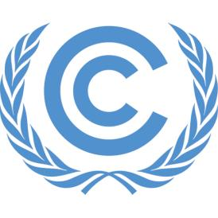
COP26
197 countries (parties) have signed up to the United Nations Framework Convention on Climate Change (UNFCCC).
The UNFCCC aims to prevent human activity from causing dangerous levels of climate change.
UNFCCC logo by UNclimatechange licensed under CC BY
Every time the member nations meet it is called a COP, which stands for Conference of the Parties. They look at the current state of the climate and discuss the actions they will take to address climate change.
This November will see the 26th of these meetings taking place, so you will hear the event being described as COP26 as well as the UN Climate Change Conference. It will be hosted by the UK in Glasgow.

Slide 21
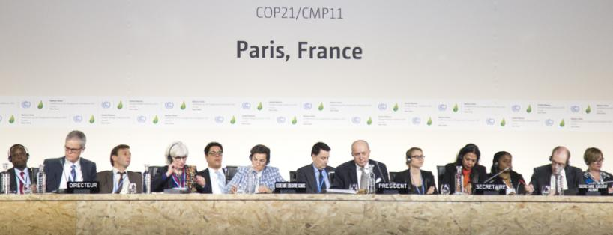
What Will Happen at COP26?
In 2015, at COP21 in Paris, the nations signed an agreement that set out an ambitious plan to tackle climate change. In the Paris Agreement, nations agreed to act together to restrict global temperature increases to 2°C and begin efforts to limit warming to 1.5°C.
To do this we will need to reach ‘net zero’ by 2050. This means that any carbon emissions will need to be balanced by removing carbon dioxide from the air.
Comité de Paris, COP21, by UNclimatechange licensed under CC BY

Slide 22
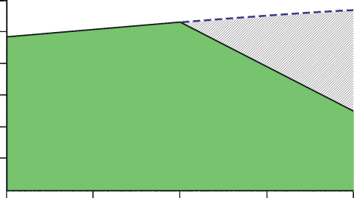
What Will Happen at COP26?
The Paris Agreement instructed governments to renew their commitment to lowering their emissions every five years, each time becoming more ambitious. New Nationally Determined Contributions (NDCs) are due to be set by countries at COP26, so it is an important moment for the planet.
Global carbon dioxide emissions continued to rise after The Paris Agreement, and are now 62% higher than they were in 1990.
Global net CO₂ emissions need to fall by 45% from 2010 levels by 2030 to limit global warming to 1.5°C.
60
expected carbon emissions based on current commitments
50
40
change needed
change needed
30
Global CO₂ Emissions (Gt)
2030 goal
20
10
2010
2015
2020
2025
2030

Slide 23
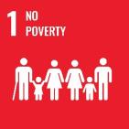
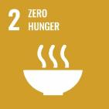
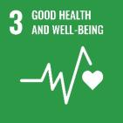

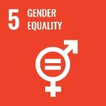
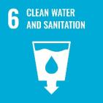
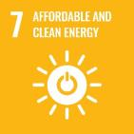
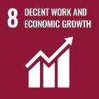

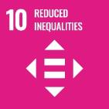
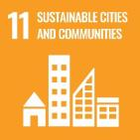
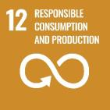
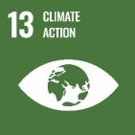
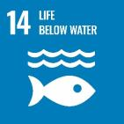
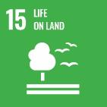

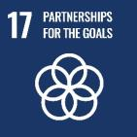
Sustainable Development Goals
In the same year that the Paris Agreement was signed, 17 Sustainable Development Goals (SDGs) were adopted by all United Nations Member States.
The 17 goals set out all of the things that need to be achieved to protect the planet and ensure that all people enjoy peace and prosperity.

Slide 24
Sustainable Development Goals
Some of the goals are to do with the state of our planet.
However, one of the most important things about the SDGs is the fact that they are all connected. All the goals need to be realised together for us to achieve a future in which every person born anywhere in the world has a healthy happy life.

Slide 25
Sustainable Development Goals
Sustainable development means that we need to reach this vision of the world without preventing future generations from also being able to meet their needs.
We need to be able to continue each action forever without running out of resources or causing damage that stops us from being able to carry on.

Slide 26
What Can We Do?
Speak Up
Act
We can make sure that world leaders know we are counting on them.
Your MP is the person that represents your community’s needs and views in parliament. You can write to them to tell them about the actions you want the government to take.
We can also reach out to businesses and our local council if we feel like they need to do things differently too.
As a school community, we can help in the fight against climate change and biodiversity loss by improving the sustainability of all aspects of our school life.
The changes that we make as a school are seen by lots of people
in our local community. This means that we can influence positive change to spread through society.

Slide 27
