Slide 1
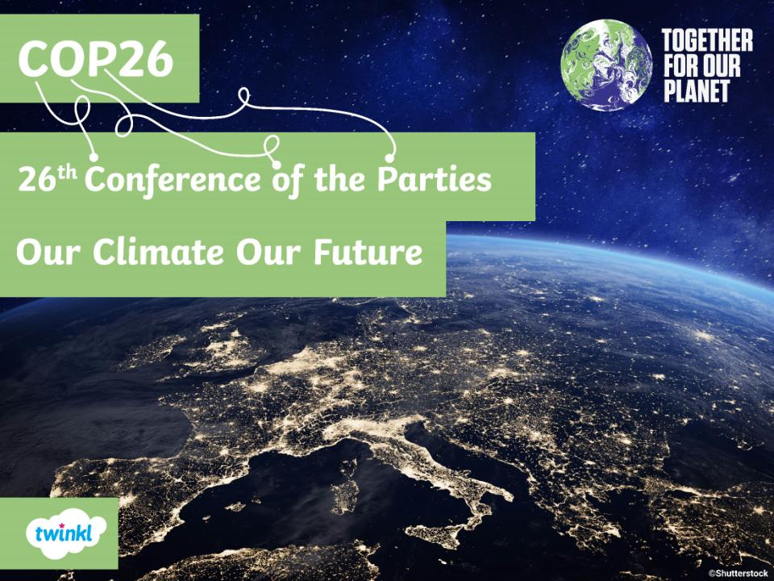

Slide 2
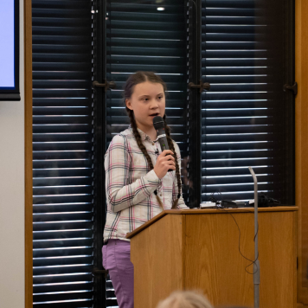
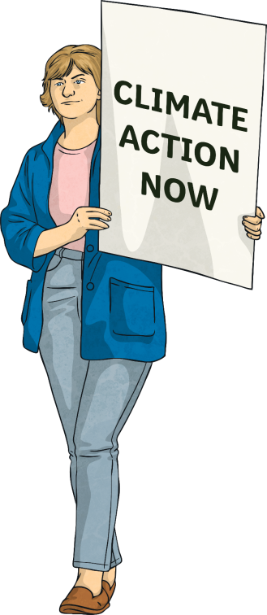
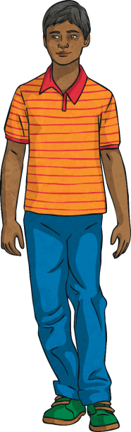
COP26 – Our Climate Our Future
Our planet is in crisis and the world must come together to find solutions.

Slide 3
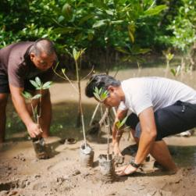
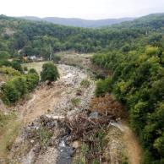
COP26 – Our Climate Our Future
The United Nations (UN) is an international organisation that comprises the majority of countries around the world that are willing to work together to discuss global problems. They identify ways to overcome them in order to benefit the entire planet.
Climate change is one of those problems. In fact, it is
a huge issue affecting the whole world and all of humanity: real people; precious animals; delicate ecosystems and, in fact, all living things.

Slide 4
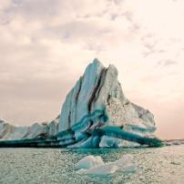
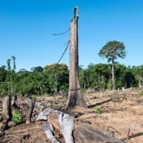
COP26 – Our Climate Our Future
The issue of global warming has been recognised for many years. As far back as 1979, the very first World Climate Conference took place.
Over the last 25 years, 197 people and organisations (known as parties) from almost every country in the world, including the European Union, have met at an annual conference to talk about reducing the human impact on the planet’s climate.
This is known as the Conference of the Parties (COP) and COP26 will be the 26th meeting.

Slide 5
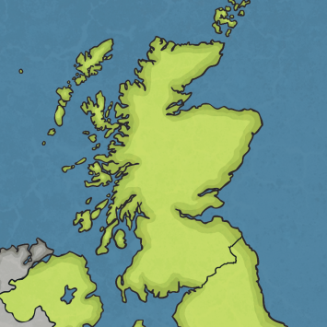
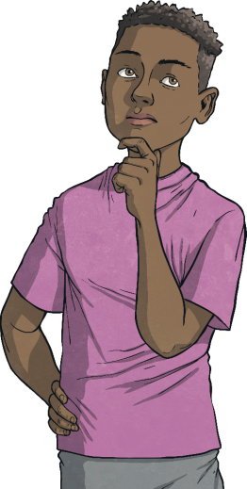
COP26 – Our Climate Our Future
‘Uniting the World to Tackle Climate Change’
Where?
Glasgow, UK
Glasgow

Slide 6

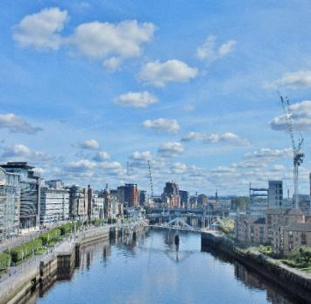
COP26 – Where?
Glasgow is…
...the Scottish city chosen to host COP26.
...aiming to be one of Europe’s ‘greenest’ cities.
...full of green spaces, parks and has the river Clyde to inspire parties to address climate change.

Slide 7
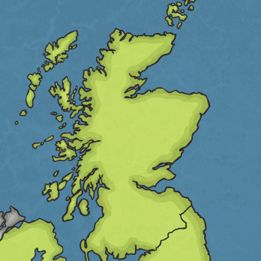
COP26 – Where?
Glasgow is…
...home to the Scottish Event Campus (SEC), which contains exhibition halls, small and large meeting spaces and has a dedicated train station.
...one of the UK’s most lively and cultural cities.
Glasgow
...co-hosting COP26 with Milan in Italy, where the pre-COP will take place. This is a meeting before COP26 to share ideas.

Slide 8
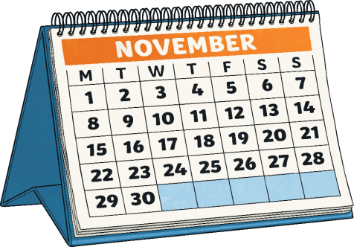
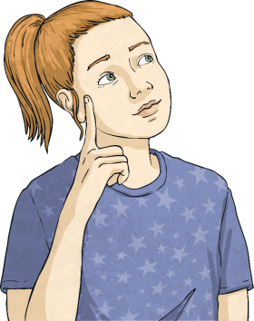
COP26 – Our Climate Our Future
‘Uniting the World to Tackle Climate Change’
When?
1st–12th November 2021

Slide 9

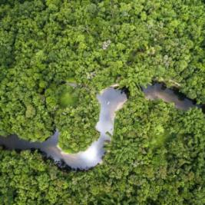
COP26 – When?
1st–12th November 2021
It is a little late: COP26 should have been taking place in November 2020 but it was postponed due to the global COVID-19 pandemic so that all parties could attend.
At the 2015 COP in Paris, the parties adopted an international climate change treaty that agreed they should all work together to limit global warming to 1.5°C each year.

Slide 10

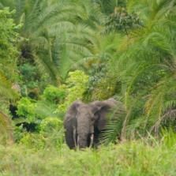
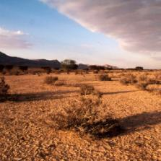
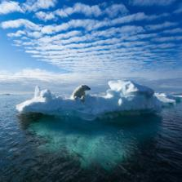
COP26 – When?
1st–12th November 2021
COP26, now six years after the Paris Agreement, is a time for parties to assess progress made so far and agree on the process for moving forward to address climate change and to make this target a reality.

Slide 11
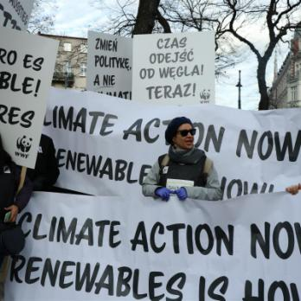
COP26 – Our Climate Our Future
‘Uniting the World to Tackle Climate Change’
Who?
About 30,000 people will attend: world leaders, climate experts, organisations and the media. In addition, every single global citizen will be affected.

Slide 12

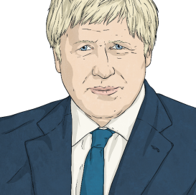

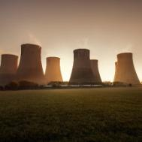
COP26 – Who?
World Leaders
Leaders of some of the world’s most wealthy countries
will attend, such as Boris Johnson, Prime Minister of
the UK, who launched COP26 with a speech rallying
the world to come together in a bid to choose a cleaner and greener future for all. Some countries may send
delegates, such as vice-presidents, deputy prime ministers
and climate or energy officials.
Negotiators
Teams of advisers to world leaders will join discussions to say what their countries can do to reduce greenhouse gas emissions and prepare their people for the effects of
climate change.

Slide 13

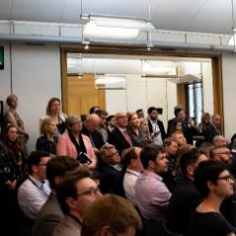

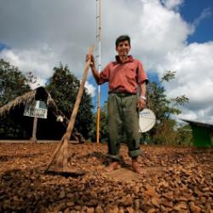
COP26 – Who Else?
Observers
Observers, who do not only observe, will be taking an active role at the conference to influence the direction that discussions might take.
Observers include UN officials, such as World Health Organisation advisers, and a host of other people:
environmental organisations
international companies
youth groups
trade unions
indigenous peoples
farmers
faith groups
the world’s media
These observers can help members of the public to understand how COP26 is going.

Slide 14


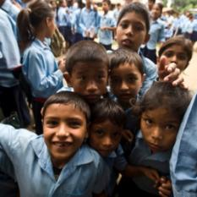
COP26 – Who Will This Affect?
Who are the people that will be affected by the decisions made at COP26?
Climate change affects real people. In many
parts of the world, the people who do the least
to cause climate change can be those most
affected by it.
COP26 must provide the path to change that will improve the lives and protect the livelihoods of people in communities around
the world.

Slide 15


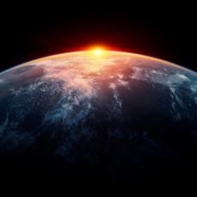
COP26 – What Is Climate Justice?
By standing together, we can find solutions that work for everyone.
It is important to consider the needs of all
people around the world, not just those in our
own country, when making any decisions and agreements about climate change.
Those that have contributed the most to climate change should lead the way in helping to find solutions to the problem.

Slide 16
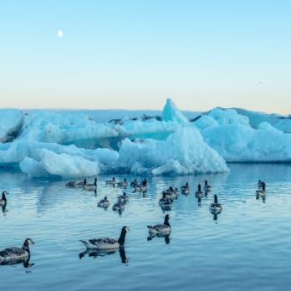
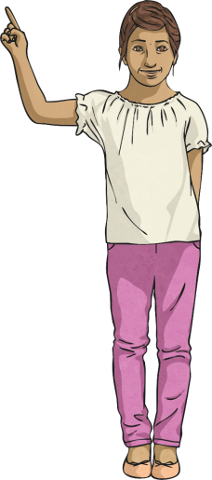
COP26 – Our Climate Our Future
‘Uniting the World to Tackle Climate Change’
What?
Agreements will be made on actions to tackle climate change.

Slide 17
COP26 – What?
Stop or Start?
What do world leaders need to agree to stop or
start at COP26 to address climate change for the future?
Goal: Limit global warming to 1.5°C
Start
Start
Start
Start
Stop
Stop
Stop
Stop
Helping communities adapt to the impacts of climate change
Using cheaper, cleaner, renewable energy (wind, solar, hydro)
Protecting natural resources (forests, oceans, wetlands)
Finding money in budgets to spend on reducing climate change
Emitting so many greenhouse gases (gases that trap heat in the Earth’s atmosphere)
Burning fossil fuels (coal, gas and oil)
Raising the risk of more extreme weather and natural disasters
Making vehicles
that emit any greenhouse gases

Slide 18
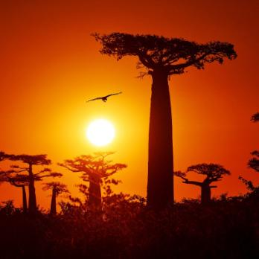
COP26 – Our Climate Our Future
‘Uniting the World to Tackle Climate Change’
Why?
The clock is ticking on climate action. The average global temperature is increasing. COP26 must find a way to limit this increase to 1.5°C and help countries adapt to the changes to come.

Slide 19

COP26 – Why?
Change for the Future
COP26 will allow the 197 parties to agree on actions in different areas that will tackle climate change and benefit the entire planet.
Food and Farming
Energy
Oceans
Land
Health and Happiness

Slide 20
COP26 - How?
COP26 will be split into three zones.
City Zone
Events will take place all across Glasgow around the time of COP26 to encourage people to get involved.
Green Zone
Members of the public can get involved here, including you! School groups are welcome to join organisations in the green zone finding out about climate change and the effect COP26 will have.
Blue Zone
This is where those world leaders and their delegates will meet and the COP President will make sure the meeting achieves what it needs to.

Slide 21

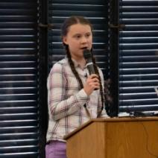

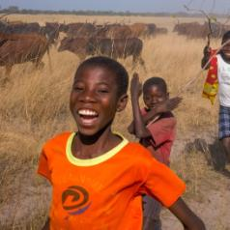
COP26 – Our Climate Our Future
COP26 will involve important people coming
together to make big decisions that will affect
people across the world: all of us!
Imagine a future very different to now.
This is ‘Our Climate, Our Future’ and the future is unwritten...
We can all work together to make changes that
will create a world where nature and humans
can live side by side, harmoniously.

Slide 22
