Slide 1
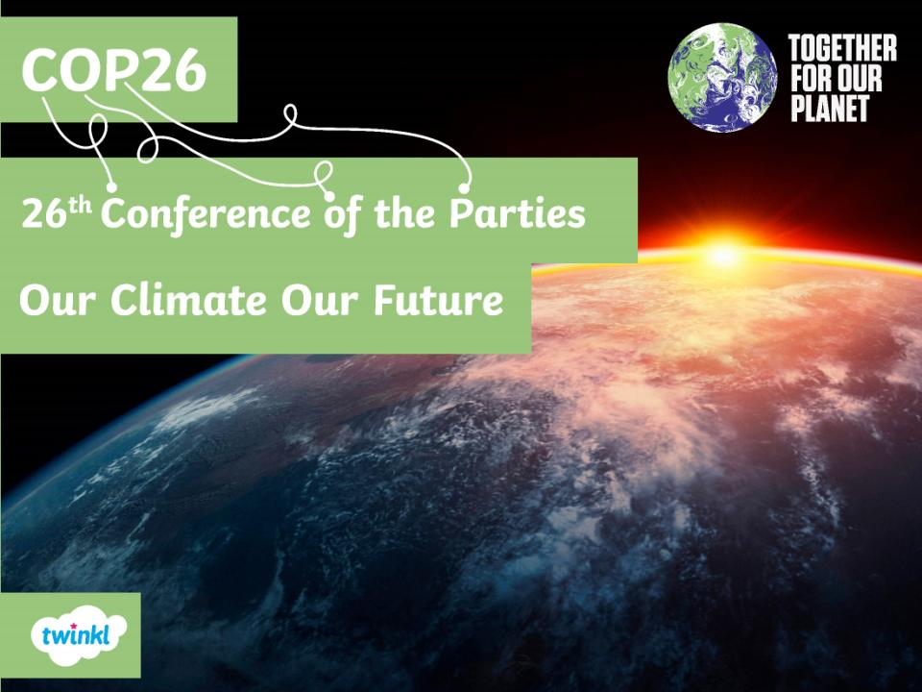

Slide 2
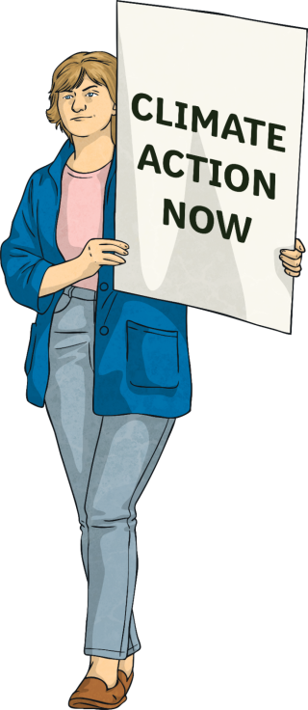

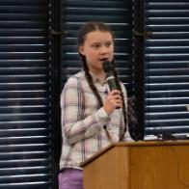
COP26 – Our Climate Our Future
Climate activists of all ages recognise that our planet is in crisis: our climate
is changing at an alarming rate and
all of the Earth’s living things are
facing the impact of this.
Human actions are the greatest cause and only by
the world coming together can solutions to climate change be found.

Slide 3
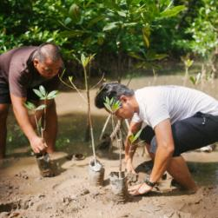
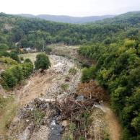
COP26 – Our Climate Our Future
The United Nations (UN) is an international organisation that comprises the majority of countries around the world that are willing to work together to discuss global problems.
Their aim is to identify ways to overcome these problems in order to benefit the entire planet.
Climate change is one of those problems. In fact, it is
a huge issue affecting the whole world and all of humanity: real people, precious animals, delicate ecosystems and, in fact, all living things.

Slide 4
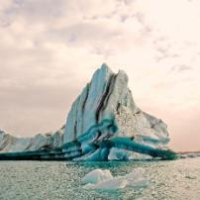
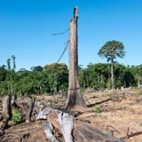
COP26 – Our Climate Our Future
The issue of global warming has been recognised for many years. As far back as 1979, the very first World Climate Conference took place.
Over the last 25 years, 197 people and organisations (known as parties) from almost every country in the world, including the European Union, have met at an annual conference to discuss actions that can be taken to reduce the human impact on the planet’s climate.
This is known as the Conference of the Parties (COP) and COP26 will be the 26th meeting.

Slide 5
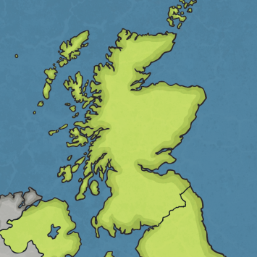
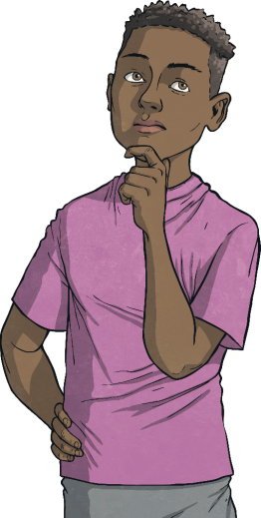
COP26 – Our Climate Our Future
‘Uniting the World to Tackle Climate Change’
Where?
Glasgow, UK
Glasgow

Slide 6

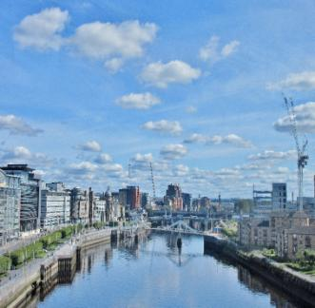
COP26 – Where?
Glasgow is…
...the Scottish city chosen to host COP26.
...deemed to be a ‘green’ and sustainable city after achieving the Global Green City award, which is supported by the UN.
...full of green spaces, parks and has the river Clyde to inspire parties to address climate change.

Slide 7

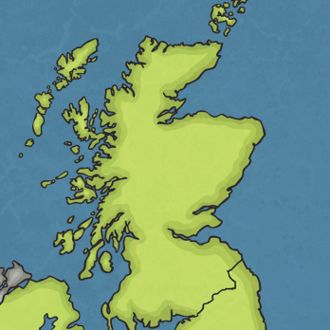
COP26 – Where?
Glasgow is…
...home to the Scottish Event Campus (SEC), which contains exhibition halls, small and large meeting spaces and has a dedicated train station.
...one of the UK’s most lively and cultural cities.
Glasgow
...co-hosting COP26 with Milan in Italy, where the pre-COP will take place. This is a meeting before COP26 to share ideas.

Slide 8
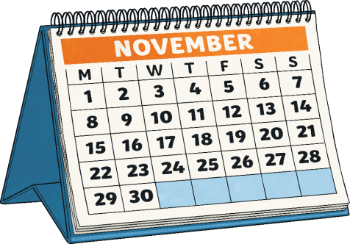
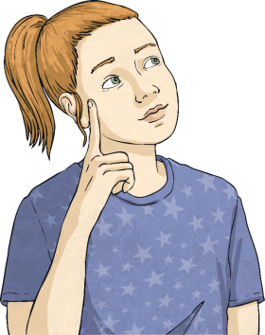
COP26 – Our Climate Our Future
‘Uniting the World to Tackle Climate Change’
When?
1st–12th November 2021

Slide 9

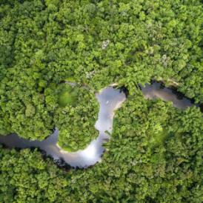
COP26 – When?
1st–12th November 2021
It’s rather late: COP26 should have been taking place in November 2020 but it was postponed due to the global COVID-19 pandemic so that all parties could attend.
At the 2015 COP in Paris, the parties adopted an international climate change treaty that
provided the pathway for change.
Then, the parties agreed on global cooperation
to ensure that global warming (the rise in global temperature) is no more than 1.5°C each year.

Slide 10

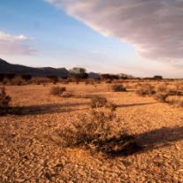
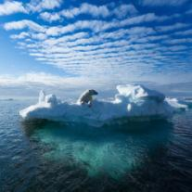
COP26 – When?
1st–12th November 2021
This target was deemed achievable because it allowed each country to set its own targets for reducing greenhouse gas emissions (the gases that trap heat in the Earth’s atmosphere).
COP26, now six years after the Paris Agreement, is a time for parties to assess progress made so far and agree on the process for moving forward to address climate change and to make this target
a reality.

Slide 11
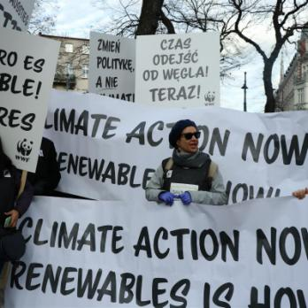
COP26 – Our Climate Our Future
‘Uniting the World to Tackle Climate Change’
Who?
Around 30,000 people will attend: world leaders, climate experts, organisations, groups and the media. In addition, every single global citizen will be affected.

Slide 12

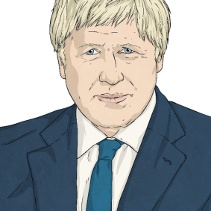

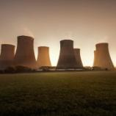
COP26 – Who?
World Leaders
Leaders of some of the world’s most wealthy, and not so wealthy, countries will attend, such as Boris Johnson, Prime Minister of the UK. He launched COP26 with a speech rallying the world to come together in a bid to choose a cleaner and greener future for all. Some countries may send delegates, such as vice-presidents, deputy prime ministers and climate or energy officials. World leaders will report on the progress they have already made towards the Paris Agreement target, as well as what they will continue to do.
Negotiators
Teams of advisers to world leaders will join discussions to say what their countries can do to further reduce greenhouse gas emissions and prepare their people for the effects of climate change.

Slide 13

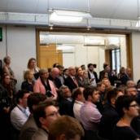
COP26 – Who Else?
Observers
Observers, who do not only observe, will be taking an active role at the conference to influence the direction that
discussions might take.
Observers include UN officials, such as World Health Organisation
advisers, and a host of other people:
environmental organisations
indigenous peoples
international companies
farmers
youth groups
faith groups
trade unions
the world’s media
These observers can help members of the public to understand how COP26 is going.

Slide 14


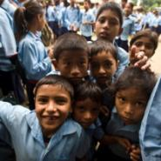
COP26 – Who Will This Affect?
Global warming caused by human actions is having an impact on people, wildlife and habitats right across the world.
In many parts of the world, the people who do the least to cause climate change can be those most affected by it. Stopping the climate crisis is critical to the collective wellbeing of humans, as well as other living things.
Who are the people that will be affected by the decisions made at COP26?
COP26 must provide the path to change that will improve the lives and protect the livelihoods of people in communities around the world.

Slide 15

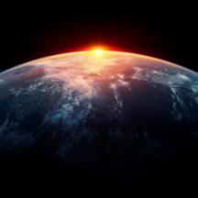
COP26 – What Is Climate Justice?
By standing together, we can find solutions that work for everyone.
It is important to take into account the needs of all people around the world, not just those in our own country, when making any decisions and agreements about climate change.
Those that have contributed the most to climate
change should take responsibility in leading the way
to find solutions that help to tackle the problem.

Slide 16
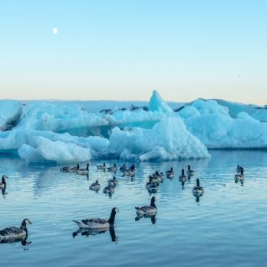
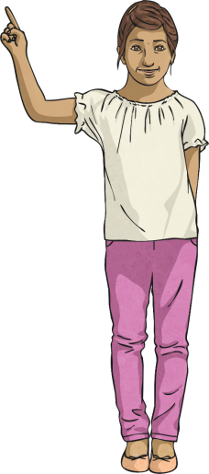
COP26 – Our Climate Our Future
‘Uniting the World to Tackle Climate Change’
What?
Countries and their leaders will justify their actions so far before further agreements will be made on actions to tackle climate change.

Slide 17
COP26 – What?
Stop or Start?
What do world leaders need to agree to stop or
start at COP26 to address climate change for the future?
Goal: Limit global warming to no more than 1.5°C
Start
Start
Start
Start
Stop
Stop
Stop
Stop
Helping communities adapt to the impacts of climate change
Using cheaper, cleaner, renewable energy (wind, solar, hydro)
Protecting natural resources (forests, oceans, wetlands)
Finding money in budgets to spend
on reducing
climate change
Emitting so many greenhouse gases (gases that trap heat in the Earth’s atmosphere)
Burning fossil fuels (coal, gas and oil)
Raising the risk of more extreme weather and natural disasters
Making vehicles
that emit any greenhouse gases

Slide 18
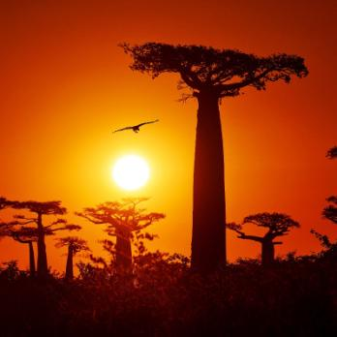
COP26 – Our Climate Our Future
‘Uniting the World to Tackle Climate Change’
Why?
The clock is ticking on climate action in order to save the Earth as we know it. The average global temperature is increasing at an alarming rate. COP26 must find a way to limit this increase to no more than 1.5°C and help countries adapt to the changes global warming will continue to bring.

Slide 19

COP26 – Why?
Change for the Future
COP26 will allow the 197 parties to agree on actions in different areas that will tackle climate change and benefit the entire planet.
Food
Energy
Forests
Oceans
Travel and Transport
Health and Happiness

Slide 20
COP26 - How?
COP26 will be split into three zones.
City Zone
Events will take place all across the host city of Glasgow around the time of COP26 to encourage people to get involved.
Green Zone
Members of the public can get involved in a range of exhibitions and campaigns here. School groups are welcome to join organisations in the green zone finding out about climate change and the effect COP26 will have. That includes you!
Blue Zone
International negotiations between world leaders and their delegates will take place here, in the blue zone. The COP President will oversee these negotiations and aim to ensure a positive outcome for the world.

Slide 21

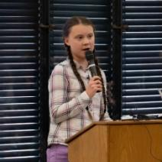

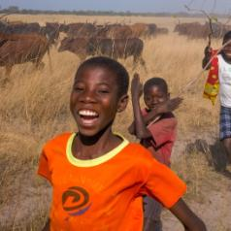
COP26 – Our Climate Our Future
COP26 will involve the world’s most significant people coming together to make important decisions that will affect people across the world: all of us!
Imagine a future very different to now.
This is ‘Our Climate, Our Future’ and the future is unwritten...
We can all work together to make changes that will create a world where nature and humans can live side by side, harmoniously.

Slide 22
