Slide 2
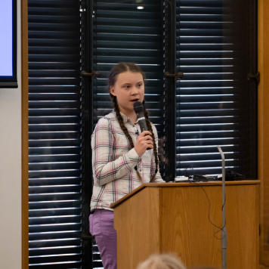
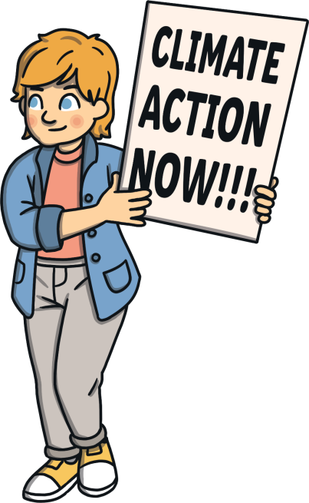
COP26 – Our Climate Our Future
Our planet is at risk and the world must come together to find solutions.

Slide 3
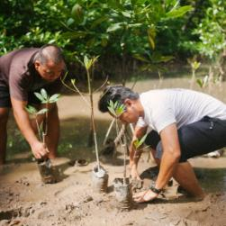
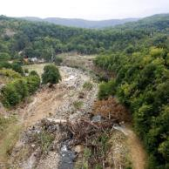
COP26 – Our Climate Our Future
An organisation, called the United Nations (UN), bring together most countries around the world to work with each other and to talk about global problems.
They find ways to work towards solving these problems in order to benefit the entire planet.
Climate change is one of those problems.
In fact, it is a huge issue affecting the whole world and all of its living things: people, animals and plants.

Slide 4
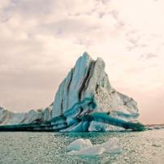
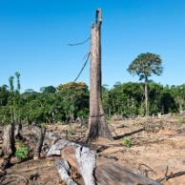
COP26 – Our Climate Our Future
Climate change is sometimes called global warming because the whole world is warming up, much more quickly than it should be.
For 25 years, people from almost every country in the world (known as parties) have been meeting every year to talk about actions that humans can take to help slow down climate change.
This is known as the Conference of the Parties (COP) and COP26 will be the 26th meeting.

Slide 5
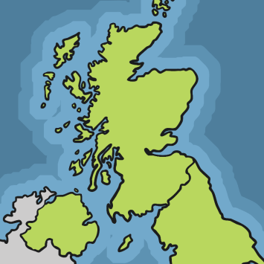
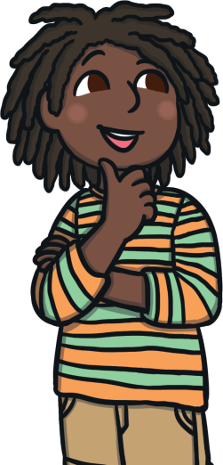
COP26 – Our Climate Our Future
‘Uniting the World to Tackle Climate Change’
Where?
Glasgow, UK
Glasgow

Slide 6
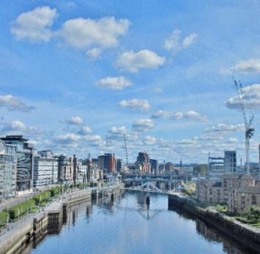
COP26 – Where?
Glasgow is…
...the Scottish city chosen to host the COP26 meeting.
...home to a big building called the SEC where the parties will meet.
...full of parks and other green spaces that can help people to think about how special the Earth is.

Slide 7
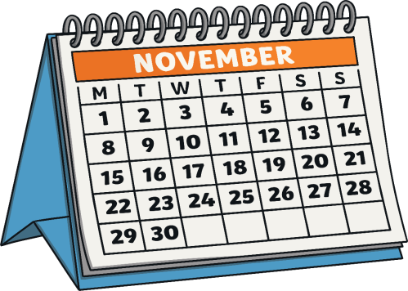
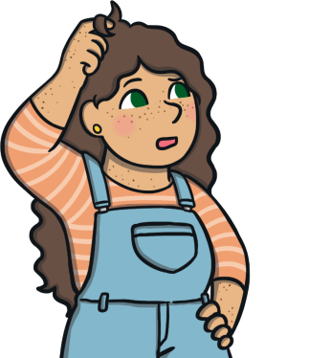
COP26 – Our Climate Our Future
‘Uniting the World to Tackle Climate Change’
When?
1st–12th November 2021

Slide 8
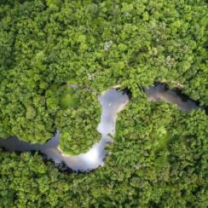
COP26 – When?
1st–12th November 2021
It’s a little late because COP26 should have taken place in November 2020, but it was changed to 2021 due to the COVID-19 virus pandemic.
At the 2015 COP meeting in Paris, the parties agreed that they should all work together to stop the temperature of the Earth rising by more than than 1.5°​C each year.
At COP26, the parties will check what each country is doing to help achieve this target.

Slide 9
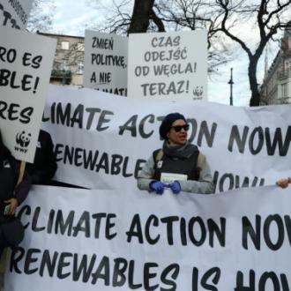
COP26 – Our Climate Our Future
‘Uniting the World to Tackle Climate Change’
Who?
Thousands of people will be at COP26.
Leaders from countries around the world will be there, as well as people who understand climate change, groups of people who want to take action and news reporters.
Every single person around the world will be affected too.

Slide 10
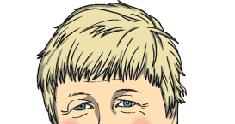
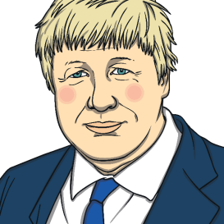
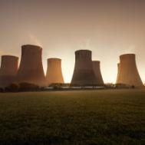
COP26 – Who?
World Leaders
The UK’s Prime Minister, Boris Johnson, will be one of these leaders. He launched COP26 by saying the world will come together to create a cleaner and greener future for all.
Negotiators
Negotiators are people who say what their countries will do to slow climate change and help people to get ready for changes.

Slide 11
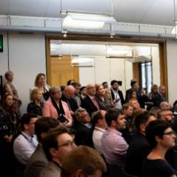
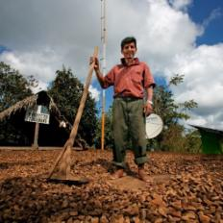
COP26 – Who Else?
Observers
Observers are groups of people who will speak out to say what actions they think are important for the leaders to take.
They can also help other people who will attend COP26 to understand what is happening.
Observers might be people from youth groups, farms, companies and news teams.

Slide 12
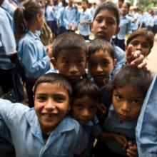
COP26 – Who Will This Affect?
‘Uniting the World to Tackle Climate Change’
Climate change affects everyone.
In many parts of the world, the people who do the least to cause climate change can be most affected by it.
The parties at COP26 must agree on actions that will help people in communities around the world to have better lives and incomes.

Slide 13
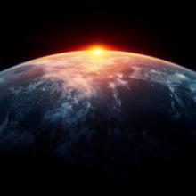
COP26 – What Is Climate Justice
People from all parts of the world must work together.
It is important that world leaders think about everyone in the world – not just people in their own countries – when deciding how to deal with climate change.
The companies and people that have helped to cause climate change should lead the way in helping to find solutions to the problem.

Slide 14
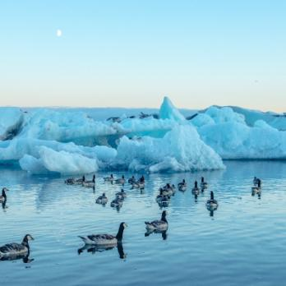
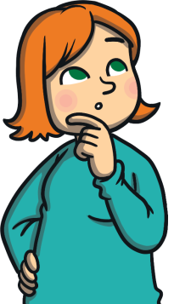
COP26 – Our Climate Our Future
‘Uniting the World to Tackle Climate Change’
What?
Parties must agree on actions to tackle climate change.

Slide 15
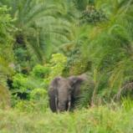
COP26 – What?
Stop or Start?
What do world leaders need to agree to stop or start at COP26 to slow down climate change?
Start
Start
Start
Start
Stop
Stop
Stop
Stop
Helping people to cope with climate change.
Using cheaper and cleaner energy (wind, solar).
Protecting natural places(forests, oceans, wetlands).
Finding more money to spend on slowing climate change.
Letting so many greenhouse gases (gases that trap heat) into the Earth’s atmosphere.
Burning fossil fuels (coal, gas, oil).
Raising the risk of more extreme weather.
Making vehicles that cause pollution.

Slide 16
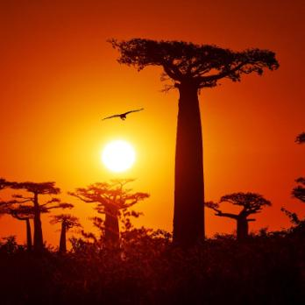
COP26 – Our Climate Our Future
‘Uniting the World to Tackle Climate Change’
Why?
The temperature of the Earth is going up. COP26 must find a way to make sure that this is not more than 1.5°​C and help people to cope with the changes to come. The clock is ticking on climate action.

Slide 17
COP26 – Why?
Change for the Future
At COP26, the parties must agree on actions that will tackle climate change and help the whole planet in different ways. These include:
Food and Farming
Energy
Oceans
Forests
Health and Happiness

Slide 18
COP26 - How?
COP26 will be split into three zones.
City Zone
People can join in with climate events all across Glasgow around the time of COP26.
Green Zone
Lots of people can join in here, including you! School groups can visit the green zone to find out about climate change and what is happening at COP26.
Blue Zone
This is where the world leaders will meet and the COP President will make sure the meeting goes well.

Slide 19
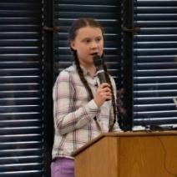
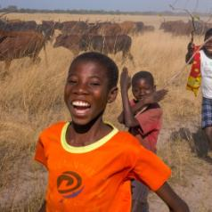
COP26 – Our Climate Our Future
COP26 will see important people coming together to make big decisions that will affect everybody across the world.
Imagine a future very
different to now.
This is ‘Our Climate, Our Future’ and the future is unwritten...
We can all work together to make changes that will protect the planet and help nature and humans to live side by side, happily.

