Slide 1
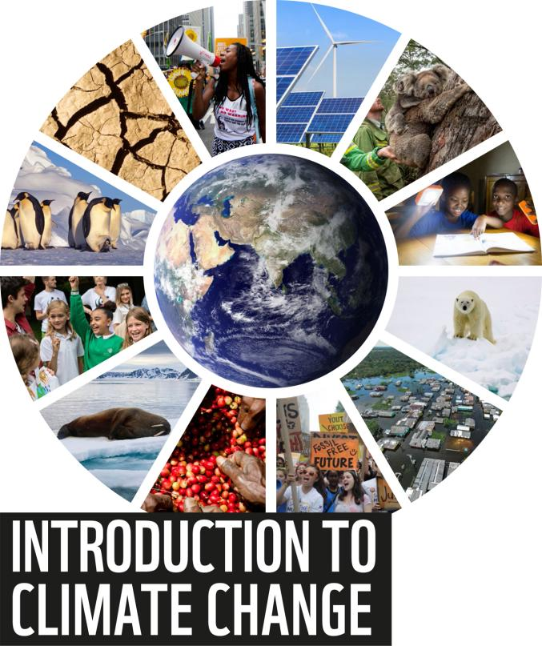
Notes:
The presentation consists of 12 slides that introduces the topic of climate change.
By learning more about the science and geography that affects our world, young people can understand what needs to be done, recognise what matters most to them, and take action to help protect people, places, wildlife and things they love.
You can access our new climate change resource pack for primary schools by visiting - https://www.wwf.org.uk/get-involved/schools/resources/climate-change-resources. Here, you can choose to use either of our two activities in a dedicated climate change module, or as part of related topics.

Slide 2
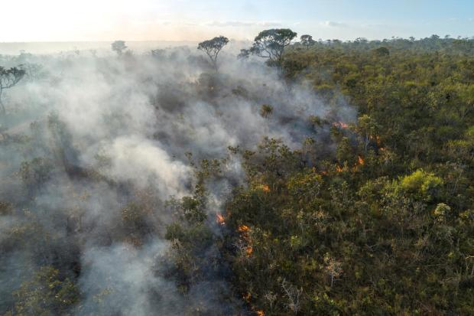
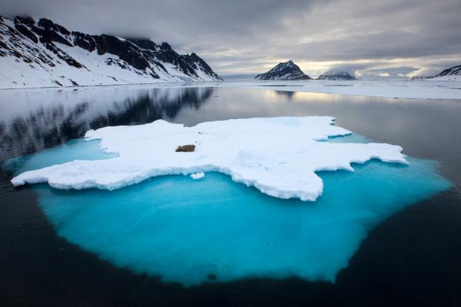
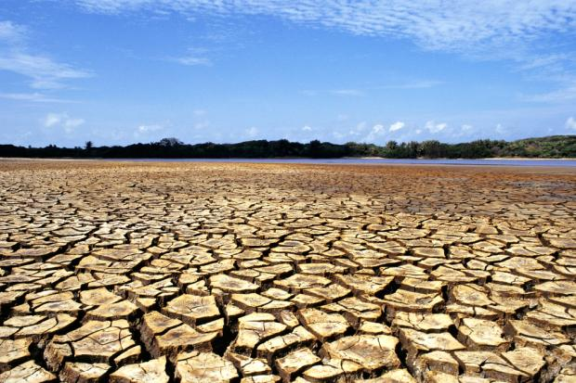
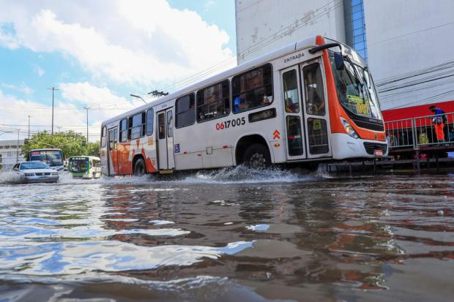
1
Notes:
**What do you see?**
What is happening in these images?
Where in the world do you think this might have happened?
Why do you think this might have happened?
How could this affect people?
How could this affect wildlife?
Images:
Dry soil - © Adriano Gambarini / WWF-Brazil
Floods - © Marcio James / WWF-Brazil
Walrus on ice - © Wild Wonders of Europe / Ole Joergen Liodden / WWF
Forest fire in the Cerrado savannah biome - © Andre Dib / WWF-Brazil

Slide 3
What is climate?
The word climate means the long-term weather patterns for a particular area.
On Earth we have different climates depending on where you are.
Can you think of any different climates?
2
Notes:
The word climate means the long-term weather patterns for a particular area.
On Earth we have different climates depending on where you are.
The equator is an imaginary line around the middle of the Earth, a bit like a belt. The areas closest to this belt have very hot climates. Areas nearest to either of the poles have very cold climates.
Image - © Greg du Toit

Slide 4
What is climate change?
Climate change is the process of our planet heating up.
Our planet has warmed by an average of 1°C in the last 100 years.
This is already having huge impacts across the planet for people and wildlife.
3
Notes:
Climate change (sometimes called global warming) is the process of our planet heating up.
Our planet has warmed by an average of 1°C in the last 100 years and if things don’t change, it could increase by a lot more than that. 1°C might sound small but this is already having a big impact, making weather around the world more extreme and less predictable, causing our sea levels to rise and causing our ice to melt.
Image - © naturepl.com / Ole Jorgen Liodden / WWF

Slide 5
Why is it happening?
The Earth’s climate is getting warmer because of human activity.
We a burn fossils fuels like coal, oil and natural gas for energy, to generate electricity, to power our cars and to use for heating and cooking.
We also cut down trees across our planet to make space for things like farming and expanding cities.
4
Notes:
The Earth’s climate is getting warmer because of human activity.
In the Earth’s atmosphere we have gases called greenhouse gases. These gases keep our planet warm, a bit like how a greenhouse helps to keep plants warm.
However, humans are increasing the amount of greenhouse gases we have in our atmosphere. We do this by burning fossils fuels like oil, coal and natural gases to generate electricity, to power our cars and to use for heating and cooking. We also produce a lot of greenhouse gases by making cement and by cutting down forests across our planet.
All of this extra greenhouse gas in the atmosphere is warming up our planet very quickly. It’s changing the Earth’s climate and affecting every part of our world.
Image - © Sam Hobson / WWF-UK

Slide 6
Greenhouse gases
When we burn fossil fuels we release greenhouse gases into the atmosphere.
Greenhouse gases keep our planet warm.
By releasing more and more greenhouse gases into the atmosphere, we are causing our planet to warm up very quickly.
5
Notes:
When we burn fossil fuels for energy and heat we release more greenhouse gases into the atmosphere. When we cut down trees they can no longer absorb greenhouse gases (carbon dioxide) from the atmopshere.
Greenhouse gases keep our planet warm, a bit like how a greenhouse helps to keep plants warm, or a bit like a blanket. Carbon dioxide is a type of greenhouse gas.
All of the extra greenhouse gases in the atmosphere from burning fossils fuels and cutting down trees is warming up our planet very quickly. It’s changing the Earth’s climate and affecting every part of our world.
Image - © Jiri Rezac / WWF-UK

Slide 7
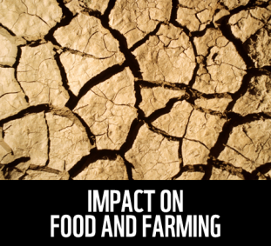
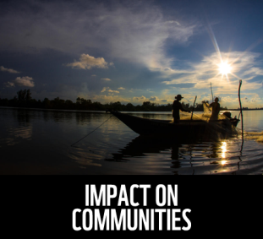
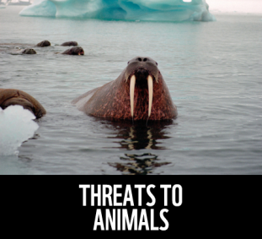
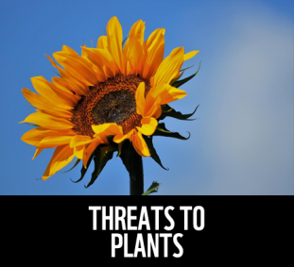
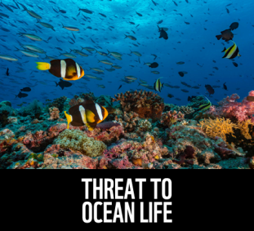
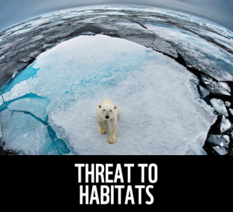
Why does it matter?
Climate change is damaging natural environments across our planet:
More extreme weather events
Sea level rise
Melting ice caps and sea ice
Warming ocean temperatures
6
Notes:
Climate change is damaging natural environments across our planet.
It’s causing more extreme weather events. Forest fires, floods, heatwaves and droughts are becoming more common which can be extremely dangerous and results in millions of people having to leave their homes, towns and villages every year.
Warmer temperatures mean that the sea ice is melting. Polar bears need sea ice to hunt and to have cubs. It’s also home to algae – an important food source for marine life. Melting ice also causes rising sea levels which causes areas of land to flood damaging animal habitats and destroying human homes.
Warming sea water damages and even kills off coral reefs. These are hugely important habitats in the ocean providing food and shelter for around one quarter of all marine species.
Scientists estimate that 1 in 6 species are at risk of becoming extinct due to climate change.
Images:
Sunflower - © Kari Schnellmann
Coral reefs - © Alexis Rosenfeld
Polar bear - © naturepl.com / Andy Rouse / WWF
Community fishing - © WWF-Malaysia / Mazidi Abd Ghani
Walrus - © Wim van Passel / WWF
Cracked Soil - © John E. Newby / WWF

Slide 8
What can we do?
What can we do at home or at school to try and tackle climate change?
7
Notes:
In November 2021 there will be an international meeting on climate change held in the city of Glasgow in Scotland. Global leaders will debate how we can reduce the amount of greenhouse gas emissions each country is producing and move to renewable energy sources such as wind, wave and solar power.
But there are things we can do as well around our homes and schools.
Image - © Sam Hobson / WWF-UK

Slide 9
What can we do?
Thinking about energy
Walk to school or on short journeys
Reduce the amount of electricity and heat you use at school
Find out what your school's energy supplier is
What else might you be able to do?
8
Notes:
- Reduce the amount of electricity and heat you use at school and at home.
- Try to walk, cycle or scoot on short journeys like on the way to school
See if you can find out what your schools energy supplier is and try to convince your school to make sure its energy comes from renewable sources rather than fossil fuels.
Image - © Shutterstock / Soonthorn Wongsaita / WWF

Slide 10
What can we do?
Thinking about food
Grow your own food at school or at home
Start meat and dairy free days at school!
What else might you be able to do?
9
Notes:
- Start growing food at school or at home – you don’t even need much space at all! Can one of your teachers start a gardening club?
Encourage your school to have meat-free days and make sure plant-based meals are always available for people to choose
Image - © Shutterstock / WWF-UK

Slide 11
What can we do?
Take positive action
Plant trees at school or in your local community
Write to your local council, MP or MSP
Make changes around your school
What else might you be able to do?
10
Notes:
- Plant a tree or trees in your school, garden or local community
- Write to your local MP/MSP to tell them how your community could be more green!
- Make sure to use the ‘three Rs’ - Reduce, Reuse and Recycle.
Start an eco group at school to take on recycling, rewilding and reducing waste!
Image - © Jaime Rojo / WWF-US

Slide 12
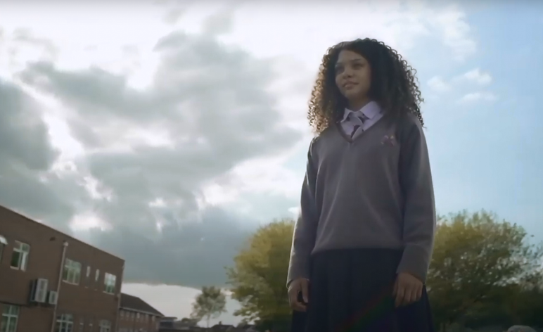
Watch!
https://www.youtube.com/watch?v=A3A2hxfF-sM
11

Slide 13
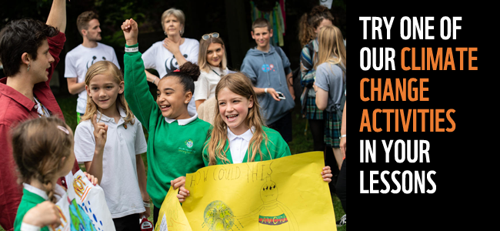
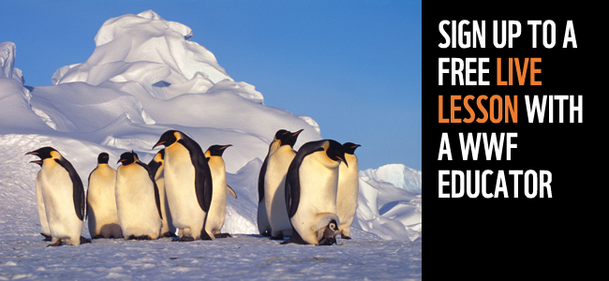
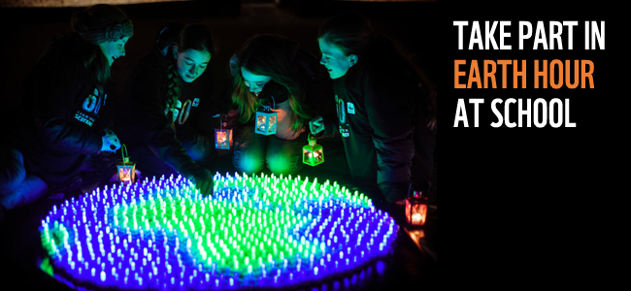
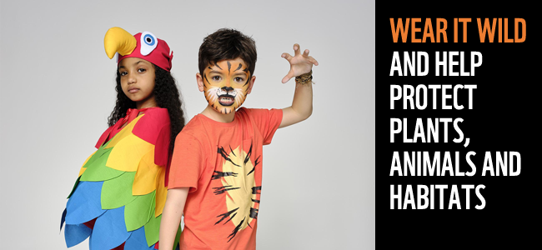
Want to do more?
12
Notes:
- Try one of our climate change activities in your lessons – find out more by visiting: https://www.wwf.org.uk/get-involved/schools/resources/climate-change-resources
- Sign up for a FREE live lesson with a WWF educator - https://www.wwf.org.uk/get-involved/schools/calendar
- Take part in Earth Hour at school - https://www.wwf.org.uk/get-involved/schools/school-campaigns/earth-hour-schools
Wear it Wild and help protect our planet’s plants, animals and habitats - https://www.wwf.org.uk/get-involved/schools/wear-it-wild
Images:
Climate activities - © Chris Ratcliffe / WWF-UK
WWF Live Lesson - © Fritz Pölking / WWF
Earth Hour - © Callum Bennetts / Maverick Photo Agency
Wear it Wild - © WWF-UK

Slide 14
Learn more about our work with UK schools. Visit us at wwf.org.uk/schools

