Slide 1
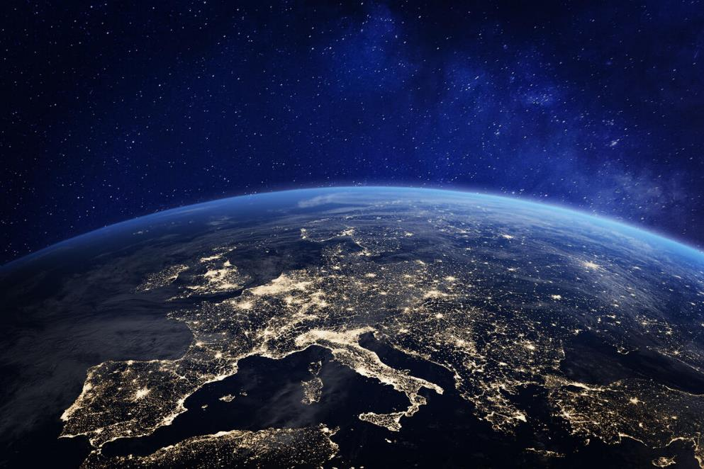


Our Climate, Our Future
What happened at COP26?
© Shutterstock
Notes:
The COP26 climate change conference took place in Glasgow from 1-12 November 2021. It was organised by the United Nations and brought together leaders from across the world to make agreements to tackle climate change.
Some fantastic pledges were made to help protect our planet. However, the hard work isn’t over, and we still have a long way to go to make sure world leaders keep their climate promises and put them into action. Here’s a look back at this crucial gathering and some of the key moments.

Slide 2
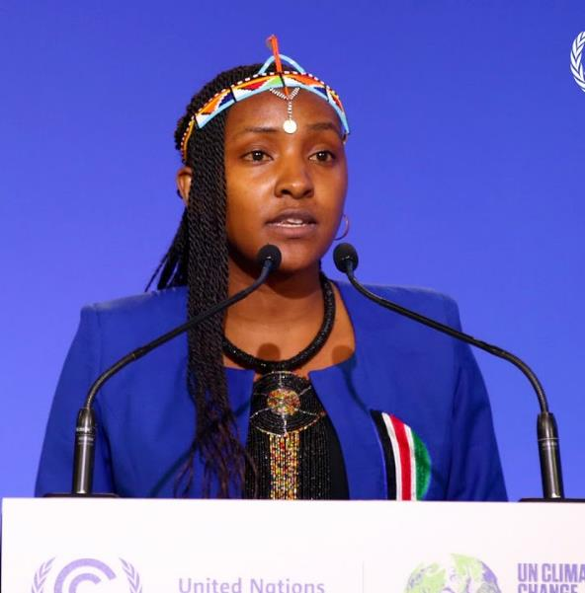
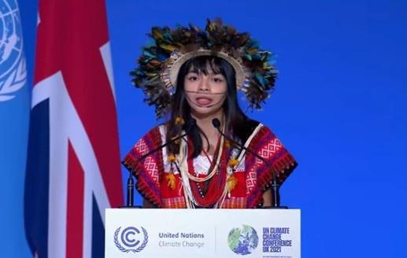
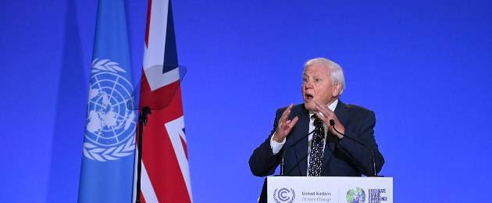
Txai Suruí
Indigenous youth activist from Brazil
Elizabeth Wathuti
Kenyan climate activist
Sir David Attenborough
People spoke up!
Notes:
People spoke up at COP26
Sir David Attenborough kickstarted a vital two weeks in the fight against climate change with a message of hope to the world. In his speech he said: “Surely working together we are powerful enough to save [the planet]. In my lifetime I've witnessed a terrible decline. In yours, you could and should witness a wonderful recovery.”
Watch Sir David’s speech here: https://www.youtube.com/watch?v=wzF1LLbSepk.
Indigenous youth activist Txai Suruí from Rondonia in Brazil gave a powerful speech as part of the opening ceremony, speaking about the impact of the climate emergency on her and other Indigenous Peoples. It’s vital that indigenous voices are heard and listened to by global leaders. Not only are indigenous communities among the most severely impacted by the climate crisis, their longstanding, deep-rooted traditions and invaluable knowledge of their homes, hold the key to saving amazing places like the Amazon rainforest.
Watch Txai Suruí’s speech here: https://www.youtube.com/watch?v=TP5Nbc5P0GM
Elizabeth Wathuti, a youth climate activist from Kenya, spoke about the impact of climate change in her home country of Kenya. She spoke about how the past two rainy seasons had failed in Kenya, causing rivers the dry up, harvests to fail and many people and animals to starve. She asked world leaders to open their hearts and tackle climate change for the sake of her people in Kenya and millions around the world who are suffering from the impacts of climate change. Elizabeth Wathuthi spoke about climate justice, she said that Sub-Saharan Africans are responsible for just 0.5% of greenhouse gas emissions yet they are seeing some of the worst impacts of climate change. The children are bearing the brunt of climate change but it is the responsibility of adults to make sure children have access to clean water and food.

Slide 3
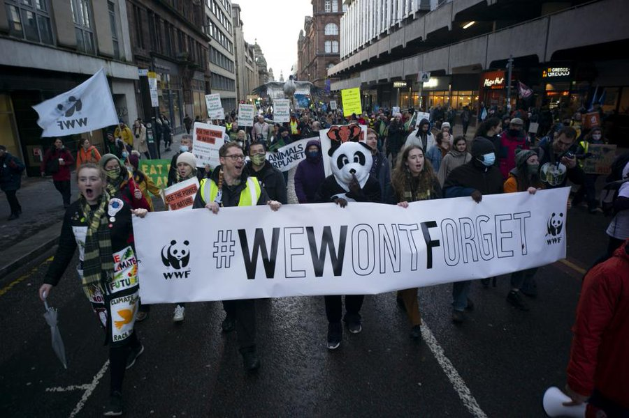
People spoke up!
100,000 people protested in Glasgow and across the UK
​© David Bebber
Notes:
On Saturday 6 November we showed the strength and diversity of public support for climate action, with over 100,000 people taking part in demonstrations in Glasgow and across the world. With public concern about climate change at a record high, we made sure our leaders were left in no doubt that we won’t forget the decisions they make at COP26 and beyond.

Slide 4
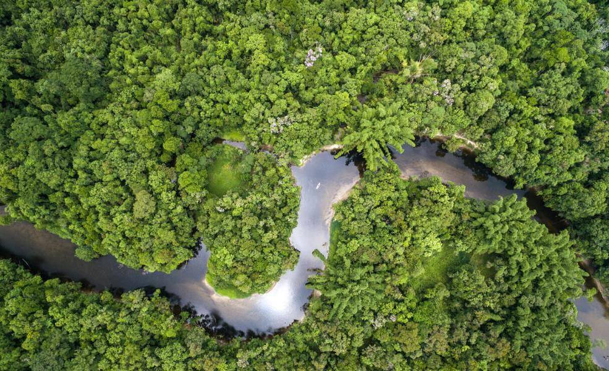
New promises were made!
130 countries agreed to end and reverse deforestation by 2030
© Shutterstock / Gustavo Frazao / WWF
Notes:
Over 130 countries including Brazil, China and Indonesia, committed to ending and reversing deforestation by 2030. These countries represent over 85% of the world's forest. This is a significant achievement, and a step up from similar promises made before. This time, leaders must follow through and deliver the action we need to see. We know that nature is a climate hero – it’s time to put it at the heart of climate action.

Slide 5
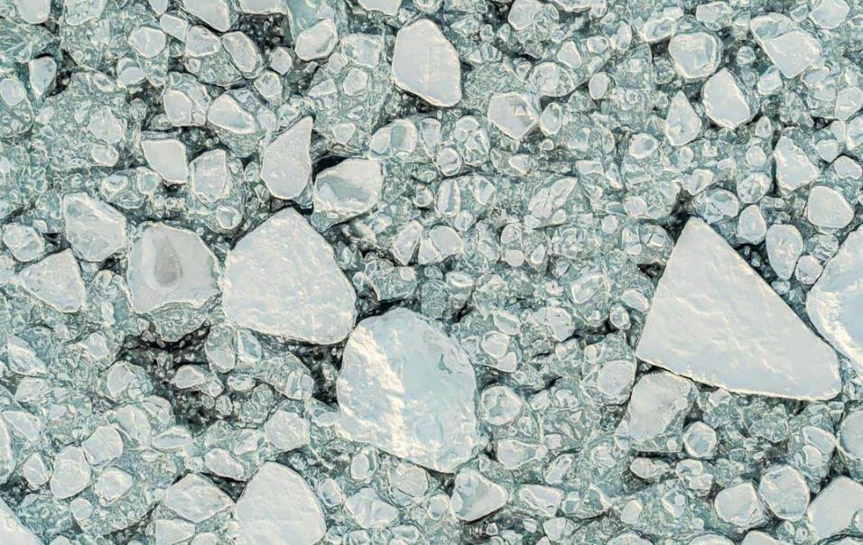
New promises were made!
80 leaders agreed to lower the emissions of methane, the second-most polluting greenhouse gas
© James Morgan / WWF-UK
Notes:
More than 80 world leaders agreed to curb emissions of methane, the planet’s second most polluting greenhouse gas by 30% by the end of the decade.

Slide 6
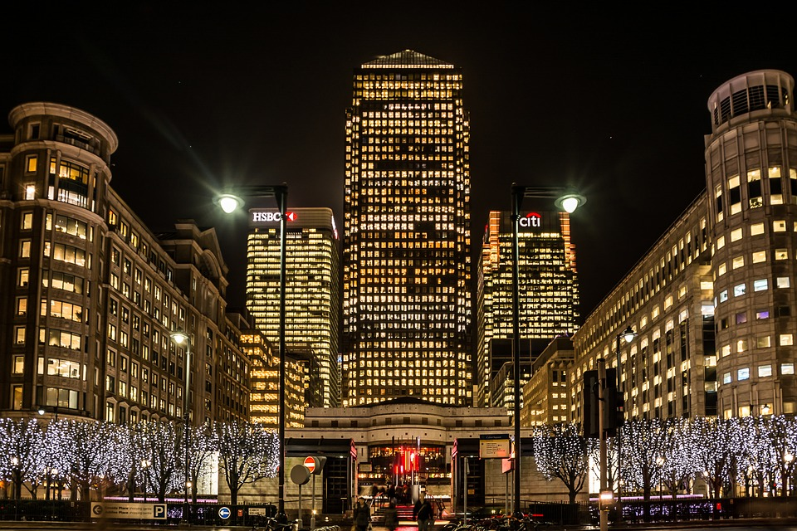
New promises were made!
All big UK businesses must now have plans to tackle climate change
Pixabay
Notes:
We saw a big breakthrough on a key UK climate promise, as Rishi Sunak announced new rules to make it mandatory for big UK firms to show plans on how they will hit their climate targets.
The impact of this is global. When these rules are introduced any company, anywhere in the world, that wants to attract investment from the UK finance sector will have to show how it is contributing towards achieving the net zero transition. This will help to drive positive climate investments that are good for the environment, wildlife and us.

Slide 7
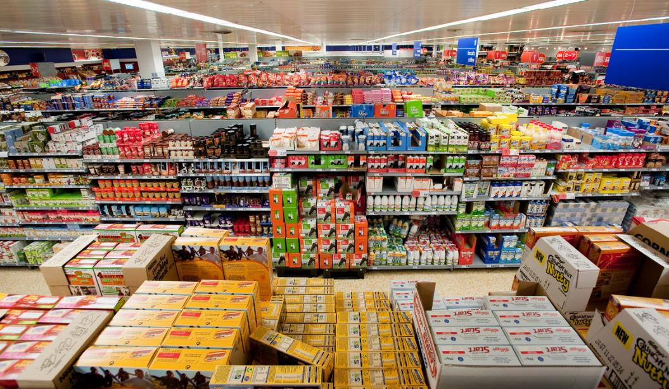
New promises were made!
Five big supermarkets will halve their environmental footprint by 2030
© WWF / Richard Stonehouse
Notes:
Five leading supermarkets pledged to halve their environmental footprint this decade. Tesco, Sainsbury's, Waitrose, Co-op and M&S will work with WWF to halve: the amount of global warming that shopping baskets cause, the forests that are cut down to fill the baskets, the impact of the agriculture and seafood in baskets and the food waste and packaging they produce.

Slide 8
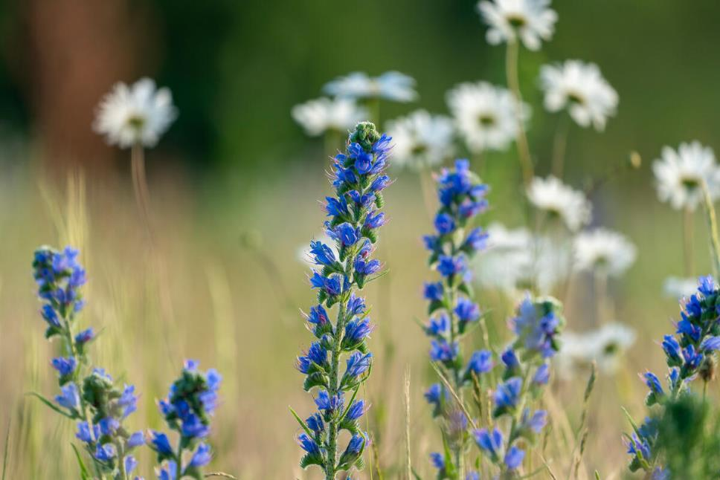
New promises were made!
New model science curriculum for UK schools will teach students about nature and their impact on the world.
New virtual National Education Nature Park and Climate Awards
© Joseph Gray / WWF-UK
Notes:
The UK announced a draft Sustainability and Climate Change strategy to equip and empower young people with the skills they need to drive the future of climate action. This includes a new model science curriculum, in place by 2023, to teach children about nature and their impact on the world around them, a new Climate Award in recognition for their work to improve their environment, with a national awards ceremony held every year, and virtual National Education Nature Park which allows students to upload their school ground biodiversity data to track their progress against other schools in the country, increase their knowledge of different species and develop skills in biodiversity mapping.

Slide 9
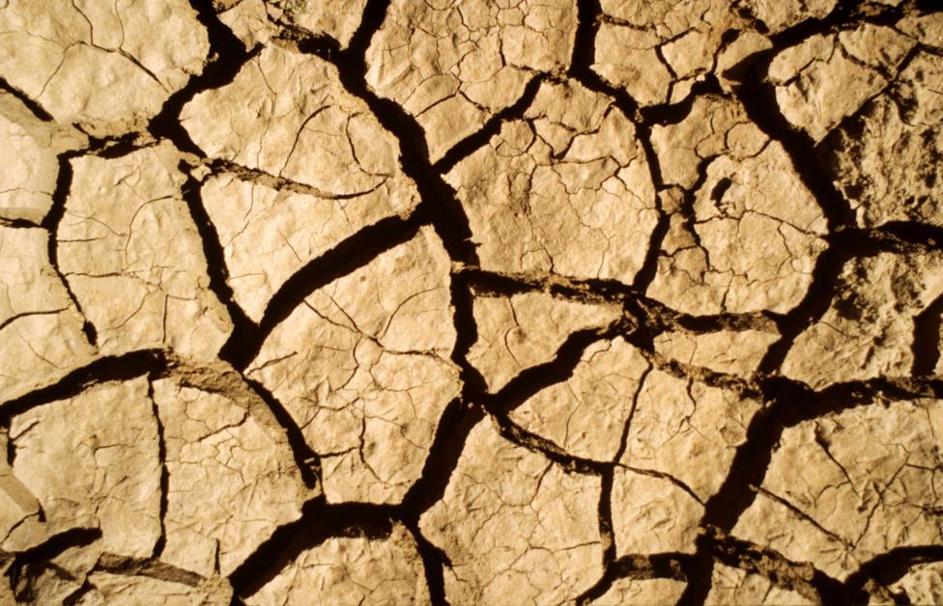
Climate Justice
Nations who are suffering the most from climate change are those that have done the least to cause it in the first place.
Agreements made at COP26 lacked enough support for the people who are suffering most from the impacts of climate change.
© John E. Newby / WWF
Notes:
Climate change affects everyone. Yet it is the world’s poorest and most vulnerable people who are hardest hit by climate change. Nations who are suffering most from climate change are those that have produced the least greenhouse gases historically and have done the least to cause climate change in the first place.
People who rely on rain to grow crops, for example coffee farmers in Thailand and cocoa farmers in west Africa are suffering as a warming climate is making it more difficult to grow coffee and cocoa. Higher temperatures and less rainfall make it more difficult to grow the beans and therefore more difficult for coffee and cocoa farmers to make money for themselves and for their families. More extreme weather events in these regions means that people have experienced lots more landslides and floods which have ruined their crops, destroyed their homes and injured people living in these communities. People who live in poorly built structures in the most exposed areas, and those who lack savings or insurance are also hit hardest from climate change, despite having done the least to cause the problem. Climate change is already forcing people from their land and homes - people in poorer countries are five times more likely to be forced to move by sudden weather disasters than people in richer countries.
Agreements made at COP26 lacked enough support for the nations suffering most from the impacts of climate change.

Slide 10
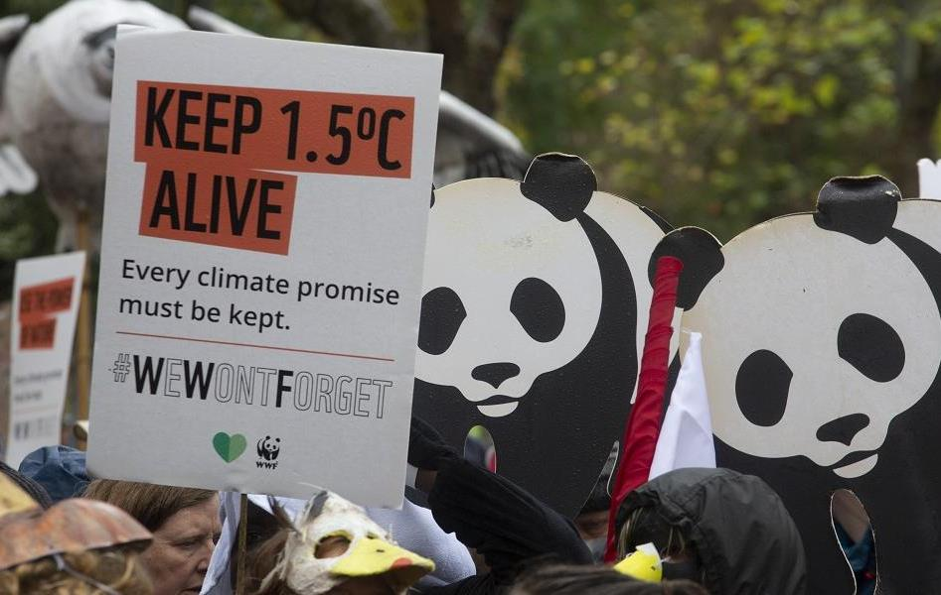
Keep 1.5° C alive!
It is vital that we keep our planet’s warming to 1.5°C. Decisions that countries and leaders make can help us reach this target.
Looking at the targets countries have made so far for 2030, we are not on track to do this. There is hope though…
© David Bebber
Notes:
The difference between a planet that is 1.5°C warmer, and a planet that is 2°C warmer, is huge.
From losing all of the world’s coral reefs, to putting 1.3 billion additional people at risk from extreme heat: we have to keep the planet as cool as possible, to keep it as safe as possible. The big job at COP26 was for world leaders to ‘keep 1.5°C within reach’ – meaning their actions left hope that we could still limit temperature rise to this target.
Countries and nations that have produced the least greenhouse gas emissions and have done the least to cause climate change in the first place are those who are suffering the most from the impacts of climate change. It is vital that
Looking at national targets for 2030 shows that the world is on track for a disastrous 2.4°C of warming. But there is some hope.

Slide 11
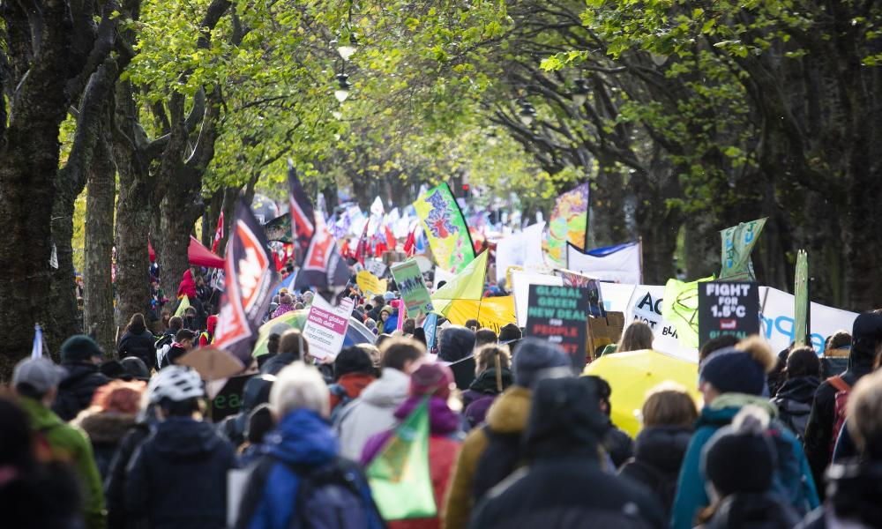
The Glasgow Climate Pact
After two weeks of discussions the Glasgow Climate Pact was agreed. By 2022 it calls on all countries to:
Strengthen their targets for 2030
Develop plans to be net carbon zero by 2050
Keep the target of 1.5° C in reach!
© David Bebber
Notes:
After two weeks of discussions at COP26 all countries signed the Glasgow Climate Pact. This pact calls on countries to come back in the next year with stronger pledges and plans for action. This means the opportunity to limit warming to the much safer target of 1.5°C is still alive, but only just. And the next 12 months are critical!
They agreed to:
Strengthen their targets for reducing emissions by 2030
Develop plans to be net carbon zero by 2050. Net carbon zero means balancing the overall carbon emissions with measures to absorb it from the atmosphere such as the planting of trees.
It is crucial that

Slide 12
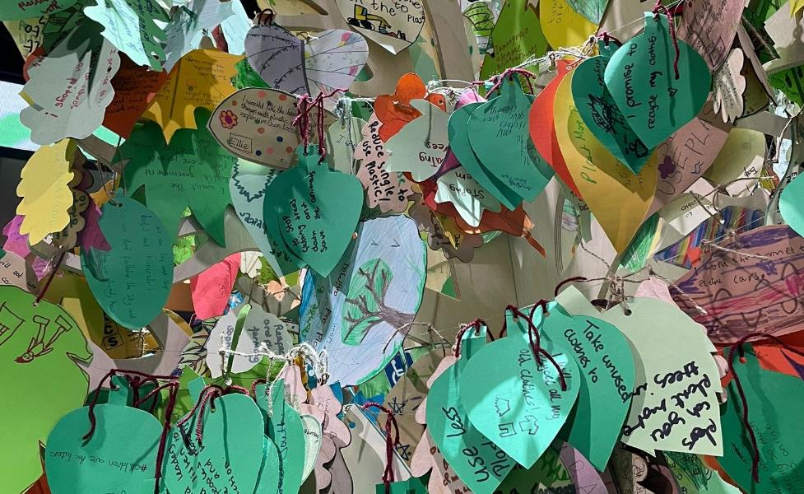
Schools took action!
Thousands of schools joined together to form a Forest of Promises for COP26!
These promises let world leaders know that young people are ready to do their part to fight climate change, and that they need world leaders to step up and make the big changes needed!
Notes:
Over 1000 schools across the UK took part in our Forest of Promises activity. These promises let world leaders know they young people are ready to do their part to fight climate change and they need world leaders to step up and make the big changes needed. Students shared leaves with their own climate promises on one side and promises they wanted world leaders to make on the otherside. At WWF we collected over 4000 individual leaves and thousands more were shared online on 5 November to mark the ‘Youth Empowerment and Education’ day of the COP26 conference.
We shared our Tree of Promises with everyone at COP26 in the Blue and Green Zones (zone for world leaders and zone for member of the public). It was visited by everyone from Nicola Sturgeon to Christiana Figueres, with WWF Global Ambassador Maisie Williams also adding a promise of her own!
If your school took part in the Forest of Promises remember you can still download your school certificate and share your school story with us.

Slide 13
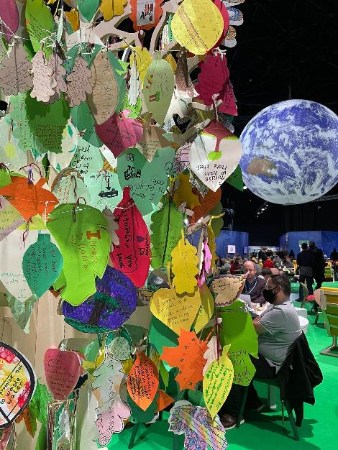
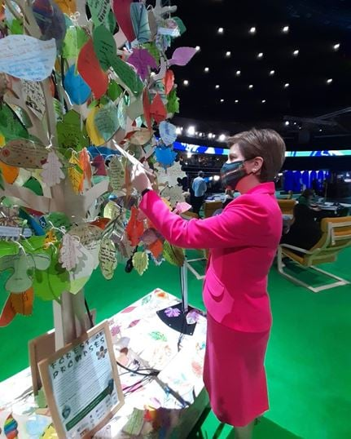
Promises in the Blue Zone
Scotland’s First Minister Nicola Sturgeon
Notes:
We shared our Tree of Promises with everyone at COP26 in the Blue and Green Zones (zone for world leaders and zone for members of the public). It was visited by everyone from Nicola Sturgeon (First Minister of Scotland) to Christiana Figueres (Executive Secretary for COP26 and Costa Rican diplomat), with WWF Global Ambassador Maisie Williams also adding a promise of her own!

Slide 14
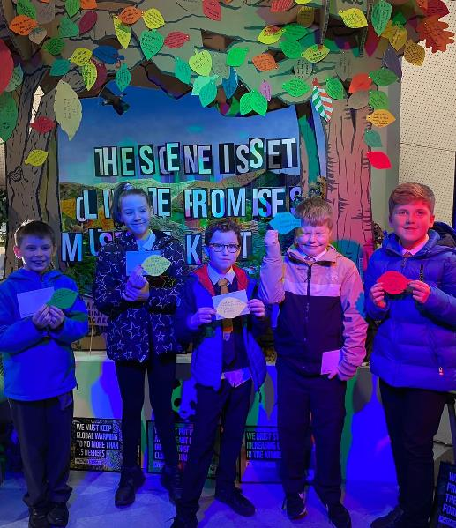
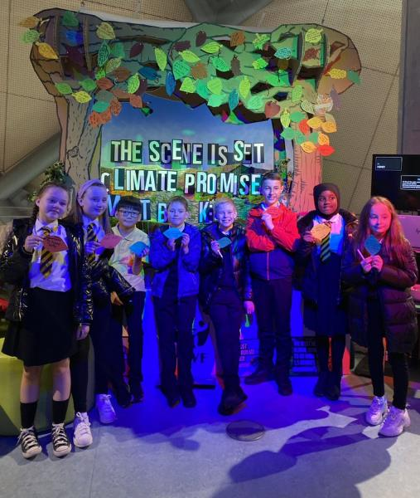
Promises in the Green Zone
Notes:
We shared our Tree of Promises with everyone at COP26 in the Blue and Green Zones (zone for world leaders and zone for member of the public). It was visited by everyone from Nicola Sturgeon to Christiana Figueres, with WWF Global Ambassador Maisie Williams also adding a promise of her own!
If your school took part in the Forest of Promises remember you can still download your school certificate and share your school story with us.

Slide 15
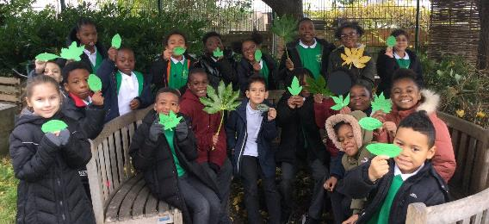
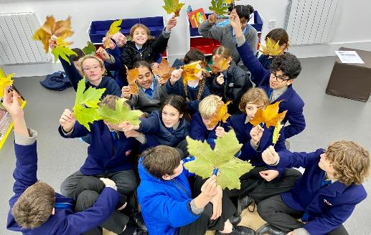
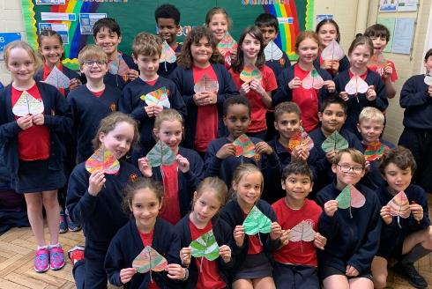
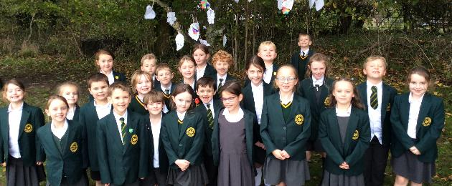
Notes:
Schools across the UK taking part in the Forest of Promises

Slide 16
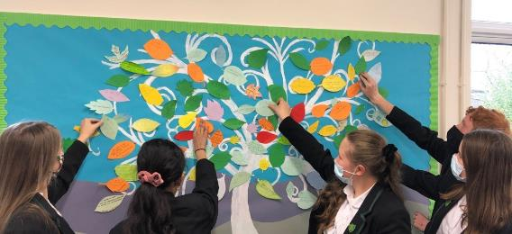
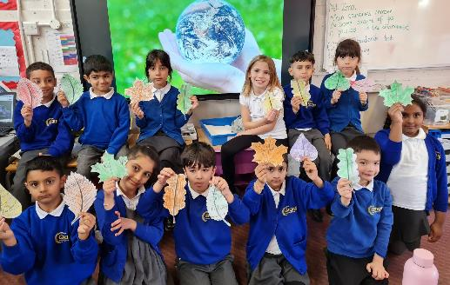
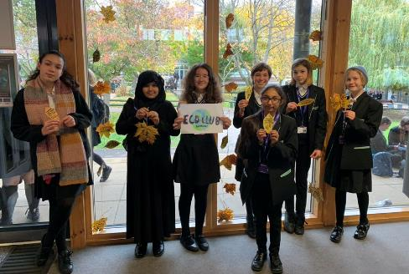
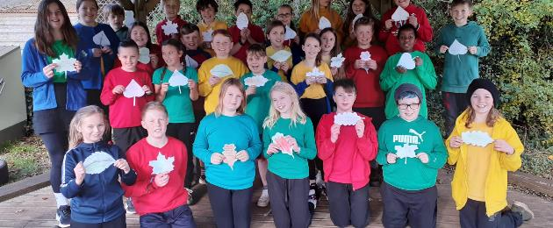
Notes:
Schools across the UK taking part in the Forest of Promises

Slide 17
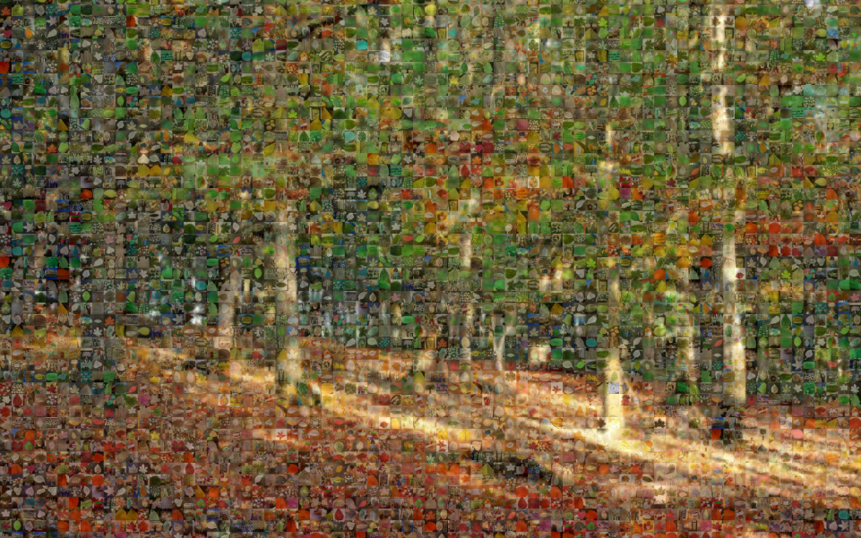
Notes:
Photo mosaic of images from participating schools. Each pixel is a different image from schools across the UK – together making a forest of promises!

Slide 18
What can your school do?
Walk to school zones
Reduce, Reuse, Recycle
School uniform swaps
Sustainable paper and other school supplies
Change school energy supply
Talk to local businesses
Campaign for nature
Keep the climate conversation going
Make sure your climate promises are kept!
Start an eco-club
Create a wildlife habitat area
Plant trees and wildflowers
Grow your own food
Biodiversity survey
Reduce carbon footprint
Meat & dairy free meals
Reduce food waste
Notes:
There are lots of things your school can do to try and reduce its carbon footprint, improve local nature and spread the word about climate change!
Together, we can keep the pressure on our leaders to slash fossil fuels and put nature at the heart of climate action. If we do these things, we can create a better future for everyone. We’re all in this together.

Slide 19
What can your school do?
Use our Introduction to Climate Change resources
Use our Shaping our Future resources
Book a WWF live lesson
Join Let’s Go Zero to reduce your school’s carbon footprint
© Shutterstock
Notes:
Download our Introduction to Climate Change teacher guide and presentation https://www.wwf.org.uk/get-involved/schools/resources/climate-change-resources
Use the ‘Shaping our Future’ classroom resources https://www.wwf.org.uk/get-involved/schools/school-campaigns/shaping-our-future
Book a WWF Live Lesson https://www.wwf.org.uk/get-involved/schools/calendar
Sign up to Let’s Go Zero to reduce the carbon footprint of your school https://letsgozero.org/

