Slide 2
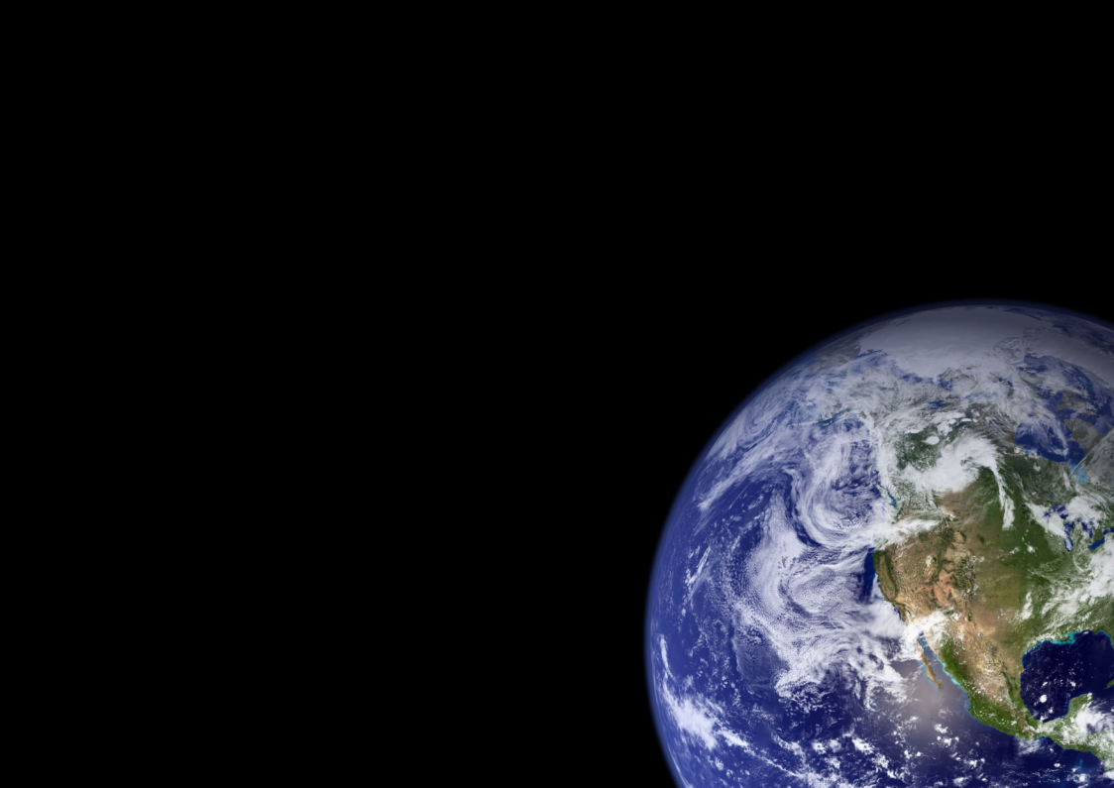

Slide 4
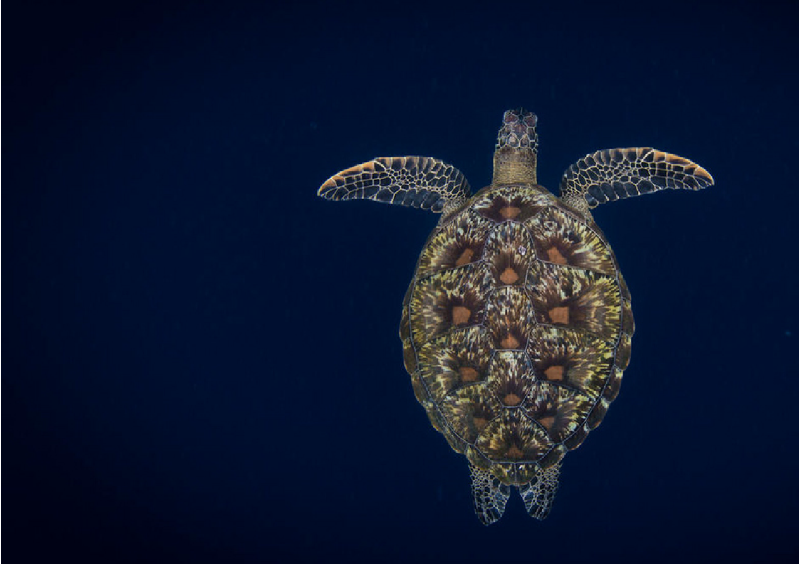

Slide 10
Notes:
https://www.youtube.com/watch?v=y0xKohBk_90

