Slide 1
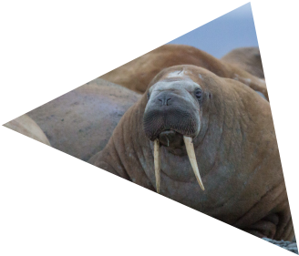
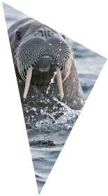
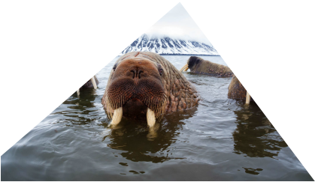
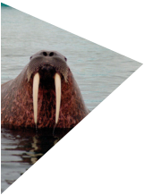
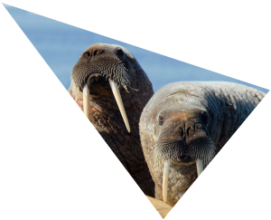
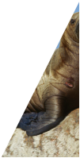
Notes:
Walrus from Space is a project run by WWF and the British Antarctic Survey. It is asking members of the public to become ‘Walrus Detectives’ to help search through thousands of satellite images taken from space to see if they can spot any walrus.
Walrus from Space will be running for five years and provides a unique opportunity for schools to get involved in a real-life wildlife conservation project. Data gathered from the project will go towards improving our understanding of how walrus are affected by climate change, help scientists spot changes over time and help us to work out how best to help these wonderful creatures to thrive.
Images: © Wim van Passel / WWF, © Paul Nicklen/National Geographic Stock / WWF-Canada, © Tor Lund, © naturepl.com / Tony Wu / WWF, © Jeff Higdon

Slide 2
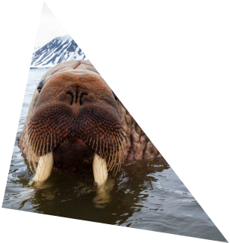
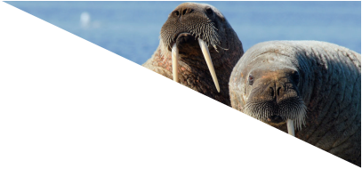
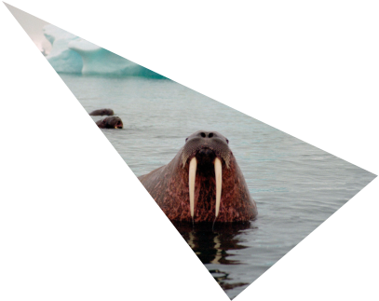
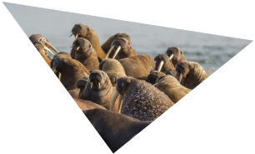
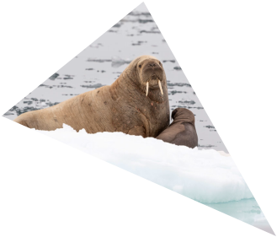
WHAT ARE WALRUS?
Notes:
Walrus are mammals, which means they are animals with fur or hair that feed milk to their young.
Walrus are marine mammals related to seals and sea lions. They are recognisable from their huge tusks and distinctive whisker moustaches!
All walrus are the same species, however there two main 'subspecies' - kinds of walrus that have evolved slightly differently in different parts of the world over thousands of years. These two main subspecies are the Pacific and the Atlantic walrus.
Pacific walrus are larger than the Atlantic walrus. They can be up to 3.6m long and weigh up to 1,500kg about the same weight as a medium sized car!
It’s thought that there are around 225,000 walrus in the wild.
These walrus numbers have mostly been counted from planes flying over the Arctic . It’s difficult to get an accurate number because walrus live in remote locations and can be found on sea ice, land and in the water, making them tough to spot! When walrus are on land they tend to pile on top of each other making it very difficult to count the individual animals.
We also have lots of knowledge about walrus and their numbers from Indigenous people who live in the Arctic. They have passed down this information to new generations over thousands of years.
Images: © Wim van Passel / WWF, © Richard Barrett / WWF-UK, © Tom Arnbom / WWF-Sweden, © naturepl.com / Tony Wu / WWF, © Jeff Higdon

Slide 3
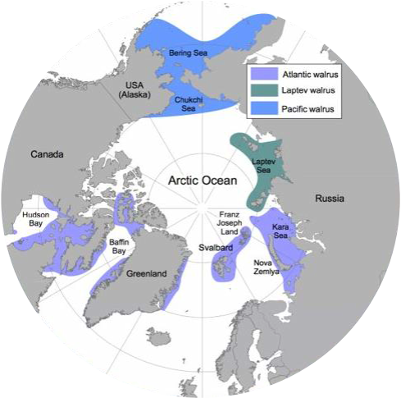
WHERE ON EARTH?
Notes:
Walrus live near the north pole in an area we call the Arctic and the sub Arctic.
This is a map of the Arctic, a view of the Earth from the North pole! The Arctic is a huge area of sea ice surrounded by land. Temperatures in the Arctic can get as low as -60°C.
Even though it can be extremely chilly, the Arctic is a very important habitat for many different animals including polar bears, narwhals, arctic foxes, whales, seals, birds and lots of different invertebrates (animals without backbones).

Slide 4
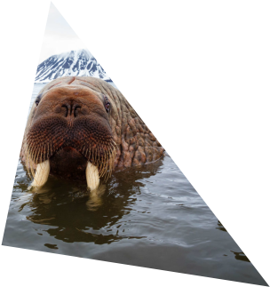
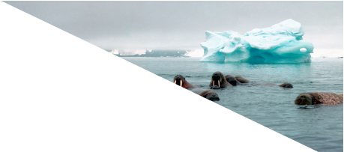
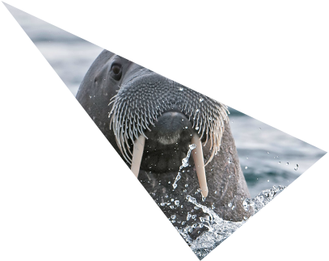
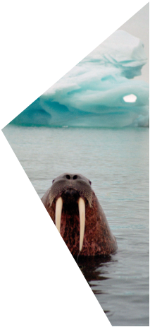
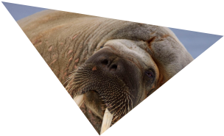
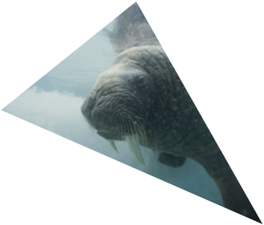
LIFE IN WATER
•Walrus have a thick layer
of blubber beneath their
skin to keep them warm
•Walrus can hold their
breath for around 10
minutes underwater to
search for food
•Walrus whiskers are
highly sensitive and help
them find food on the sea
floor
Notes:
Walrus spend their lives on land and in the water so they have adaptations to suit both of these different environments.
Life in the water
Animals lose heat faster in water than they do in air, so walrus have a thick layer of blubber beneath their skin to keep them warm in the chilly polar waters.
Walrus can hold their breath for around 10 minutes underwater which enables them to search for food without having to come up for air! They also have lots of whiskers on their snout, which are highly sensitive, and help them find food on the sea floor.
Walrus are usually a cinnamon-brown colour but they can look almost white after a long swim in cold water. This is due to blood vessels near the skin getting narrower to save body heat.
Images: © Norbert Rosing/National Geographic Stock / WWF-Canada, © Wim van Passel / WWF, © Richard Barrett / WWF-UK, © Tor Lund, © naturepl.com / Tony Wu / WWF

Slide 5
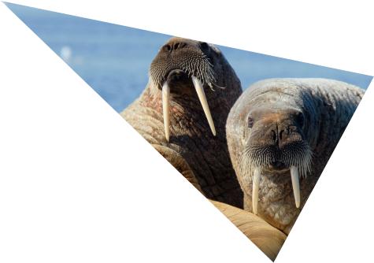
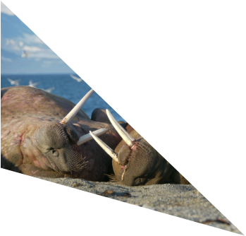
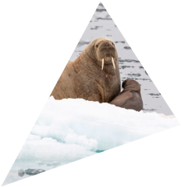
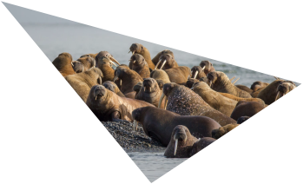
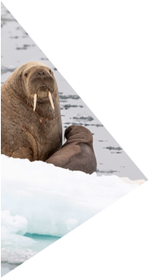
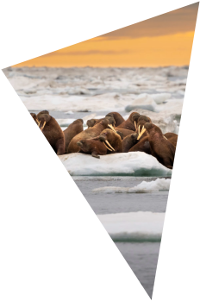
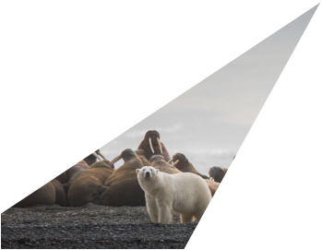
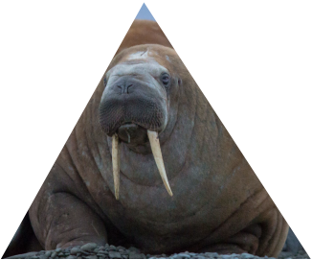
LIFE ON LAND
•Walrus use their tusks to
haul themselves out of
the water
•Walrus tusks can grow up
to 1m long and weigh 5kg
in large males!
•Walrus have thick skin
around their necks which
gives them good
protection when fighting
and from predators.
Notes:
Both male and female walrus have large tusks. Q: What might these be used for?
Walrus use their tusks to help them haul themselves out of the water and onto sea ice. Their tusks are also used for fighting with other walruses, and defence against predators.
Walrus tusks are really just their canine teeth – the pointy teeth we, and other mammals, have at the front of our mouths. Walrus tusks can grow up to 1m long and weigh 5kg in large males. Female walrus have smaller tusks that are up to 80 cm long but that’s still pretty huge! Can you imagine if your canine teeth were 80 cm long?
Images: © Alexei Ebel / WWF-Canon, © Richard Barrett / WWF-UK, © Alexei Ebel / WWF-Canon, © Jeff Higdon, © Tom Arnbom / WWF-Sweden

Slide 6
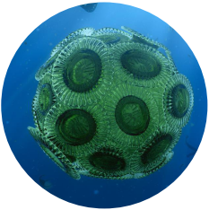
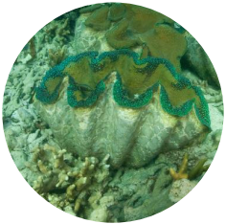
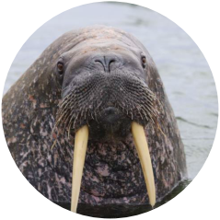
WHAT DO WALRUS EAT?
Phytoplankton _{Clam Walrus}
Producer Consumer Consumer
How many clams can one walrus eat in one dive?
Notes:
Q: What do walrus eat?
A: Walrus are carnivores which means they eat other animals. They like to eat invertebrates like clams, worms, snails, soft shell crabs, shrimp and sea cucumbers. In just one dive, one walrus can eat over 60 clams!
Images: © Yulia Bogomolova / WWF-Russia, © BDH Creative / Silverback/Netflix, © Jürgen Freund / WWF

Slide 7
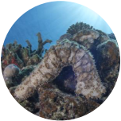
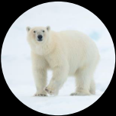
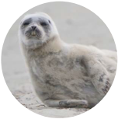
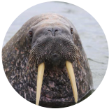
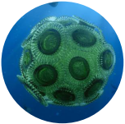
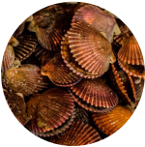
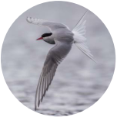
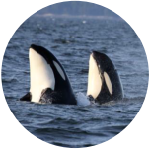
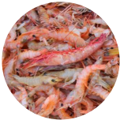
Sea cucumber
Polar bear
Seal
Phytoplankton Molluscs
Walrus
Sea bird
Orca
Shrimp
Notes:
But they don’t just eat clams and invertebrates. Walrus are ‘opportunistic predators’. This means they eat whatever they can find rather than having one particular prey that they always eat. For example some walrus may prey on seals, small whales and even seabirds if they need to.
Walrus are very large so they have few natural predators but young walrus calves can be preyed upon by polar bears and orca.
Images: © Yulia Bogomolova / WWF-Russia, © BDH Creative / Silverback/Netflix, © Jürgen Freund / WWF, © Tom Vierus / WWF-US, © Meridith Kohut / WWF-US, © Staffan Widstrand / Wild Wonders of China / WWF, © Tom Arnbom / WWF-Sweden, © Richard Barrett / WWF-UK, © Natalie Bowes / WWF-Canada, © Ola Jennersten / WWF-Sweden

Slide 8
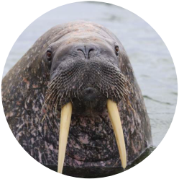
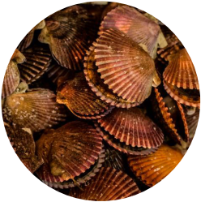
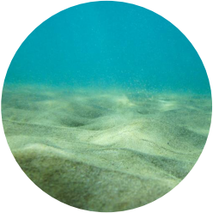
KEYSTONE SPECIES
Notes:
Walrus are a keystone species in the Arctic. This means that they have a very large impact on the environment they live in.
Walrus have such a great impact on the Arctic environment through the way that they feed. They spend hours and hours foraging for clams and other marine animals on the sea floor. Whilst they are doing this they churn up huge amounts of mud and silt and rotting organisms.
Images: © Yulia Bogomolova / WWF-Russia

Slide 9
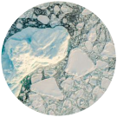
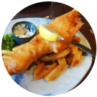
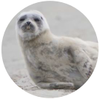
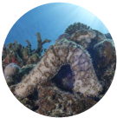
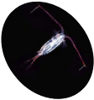
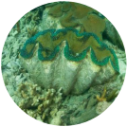
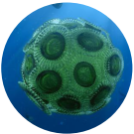
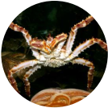
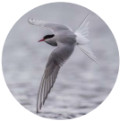
Zooplankton
Humans
Sea cucumber
Sea ice _{Seal}
Clams
Phytoplankton
Crab ^{Sea bird}
Polar bear
Walrus
Mud & silt ^{Ro�ng organisms} Fish Orca
Notes:
This churning action impacts the entire Arctic ecosystem - the community of all living and non living things in the Arctic environment.
This is because the churning action from the walrus releases nutrients into the water which can be used by primary producers such as phytoplankton – tiny microscopic plant-like organisms. It also stirs up small crustaceans and larvae which creates food for bigger crustaceans and bigger fish. These larger animals in the ecosystem then provide food for seals, seabirds and all the way up to orca, polar bears and even humans!
Without walrus our Arctic ecosystems would be very different!
Images: © Yulia Bogomolova / WWF-Russia, © BDH Creative / Silverback/Netflix, © Jürgen Freund / WWF, © Tom Vierus / WWF-US, © Staffan Widstrand / Wild Wonders of China / WWF, © Tom Arnbom / WWF-Sweden, © Richard Barrett / WWF-UK, © Natalie Bowes / WWF-Canada, © James Morgan / WWF-UK, © Ola Jennersten / WWF-Sweden, Wikimedia,

Slide 10
THREATS TO WALRUS
Data: NOAA
Notes:
The greatest threat to walrus is climate change. Warming temperatures are causing the area of sea ice in the Arctic to decrease in size.
Walrus rely on the Arctic sea ice for resting between feeding dives in shallow waters and for breeding but warmer temperatures are causing the Arctic sea ice to melt more and more each year.
The sea ice is retreating to waters that are now too deep for the walrus to feed. This means that the walrus now need more energy to reach their food, and it also causes coastal areas to become extremely crowded.
Walrus have to gather on land in large groups – called a haul out - and go to sea to find food from there instead of from the sea ice. These ever growing gatherings can be deadly, especially for young calves who can get squashed by large adults.

Slide 11
THREATS TO WALRUS
Climate change is causing
the oceans to become more
acidic.
This makes is difficult for
animals like clams, sea snails
and crabs to build their
shells.
Walrus are also disturbed by
low flying planes and ships
near the coast. If they panic,
walrus can stampede.
Notes:
Climate change isn’t just causing the sea ice to melt, it’s also causing the Arctic Ocean to become more acidic. This is happening because carbon dioxide in the atmosphere is dissolving in the ocean waters. Water and carbon dioxide combine to form a weak acid.
Oceans becoming more acidic makes it difficult for animals like clams, sea snails and crabs to build their shells. Since these animals are the main prey for walrus it makes it more difficult for the walrus to find as much food.
Walrus are also easily disturbed by low flying planes and ships near the coast. They are easily panicked into stampedes which can lead to walrus being injured or killed.
Images: © Wim van Passel / WWF, © Richard Barrett / WWF-UK, © Tom Arnbom / WWF-Sweden, © naturepl.com / Tony Wu / WWF, © Jeff Higdon

Slide 12
•Count Atlantic and Laptev walrus –
where are they and how many are
there?
•Using satellite images taken from space!
•Satellites do not disturb walrus and can
cover vast areas that are difficult to
access.
•Help scientists work out what habitats
walrus prefer and how walrus are being
affected by climate change.
Notes:
Walrus from Space is a project that aims to count Atlantic and Laptev walrus populations over five years. This will help scientists to spot changes over time, find out how quickly and how seriously the climate crisis is affecting walrus populations and help us to understand how we can help our wonderful walrus.
It’s important for scientists to measure populations of different species, especially keystone species like walrus, so that we can understand our impact on the natural world. By monitoring animal populations over time, we can identify any changes that might be causing problems for certain ecosystems or for the whole planet.
How does it work?
Satellites in space are continuously capturing images of Earth. Using these high-resolution images, we can identify where walrus are, and later estimate how many walrus there are at certain locations.
Satellites do not disturb walrus and it means that we can cover vast areas at once, many of which would normally be difficult and extremely time-consuming to access.
Using this information from satellite images will help scientists work out how many walrus we have, what habitats they prefer to be in and work out what is likely to happen to our walrus if the climate continues to warm.

Slide 13
BECOME A
WALRUS DETECTIVE
Notes:
Tips when looking for walrus
Despite being very big, from space, walrus look very small! Depending on your screen size a walrus can look as small as an ant.
2. Walrus change colour! Walrus vary from a reddish brown to a pale brown and if they have just come out of the cold sea they will look grey!
3. Can you see the coastline? If the image is just sea – or just land – you will not see any walrus. The groups of walrus, or ‘walrus haul-outs’ we are looking for, will only be on the beach or rocky coastline.
Images: © Satellite imagery 2021 Maxar Technologies

Slide 14
WALRUS OR NO WALRUS?
Notes:
Take a look at the following images and see if you can spot any walrus from space
Images: © Satellite imagery 2021 Maxar Technologies

Slide 15
WALRUS!
Notes:
Take a look at the following images and see if you can spot any walrus from space
Images: © Satellite imagery 2021 Maxar Technologies

Slide 16
WALRUS OR NO WALRUS?
Notes:
Take a look at the following images and see if you can spot any walrus from space
Images: © Satellite imagery 2021 Maxar Technologies

Slide 17
NO WALRUS
Notes:
Take a look at the following images and see if you can spot any walrus from space
Images: © Satellite imagery 2021 Maxar Technologies

Slide 18
WALRUS OR NO WALRUS?
Notes:
Take a look at the following images and see if you can spot any walrus from space
Images: © Satellite imagery 2021 Maxar Technologies

Slide 19
WALRUS!
Notes:
Take a look at the following images and see if you can spot any walrus from space
Images: © Satellite imagery 2021 Maxar Technologies

Slide 20
BECOME A
WALRUS DETECTIVE
Walrus from Space video: https://www.youtube.com/watch?v=qTg5oircxrw&t=69s
Notes:
Walrus from Space needs your help!
Play Walrus from Space introduction video (1:14) https://www.youtube.com/watch?v=qTg5oircxrw&t=69s
You can become ‘walrus detectives’ and help search for walrus in the thousands of images that will be gathered by satellites over five years.
You can also take part in our Walrus from Space class activities to learn even more about our wonderful walrus and download our Walrus Detectives certificate for your class.

