Slide 1
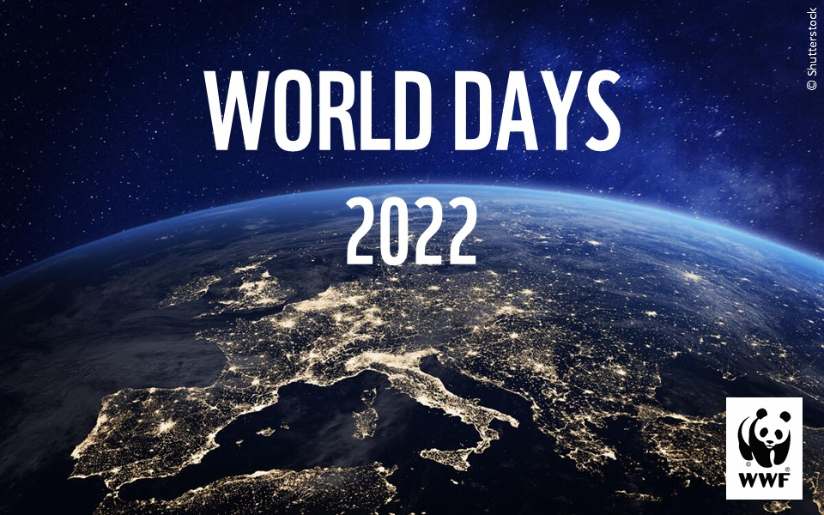
© Shutterstock
Notes:
This slide pack contains slides for world days throughout 2022 relating to wildlife and the environment.
In the notes section each slide contains:
Animal or environment facts
Discussion points for assemblies or starter activities
Links to further related resources

Slide 2
Notes:
Tigers are the largest of the big cats we have.
There are thought to be around 3,900 tigers left in the wild (2016 census). Most of these tigers live in India.
Tigers have soft toe pads which help them walk silently through their habitat. A tiger will typically travel 6-12 miles during a night’s hunting.
As top predators, tigers help to keep their environment healthy. It’s the way things naturally work in the wild – the predators prey on other animals, in this case herbivores (plant eaters) such as deer. But without enough tigers to eat them, herbivores can overgraze and damage the land, disrupting the balance of the local environment. Local people also depend on a healthy environment for food, water and lots of other resources.
Fun fact: tiger urine smells like buttered popcorn!
Over the last century, over 95% of the world's tiger population has been lost and they continue to face serious threats from poaching, habitat loss and the illegal wildlife trade.
Since 2010, WWF have been working to help double the number of wild tigers, with the aim of reaching 6,000 in the year 2022. We don’t have the estimates on tiger numbers yet but thanks to dedicated conservation work we know that tiger numbers are definitely increasing once again in India, Nepal, Bhutan, Russia and China.
This offers a rare glimmer of hope for our biodiversity across the world and proof that conservation efforts and working with local communities can really work. These conservation efforts has reversed decades of decline in tiger numbers!
2022 is the Chinese Year of the Tiger. It’s our opportunity to work with local communities to ensure that tiger areas are protected and that tiger ranges are able to expand.
Discussion points?
What adaptations do tigers have to make them top predators?
Why do you think people might poach tigers?
Further resources:
Top facts about tigers: https://www.youtube.com/watch?v=zsMQHHhgOqI
Adopt a tiger: https://support.wwf.org.uk/adoptions

Slide 3
Notes:
Pangolins are small mammals with distinctive scales made from keratin - the same material your fingernails are made from.
Pangolins have long snouts and even longer tongues, which they use to lap up ants and termites they dig up from mounds with their powerful front claws.
For self-defence pangolins roll up into a ball just like a hedgehog.
The word Pangolin comes from the word ‘penggulung,’ which the Malay word for ‘roller’.
There are eight different species of pangolin. Four can be found in Africa and four in Asia.
Discussion points?
Pangolins are threatened by the illegal wildlife trade. Why might people want to trade pangolins? (People catch and trade them for their unique scales and meat.)
Further resources
Fascinating facts about pangolins video: https://www.youtube.com/watch?v=2snwy8OQV6k

Slide 4
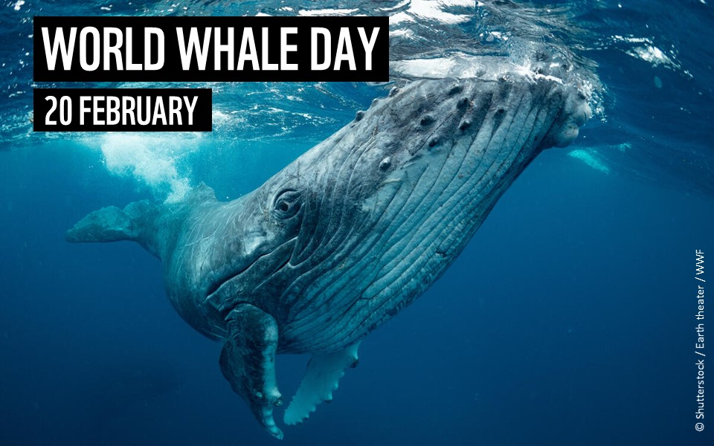
Notes:
There are two main types of whale - baleen whales and toothed whales.
The baleen whales have big plates in their mouths for filtering krill, plankton and crustaceans.
The toothed whales have teeth which allows them to feed on larger prey such as fish and squid.
Toothed whales also have a 'melon' in their heads. They use this melon to focus sounds and to communicate with other whales using echolocation.
Some whales blow circles of bubbles to catch their prey. These bubbles trap the prey making it easy for the whales to eat them.​
The Antarctic blue whale is the largest animal on the planet. They can eat 3,600kg of krill every single day - that's about the same weight as three cars!
Despite being known as 'killer whales', orcas are not whales and are actually the largest species of dolphin!
Discussion points
How are whales affected by the plastics we use?
How might climate change be impacting whales?
Further resources
Antarctic krill superheroes of the southern ocean video: https://www.youtube.com/watch?v=km0GAPvQLBc
Top facts about whales video: https://www.youtube.com/watch?v=B4dwXKONyro
Our seas classroom resources: https://www.wwf.org.uk/get-involved/schools/our-planet

Slide 5
Notes:
Polar bears are Arctic predators – their main prey is bearded seals and ringed seals.
Polar bears have a very strong sense of smell. They can even detect a seal in the water beneath a metre of compacted snow and a kilometre away.
Polar bears' large paws are specially adapted for swimming. They use them to paddle through the water while holding their hind legs flat like a rudder
Underneath all that thick fur, polar bear skin is jet black which helps them absorb and keep in heat.
Polar bears live in the Arctic and rely on the sea ice for hunting and for raising their cubs
Discussion points?
Polar bears, like many other Arctic animals, are affected by climate change - how do you think climate change is impacting polar bear lives? (melting sea ice means less space for hunting and raising their cubs, disrupted food chains and less food to eat, more contact with humans as they come further in land)
The Arctic can get to temperatures of -40 degrees Celsius! How are polar bears adapted for living in the cold Arctic climate?
Further resources
Polar Bear facts video https://www.youtube.com/watch?v=hqSXcMujzsI
Meet the Polar Bear Patrol video https://www.youtube.com/watch?v=Hf_WX7JcJXI&list=RDCMUCOFPJWr7NVoDuwGPOh3MdbQ&index=13
Our Frozen worlds resources https://www.wwf.org.uk/get-involved/schools/our-planet
Adopt a polar bear: https://support.wwf.org.uk/adoptions

Slide 6
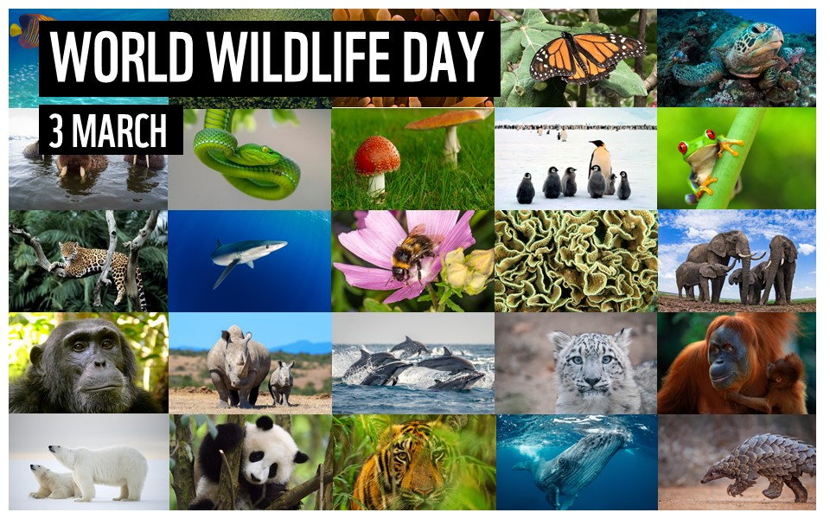
Notes:
Biodiversity is all the different kinds of life you’ll find in one area; the variety of animals, plants, fungi, and even micro-organisms like bacteria that make up our natural world.
Each of these species and organisms work together in ecosystems, like an intricate web, to maintain balance and support life.
Rainforests cover only 7% of the land but they are thought to produce 25% of our oxygen and provide homes and food for half of all animals on land! One single tree in the rainforest can provide homes for more than 2,000 species of bird, reptile, amphibian, mammal, fungi and plant!
Coral reefs cover less than 1% of the ocean floor but they provide shelter and food for around a quarter of marine creatures including marine turtles, tropical fish, sea anemones, rays, crabs, octopus, jellyfish, sea cucumbers and sharks!
The Living Planet Report is produced every two years by WWF and is a health-check for the planet, showing how the natural world is doing, what threats it faces and what this means for us humans. Our latest Living Planet Report tells us that wildlife populations globally have sadly declined by 68% since 1970.
Discussion points
What different wildlife can you see in the slide?
What wildlife have you seen around your local area?
What could you do around your school or home to benefit local wildlife?
Further resources:
How to bring wildlife into your garden video: https://www.youtube.com/watch?v=Y8_--YV4inE&list=RDCMUCOFPJWr7NVoDuwGPOh3MdbQ&index=6
Seek wildlife spotting: https://www.wwf.org.uk/discover-nature-seek-app
Living Planet Report: https://www.wwf.org.uk/get-involved/schools/living-planet-report
Living Planet Report video: https://www.youtube.com/watch?v=YiTb08jf7vU&t=7s
UK marine wildlife video: https://www.youtube.com/watch?v=Azd0XC2Opic
How to plant wildflowers: https://www.youtube.com/watch?v=WmQIixsk_bo&t=53s
Sounds of UK nature (1 hour nature soundtrack): https://www.youtube.com/watch?v=-SFE4o0v4TM

Slide 7
Notes:
Giant panda, also known as pandas, live mainly in temperate forests high in the mountains of southwest China
The giant panda's black-and-white markings help them to camouflage. Most of the panda - its face, neck, belly, rump - is white to help it hide in snowy habitats. The arms and legs are black, helping it to hide in shade.
Giant pandas spend 10-16 hours a day feeding, mainly on bamboo. They need at least two different types of bamboo in their habitat to avoid starvation.
Pandas are 99% vegetarian but 1% of their diet can be made from eggs and small animals. They have been known to forage in farmland for pumpkin, kidney beans, wheat and domestic pig food.
Pandas sometimes do handstands when they wee! They do this against trees and it’s a way of leaving their scent to other pandas.
Pandas have an extended bone in their wrists that they use like a thumb to help them grip food.
Panda’s used to be critically endangered but thanks to huge conservation efforts over the last 60 years pandas are recovering and they are now listed as ‘vulnerable’ rather than ‘critically endangered’.
Discussion points?
Why is it important to try and protect endangered animals like the panda?
Further resources:
Top facts about pandas video: https://www.youtube.com/watch?v=O5f-4h7L5ts
Adopt a panda: https://support.wwf.org.uk/adopt-an-animal

Slide 8
Notes:
Our little blue planet is actually pretty green. Almost a third of the Earth’s land surface is covered by forest. And forests aren’t just full of trees – they’re teeming with all kinds of life.
Forests are home to around 80% of amphibian species, 75% of bird species and nearly 70% of mammal species. Just one single tree species can be home to over 1,000 different species of beetle.
300 million people live in forests - including 60 million indigenous people. Over 2 billion people rely on forests for shelter, livelihoods, water, fuel, food and medicines.
We know that trees absorb or ‘breathe in’ carbon dioxide. By doing this the world’s forests store 250 million tonnes of carbon in their roots, trunks and branches.
Forests also produce a lot of the oxygen we need to breathe, and they can even control rainfall and climate patterns around the world.
Rainforests only cover 7% of the land yet half of the planet’s land based animals live in the rainforests.
Every 2 seconds an area of rainforest the size of a football pitch is cut down on Earth!
Discussion points?
What different animals live in forests?
What resources do forests provide?
Why are our forests under threat? (deforestation, making space for farming, mining, expanding towns and cities, logging and forest fires)
Further resources
10 myths about deforestation video https://www.youtube.com/watch?v=P_bJjPR4Xog
Helping to Protect Forests video https://www.youtube.com/watch?v=FUeegWTo6WQ
Our Forests and Jungles resources: https://www.wwf.org.uk/get-involved/schools/our-planet

Slide 9
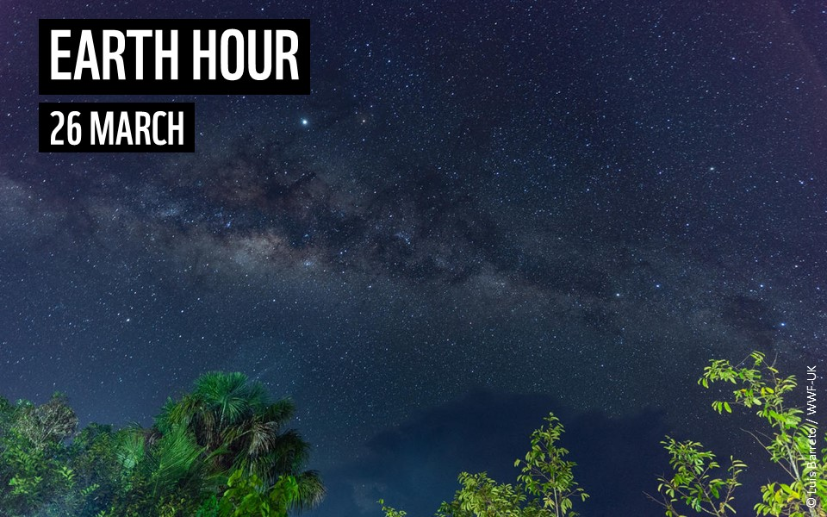
Notes:
Earth Hour is one of the world’s largest movements for our planet. Millions of people around the world switch off their lights to show they care about the future of our planet – our shared home.
Joining Earth Hour’s switch off reminds us that even small actions can make a big difference.
When we make changes in our own lives, and when we share that with others, we also inspire the people around us to change – and we help grow a movement that businesses and governments can’t ignore.
By 2030, nature and wildlife could be recovering all around us. We could have green jobs, cleaner air and a healthier future for the next generation. Everyone has a part to play in making that happen. And it all starts with a single switch.
How to take part
Switch off – join millions of people across the world by switching off non-essential lights in the week before Earth Hour (26 March)
Take action – take action at school by doing something that will help protect the planet – you could build a bird feeder or bug hotel, walk to school, eat a plant-based meal, get your schools energy supplier changed, plant a tree or wildflowers, raise money for WWF, you name it!
Discussion points
Why do we need to stand up for nature?
How could you help to protect the planet at school?
Further resources: Earth Hour activity pack: https://www.wwf.org.uk/get-involved/schools/school-campaigns/earth-hour-schools
Our Planet full episodes on YouTube: https://www.youtube.com/watch?v=aETNYyrqNYE&list=PL7rb3uMaYmjHqT_JUcQYCBa4nEtfDKuSa

Slide 10
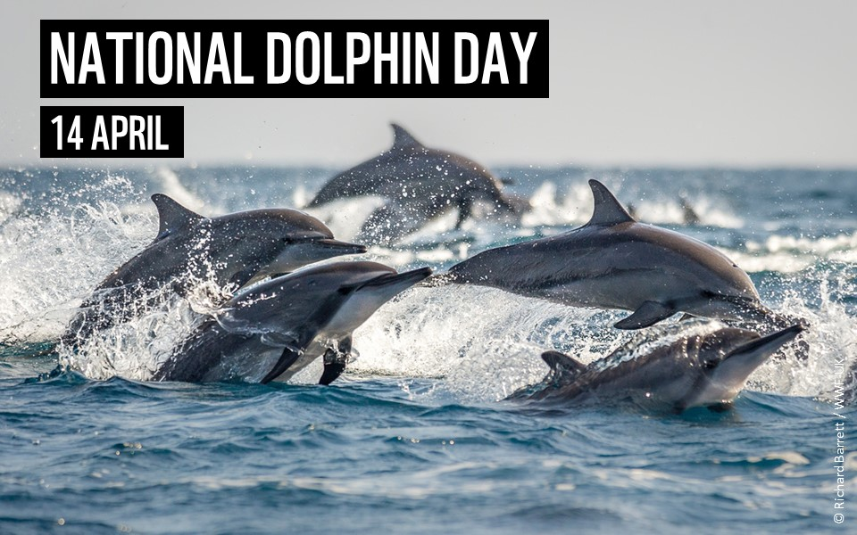
Notes:
There are 36 species of marine dolphins - living in nearly all aquatic environments, including oceans, coastal waters and rivers. They live in temperatures ranging from less than 0°C to more than 30°C.
Bottlenose dolphins sleep with one half of their brain at a time, and keep one eye open. It's believed they do this to keep an eye out for their group and to look out for predators like sharks.
Dolphins make a variety of sounds including whistles, clicks, squawks, squeaks, moans, barks, groans and yelps.
Bottlenose dolphins swallow a fish head first so the fish's spines don't catch in their throat.
When hunting, some dolphins produce bubbles to herd their prey to the surface. They sometimes also use a hunting technique called 'fish-whacking', where they use their tail to hit fish and so stun them - making them easier to catch.
Fishing gear is a major threat to dolphins, Bottlenose dolphins are often killed various nets, lines and hooks used in fisheries. WWF and its partners are working with fisheries across the world to test and encourage the use of sustainable fishing gear.
Discussion points
How do the plastics we use impact life in the ocean?
How does climate change affect ocean life?
Further resources:
Our seas resources: https://www.wwf.org.uk/get-involved/schools/our-planet
Top facts about dolphins video: https://www.youtube.com/watch?time_continue=1&v=MyoqoRXZNH4&feature=emb_logo
Our oceans and plastics resources: https://www.wwf.org.uk/sites/default/files/2020-01/WWF_Oceans_and_Plastics_Teacher_Handbook_Activities.pdf
Adopt a dolphin: https://support.wwf.org.uk/adopt-an-animal

Slide 11
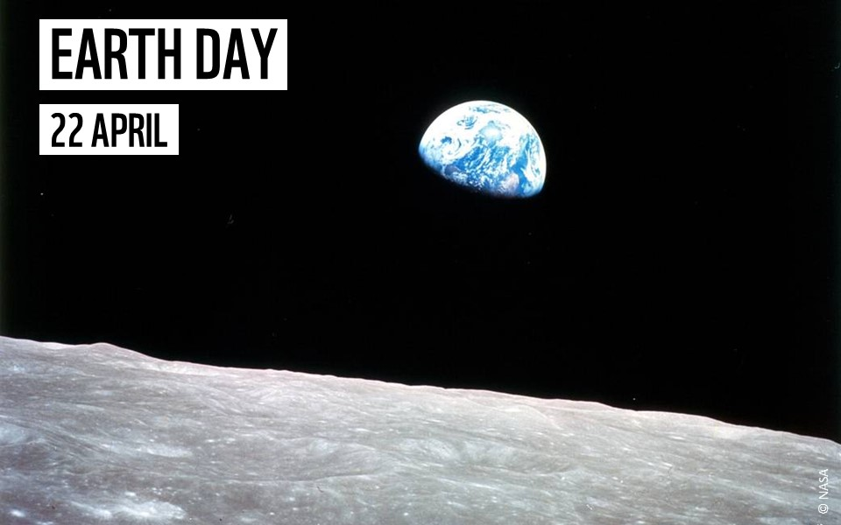
Notes:
Nature is vital – we can’t survive without it. But our planet Earth is under threat like never before.
Climate change and our use of fossil fuels is causing us to have more extreme weather events like storms and heatwaves, sea levels are rising and the ice caps are melting
Deforestation is destroying habitats for wildlife and releasing more greenhouse gases into the atmosphere
Plastic is choking our rivers and oceans and destroying animal habitats
Corals are bleaching and struggling to provide homes and food for marine creatures
It’s up to all of us to make a difference and stand up for our world
This photograph called ‘Earthrise’ was taken in 1968 when astronauts first orbited the moon. This was the first time humans had ever seen the whole of the Earth in one image.
Discussion points
What features of planet Earth can you see? What can you not see?
How does this Earthrise photograph make you feel?
How do you think this photo, showing the Earth as a ball floating in space, changed how people thought about our planet?
What can you do around school to help our planet?
Further resources
What happens if the world warms by 2 degrees video: https://www.youtube.com/watch?v=0zOvpSLXG18
Climate change dace against time video: https://www.youtube.com/watch?v=ZDXNN3Mp_So
Why do we need nature video: https://www.youtube.com/watch?v=Hiy9tlMMsXA
Our Planet classroom resources: https://www.wwf.org.uk/get-involved/schools/our-planet
Our Planet full episodes on YouTube: https://www.youtube.com/watch?v=aETNYyrqNYE&list=PL7rb3uMaYmjHqT_JUcQYCBa4nEtfDKuSa

Slide 12
Notes:
There are 18 different species on penguin on our planet – the biggest are the Emperor penguins which can be around 120cm tall and the smallest are the little penguins which are around 30cm tall.
All penguins living in the wild live in the Southern Hemisphere – which is another word for the bottom half of our planet.
Emperor penguins are the Olympic divers of the bird world. The deepest recorded dive was 564 m – that’s like the height of the Shard Europe’s tallest building, times two!
Penguins are well camouflaged in the water. The black feathers on their backs blend in with the sea below and the white feathers on their bellies blends in with the sunlight above making it difficult for predators to see them!
Penguins are amazing swimmers. They have a streamlined torpedo shaped body and short wings that act like paddles in the water to swim faster
Discussion points
Many species of penguins rely on the sea ice – how might climate change be affecting penguins?
How are penguins adapted for life in the water and on land?
Further resources:
Top facts about penguins: https://www.youtube.com/watch?v=6LUmFShvWLU
Our frozen worlds class resource: https://www.wwf.org.uk/get-involved/schools/our-planet
Our Planet Frozen Worlds full episodes on YouTube: https://www.youtube.com/watch?v=aETNYyrqNYE&list=PL7rb3uMaYmjHqT_JUcQYCBa4nEtfDKuSa
Adopt a penguin: https://support.wwf.org.uk/adoptions

Slide 13
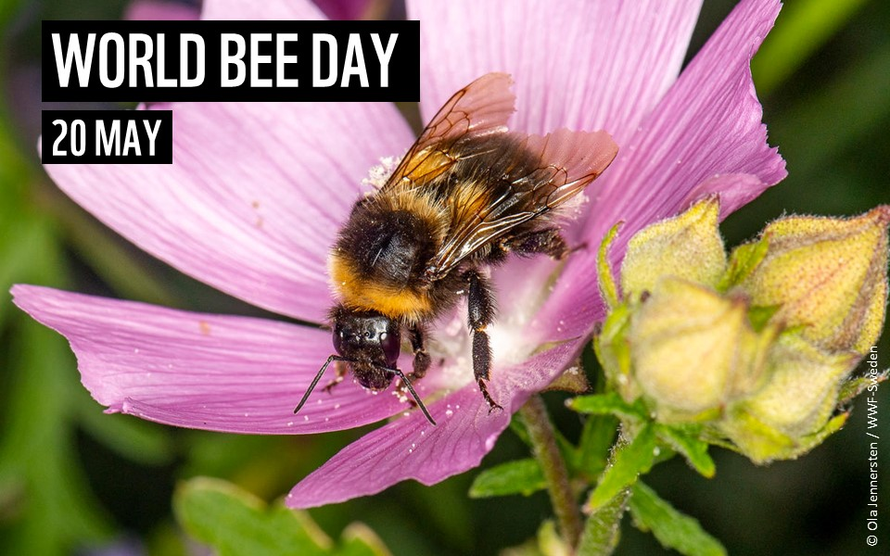
Notes:
There are over 250 species of bee in the UK!
One out of every three mouthfuls of our food depends on pollinators like bees
Honeybees have a dance move called the ‘waggle dance’. It’s a clever way of telling their nestmates where to go to find the best source of food.
If honeybees need to appoint a new queen bee they select a young larva and feed it a special food called royal jelly.
The buff-tailed bumblebee has a brain the size of a poppy seed. This is quite incredible given the fact scientists have managed to train them to score a goal in ‘bee football’ in return for a sugary treat.
Discussion points
Why are bees are crucial for growing food crops like tomatoes, apples, strawberries and courgettes? (pollination)
Many types of bee are becoming endangered – why do you think this might be happening? (pesticides, wildflower meadow decline, climate change)
What can we do about it? (plant wildflowers and other bee-friendly flowers, bee hotels)
Further resources
Top facts about bees video: https://www.youtube.com/watch?v=1ziLEcU8pAQ&t=2s
Facts about wildflowers: https://www.youtube.com/watch?v=339R0lp9d_s&t=1s

Slide 14
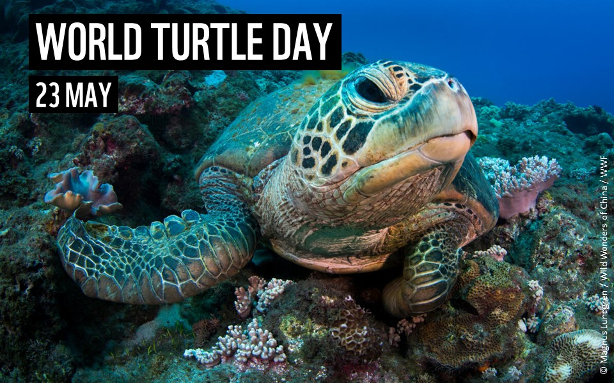
Notes:
Marine turtles evolved more than 100 million years ago - and lived alongside dinosaurs!
Turtles don't have teeth. They use their beak-like mouth to grasp their food. This beak is made of keratin (the same stuff your fingernails are made of).
Turtle shells are made of over 50 bones fused together - so they're literally wearing their bones on the outside.
Marine turtle species vary greatly in size. The smallest, Kemp’s Ridley, is around 70cm long and weighs up to 40kg. The leatherback can reach up to 180cm long and weigh 500kg. That’s over 10 times heavier!
Marine turtles can migrate incredibly long distances – the longest known record is for a female leatherback who swam nearly 13,000 miles over 647 days from Indonesia to the west coast of America.
Discussion points
Plastic pollution is causing huge problems for marine turtles – how can we reduce the amount of plastic going in to the ocean?
Further resources
Top facts about turtles: https://www.youtube.com/watch?v=qJfAbyz4qS0
Adopt a turtle: https://support.wwf.org.uk/adoptions
The oceans and plastic pollution class resource: https://www.wwf.org.uk/get-involved/schools/oceans-and-plastics

Slide 15
Notes:
World Environment Day is the United Nations day for encouraging worldwide awareness and action to protect our environment.
Nature is vital – we can’t survive without it. But our planet Earth is under threat like never before.
Climate change and our use of fossil fuels is causing us to have more extreme weather events like storms and heatwaves, sea levels are rising and the ice caps are melting
Deforestation is destroying habitats for wildlife and releasing more greenhouse gases into the atmosphere
Plastic is choking our rivers and oceans and destroying animal habitats
Coral reefs are bleaching and struggling to provide homes and food for marine creatures
We’ve lost 97% of our wildflower meadows in the UK since 1970
It’s up to all of us to make a difference and stand up for our world
Discussion points
Why is important that we act to protect our environment?
What can you do at home or at school to help the environment?
Further resources
Our planet resources: https://www.wwf.org.uk/get-involved/schools/our-planet
Our Planet full episodes (free): https://www.youtube.com/watch?v=aETNYyrqNYE&list=PL7rb3uMaYmjHqT_JUcQYCBa4nEtfDKuSa
Why do we need nature video: https://www.youtube.com/watch?v=Hiy9tlMMsXA&t=43s

Slide 16
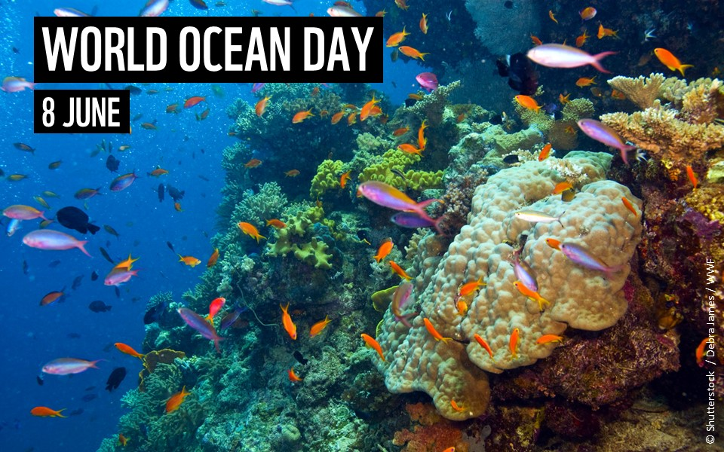
Notes:
Oceans cover 2/3 of the Earth’s surface.
there are over 240,000 known species living in the oceans but scientists estimate that up to 80% of marine species haven’t even been discovered yet!
Did you know that oceans create half of the oxygen humans use to breathe? This is because there are tiny microscopic plants in the ocean called phytoplankton that produce oxygen.
Oceans are also extremely important for keeping our planet’s temperature stable. They absorb heat from the atmosphere, and they absorb lots of the carbon dioxide gas which we produce from our cars and factories helping to slow down climate change.
The oceans are home to coral reefs. Coral reefs cover less than 1% of the ocean floor but they are home to over a quarter of all marine species. Coral reefs are important because they provide a habitat, shelter and food for lots of different marine species including fish, turtles and sharks.
Discussion points
Why are the oceans important for life on Earth? (food, jobs, habitats, produce oxygen, water cycle, evolution of life)
What animals rely on coral reefs for food and shelter?
Why is plastic a problem in our oceans?
How does climate change affect the oceans?
Further resources
Amazing facts about the ocean video: https://www.youtube.com/watch?v=tvsa4zgRW40
Oceans and plastic pollution resource: https://www.wwf.org.uk/get-involved/schools/oceans-and-plastics
Our seas resources: https://www.wwf.org.uk/get-involved/schools/our-planet

Slide 17
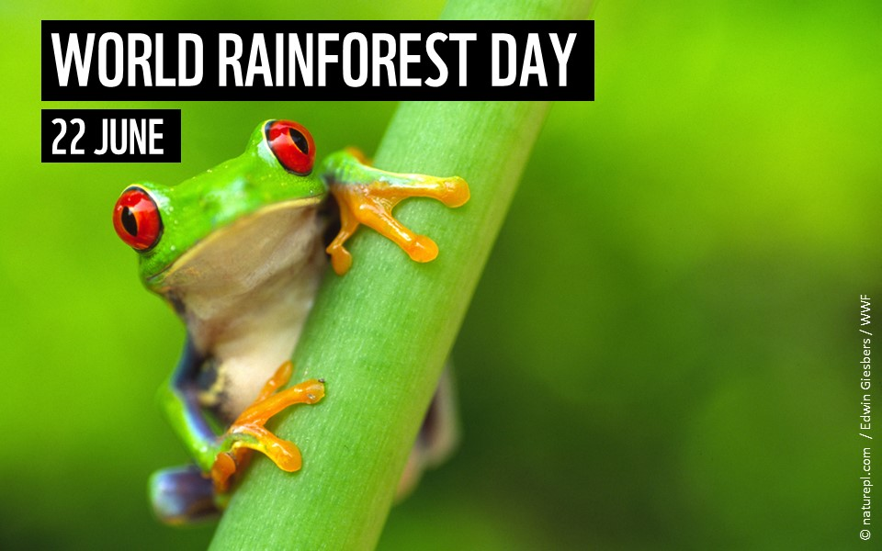
Notes:
Rainforests only cover 7% of the land yet half of the planet’s land based animals live in the rainforests.
Forests provide us with so many important resources, including wood, paper, medicines and food such as bananas, pineapples, cashews, brazil nuts, coffee and chocolate! Rainforests are also the lungs of the planet - they produce over one third of our oxygen and importantly suck up carbon dioxide, helping slow down climate change!
The biggest rainforest on our planet is the Amazon rainforest in South America.
Every 2 seconds an area of rainforest the size of a football pitch is cut down on Earth!
Rainforests in Borneo and other parts of the world are being cut down and replaced with a type of tree called oil palm.
Oil palm trees produce palm oil, an oil that is in lots of different products like chocolate, biscuits, peanut butter, cakes, toothpaste and shampoo. Oil palm plantations only contain one type of plant compared to the hundreds of different species that would have been in the rainforest land. Therefore replacing rainforest with oil palm plantations is destroying the habitat of already endangered species like the Orangutan, pygmy elephant and Sumatran rhino.
The good news is that we can produce palm oil sustainably - protecting species like the orangutan - if we make sure that it is deforestation free. This means planting on already damaged or used land rather than replacing jungle with oil palm. As consumers, we can fight to only buy sustainable palm oil. Just avoiding palm oil isn’t the answer; demanding more action is!
Discussion points?
Can you name any animals that live in the rainforest?
Why are our rainforests under threat? (deforestation, making space for farming, mining, expanding towns and cities, logging and forest fires)
What resources do we get from our rainforests?
Further resources
10 myths about deforestation video https://www.youtube.com/watch?v=P_bJjPR4Xog
Helping to Protect Forests video https://www.youtube.com/watch?v=FUeegWTo6WQ
Threats facing the Amazon video: https://www.youtube.com/watch?v=o_4qvQvy5x0&list=RDCMUCOFPJWr7NVoDuwGPOh3MdbQ&index=12
Our Forests and Jungles resources: https://www.wwf.org.uk/get-involved/schools/our-planet

Slide 18
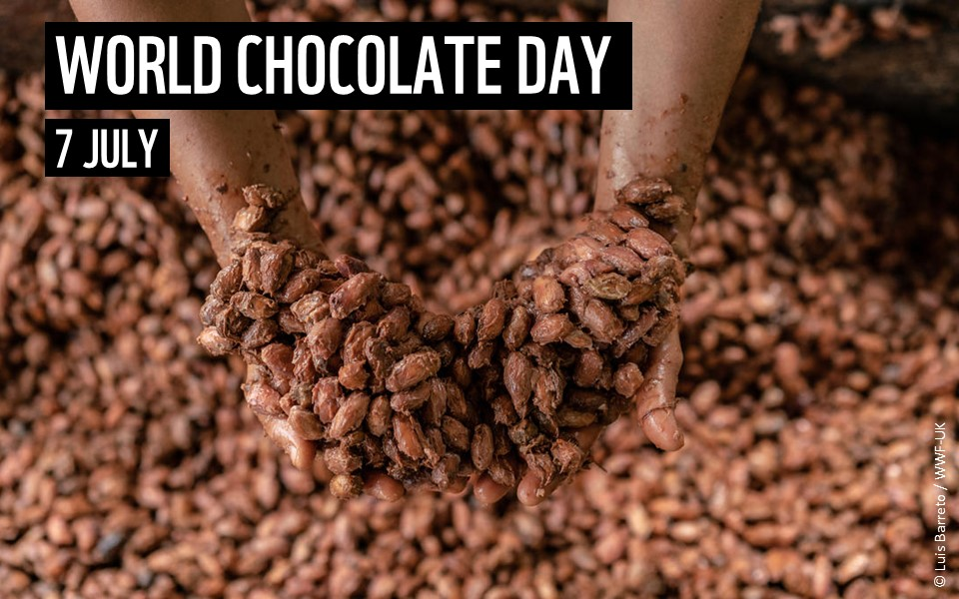
Notes:
At least 2,000 years ago, people in South and Central America began farming the cocoa tree for its dark, bitter beans, which they brewed into a drink spiced with hot peppers.
Today, we blend these cocoa beans with sugar and sometimes milk and we call it chocolate and its one of the UK favourite foods!
Around 70% of the world’s cocoa beans are now grown in West Africa mainly in the countries of Côte d’Ivoire and Ghana.
Climate change is causing unpredictable weather and higher temperatures in West Africa as well as longer dry spells. That’s not good news for local cocoa farmers as cocoa trees are sensitive to heat and drought.
On average, cocoa farmers earn just 6% of the final value of a bar of chocolate. These poor returns have resulted in younger generations choosing careers outside of farming, which threatens the future of cocoa.
Sometimes tropical forests are cleared to plant new cocoa trees rather than reusing the same land. That practice has increased deforestation in West Africa, particularly in Côte d’Ivoire.
Discussion points
How does deforestation affect wildlife?
What would happen if cocoa continued to become more difficult to grow in West Africa?
What logos can you look out for when buying chocolate products to make sure they are sustainable and giving the famers a fair wage?
Further resources
How is our food causing deforestation? Video: https://www.youtube.com/watch?v=iWWsstJLTuE
Our forests and jungles resources: https://www.wwf.org.uk/get-involved/schools/our-planet

Slide 19
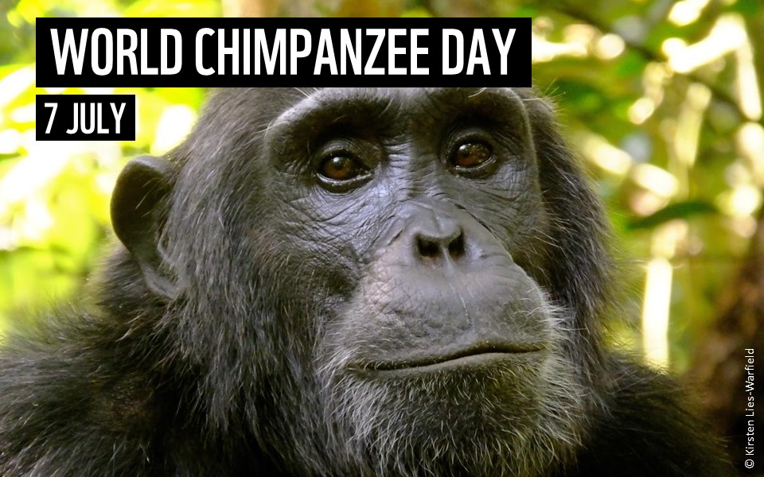
Notes:
Like us, chimps are highly social animals, care for their offspring for years and can live to be over 50.
Chimpanzees are our closest animal relatives; we share about 98% of our genes with chimps.
In their habitat in the forests of Central Africa, chimpanzees spend most of their days in the treetops. When they do come down to earth, chimps usually travel on all fours, though they can walk on their legs like humans for as far as a mile.
Chimps are omnivores and survive on a diet of ripe fruits, young leaves, stems, roots, seeds, bark and insects.
Chimpanzees use sticks to poke termites out of mounds and bunches of leaves as cups to collect drinking water.
Chimps used to be found in 25 countries in Africa but are now only found in four.
Discussion points?
Lots of chimpanzee habitats are being cut down in order to make space for farming. Why is this a problem for Chimpanzees? (loss of habitat, loss of fruit trees for food)
Poaching is another prominent threat. Bushmeat has always been a primary food source in Central and West Africa, but in recent years poaching has become commercialized to satisfy the appetites of wealthy urban residents. Infant chimpanzees are frequently taken alive and sold in cities as pets.
Further resources:
Our forests and jungles resources: https://www.wwf.org.uk/get-involved/schools/our-planet

Slide 20
Notes:
Young lions have circular patterns called rosettes and spots on their sandy coats, but these generally disappear as they get older.
Male lions grow impressive manes the older they get. These manes grow up to 16cm long and are a sign of dominance. The older they get, the darker their manes go.
Lions can live in very dry areas like the Kalahari Desert. Here they get most of their water from their prey and will even drink from plants such as the Tsamma melon.
Lions do most of their hunting at night as their eyes have adapted to the dark. They hunt more during storms as the noise and wind make it harder for prey to see and hear them.
There are thought to be as few as 23,000 lions left in the wild. When you think there are around 415,000 wild African elephants, you realise lion numbers are incredibly low.
Discussion points
When lions come into contact with human communities and might end up being shot or poisoned. One solution to helping lion populations is for farmers to paint big eyes on the backsides of their cattle. How do you think this might help the lion populations?
(The lions like to sneak up on animals from behind but they can’t attack the cattle as they think the cattle are watching them from behind. This mean that lions don’t come into human communities anymore to find food and there is much lower risk of human-lion conflict)
Further resources
Land for Life classroom resources: https://www.wwf.org.uk/schools/landforlife
Top lion facts video: https://www.youtube.com/watch?v=WA3q1x6aCTE&list=RDCMUCOFPJWr7NVoDuwGPOh3MdbQ&index=10
Adopt a lion: https://support.wwf.org.uk/adoptions

Slide 21
Notes:
The African elephant is the world's largest land mammal – with males on average measuring up to 3m high and weighing up to 6 tonnes.
Elephants keep their skin clean and protect themselves from sunburn by taking regular dust and mud baths.
Elephants have around 150,000 muscle units in their trunk. They can use their trunks for eating, drinking and even as a snorkel when swimming.
Elephant tusks are actually enlarged incisor teeth which first appear when elephants are around 2 years old. Elephant tusks continue growing throughout their lives.
An elephant’s skin is 2.5cm thick in most places. The folds and wrinkles in their skin can retain up to 10 times more water than flat skin does, which helps to cool them down.
Elephants are at risk from habitat loss, human-wildlife conflict and poaching for ivory.
Discussion point
Elephants can be dangerous if they enter human communities or farmland areas. They can damage buildings and water containers, injure people and eat huge amounts of crops. To try and keep elephants away from villages sometimes people plant chilli pepper plants around their farmland. How could this keep elephants away? (too spicy for elephants so deters them!)
Further resources
Top facts about elephants video: https://www.youtube.com/watch?v=WA3q1x6aCTE&list=RDCMUCOFPJWr7NVoDuwGPOh3MdbQ&index=10
David Leto elephant ranger video: https://www.youtube.com/watch?v=U81bitC4AwA
Land for life classroom resources: https://www.wwf.org.uk/schools/landforlife
Adopt an elephant: https://support.wwf.org.uk/adoptions

Slide 22
Notes:
There are three species of Orangutan - the Bornean, the Sumatran and the Tapanuli.
These great apes are only found in the wild on the islands of Borneo and Sumatra in Indonesia.
Orangutans make a nest every night by pulling several large branches together, using smaller branches for a mattress and binding it all together with flexible branches. In wet weather, they sometimes add a roof!
Some Sumatran orangutans use tools - like sticks to get termites, ants or bees out of tree holes. These clever creatures have also been observed making a 'glove' out of leaves when handling prickly fruits or thorny branches.
Orangutans have an arm span of about 2.2 m from fingertip to fingertip. Their arms are so long they stretch to their ankles when standing!
Young orangutans stay with their mother until they are around 7 years old. Young orangutans piggy-back on their mothers and sleep in their nests until they develop enough skills to survive on their own.
Discussion points
Unsustainable palm oil is a huge threat to many animals but especially orangutans, why do you think this is? (habitat loss and fragmentation, loss of homes, food source, more contact with humans)
The good news is that we can produce palm oil sustainably - protecting species like the orangutan - if we make sure that it is deforestation free. This means planting on already damaged or used land rather than replacing jungle with oil palm. As consumers, we can fight to only buy sustainable palm oil. Just avoiding palm oil isn’t the answer; demanding more action is!
Further resources
Top facts about orangutans: https://www.youtube.com/watch?v=uPB2AcuekpI
Sounds of the Bornean jungle (hour long nature soundtrack) https://www.youtube.com/watch?v=q1PlNww4c20
Our Forests and Jungles resources: https://www.wwf.org.uk/get-involved/schools/our-planet

Slide 23
Notes:
There are 5 species of rhino – Black, White, Greater One-Horned, Sumatran and Javan.
Black and White rhinos are from Africa and Greater One-Horned, Sumatran and Javan rhinos are from Asia.
The Black, Sumatran and Javan rhinos are all are critically endangered.
Rhino horn is made up of keratin - the same stuff which our hair and nails are made from.
Male rhinos are called bulls and females are called cows. Baby rhinos are called calves. Together, a group of rhinos is called a ‘crash’.
Discussion points:
Why are rhinos endangered?
Rhinos are endangered largely due to poaching for rhino horn. Ground up rhino horn used in traditional Asian medicines. Rhino horn is also seen as a status symbol particularly in Vietnam. Habitat loss due to expanding human towns and villages is another threat to rhinos.
Further resources
Top facts about rhinos video: https://www.youtube.com/watch?v=miSL3yX28fc
Adopt a rhino: https://support.wwf.org.uk/adoptions

Slide 24
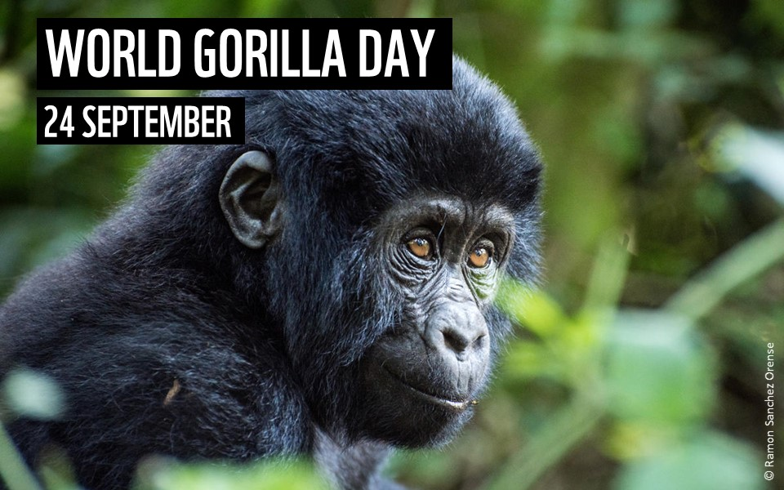
Notes:
Mountain gorillas live in just two groups in east Africa – one group in the Virunga Volcanoes (a region spanning 3 national parks in Uganda, Rwanda and Democratic Republic of Congo (DRC)) and one in Bwindi Impenetrable National Park in Uganda and DRC.
They’re found in mountain areas and bamboo forests, which are surrounded by farms and settlements.
Male gorillas between 8-12 years are called 'blackbacks'. Then from 12 years old, they develop a silver section of hair over their back and hips, earning them the name 'silverback’.
Mountain gorillas spend about a quarter of their day eating mainly leaves and shoots, but have also been known to eat snails, ants and bark (a good source of sodium).
At night, mountain gorilla groups sleep together in nests on the ground, or in trees, that they make from foliage. Infants will share their mother’s nests, staying safe and warm.
Most mountain gorillas live in family groups of around 10 individuals. There is usually one dominant male and several females. Both males and females in the group care for their infants; hugging, carrying and playing with them.
Mountain gorillas are endangered - there are an estimated 1,063 in the wild according to the latest census results.
Discussion points
As human populations grow in Uganda, Rwanda and the Democratic Republic of Congo, the forest land the gorillas need is being turned into farmland. How do you think this impacts mountain gorillas? (less space, less opportunity to find food, more contact with human communities which could end up in gorillas being injured or lead to spread of disease from humans to gorillas)
Further resources:
Top facts about gorillas: https://www.youtube.com/watch?v=hn4zvN93QUA&list=RDCMUCOFPJWr7NVoDuwGPOh3MdbQ&index=9
Adopt a gorilla: https://support.wwf.org.uk/adoptions

Slide 25
Notes:
Snow leopards live high in the mountains at elevations of 3,000-4,500m. Having short forelimbs and long hind legs helps them move around in their steep and rocky environment.
Snow leopard fur keeps them warm in freezing cold weather - it can be 5cm long on their back and sides and almost 12cm long on their belly. They also wrap their tales around themselves for added warmth.
Unlike other big cats, snow leopards can't roar. Snow leopards have a call that sounds like a 'piercing yowl'. It's so loud it can be heard over the roar of a mountain river.
Despite being called the snow 'leopard', this big cat is more closely related to the tiger than the leopard.
Snow leopards' wide, fur-covered feet act as natural snowshoes - helping distribute their weight over soft snow and protecting them from the cold.
Discussion points
As temperatures on Earth increase, snow leopards snowy habitats are shrinking. This brings them in closer contact with human communities. How might this impact snow leopards? (more likely to prey on livestock animals causing conflict between snow leopards and humans)
Further resources:
Top facts about snow leopards: https://www.youtube.com/watch?v=UozM1q-sNm4
Adopt a snow leopard: https://support.wwf.org.uk/adoptions

Slide 26
Notes:
There are two types of walrus the Atlantic and the Pacific. They both live in different areas of the Arctic.
Both male and female walrus have tusks. They use their tusks to help them haul themselves out of the water, to fight with other walrus and as defence against predators.
Mother walrus are very protective of their calves. A mother will pick a calf up with her flippers and hold it to her chest if it’s threatened, diving into the water with it to escape predators.
Walrus seem to prefer feeding at the bottom of shallow waters, eating clams, molluscs, worms, snails, soft shell crabs, shrimp and sea cucumbers.
Male Pacific walruses can reach 3.6 m long and weigh over 1,500kg - that's more than the weight of a car!
The greatest threat to walrus is climate change. Walrus rely on the Arctic sea ice for feeding and for breeding but warmer temperatures are causing the Arctic sea ice to melt more and more each year.
Walrus from Space:
Walrus from Space is a project run by WWF and the British Antarctic Survey. It is asking members of the public to become ‘Walrus Detectives’ to help search through thousands of satellite images taken from space to see if they can spot any walrus. Walrus from Space will be running for five years and provides a unique opportunity for schools to get involved in a real-life conservation citizen science project. Data gathered from the project will go towards improving our understanding of walrus, help scientists spot changes over time and help us to work out how best to help these wonderful creatures.
Further resources
Walrus from Space classroom resource https://www.wwf.org.uk/get-involved/schools/resources
Top facts about walrus video: https://www.youtube.com/watch?v=JrRKqpCMwVQ&t=1s
Walrus from space video: https://www.youtube.com/watch?v=qTg5oircxrw&t=2s

Slide 27
Notes:
The jaguar is the third biggest cat in the world - after the tiger and the lion. They can grow up to 170cm long, not including their impressive tails which can be up to 80cm.
Jaguars have black dots in the middle of some of their rosettes (circular markings), whereas leopards don’t. Jaguars also have larger, rounded heads and short legs.
Jaguars can appear almost black and we call this 'melanistic'. Melanistic jaguars (and leopards) are known as black panthers.
Unlike many domestic cats, jaguars don’t avoid water. They often live near lakes, rivers and wetlands, and are excellent swimmers, known to swim across large rivers.
Jaguars can prey upon almost anything they come across. Capybaras, deer, tortoises, iguanas, armadillos, fish, birds and monkeys are just some of the prey that jaguars eat. They can even tackle South America’s largest animal, the tapir, and huge predators like caiman!
Almost 90% of all the world’s jaguars live in the Amazon rainforest. To protect their home, we need to help Indigenous peoples defend theirs.
Discussion point
One problem for jaguars is habitat fragmentation, this is when their habitats are split up into smaller and smaller areas by deforestation. Why might this be a problem for jaguars? (smaller habitat, means less prey animals, smaller areas cannot support as many jaguars as they don’t have enough food to eat)
Further resources:
Top facts about jaguars: https://www.youtube.com/watch?v=DHmDOJrNE0M
Adopt a jaguar: https://support.wwf.org.uk/adoptions
Our Forests and Jungles resources: https://www.wwf.org.uk/get-involved/schools/our-planet

Slide 28
Notes:
The Living Planet Report is produced every two years by WWF and is a health-check for the planet, showing how the natural world is doing, what threats it faces and what this means for us humans.
Our latest Living Planet Report in 2020 tells us that wildlife populations globally have sadly declined by 68% since 1970.
For 60 years, WWF have been fighting for a future where people and wildlife thrive but there’s still a lot more to be done.
Tigers
There are only around 3,900 tigers left in the wild.
Since the beginning of the 20th century, we’ve lost over 95% of the world’s wild tiger population.
Tigers naturally travel great distances to find new territory, but with expanding human settlements and shrinking tiger habitat, tigers are increasingly likely to come into contact and conflict with people.
However, there have been successes in tiger conservation. Tigers in Russia have made a spectacular comeback since the 1930s, when the population fell as low as 20–30 animals. WWF are working with governments and local partners to help recover and double the wild tiger population to over 6,000 by 2022 for the Chinese year of the tiger.
Pandas
There are around 1,860 giant pandas left in the wild.
After decades of being listed as endangered, in 2016 they were reclassified as ‘vulnerable’. This is a major step in giant panda conservation, but there’s still work to do.
WWF are working with the Chinese Government and local partners to protect vital panda habitat and create wildlife corridors to reconnect isolated panda populations.
WWF have planted over 500 hectares of bamboo forest, removed over 15,000 metres of artificial fences and helped local communities to develop sustainable livelihoods.
Mountain Gorillas
There are only an estimated 1,063 mountain gorillas left on our planet.
Today they can be found living in just two isolated populations across national parks in Uganda, Rwanda and the Democratic Republic of Congo.
he International Gorilla Conservation Programme (IGCP) is a partnership of a few organisations including WWF. The IGCP works to protect this iconic animal by working with local communities to ensure that they benefit from conservation efforts, which helps improve attitudes to mountain gorilla conservation.
The IGCP also supports monitoring of the mountain gorilla populations that we have left to ensure that populations are healthy and have the best chance of maintaining numbers.
Black Rhino
It's estimated that there are just over 5,000 black rhinos left in the wild.
They are critically endangered and 98% of their population is found in just four countries: South Africa, Namibia, Kenya and Zimbabwe.
High prices for rhino horn have driven demand and in turn poaching levels. Between 2013 and 2015 poaching more than doubled.
But there is hope. In the early 1990s there were less than 2,500 individuals left, but their numbers have been steadily increasing since 1995. WWF are working to get stronger law enforcement in relation to the illegal rhino horn trade in countries with black rhinos and in countries where the rhino horn is a precious material.
Discussion points:
What impacts do humans have on our wildlife around the world?
Why is it important to stand up for wildlife?
What actions could you take to help protect your local wildlife?
Further resources:
Living planet report: https://www.wwf.org.uk/get-involved/schools/living-planet-report
Living planet report video: https://www.youtube.com/watch?v=YiTb08jf7vU
Our planet resources: https://www.wwf.org.uk/get-involved/schools/our-planet
Our Planet full episodes, free on YouTube: https://www.youtube.com/watch?v=aETNYyrqNYE&list=PL7rb3uMaYmjHqT_JUcQYCBa4nEtfDKuSa

