Slide 1
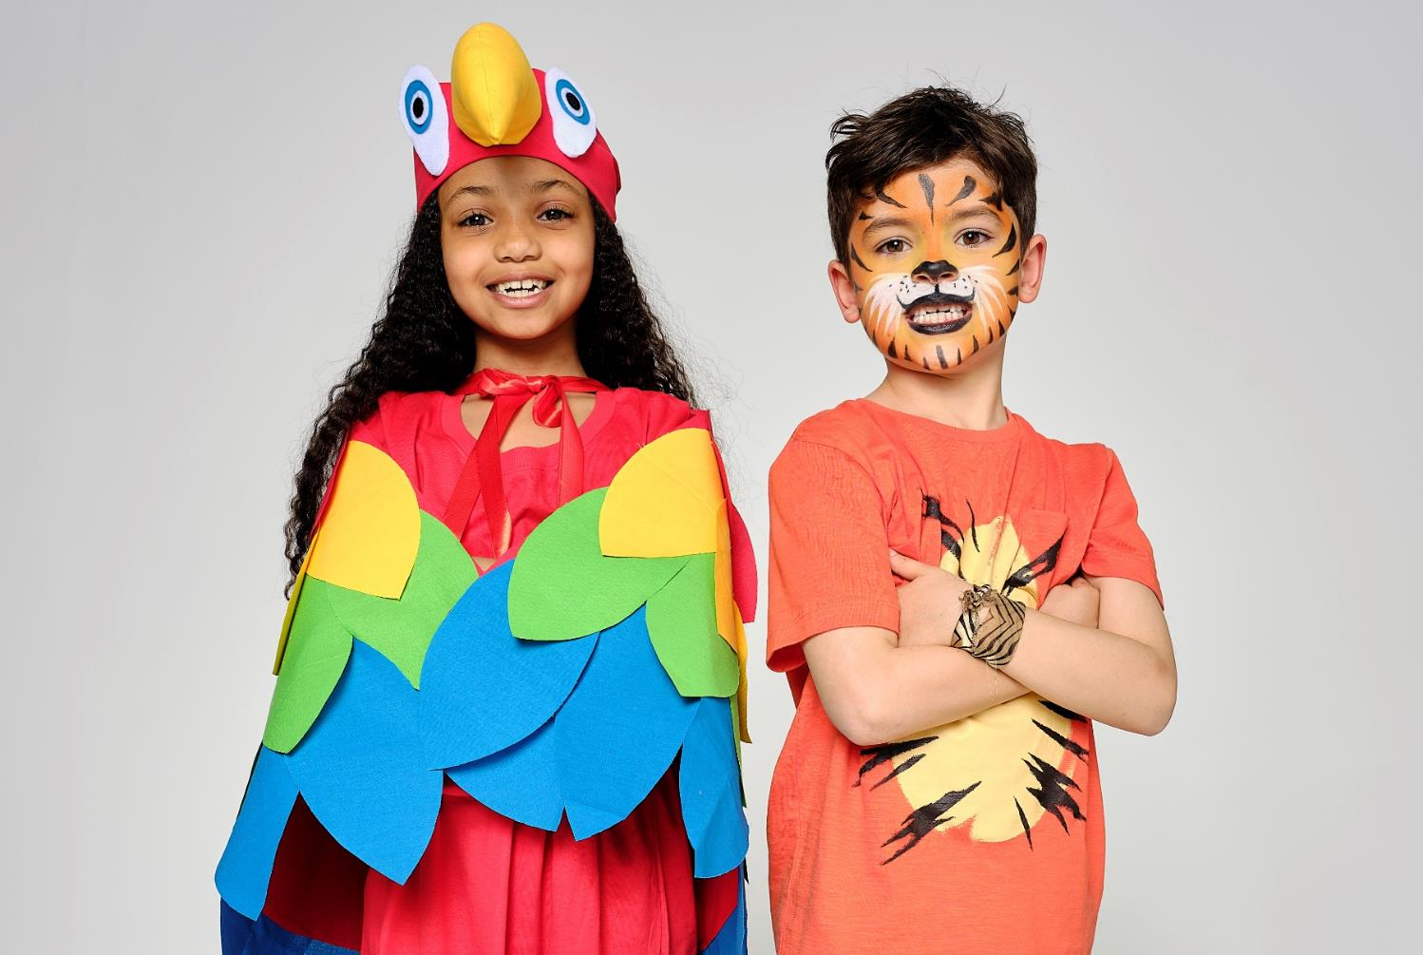
WEAR IT WILD ASSEMBLY

Slide 2
WHAT IS WEAR IT WILD?
Wear it Wild is WWF’s annual fundraising event.
In workplaces, schools and homes across the country, people will be wearing an item of wildlife-inspired fancy dress to raise funds, raise awareness and have grrrrrreat fun too!
The funds raised will help protect our amazing world and it’s wildlife: like elephants, rhinos and tigers.

Slide 3
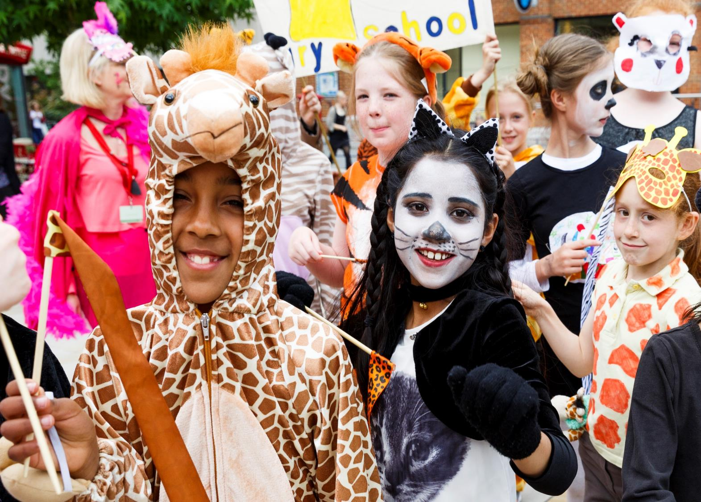
Notes:
© Tristan Fewings/WWF.

Slide 4
WHY IS WWF DOING THIS?
Watch our short film One Planet Future to find out more……
https://youtu.be/t2A24Osp_2s
Notes:
Ask pupils to watch the film closely

Slide 5
WHY IS WWF DOING THIS?
Around the world, we have lost 68% of our wildlife populations since 1970.
95% of wild tigers have disappeared since the start of the 20th century leaving around just 3,900.
Over 7,100 African rhinos have been killed by poaching in the last 10 years.

Slide 6
TAKING PART IN WEAR IT WILD
By taking part in Wear it Wild, you’ll be helping WWF to protect some of our amazing wildlife, such as:
Giant pandas
Tigers
Rhinos
Polar bears
Lions

Slide 7
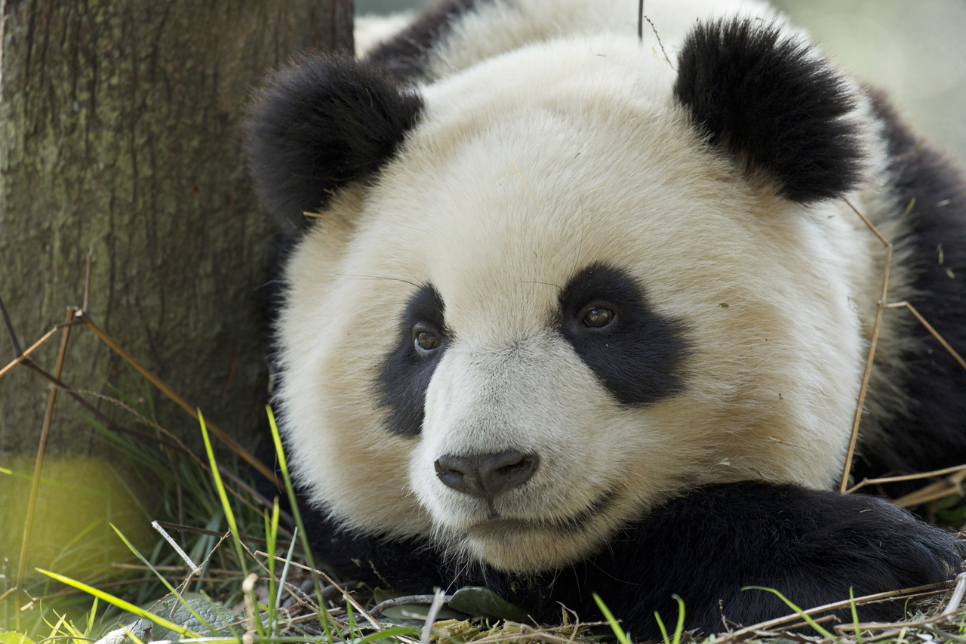
Notes:
© Naturepl.com Andy Rouse/WWF.

Slide 8
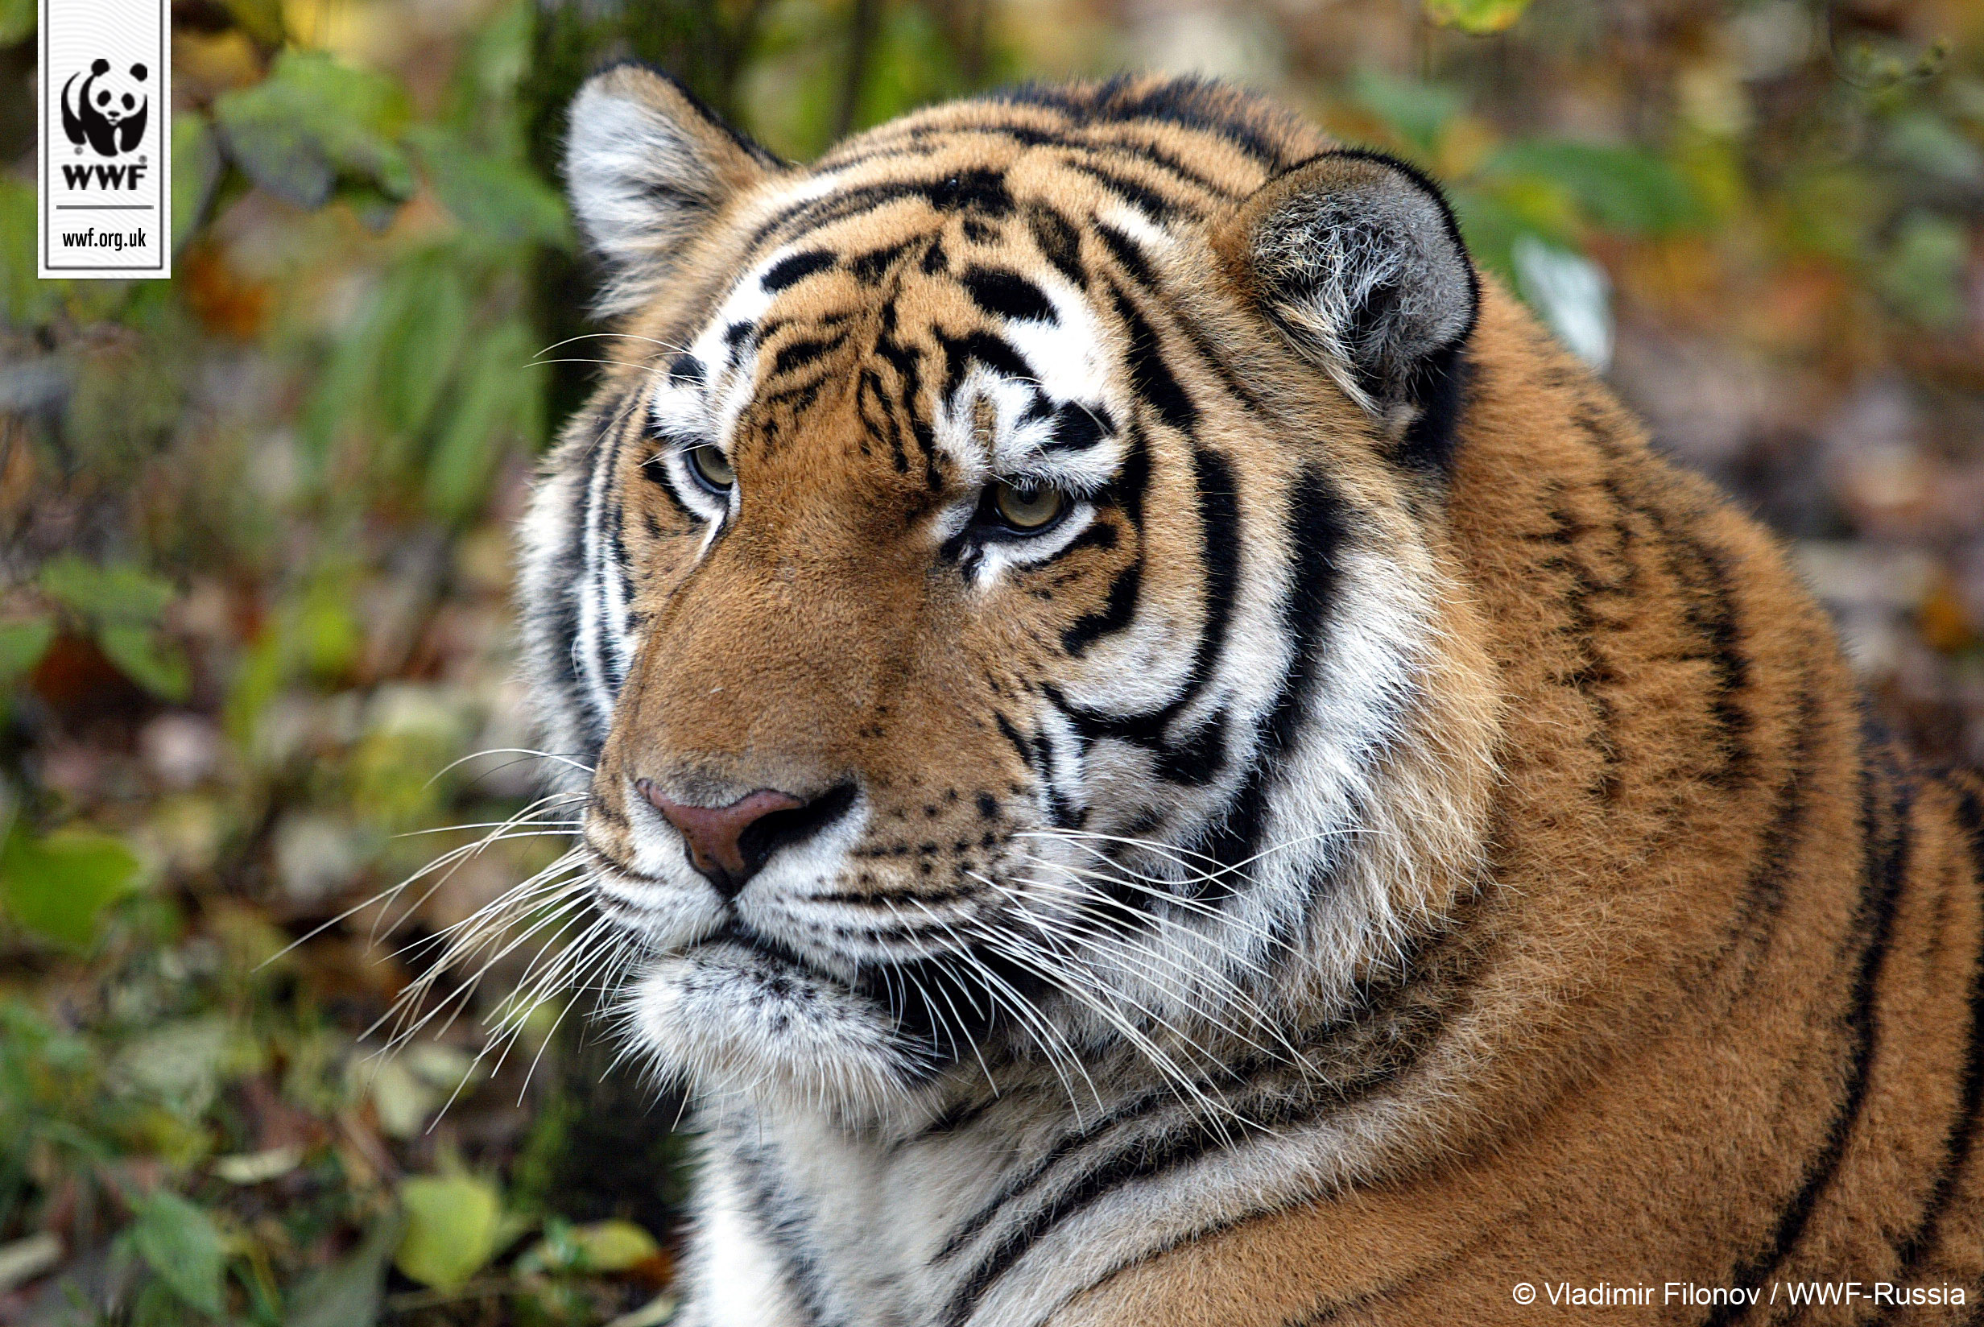
Notes:
© Naturepl.com Andy Rouse/WWF

Slide 9
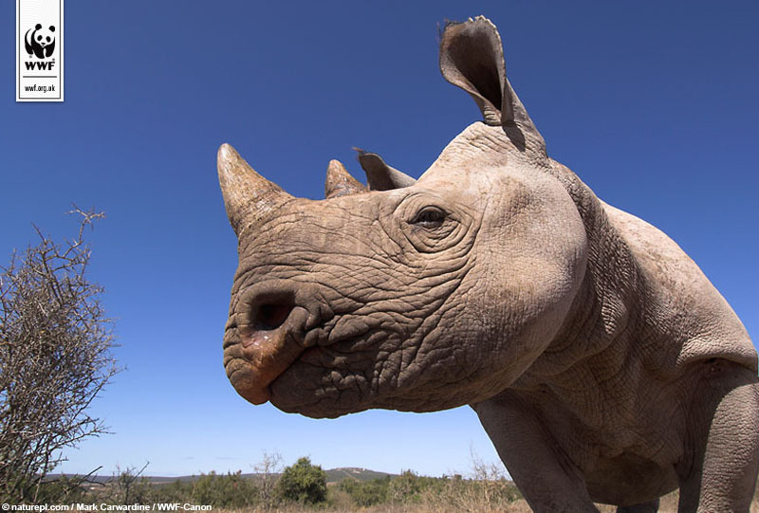

Slide 10
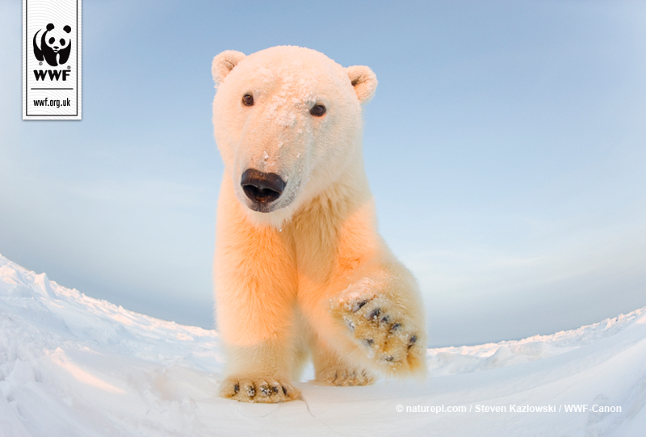

Slide 11
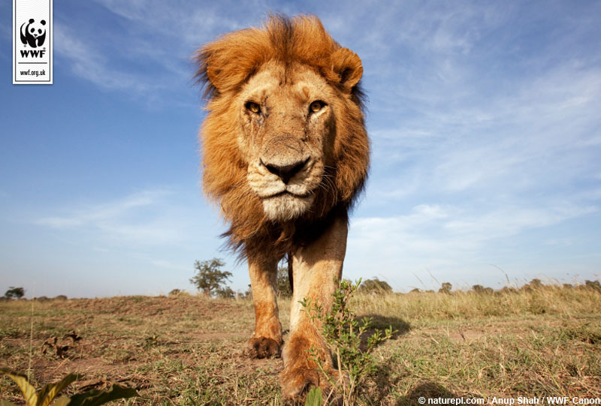

Slide 12
IDEAS TO WEAR IT WILD
Here’s some ideas of what you can do to have a really wild day:
Face-painting
Create Wear it Wild masks
Dress up in Wear it Wild outfits
Organise a Wear it Wild cake sale
Animal Olympics!
What else can you think of?

Slide 13
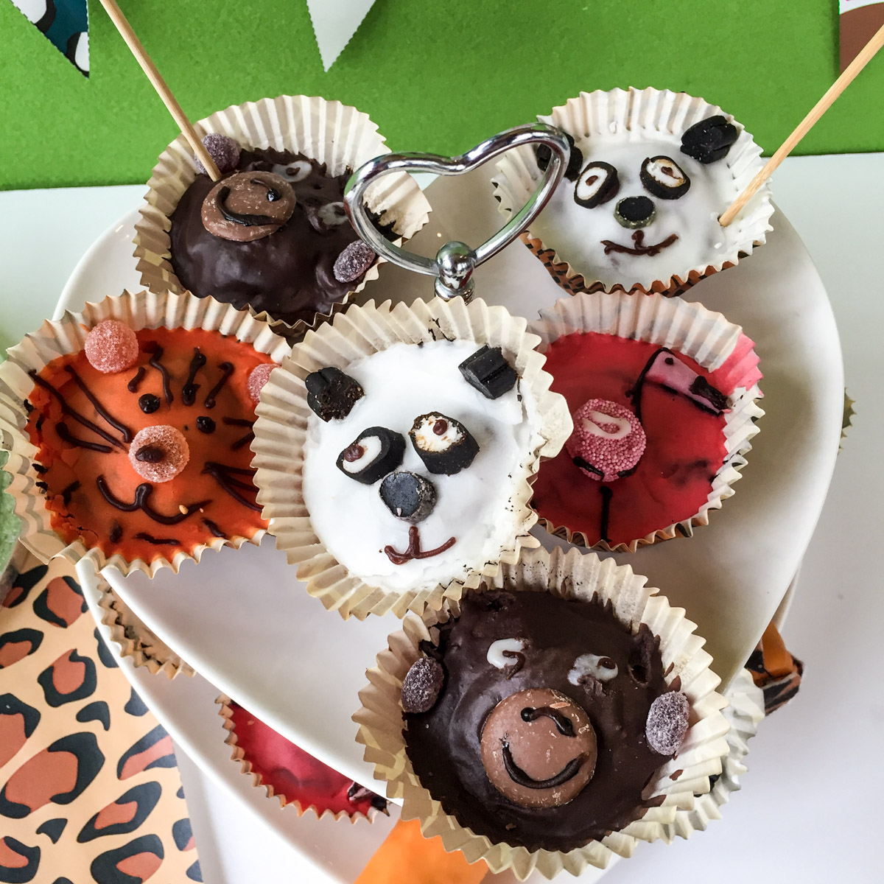

Slide 14
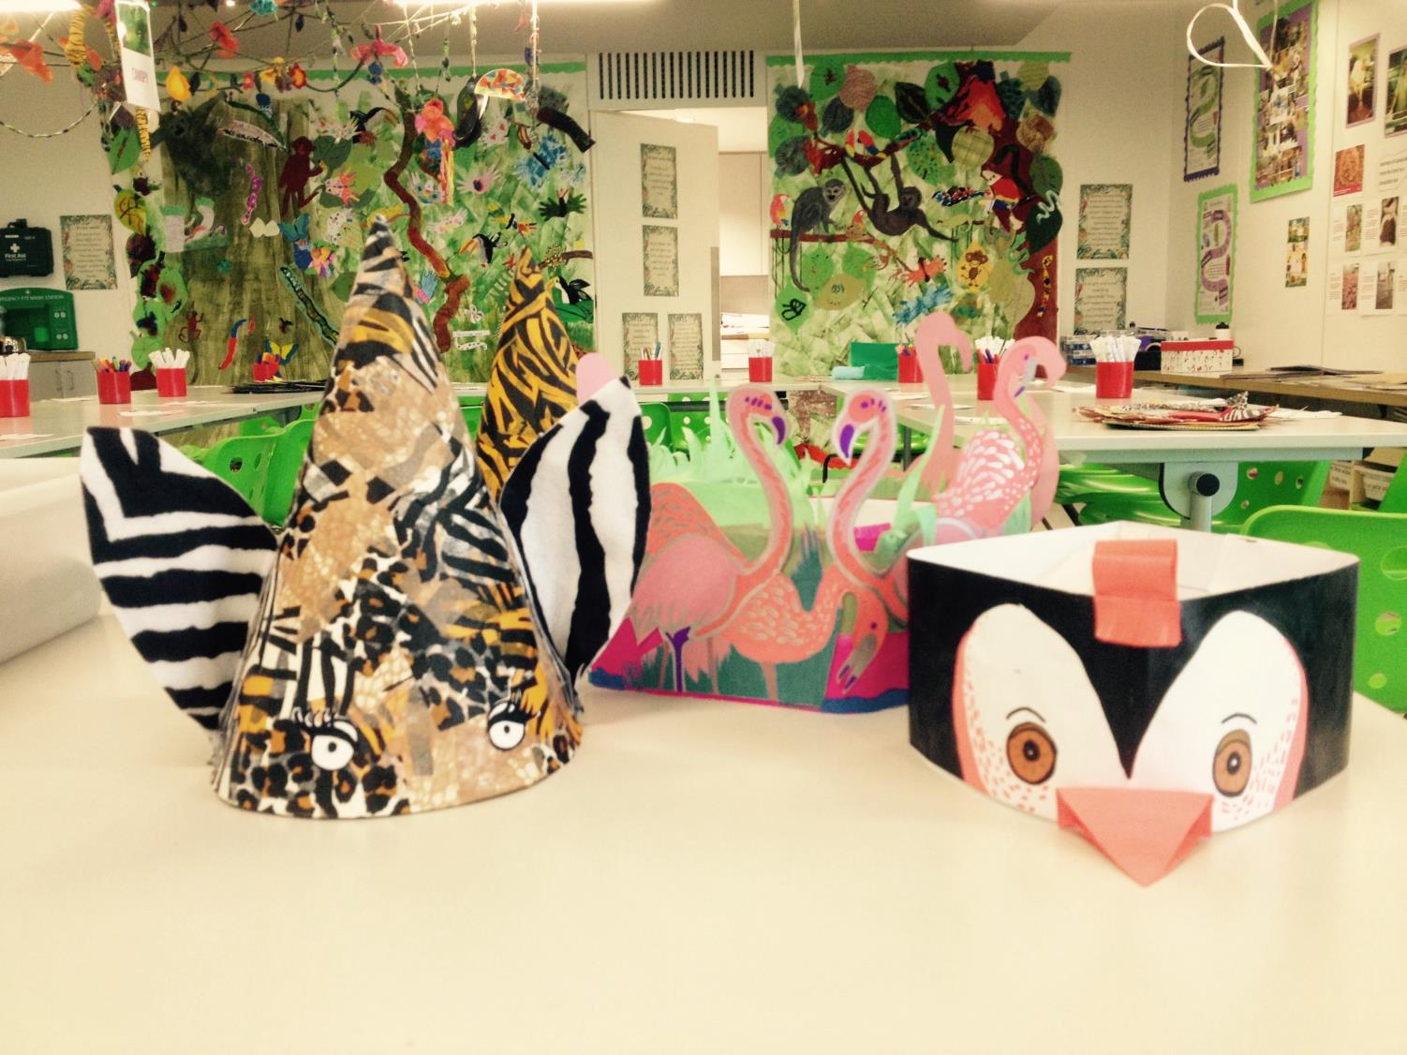

Slide 15
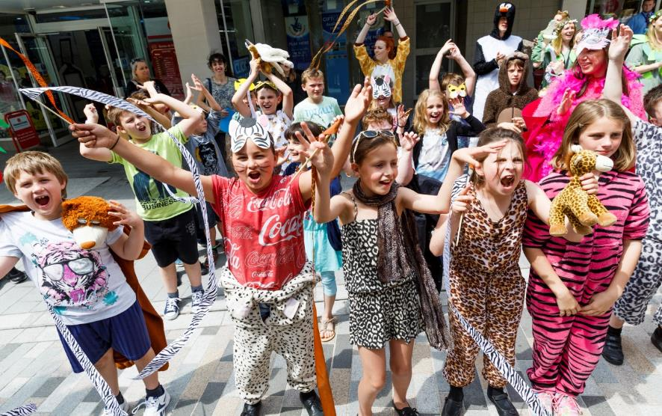
THANK YOU!
Thank you for taking part in Wear it Wild. Your kind support means a lot to us and we hope you all have a GRRRRRREAT Wear it Wild day!
Notes:
© Tristan Fewings/WWF.

