Slide 1
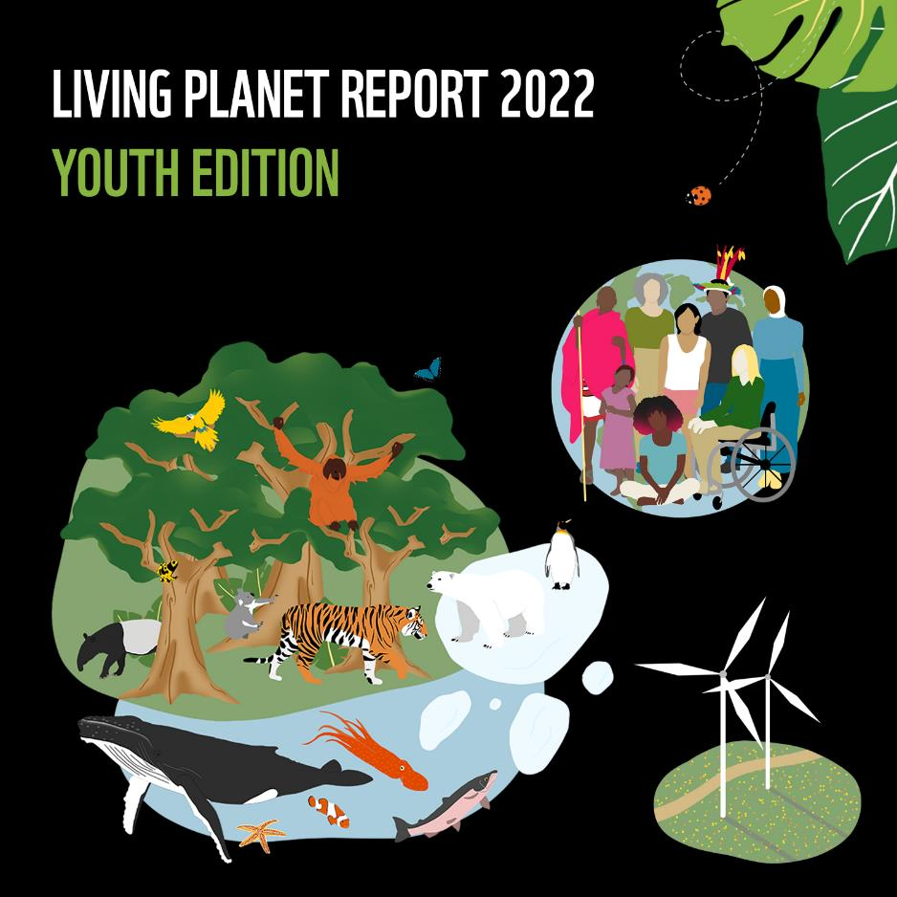
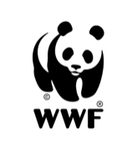
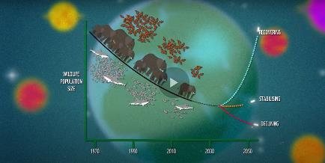
The LPR is published every two years by WWF and the Zoological Society of London (ZSL).
It is a health-check for the planet, showing how the natural world is doing, what threats it faces, and what this means for us humans.
PLAY
VIDEO
Notes:
The Living Planet Report (LPR) is produced every two years by WWF, with input from leading experts and other organisations.
It is a health-check for the planet, showing how the natural world is doing, what threats it faces and what this means for us humans.
The conclusions and recommendations in the LPR are based on an analysis of several measures of biodiversity, one of the biggest being the Living Planet Index (LPI).
The world works like a living system – all the different living processes result in there being the conditions that we are used to – and that allowed humans to evolve and thrive. The planet is one living system in the same way our body is – which is itself made up of different kinds of living systems such as our organs or the tiny organisms that perform services to our body.
Living systems (eg biomes such as ocean, freshwater or jungle) have lots of parts that need to work together for the whole thing to play its part in the global system.
EG role of jungles in freshwater cycle and movement of freshwater around the world. Oceans – role in cloud formation and carbon capture.
In both cases, all the different living parts of the system (the different species and individual creatures and plants) rely on each other, so changes to the species present or population sizes of species can change the whole system and make it fail or function differently.

Slide 2
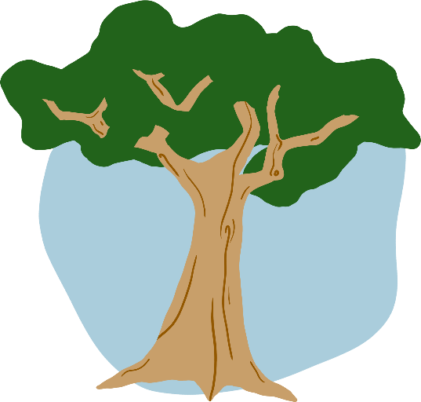
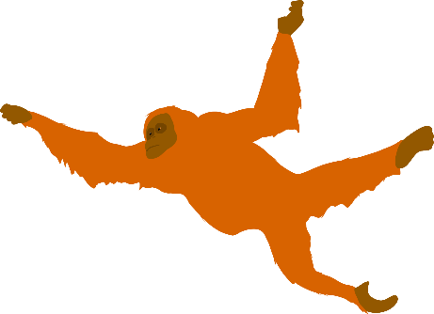
Glossary of key terms
Biodiversity: all the different living things found in an area.
Ecosystems are communities of living and non-living things in an environment. All parts of an ecosystem are connected and these connections are essential for life on Earth. Ecosystems can be studied at different scales – for example you could consider the ecosystem of a small pond, of the whole ocean, or even of the planet.
When an ecosystem has a lot of biodiversity it is usually more resilient to change or problems, because there are so many connections and relationships that each living thing is more likely to find another way to cope if one of these is lost or damaged.

Slide 3
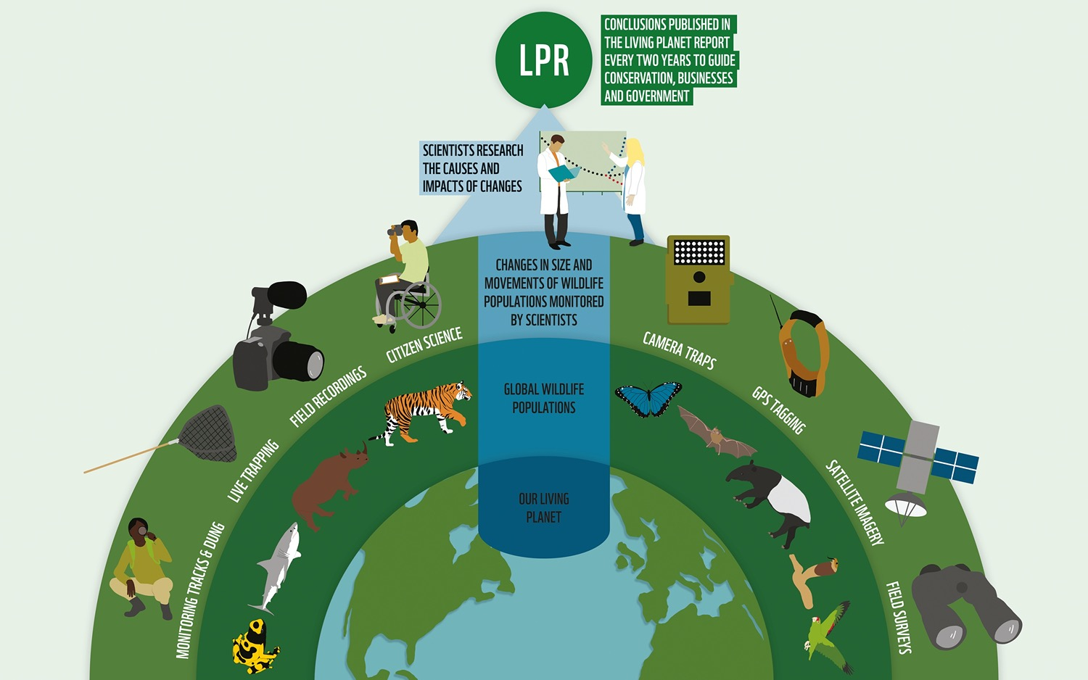
What is the Living
Planet Index (LPI)?
Notes:
In the Living Planet Report our planet’s biodiversity (variety of all living things) is calculated using a measurement called the Living Planet Index (LPI).
ZSL scientists all around the world collect and analyse data to calculate the LPI.
The Living Planet Index measures the differences in animal populations (groups of the same animals) across the world using information gathered from satellite images, animal trapping, camera traps, GPS tracking and even motioning animal dung!
The populations that are monitored for the LPI are chosen because scientists can tell a lot about how the wider ecosystem is doing by the changes in numbers and movement of those species.
Experts all over the world have been measuring changes over time in the populations of thousands of animal species. Scientists bring all of this data together into a database and analyse it to come up with the Living Planet Index (LPI).
The LPI only uses data for species that have been monitored at least twice at any time since 1970, which is considered the baseline year. Even so, the LPI is able to track changes in almost 32,000 populations of 5,230 species including mammals, birds, reptiles, amphibians and fish. The patterns that scientists find in these data help them to understand the health of the wider ecosystems.
The LPI (and some other measures of biodiversity) is then studied by scientists from WWF and ZSL to draw conclusions that can guide our next steps, and these are published in the Living Planet Report every two years.

Slide 4
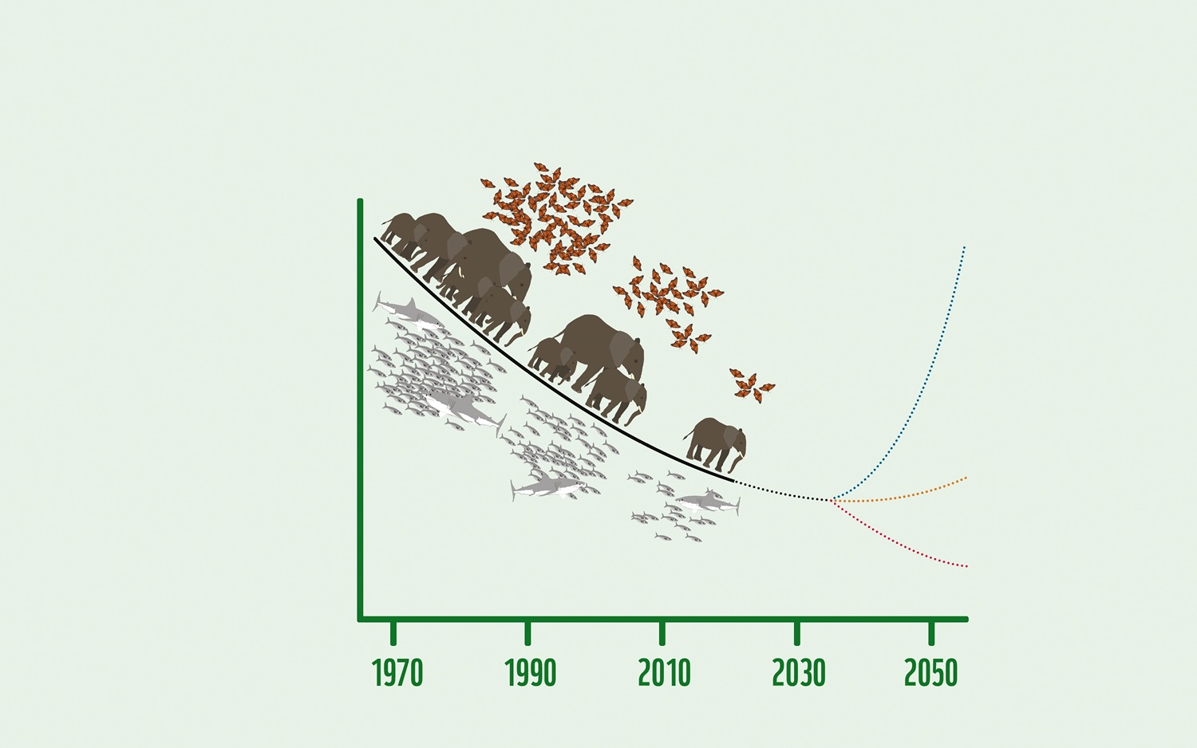
How can we bend the curve?
Wildlife
population size
Recovering
69%
decline in average population size in global wildlife populations since 1970.
Stabilising
Declining
Notes:
This is a graph showing the Living Planet Index for 2022, and three possible ways that the graph could look in the future.
The LPI shows that, globally, the average population size of mammals, fish, birds, reptiles and amphibians has declined by 69%
since 1970.
Ask students why they think this is happening? What could be the causes? (If too big a class / too difficult to get questions just continue)
Possible causes: habitat destruction, poaching, over-fishing, pesticides, pollution
If we change nothing about the way we treat the natural world, the red line will be the path that we follow over the next decades – and we will continue to lose more and more of our planet’s biodiversity. The more we lose, the less resilient the ecosystems that support life, and it becomes less and less likely that we can ever recover what we lose.
If we take action to protect habitats and stop practices that damage the natural world we could follow the orange line and ‘stabilise’ biodiversity on our planet. This means we stop the decline in wildlife populations, and keep them at their current levels, possibly by taking less from the natural world. This would be better for the planet, though it might mean we struggle to feed our growing human population, and we would be living on a planet that has far less biodiversity than it had just a few decades ago - and as a result is much less resilient than it was. Problems such as climate change could cause major issues for us and wildlife in the near future.
If we change our systems and find new ways to benefit from the planet’s natural resources in a way that works with nature rather than just taking from it, we may be able to restore lost biodiversity and bend the curve upwards (the blue line on the graph). This would allow us to bring wildlife populations back up to previous levels, making them more resilient to future threats, and helping us tackle climate change.
Ask students what changes they think we might mean when we talk about changing ‘systems’?
Possible answers: Food, transport, energy, economy
Our food system currently works in a way that leads to waste, carbon emissions that speed up climate change, and destruction of habitats.
In fact, globally, agriculture and land use for food production are responsible for almost 60% of biodiversity loss and 30% of greenhouse gas emissions – making it one of the biggest threats to our environment.
Ask students if they can think of problems with the food system that could be changed.
Possible answers: Cutting down rainforest to make farmland instead of using existing farmland better so it doesn’t become degraded. Transporting food all around the world instead of eating what is produced locally. Using pesticides and fertilisers that harm wildlife. Producing too much dairy and meat which takes huge amounts of land compared to plants that can be more of our diet.

Slide 5
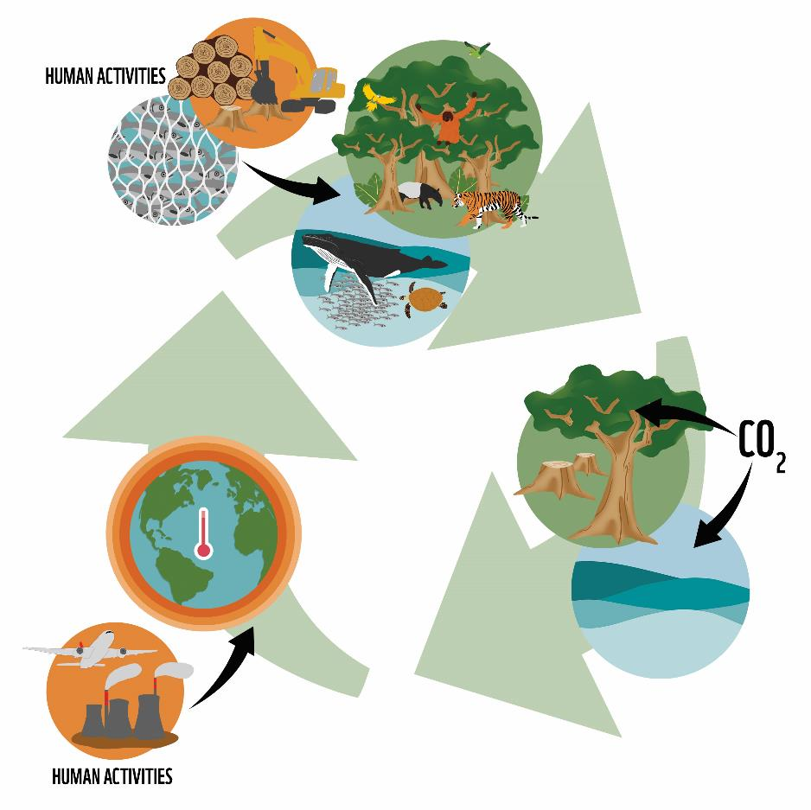
Climate and Nature
Human activities damage ecosystems
The global double emergency
Climate change is talked about more than the loss of wildlife and habitats, but these two crises are strongly connected.
Rapid climate change threatens ecosystems
Weakened ecosystems absorb less carbon
Notes:
Climate change is talked about more than loss of biodiversity – but we need biodiversity to stabilise the climate.
Forests and oceans cannot do their bit to absorb carbon if we destroy biodiversity.
The damage that is being caused to the natural world by habitat destruction is making our planet less able to draw carbon from the atmosphere, and in many cases releases more carbon that was previously stored as wood or in the soil. This means that more carbon dioxide enters the atmosphere and speeds up global warming.
Climate change is already starting to have effects in the natural world, and if the average increase in global temperature is allowed to go above 1.5 degrees, climate change will become a greater and greater threat to wildlife.
We cannot solve either of these two problems unless we address both together.

Slide 6
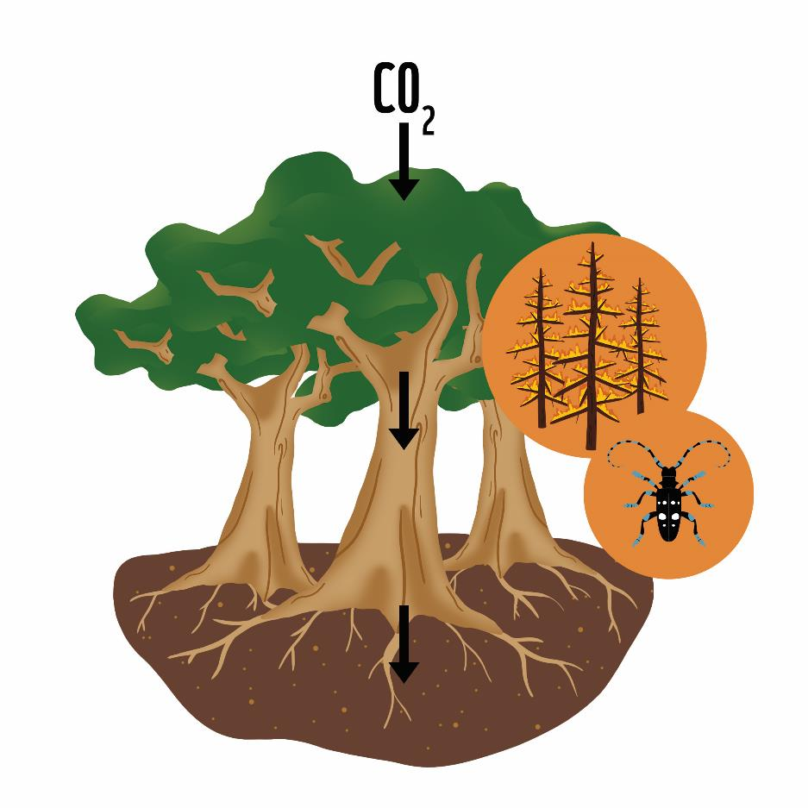
Climate and Nature
Forests
Healthy forests draw carbon from the atmosphere as CO2,
and lock it into trees and soil.
Climate change increases the risks from forest fires and
invasive pests, which are especially damaging for forests that are fragmented by human activities.

Slide 7
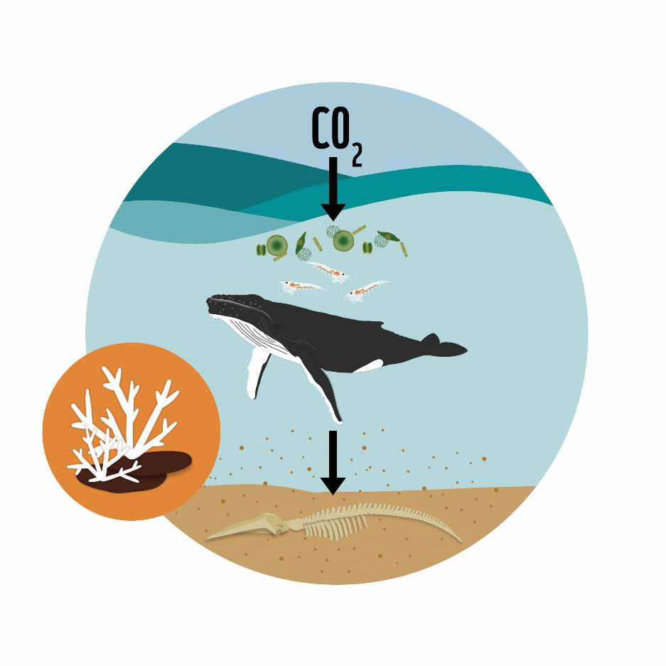
Climate and Nature
Oceans
In a thriving ocean ecosystem carbon is drawn from the
atmosphere by phytoplankton, stored in wildlife biomass,
then sinks to the ocean floor as poo and debris.
Climate change threatens key habitats that are vital for
sustaining ocean ecosystems – such as coral reefs.

Slide 8
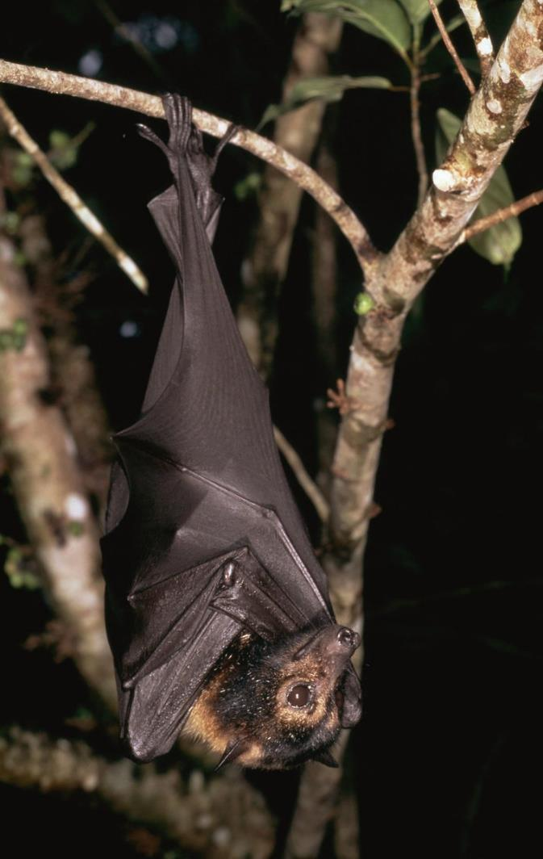
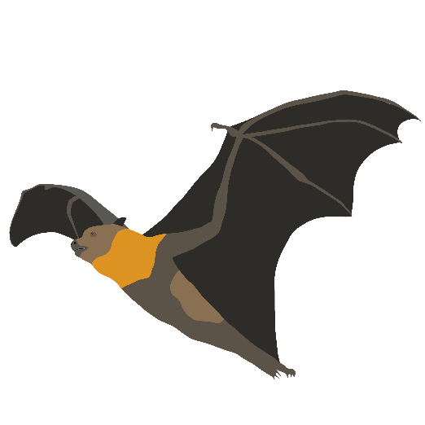
Climate and Nature
Increasing heatwaves and droughts resulting from higher global temperatures threaten many species.
During a heatwave in Australia in November 2018 at least 23,000 ‘flying fox’ bats died from the heat over two days, reducing the nation’s population by almost a third.
© Martin Harvey / WWF

Slide 9
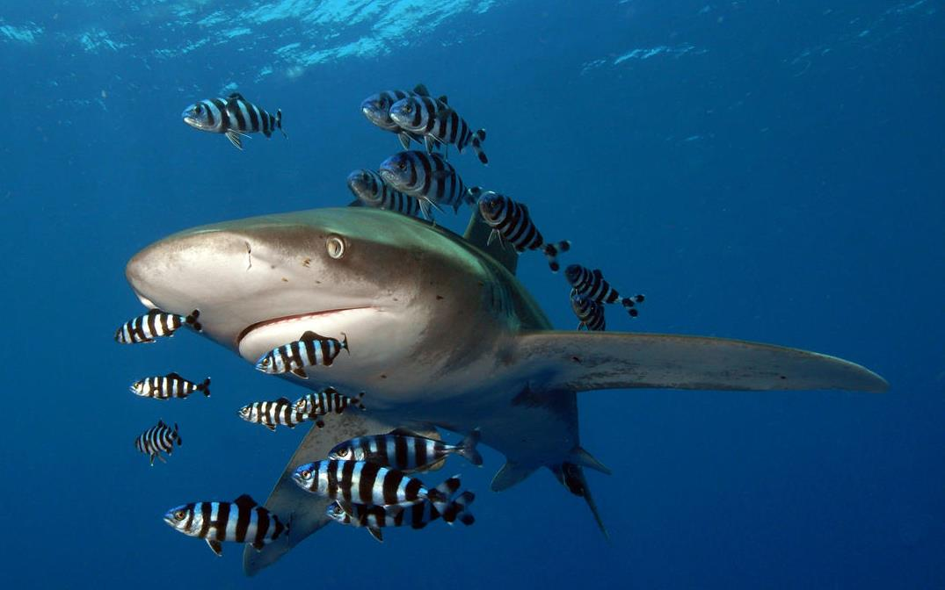
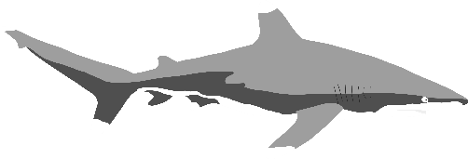
Deep Dive: Freshwater
CRITICALLY
ENDANGERED
95%
global decline in
Oceanic Whitetip Sharks
84%
decrease in population size in freshwater environments
© Elke Bojanowski / WWF-HK
Notes:
69% is only an average – some species and biomes are affected more.
The oceanic Whitetip shark has declined by 95% globally, and is now classed as critically endangered on the IUCN Red List.
The population size of sharks and rays worldwide has dropped by 71% over the last 50 years, mainly due to fishing practices.
By 2020 more than three quarters of all ocean-dwelling species of shark and ray (24 out of 31) were at risk of extinction.
Sharks and rays are top predators in ocean food webs, and their loss can cause huge problems for other species when the ecosystem becomes unbalanced.
Sharks are also extremely important to people in communities who rely on fishing. The loss of sharks can lead to changes in behaviour in other species that would usually restrict their movements and actions to avoid being preyed on by sharks. Without the sharks, these predators can severely reduce the population of other species, resulting in fishing nets coming up empty.
Oceanic whitetips spend most of their lives in deep water. They're frequently accompanied by remora and pilot fishes, with whom they have a mutualistic relationship (they help each other). Sharks protect pilot fishes from other predators, and the pilot fish keeps sharks free of external parasites.

Slide 10
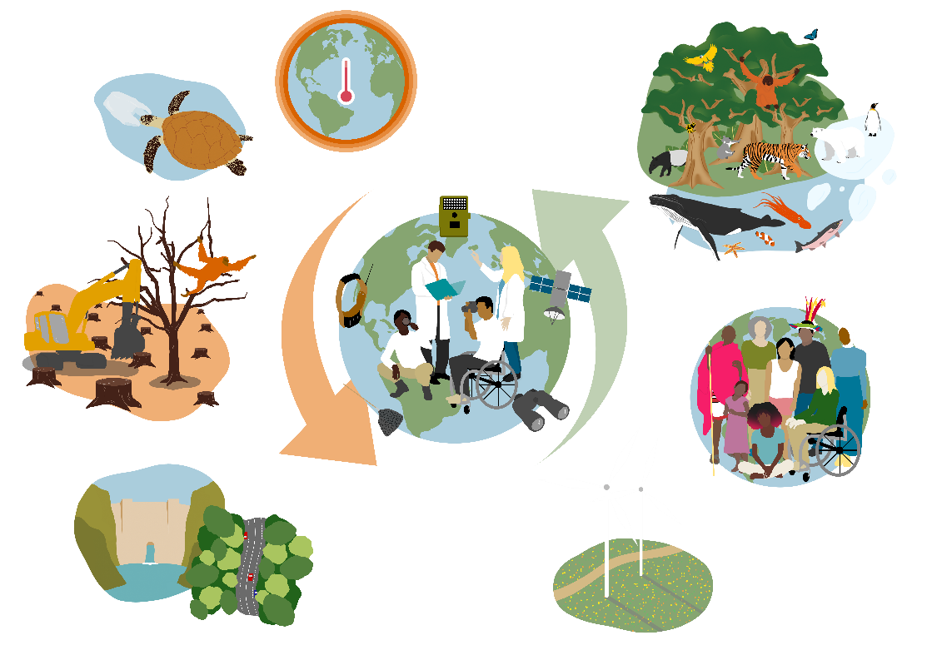
Transforming our relationship with nature
…to a healthy living planet that works for…
From…
Climate change
Pollution
Habitat loss / fragmentation
Wildlife extinctions
Nature
People
Climate
Notes:
From this…
Climate Change The Earth has warmed by 1.2ºC since pre-industrial times, and current human activity and political pledges will fail to prevent it warming more than 2ºC. Beyond 1.5ºC global warming will cause huge problems for people and nature.
Pollution 300-400 million tonnes of pollution are dumped into freshwater ecosystems every year.
Ocean plastic pollution has increased by ten times since 1980, and now affects more than 267 species – including 86% of marine turtles.
Habitat loss 75% of the Earth’s ice-free land surface has been changed by humans, mainly to create farmland for food production. 90% of wetland area has been lost globally. About 100,000 sq km of forest is lost per year, or roughly one football pitch every two seconds.
Wildlife extinctions 1 million species are threatened with extinction many in the coming decades .
Habitat fragmentation Natural processes are becoming disrupted as habitats in land, sea and freshwater are fragmented.
…to a healthy living planet that works for…
Nature Connections between protected and restored habitats worldwide allow movement of wildlife species and the flow of natural processes.
People Fair, just management of natural resources to ensure everyone has access to healthy food and a stable environment. Conservation led and informed by Indigenous Peoples.
Communities most affected by climate change nature loss are involved in decisions that affect their lives, and supported to adapt.
Climate Global carbon emissions cut through a shift to renewable energy and sustainable practices. Global warming limited to 1.5 degrees.
Data
Data on wildlife populations, climate change and habitat connectivity collected for the LPI, BII and other measures, allows us to identify and understand problems, and assess whether our solutions are helping to address them.

Slide 11
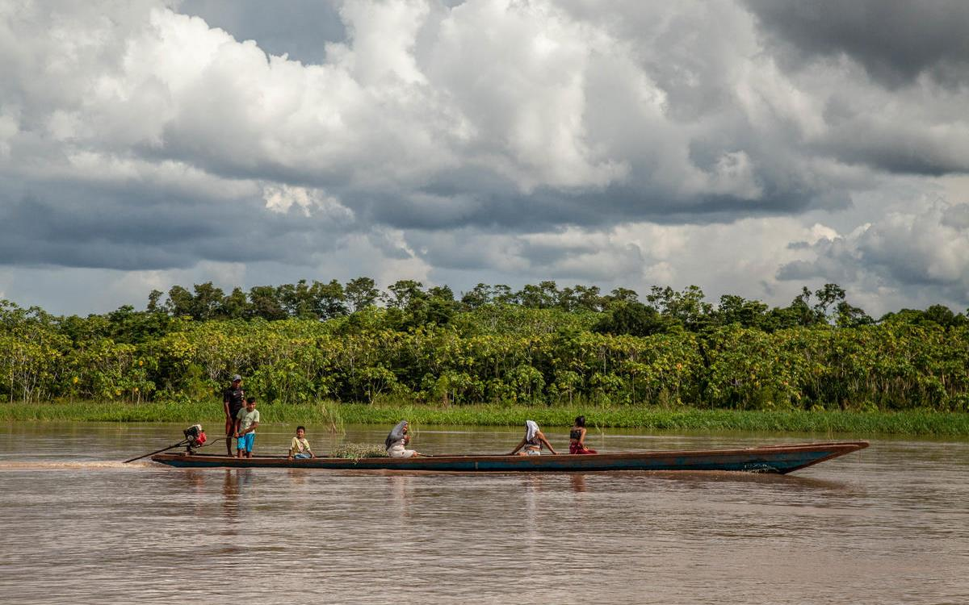
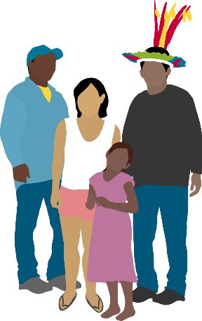
Indigenous Peoples means the first human inhabitants of an area.
Their leadership and local knowledge is vital to any effort to protect a landscape and its wildlife.
Their rights must be respected and promoted at all times.
© Daniel Martínez / WWF-Peru
Notes:
Indigenous Peoples means the first human inhabitants of an area, who have traditions and culture associated with a landscape because they have generations of history there. It is ‘Peoples’ rather than ‘People’ because it refers to many different groups.
Indigenous peoples are very important to any effort to protect wildlife, because they often have the best understanding of the ecosystem and how to draw benefits from a landscape without breaking the natural balance. Often they are the most affected by issues caused by unsustainable use of a landscape’s resources, despite not being to blame for these practices and the resulting problems. This means that as well as protecting wildlife in a landscape, we must respect and promote the rights of Indigenous Peoples.
Since 2007 more than 140 countries around the world have agreed to respect and protect the rights of Indigenous Peoples, set out in The UN Declaration on the Rights of Indigenous Peoples.
UN Declaration on the Rights of Indigenous Peoples: https://www.un.org/development/desa/indigenouspeoples/wp-content/uploads/sites/19/2018/11/UNDRIP_E_web.pdf Youth-friendly version: https://www.un.org/development/desa/indigenouspeoples/publications/2013/09/adolescent-friendly-version-of-the-un-declaration-on-the-rights-of-indigenous-peoples/

Slide 12
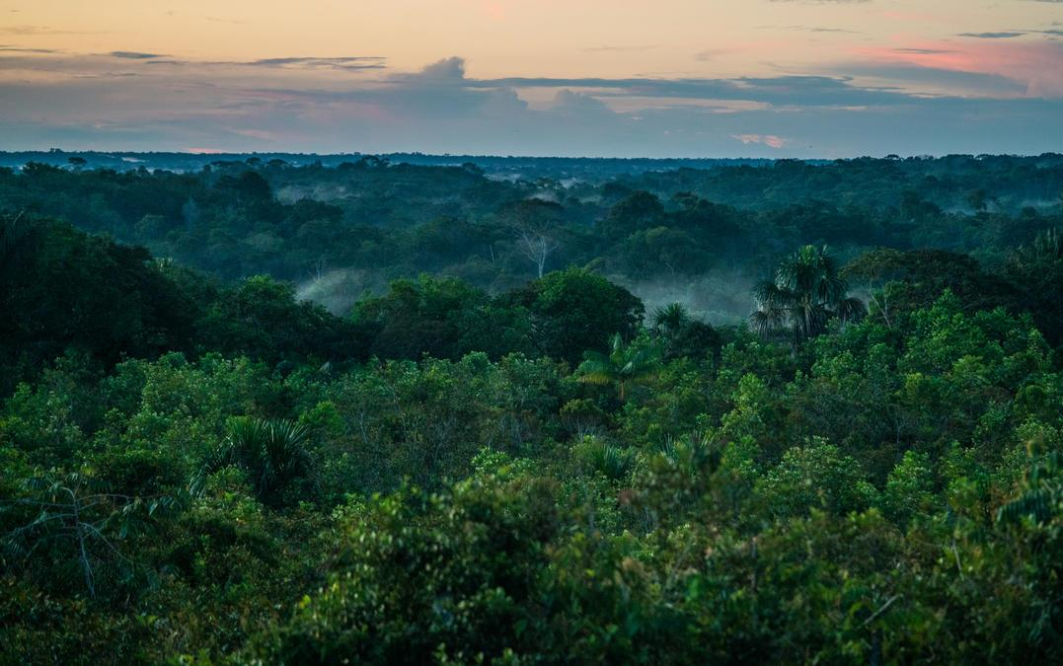
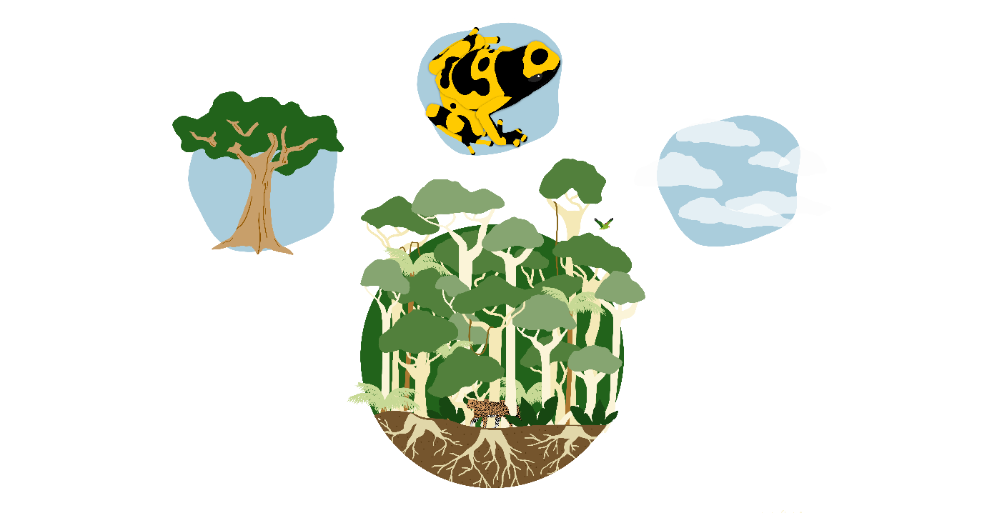
Spotlight on the Amazon
© Luis Barreto / WWF-UK
Notes:
The Amazon is the largest rainforest in the world, and it is hugely important to nature and people.
Question for students: Why is the Amazon important? What does it do that helps us, and the planet?
Answer (click to reveal):
Providing freshwater to the world: 20 billion tonnes of water released into the atmosphere per day
Fighting climate change - 76 billion tonnes of carbon are locked in the Amazon forest in the trees and soil.
Supporting biodiversity: 10% of all species on Earth can be found in the Amazon
Resources: timber, medicines, foods etc are sourced in the Amazon
Over 30 Million people live in the Amazon, including almost 3 Million Indigenous Peoples (made up of about 350 different groups).

Slide 13
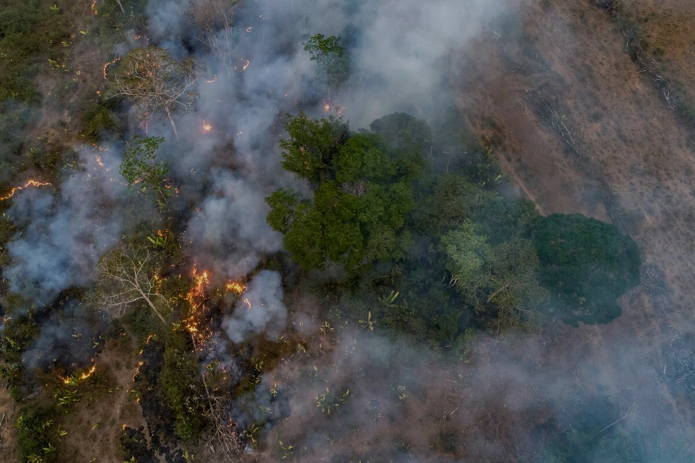
Spotlight on the Amazon
What threatens the Amazon’s biodiversity?
Land conversion
for farming
Roads and railways
Mining
Dams
Illegal logging
Forest degradation
© Andre Dib / WWF-Brazil
Notes:
What threats are faced by the Amazon?
After suggestions from the students, click to reveal.
We have lost 17% of the total forest cover in the Amazon due to felling of trees for timber or conversion of forest to farmland, and another 17% has been degraded. Land is described as ‘degraded’ when it is not completely deforested but it has lost some of its vegetation and is no longer able to support the ecosystem as much as before. Science Panel for the Amazon (2021).

Slide 14
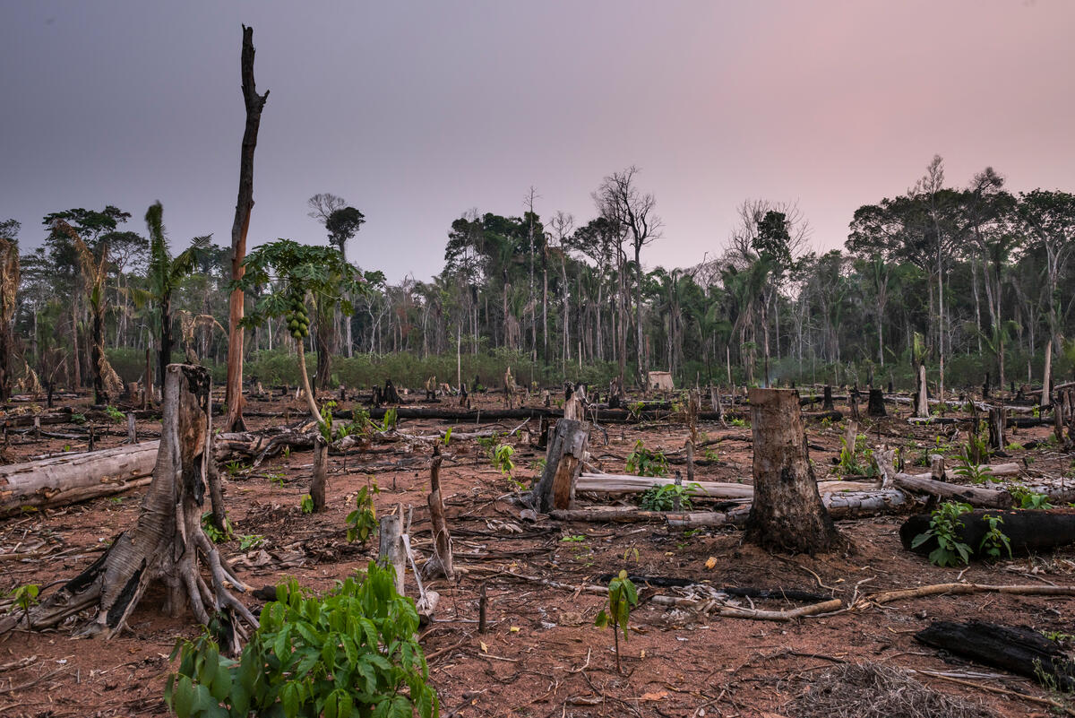
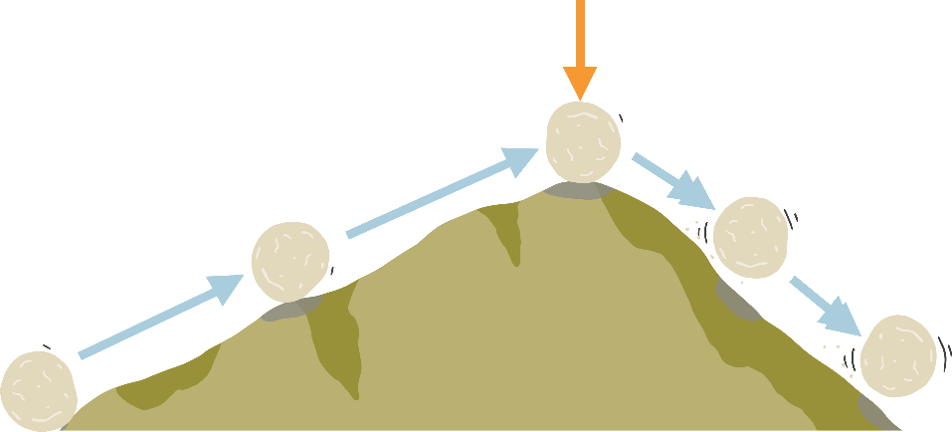
Spotlight on the Amazon
Tipping Point
© Andre Dib / WWF-Brazil
Notes:
Scientists say that if we continue to destroy the Amazon at this rate we will soon reach a tipping point, when the forest will no longer be able to work in the same way. The whole planet will lose the benefits of the Amazon, which will gradually become a drier and less biodiverse ecosystem, similar to a savannah (a grassy plain with few trees).
Click to reveal:
Tipping point refers to the point at which big changes are triggered that could be impossible to reverse. You can think of it as rolling a big rock over the top of a hill, at which point it will start to roll down the other side and may be impossible to stop.

Slide 15
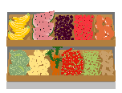
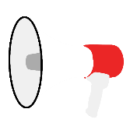
What can you do?
Make informed choices about what you eat, the way you travel and the things you buy. If you don’t know what the impact on the planet might be, try to find out.
Speak up about the importance of protecting and restoring nature through peaceful protest, blogging, writing for a local paper or sharing your thoughts with your school, local decision-makers and businesses. Remember that the people you influence may then be able to make have more impact through their choices and actions than you.
Plan a sustainable career pathway by building up your knowledge and skills in sustainability so you can choose and succeed in a career that is good for you and the planet. Any career can be green!
Notes:
We can all feel very small in the face of these big issues, and that can be worrying. But we are not helpless, and we are not alone.
Everyone can play a part in shaping a positive future for people and nature. That includes you!
We know that the way humans live on our planet now is unsustainable, and that changes must be made. But what the future will look like is not yet defined. It’s up to all of us to ensure that we shape the world we want – where the needs of people and nature are met in a way that is fair to all.
Humans are the best problem solvers that have ever lived on our planet, and addressing issues like climate change, loss of biodiversity and plastic pollution doesn’t just mean having to sacrifice things we enjoy today. If we use our imaginations and work together we can reimagine our relationship with this living planet and enjoy delicious food, travel, and fun pursuits in beautiful surroundings, without taking away from the wildlife and people who share our planet.
We are not helpless! We can make change happen faster, and in the way that will shape the positive future that we want.
You have more influence than you realise. Think about people who may be affected by what you do and say. It might be your family, friends, and social media followers. Then think about systems you can influence – your school, local businesses, or even the decision-making in your local community, district or country. Each person you inspire to act sends out their own ripples of change through their own sphere of influence. Remember – if you can come together with others who feel the same you will have a louder voice, more influence, and greater impact.

Slide 16
Notes:
Give nature a hand Whether you live in the heart of a city, on the seashore, or in the countryside, your local patch is part of a connected living landscape, and when it supports wildlife the whole world benefits. Get out and see what wildlife shares your local environment, record it to help scientists monitor the health of our living planet, and see what you can do to help local wildlife thrive. Could you plant more trees, or create new habitats such as a pond, woodpile or bird box? Use the free Seek by iNaturalist app to identify, record and submit your wildlife sightings, and you can help scientists monitor global biodiversity.

Slide 17
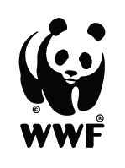
Notes:
Questions from students

