Slide 3
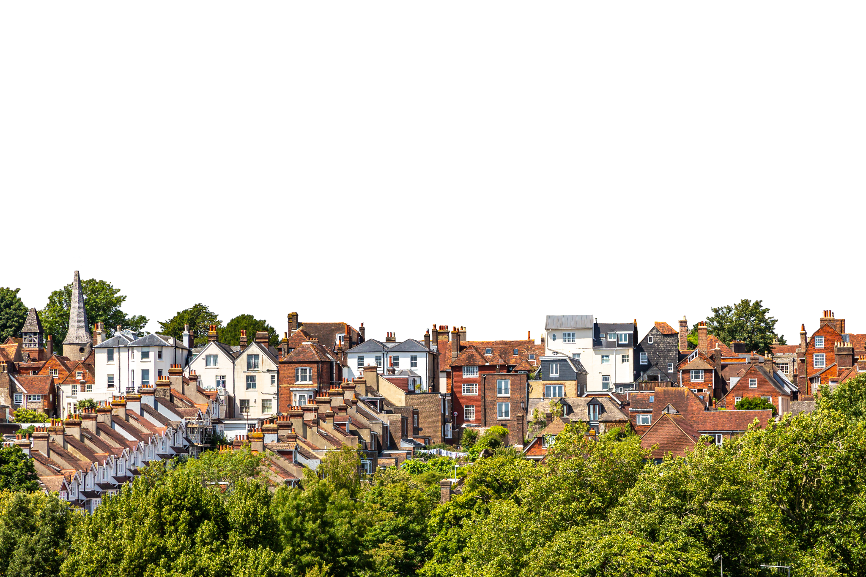

Slide 4
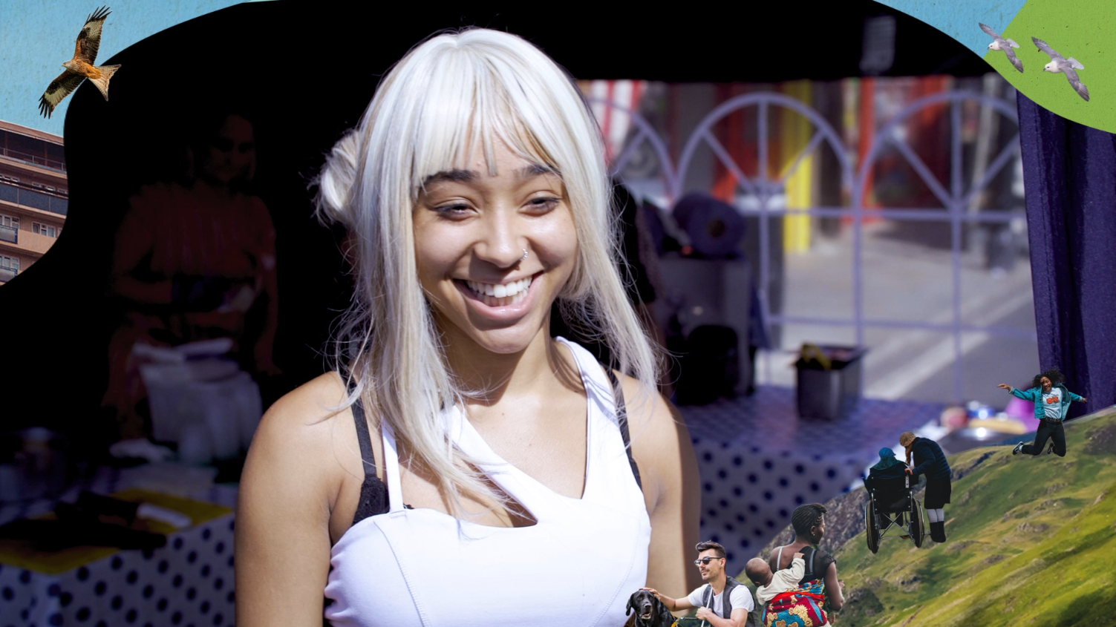
Notes:
Peoples plan for nature video (1 min) RSPB YouTube channel: https://www.youtube.com/watch?v=7oWRulVDgqs

Slide 5
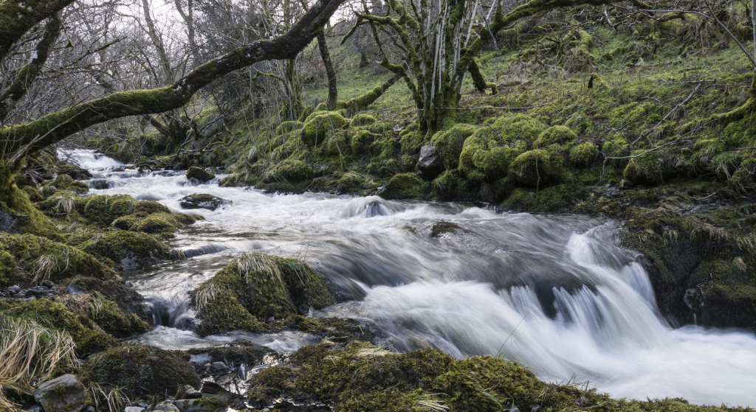
Notes:
What words do children think of when they look at these different landscapes?
What can they see? What can they imagine hearing, smelling, feeling?
What would they want to do in this landscape?
What wildlife might they find?

Slide 6
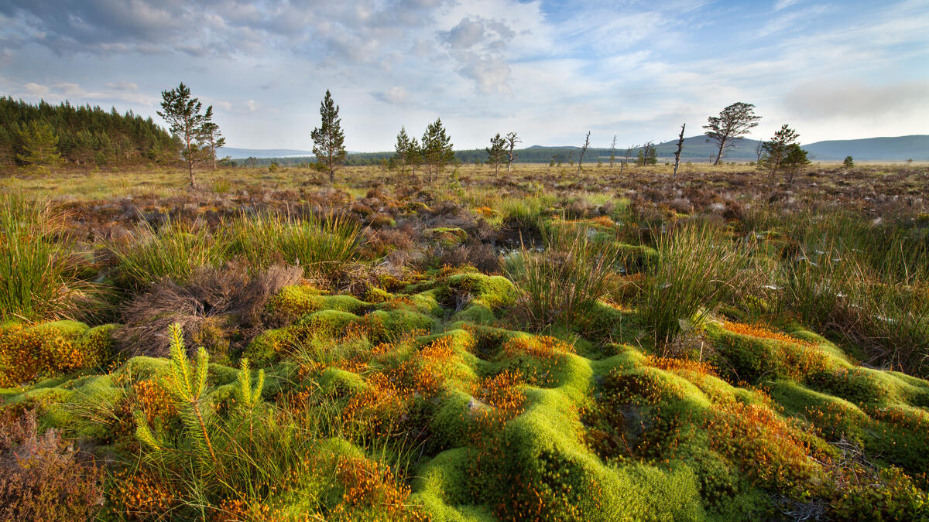
Notes:
What words do children think of when they look at these different landscapes?
What can they see? What can they imagine hearing, smelling, feeling?
What would they want to do in this landscape?
What wildlife might they find?

Slide 7
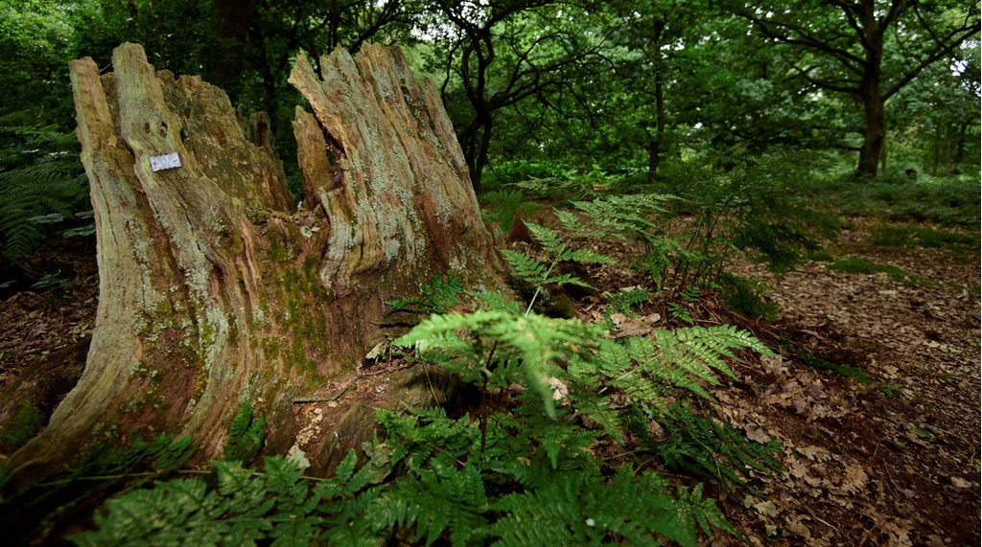
Notes:
What words do children think of when they look at these different landscapes?
What can they see? What can they imagine hearing, smelling, feeling?
What would they want to do in this landscape?
What wildlife might they find?

Slide 8
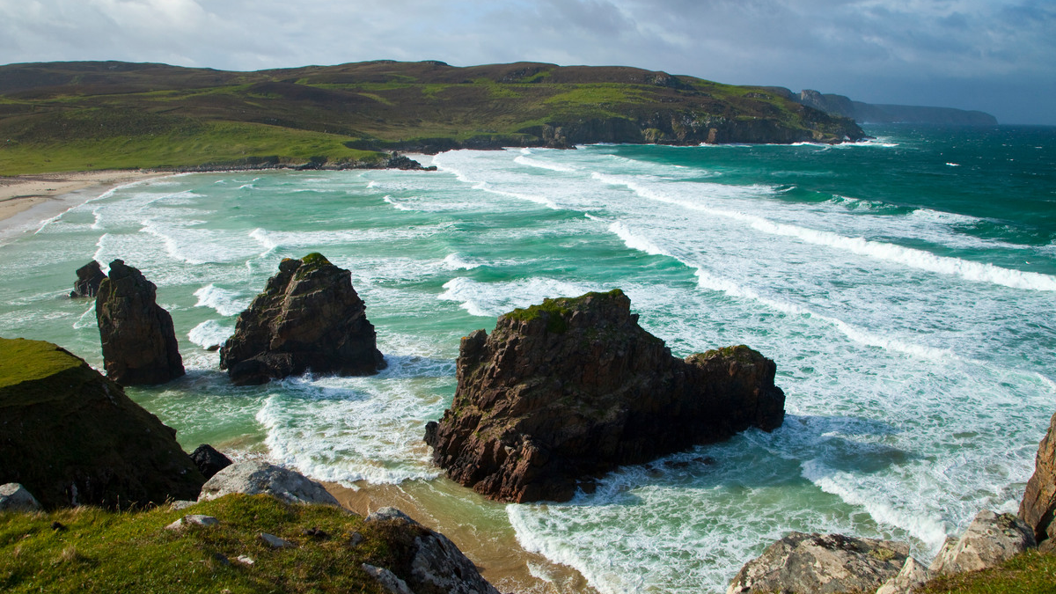
Notes:
What words do children think of when they look at these different landscapes?
What can they see? What can they imagine hearing, smelling, feeling?
What would they want to do in this landscape?
What wildlife might they find?

Slide 9
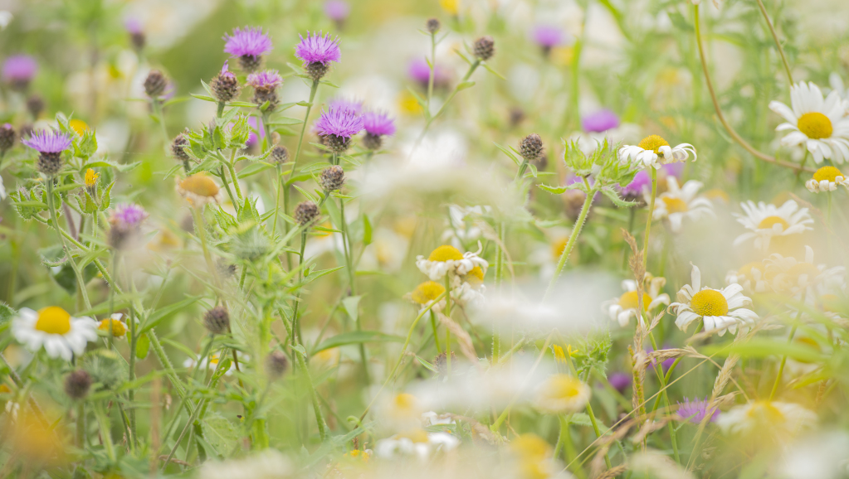
Notes:
What words do children think of when they look at these different landscapes?
What can they see? What can they imagine hearing, smelling, feeling?
What would they want to do in this landscape?
What wildlife might they find?

Slide 10
Notes:
What wildlife and habitats can be found locally? Are there any wild places students can describe? Which are their favourite places for nature and why?
You might wish to insert a photo of the schoolground and practice the same senses exercise with that, for students to consider what wildlife they can experience – and what they might like there to be that might be added.

Slide 12
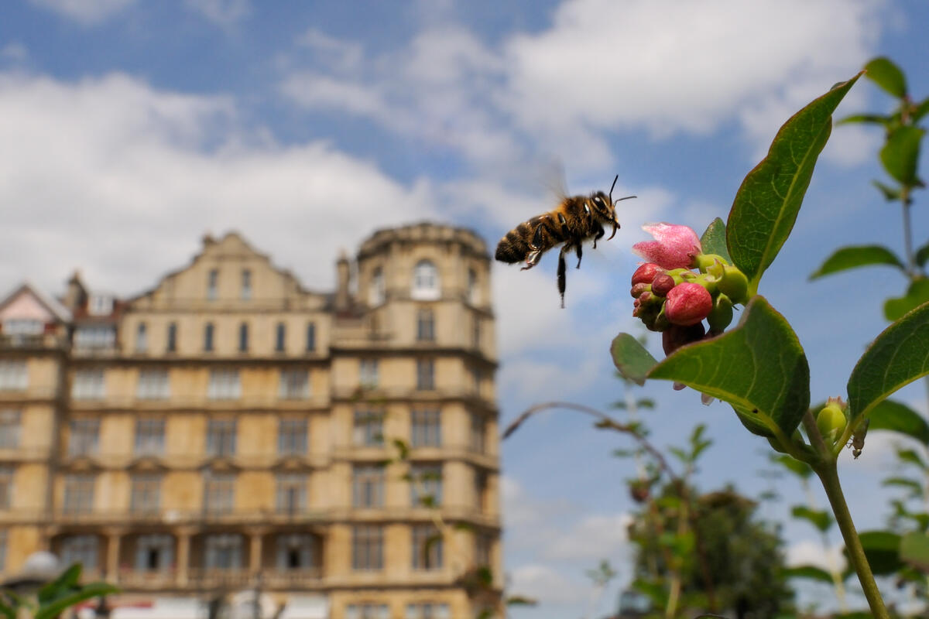
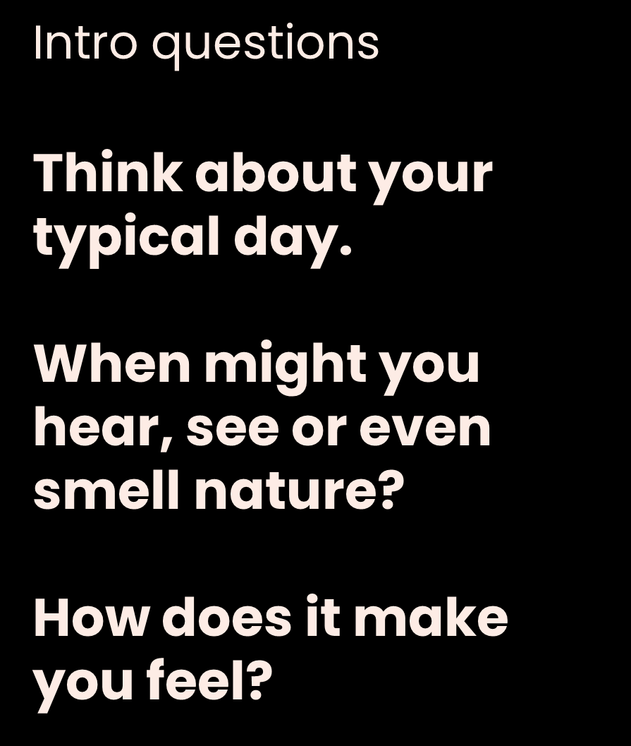
Notes:
Ask class to think through their typical day and when they might come into contact with nature – when might they see nature, hear nature, smell or even touch nature. Work in partners and share ideas with the class.
Examples might include seeing yellow and orange Autumn leaves in the trees, smelling the damp leaves or the ground or hearing the crunch of crisp leaves on a dry day, seeing bees collecting pollen in colourful flowers, hearing buzzing insects, squirrels running up trees or birds calling from rooftops.
Ask children to think about how they feel when they see nature – is it calming? Is it exciting? Is it funny? Is it relaxing? Does it make you ask questions? Again work in partners and share ideas with the class.

Slide 13
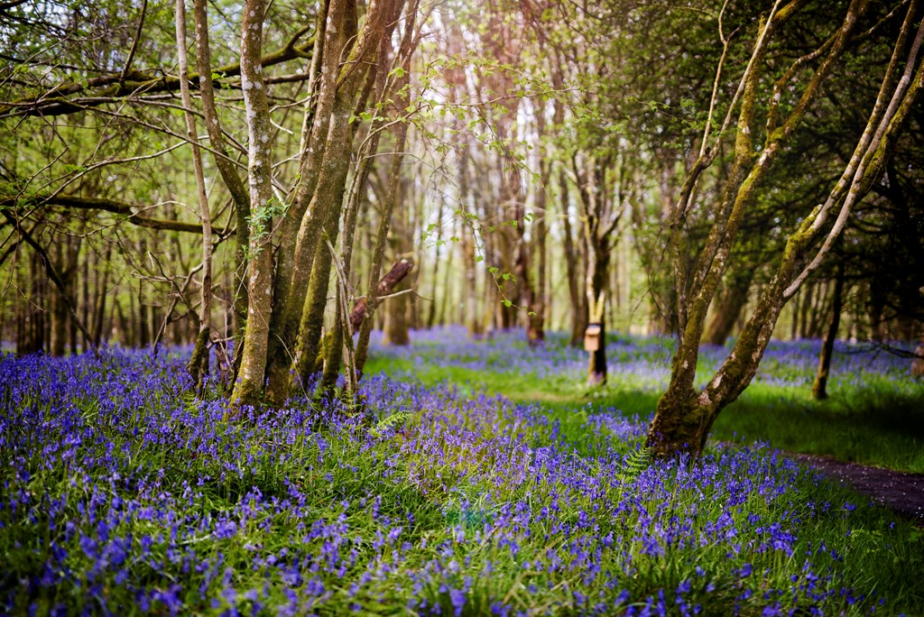
Notes:
Ask class to think of a time when they have had the most fun in nature – hands up or write on whiteboards. When answering ask children to explain what made their experience so fun.

Slide 14
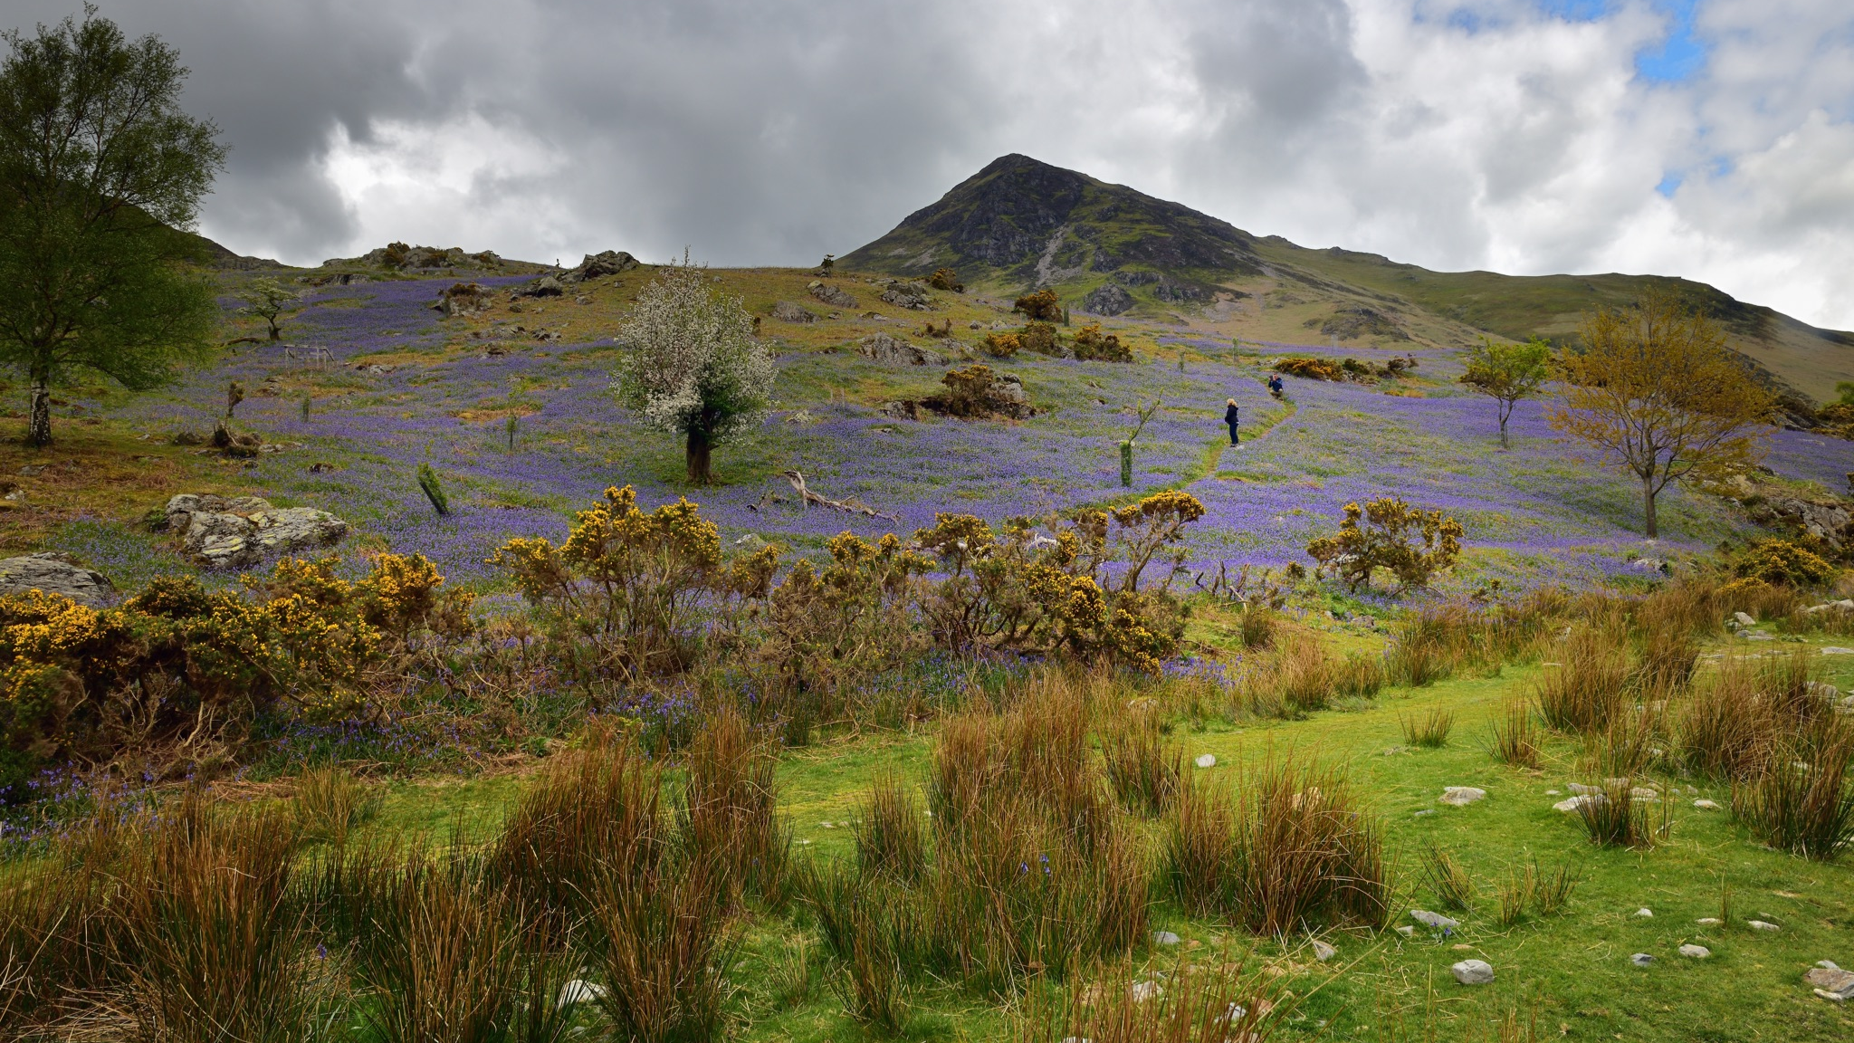
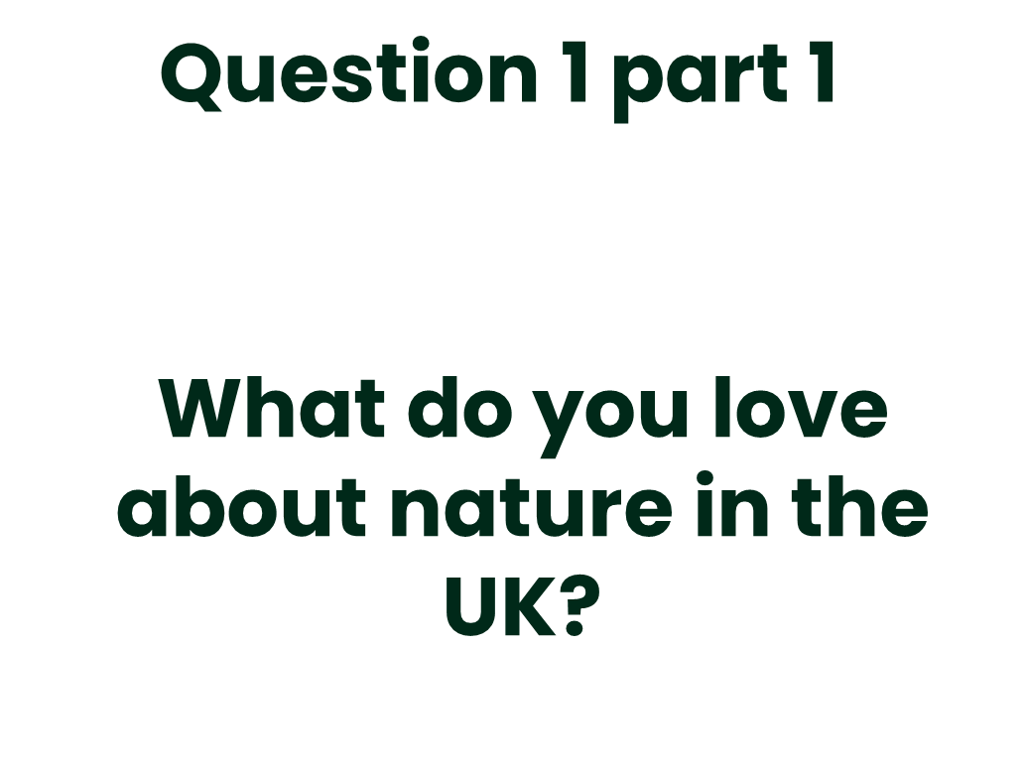
Notes:
Children to discuss with partners and then ask each child in the class to say one thing they love about nature. Write down words on the board for class to see range of answers

Slide 15
Notes:
Children put heads down and close their eyes for 1 minute and imagine that there is no nature left in the UK. What would you miss if all our nature disappeared? Hands up for answers. Keep focussed on nature we have here in the UK or nature around your local area rather than rainforests, polar regions etc.
Run through some of these and get thoughts from the class on why they are important. Decide on shortlist based on children's responses, write these on whiteboards and place on different tables throughout the classroom. Ask children to walk around the classroom reading the statements and putting a mark on the whiteboard they most agree with.

Slide 16
Notes:
If nature was doing well what sort of animals do you think you would see around the school (keep UK focused e.g. hedgehogs, foxes, blue tits, blackbirds, frogs, newts, bees, butterflies etc.)? Would anything look different in a world where nature was doing well? (e.g. more trees, more wind turbines, less litter, more recycling bins etc.).
Start with hands up for some ideas and then ask children to draw a picture of their local area or place they visit in the UK with nature thriving.
Teacher notes down key themes for question 1 and 2 for combined answer and adds to peoplesplanfornature.org

Slide 18
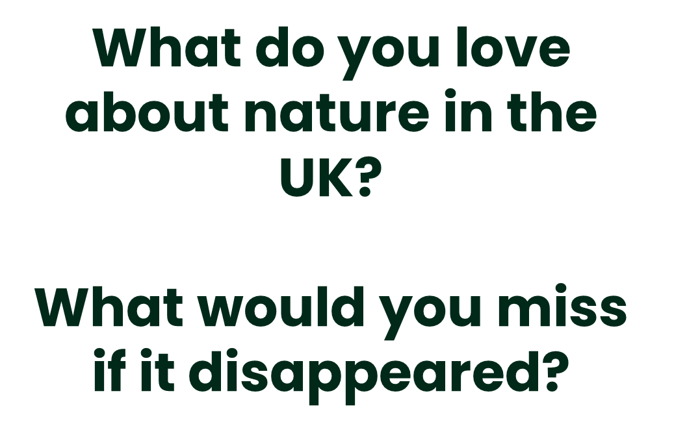
Notes:
Q1a What do you love about nature in the UK?
Get students to work with a partner to answer this question and then share with the class.
Q1b What would you miss if it disappeared?
Get students to work with a partner to answer this question and then share with the class.
Note down answers on board to both questions and get students to vote for their favourite three by giving them three pen marks/stickers and allowing them to come and place their marks on the board next to the three things they most love and would most miss. Create a shortlist of the top 5 which have the most marks next to them.

Slide 19
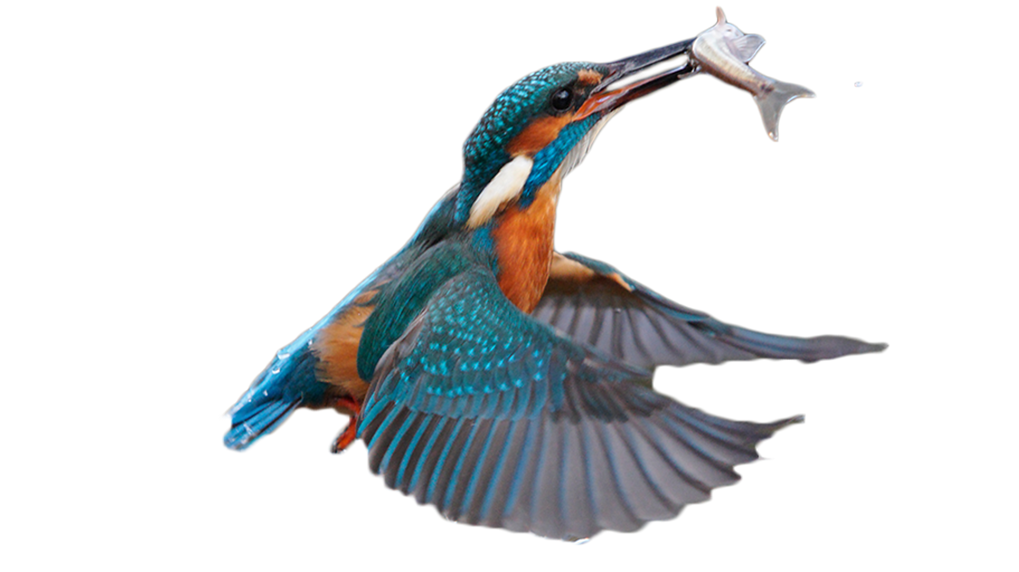
Imagine it's 2050 and nature in the UK is thriving.
What is different from now?
Notes:
Q2 – what would a future UK be like if nature was thriving? Make sure to keep focussed on UK nature but students can think about global implications of nature thriving in and around the UK and knock on impacts to other regions.
Give students a piece of A3 scrap paper and in groups of 3-4 get them to discuss and write down their ideas on one half of the paper. After 5 minutes students nominate someone from their group to feedback their responses to the rest of the class.

Slide 20
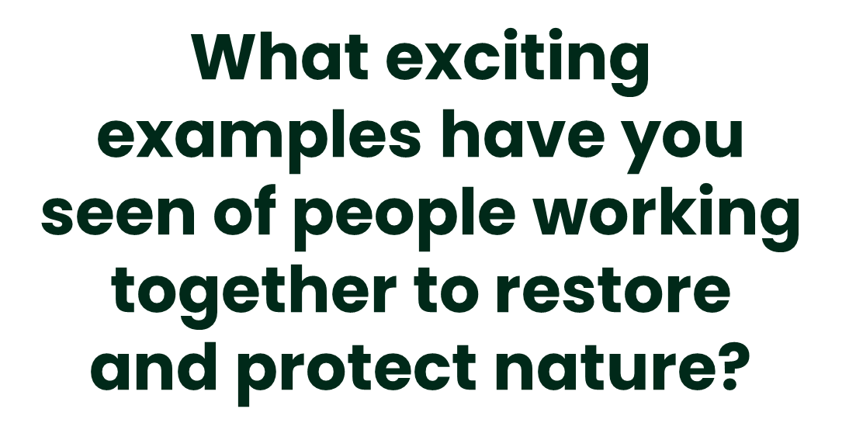
Notes:
Q3 What exciting examples have you seen of people working together to restore and protect nature?
On the other half of the scrap paper gets students to discuss in groups of 3-4 any examples they have seen around their local area or on the news of people working together to restore nature. If unsure prompt them to think about any local rewilding projects, local food growing and sharing, local beach cleans, fundraising events, local environment groups, new projects to help limit waste, local second hand or borrowing initiatives (e.g. tools). This could form a research homework task for them to find out more about local nature and environmental grassroots projects.
Collate responses from groups and use to respond to the three questions at peoplesplanfornature.org

