Slide 1
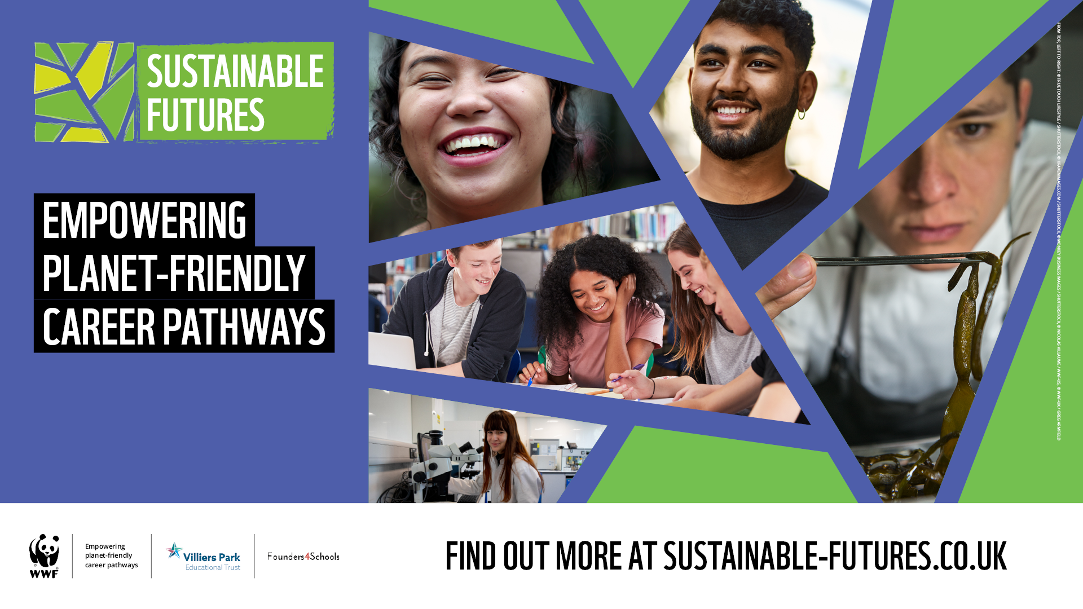
Notes:
This resource has been written as a taster introduction to WWF’s Sustainable Futures programme, a free careers programme for UK secondary schools and colleges that equips young people to thrive in a future green economy, regardless of their career path.
Slides 2 to 17 can be delivered in assembly, form or PSHE time.
Slides 18 to 20 include group activities suitable for form or PSHE time.

Slide 2
What does nature provide?
Food
Crop irrigation
Medicines
Physical and mental health benefits
A home
Drinking water
Metals & minerals
Air
Weather
Sanitation
Jobs
Energy
Leisure activities
Underpins economy
Wood & paper
Tourism
Notes:
Ask: What does nature give us?
Click to reveal answers
Nature gives us everything we need. It underpins our economy and our society. Nature gives us forests, rivers, oceans and soils which provide us with all the food we eat, the air we breathe, the water we drink as well as many other benefits like health, leisure and tourism.
These natural assets are often called the world's 'natural capital’ covering things like health and tourism and leisure. If you add them all up, the total value is estimated to be at least US$125 trillion every year.

Slide 3
What impact do we have?
Overfishing
Urbanisation
Transport
Habitat destruction / fragmentation
Deforestation
Ocean acidification
Species decline
Intensive farming
Climate change
Illegal wildlife trade
Mining
Coral bleaching
Fossil fuels
Air pollution
Dams
Extreme weather events
Plastic and microplastic pollution
Land use change
Notes:
Ask: What impact do we as humans have on nature?
Click to reveal answers
Because nature is free, we often take it for granted and overexploit it.
We clear forests, overfish oceans, pollute rivers and build over wetlands. By not taking into account the benefits we get from nature, we create huge social and economic costs for ourselves.

Slide 4
The Anthropocene
© Luis Barreto / WWF-UK
Notes:
Ask: Has anyone heard of the Anthropocene? Can anyone guess what it might mean?
Click to play video - video starts automatically at 00:30. Stop video at 02:07
The Anthropocene: https://www.youtube.com/embed/0Puv0Pss33M?start=30&end=128
NB – the Anthropocene is a ‘thought exercise’ not an established geological epoch yet.

Slide 5
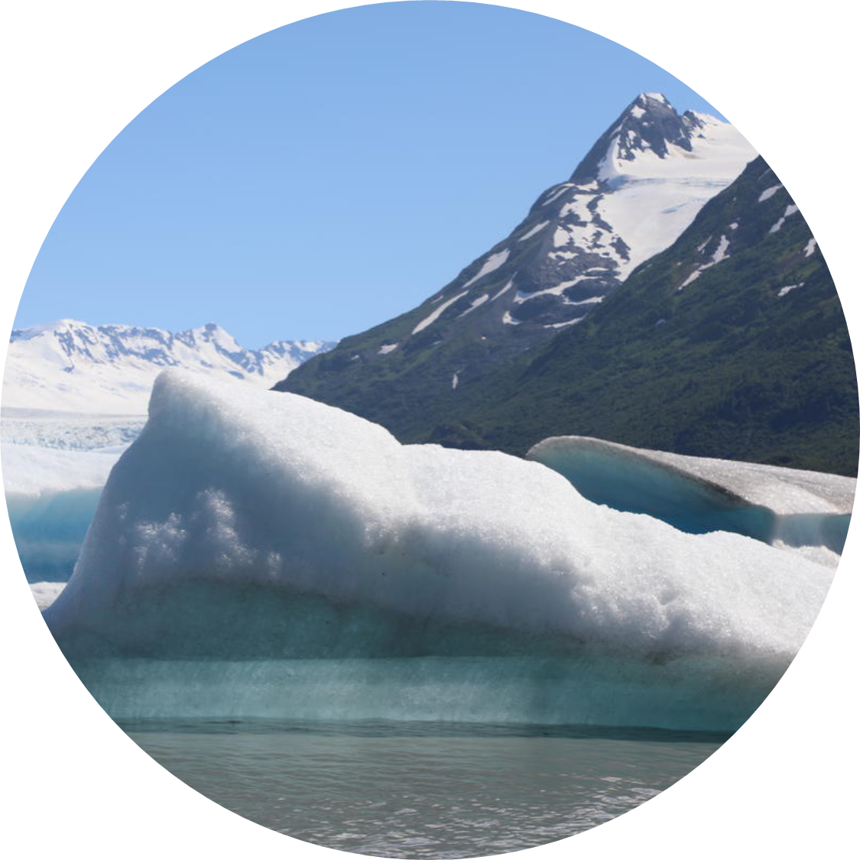
Climate change & nature quiz!
Present day climate change is caused by human activity
True
False
© WWF - US / Irene Magafan
Notes:
Now let's do a quick quiz on climate change and nature.
Task: put your hand up when the answer you think is right is called out.

Slide 6
Climate change & nature quiz!
Present day climate change is caused by human activity
True
False
© WWF - US / Irene Magafan
Notes:
The Earth’s climate is getting warmer because of human activity.
We burn fossil fuels like coal, oil, and natural gases for energy, to generate electricity, to power our cars and to use for heating and cooking. Burning these fossil fuels releases huge amounts of greenhouse gases into our atmosphere which causes it to warm up.
We also cut down trees across our planet to make space for things like farming and expanding cities. Trees are great at absorbing carbon dioxide (the main type of greenhouse gas) but if we are cutting them down, trees cannot absorb as much carbon dioxide as they used to.

Slide 7
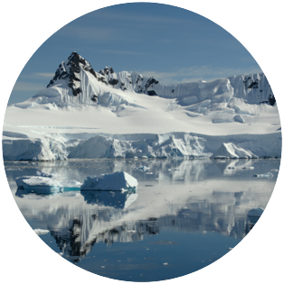
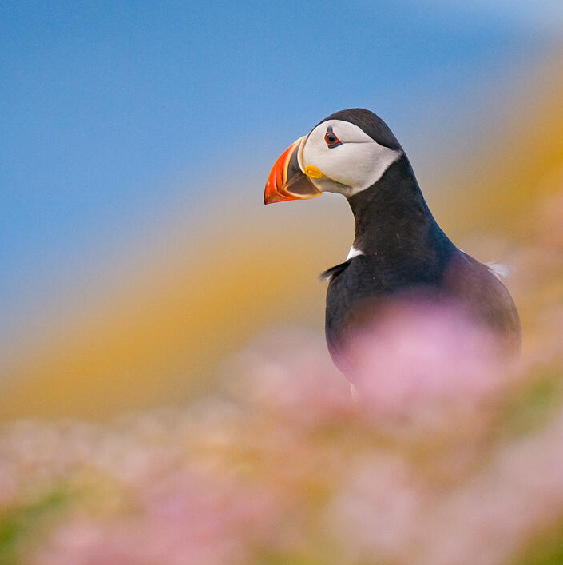
Climate change & nature quiz!
The UK is one of the most nature depleted countries in the world
True
False
© Andrew Parkinson / WWF-UK

Slide 8
Climate change & nature quiz!
The UK is one of the most nature depleted countries in the world
True
False
© Andrew Parkinson / WWF-UK
Notes:
When ranking countries based on their biodiversity and how its declined over the past 50 years the UK comes in the bottom 10%. One in seven of our native species face extinction and more than 40% of our species are in decline.

Slide 9
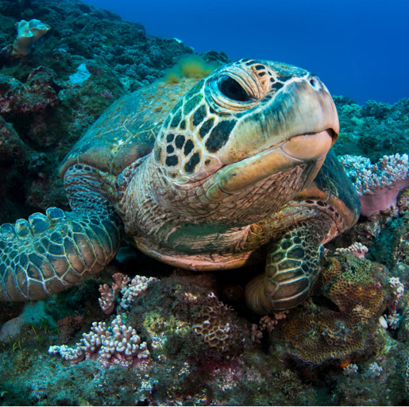
Climate change & nature quiz!
Which of these factors influences the sex of baby green turtles?
Amount of rain
Temperature
Amount of food mother gets
© Magnus Lundgren / Wild Wonders of China / WWF ​

Slide 10
Climate change & nature quiz!
Which of these factors influences the sex of baby green turtles?
Amount of rain
Temperature
Amount of food mother gets
© Magnus Lundgren / Wild Wonders of China / WWF ​
Notes:
Green turtles lay their eggs in places where temperatures are around 29 degrees. Warmer temperatures whilst the eggs are in the nest means that its more likely turtles will be female and cooler temperatures mean that the turtles that hatch will more likely be males. Historically this means you get a mixture of male and female turtles.
Increasing temperatures from climate change means that baby green turtles that hatch are more likely to be female. In fact one population of hatching green turtles from an island in Australia has reported as being 99% female for the past 2 decades.

Slide 11
Climate change & nature quiz!
Which Sustainable Development Goal is this?
Zero hunger
Clean water and sanitation
Life below water

Slide 12
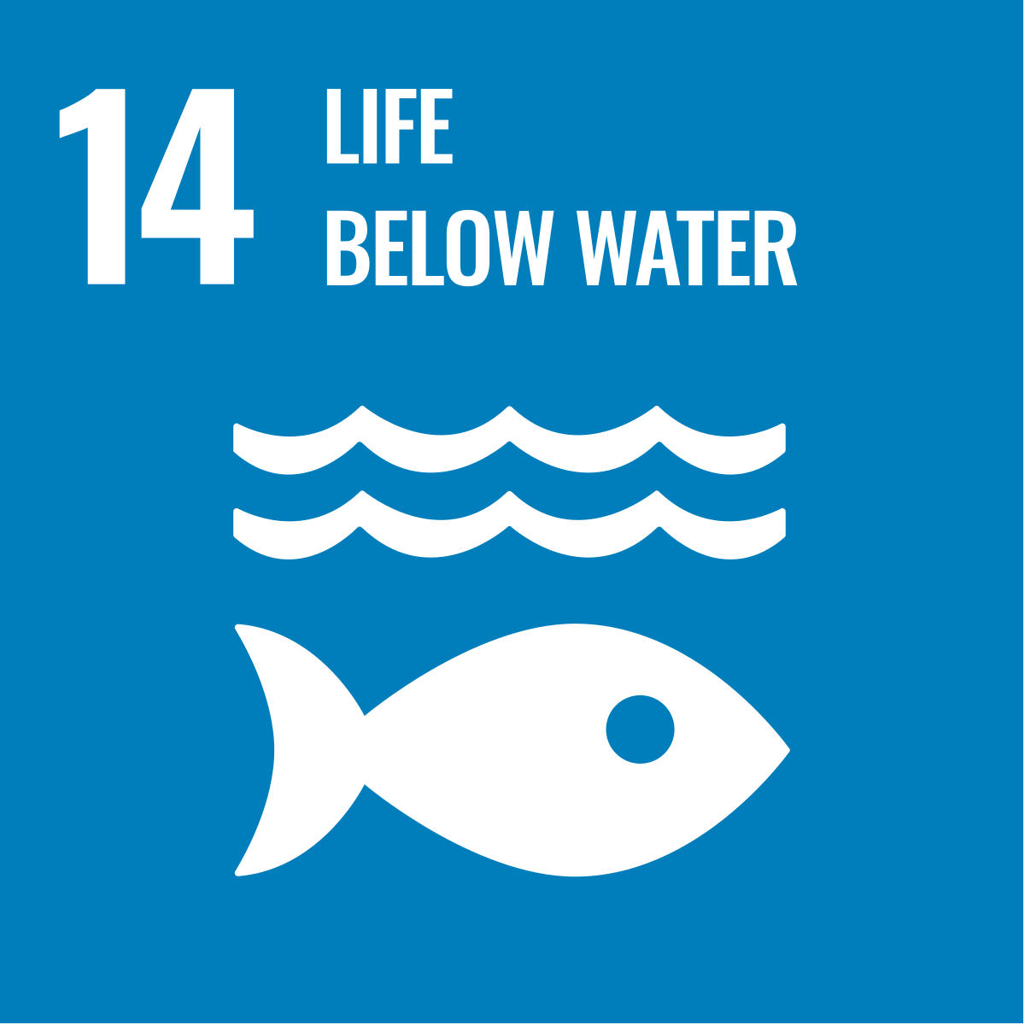
Climate change & nature quiz!
Which Sustainable Development Goal is this?
Zero hunger
Clean water and sanitation
Life below water
Notes:
Sustainable Development Goal number 14 - Conserve and sustainably use the oceans, seas and marine resources for sustainable development

Slide 13
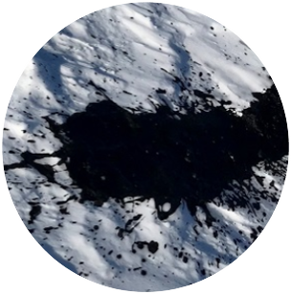
Climate change & nature quiz!
These polar animals are all affected by climate change – but who’s poo is this?
Polar bear
Walrus
Adélie penguin

Slide 14
Climate change & nature quiz!
These polar animals are all affected by climate change – but who’s poo is this?
Polar bear
Walrus
Adélie penguin
Notes:
A polar bear’s main diet is seals which are very oily – which means that they have very oily poo!

Slide 15
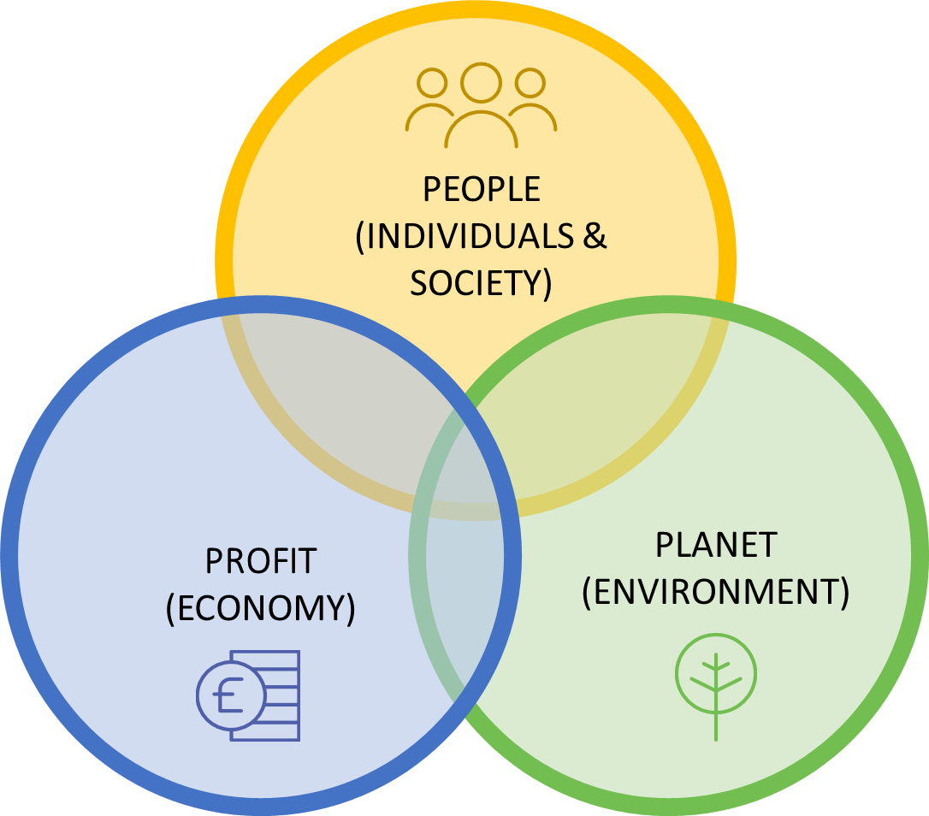
Sustainability
“Meeting the needs of the present without compromising the ability of future generations to meet their needs”
Built on three pillars: society, economy and environment
Notes:
Now let’s look at sustainability.
Ask: Can anyone define the word ‘sustainability’?
Click to reveal.
The word sustainability is defined as “meeting the needs of the present without compromising the ability of future generations to meet their own needs” (Brundtland Report, 1987)
Our planet can only replenish a finite number of resources and is only able to withstand a certain degree of global temperature rise before ecosystems are pushed beyond repair.
Sustainability is often linked with being ‘environmentally friendly’, but this is only one factor.
Sustainability is built on the principle of the 3 Pillars of Sustainability or the 3 Ps model: (Profit/Economy, People /Society and the Planet/Environment).
So to be truly sustainable something must achieve value for money on a whole life basis, generating benefits not only to the organisation, but also to society and the economy, while minimising damage to the environment.
For example, even if something is considered good for the environment, if it’s economically inefficient (if it costs too much money or needs replacing every year) or isn’t ethical (if its factories have poor labour conditions, perhaps) then it isn’t a sustainable option.

Slide 16
‘Green’ jobs and skills
Net zero – refers to achieving an overall balance between emissions produced and emissions taken out of the atmosphere.
Green skills – “are the knowledge, abilities, values and attitudes needed to live in, develop and support a sustainable and resource-efficient society” (UN, 2022).
Green economy - UNEP, “A green economy results in improved human well-being and social equity, while significantly reducing environmental risks and ecological scarcities. ”
27% of all young people 16-25 years old have heard the term ‘green jobs' and could explain what this means
© Luis Barreto / WWF-UK
Notes:
So how does sustainability tie into your career?
One priority for governments and businesses is to achieve its net zero targets. To do this, it’s essential to have a workforce equipped with the right knowledge and skills to meet the demand of ‘green’ jobs.
Ask: Can anyone define or give examples of green jobs?
Click to reveal definitions
The UN defines green skills as the knowledge, abilities, values and attitudes needed to live in, develop and support a sustainable and resource-efficient society.
The UNEP (United nations Environment Programme defines a green economy as an economy which “results in improved human well-being and social equity”.
There is no clear universal definition for green jobs and skills. But one thing that is clear is that green and sustainable jobs and skills are on the rise.
The UK is adding green jobs faster than other countries, with green jobs making up 33% of postings on LinkedIn in 2023 (LinkedIn, 2023).
Stat source:
The Generation Green Jobs? report carried out by The Prince’s Trust and Public First warns of a green skills crisis looming. They polled 2,054 young people aged 16 to 25 years old https://assets.ctfassets.net/qq0roodynp09/2LyIxyPZwCb7aEaPrL9NH6/6065a0c558ba48a8b1b9c43b4924a0d7/Generation-Green-Jobs-Report-Nov-2023-1.pdf

Slide 17
Case study: sport
© Luis Barreto / WWF-UK
Notes:
Let’s now look at a sustainable career in sport.
Click to play video - the video is 03:16 long but you can stop at 02:05 if you are short for time.
Southampton Football Club https://www.youtube.com/watch?v=GBdAVuE9Yaw&list=PLIhjq4DG3Rs0p9g2xUUETcUMe39-Dx6Dq

Slide 18
Sustainable Development Goals
© Luis Barreto / WWF-UK
Notes:
Play video

Slide 19
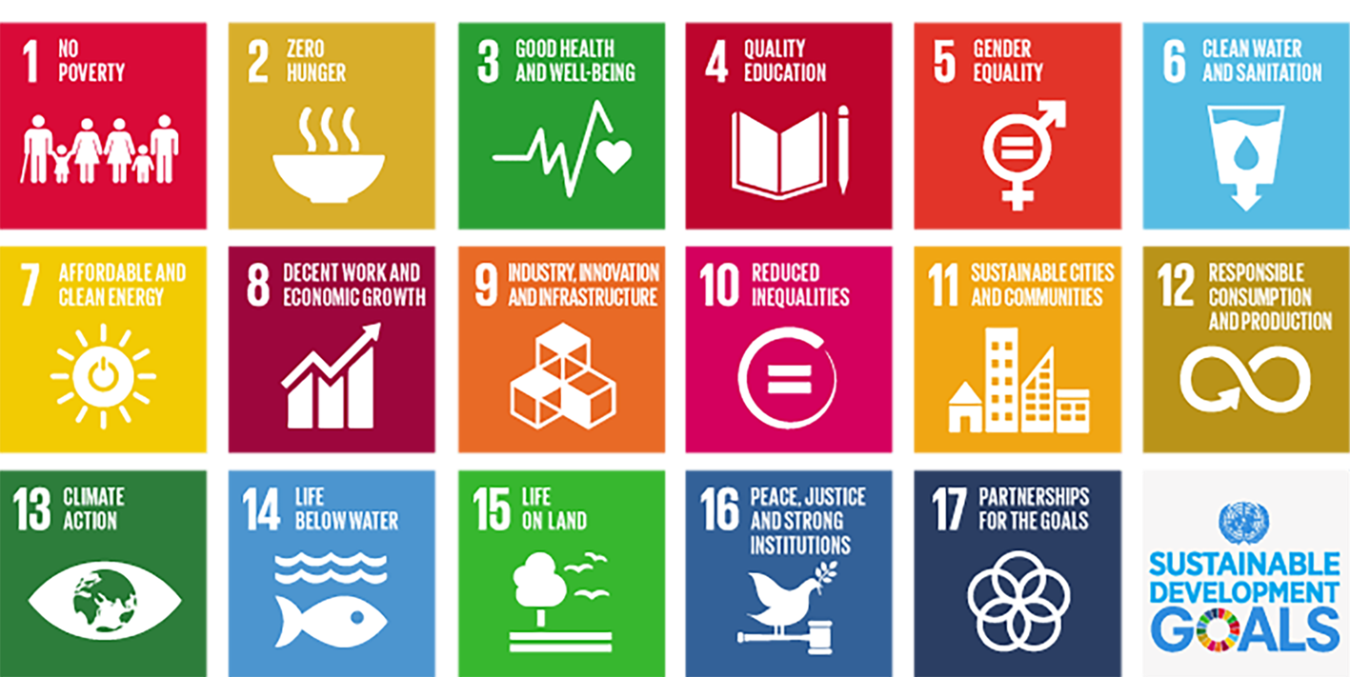
Sustainable Development Goals
© Luis Barreto / WWF-UK
Notes:
The SDGs or Global Goals set out all the things society should achieve to ensure a healthy and fair future for people and our planet.
A green career should link to at least of 1 SDG.
Task:
Think of a career that contributes to as many SDGs as possible
Have a mini competition (who can link to the most) - Ask students to explain their answers e.g. teacher = SDG 4., SDG 1, etc.
There is no right or wrong answer, but this task encourages students to critically think how jobs can contribute to SDGs if approached in a certain way

Slide 20
Sustainable careers
Sort the list of careers by ‘most sustainable’ down to ‘least sustainable’.
Architect
Accountant
Fashion Designer
Airplane Pilot
Solar Panel Installer
Insurance Provider
Estate Agent
Lawyer
Chef
Supermarket Manager
Teacher
Farmer
Personal Trainer
Electrician
© Luis Barreto / WWF-UK
Notes:
Task:
In groups ask students to sort the list of careers by ‘most sustainable’ down to ‘least sustainable’.
Discuss:
How it depends on the company’s values or the way a job is undertaken?
Are there any considered ‘least sustainable’ that could be a force for good with some different approaches?
The choices someone in a career might have about how/where they work and what difference this could make to their positive impact on the world?

Slide 21
Notes:
Sustainable Futures is a free careers programme for UK secondary schools and colleges that equips young people to thrive in a future green economy, regardless of their career path.
For more information please visit: Sustainable Futures - free secondary schools programme | WWF
Or email education@wwf.org.uk.

