Slide 1
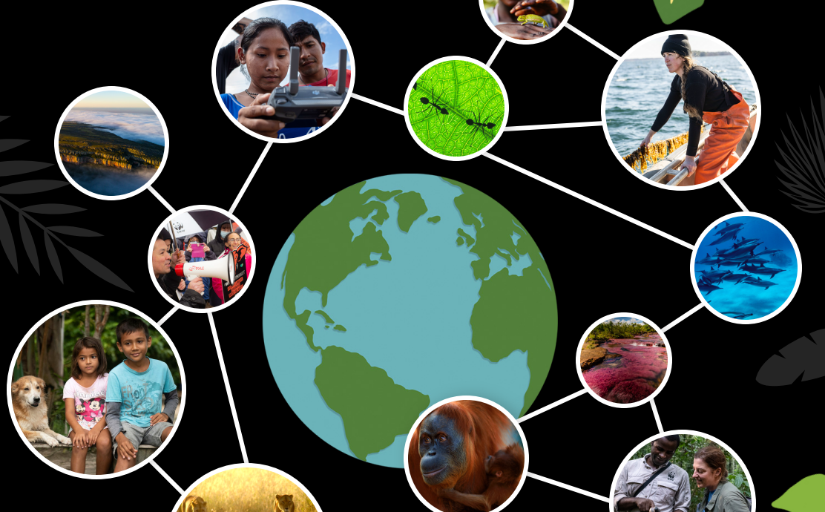
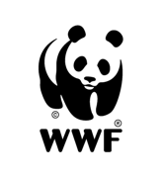


Slide 2

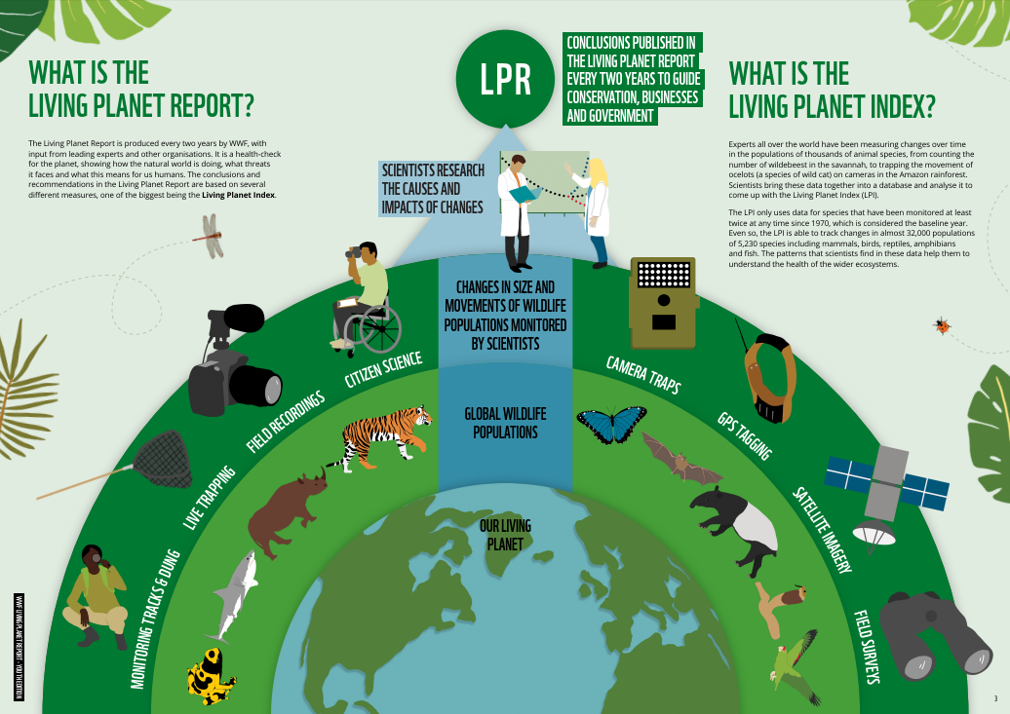
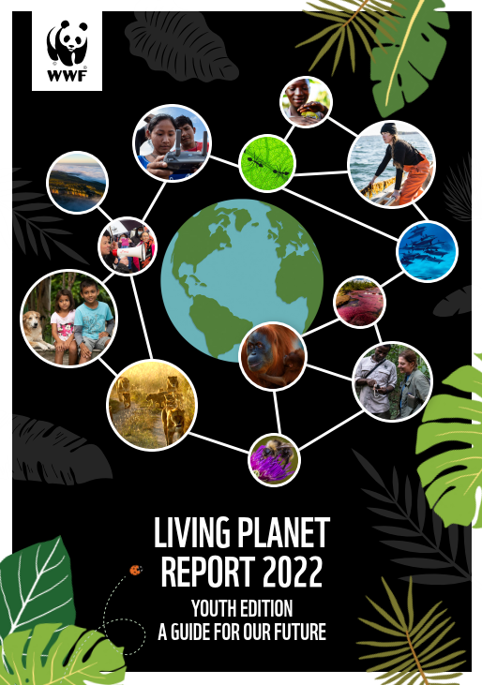
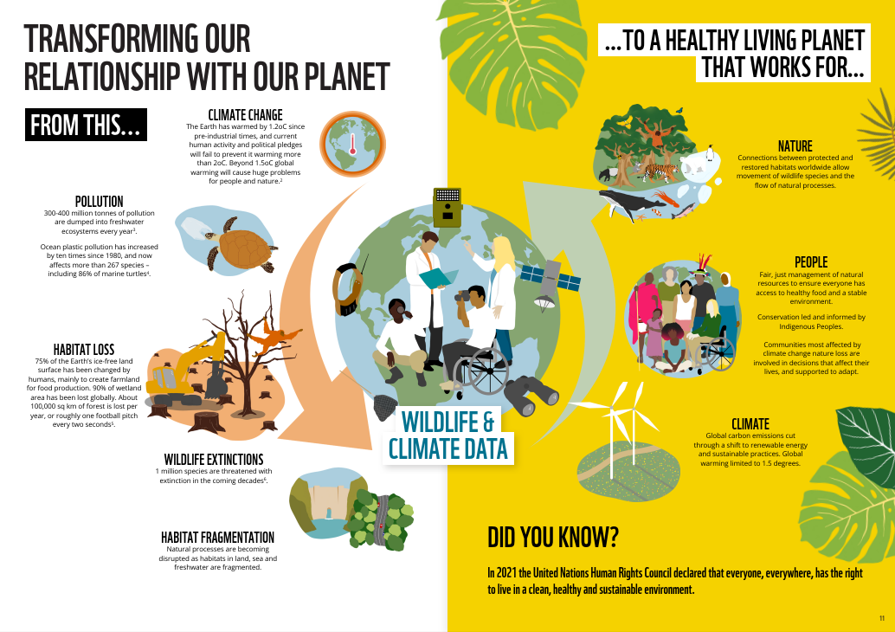
Notes:
The Living Planet Report is produced every two years by WWF, with input from leading experts and other organisations.
It is a health-check for the planet, showing how the natural world is doing, what threats it faces and what this means for us humans.
Just like you might measure a human’s health by taking their temperature, checking their eyesight or blood pressure, scientists can measure the planet’s health by measuring things like its temperature, the amount of carbon dioxide in its atmosphere, the volume of its ice sheets or its biodiversity.
The Living Planet Report uses biodiversity as a measure for our planet’s health – but what does biodiversity mean?

Slide 3
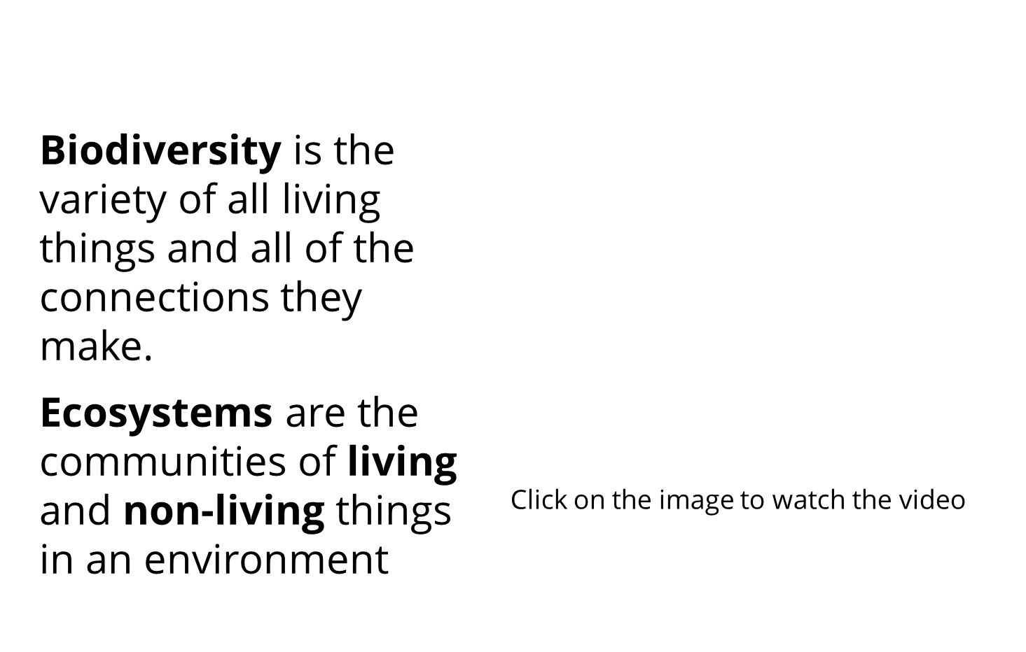
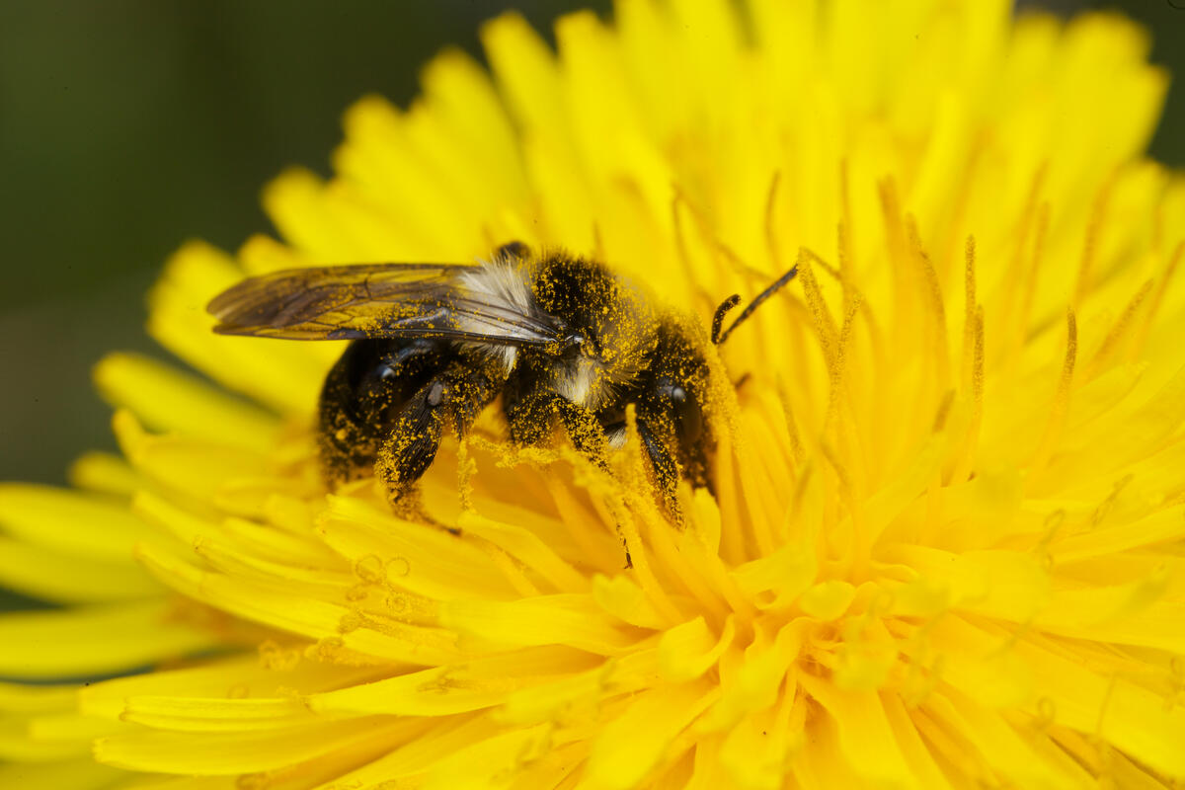
Notes:
Biodiversity is the term for the variety of all life on Earth. Thousands of different habitats, millions of different species and billions of individual animals and all of the connections and relationships they have with each other.
Ecosystems are the communities of living and non-living things in an environment.
Biodiversity and all of our planet’s ecosystems provide everything we need to survive! They provides us with clean air, freshwater and all the food we need to eat!
The more biodiversity we have, the more stable our ecosystems are and the more stable the planet is. That’s because a planet with lots of biodiversity is better able to cope with change or problems. If there is lots of biodiversity in an ecosystem there are lots of connections and relationships between plants, animals, fungi and microorganisms. If a change were to happen and one of these connections was damaged, the living things are more likely to be able to find other ways to cope if there is lots of biodiversity.
Biodiversity video (3mins) https://www.youtube.com/watch?v=b6Ua_zWDH6U

Slide 4
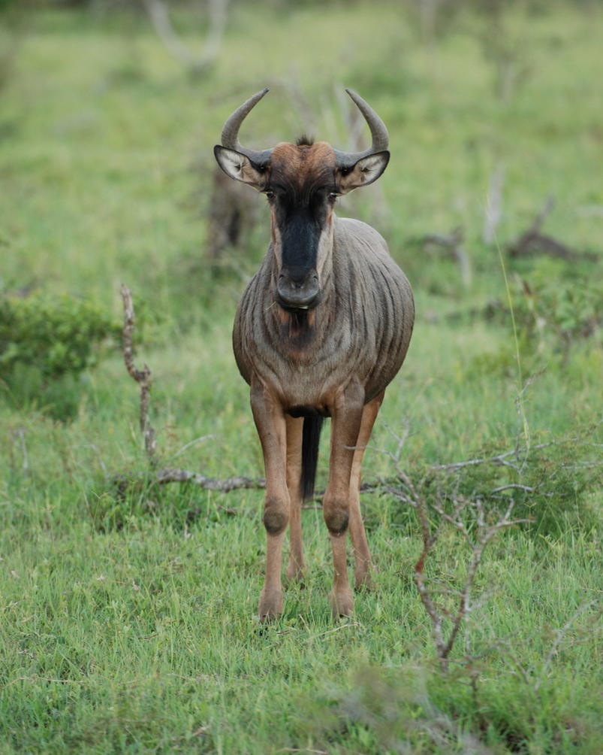
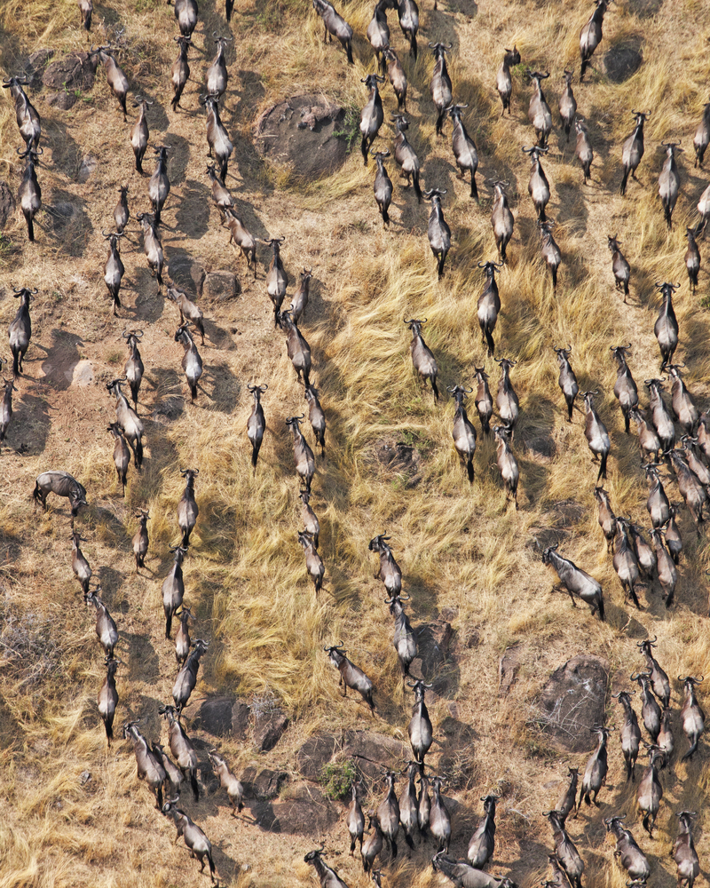
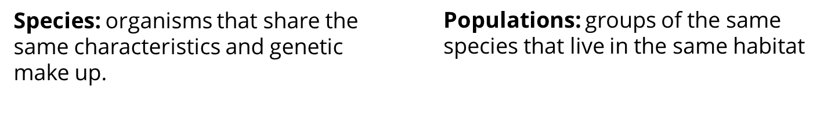
Notes:
The Living Planet Report talks about populations of animals.
Species are organisms (like plants, animals or fungi) that share the same characteristics and genetic make up.
Q: can you think of any examples of different species?
Human beings are an example of a species as are giant pandas, green turtles and the common wildebeest (on the slide). Things like bugs or fish for example are species because there are thousands of different types of bugs and fish.
Populations are groups of the same species that live in the same habitat – for example there might be a population of 1000 common wildebeest living in a particular part of the savannah grassland, but there might be other populations of common wildebeest living in other parts. Similarly there are different populations of humans who live in different countries and regions around the world – the population of the UK is different to the population of France for example but we are all the same species.

Slide 5
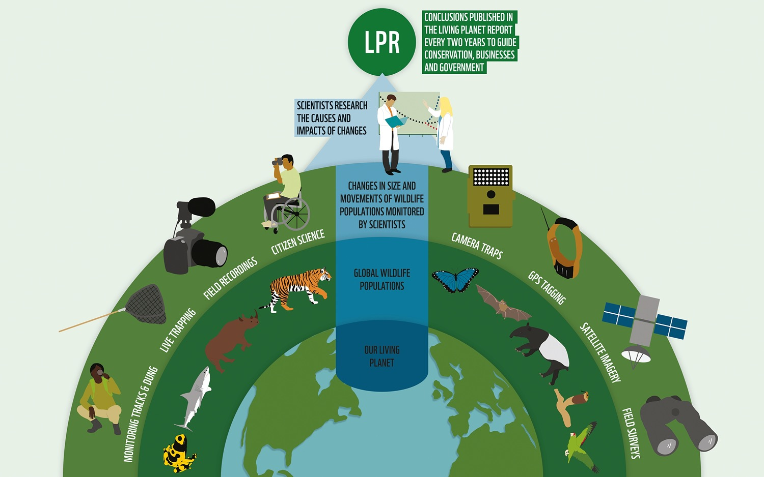

Notes:
In the Living Planet Report our planet’s biodiversity is calculated using a measurement called the Living Planet Index.
The Living Planet Index measures the changes in population size for thousands of groups of animals around the world.
To work out the Living Planet Index, scientists all around the world collect and analyse data form lots of different sources including information gathered from satellite images, camera traps, GPS tracking and even motioning animal dung!
The Living Planet Index is currently able to track what is happening for almost 32,000 populations of mammals, birds, reptiles, amphibians and fish. The trends that scientists find in these data help them to draw conclusions about the health of the wider ecosystems on our planet.

Slide 6
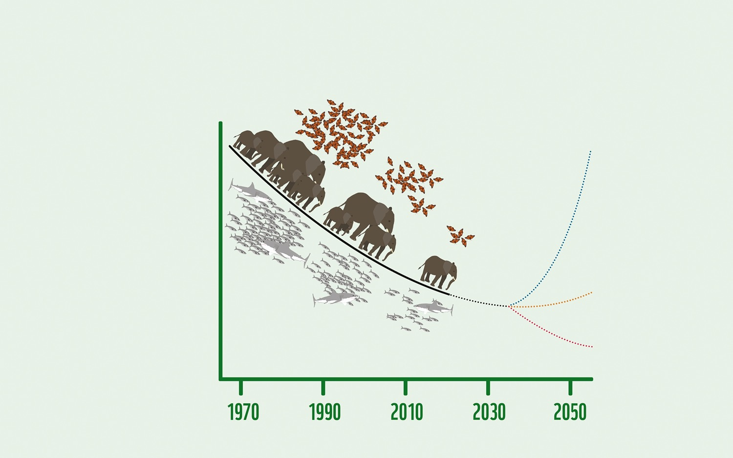
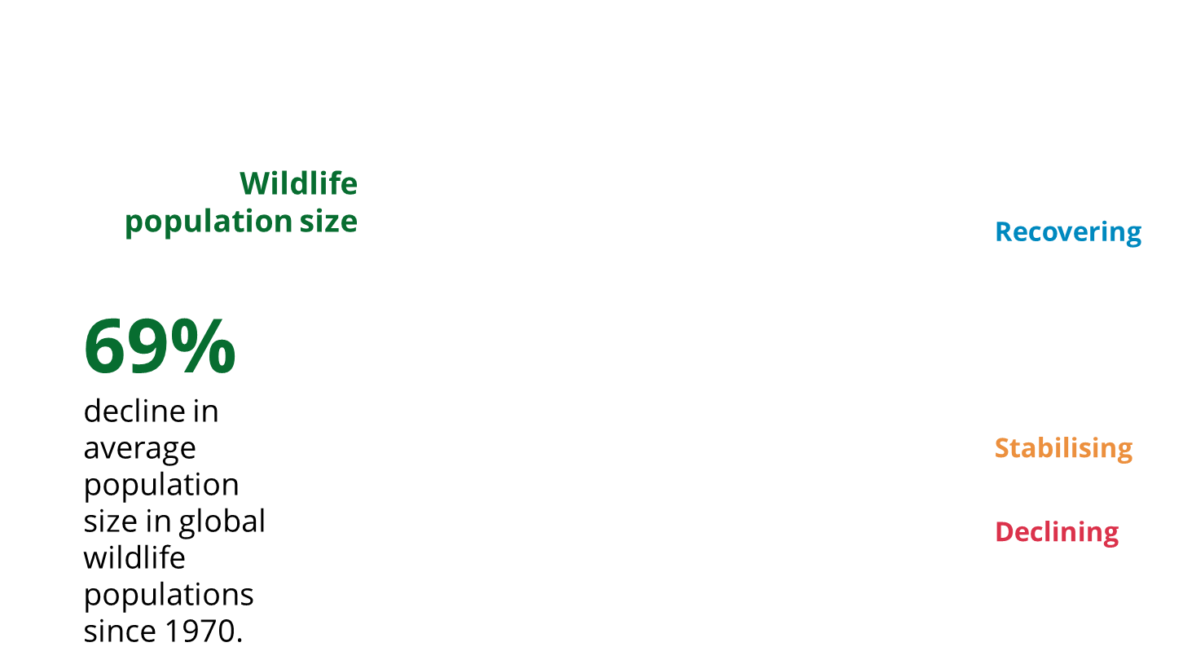
Notes:
So what does the Living Planet Index show?
This is a graph showing the Living Planet Index for 2022, and three possible ways that the graph could look in the future.
The Living Planet Index shows that, globally, the average population size of mammals, fish, birds, reptiles and amphibians has declined by 69% (over two thirds) since 1970. This doesn’t mean the animals themselves got smaller, it means that number of animals in the groups is fewer.
Q: Why do you think populations of animals have declined over the past 50 years?
Possible causes: habitat destruction, climate change, poaching, over-fishing, pesticides, pollution
Declining line: if we change nothing about the way we treat the natural world, the red line will be the path that we follow over the next decades – and we will continue to lose more and more of our planet’s biodiversity. The more we lose, the less our planet will be able to support life, and it becomes less and less likely that we can ever recover what we lose.
Stabilising line: if we take action to protect habitats and stop doing things that damage the natural world we could follow the orange line and ‘stabilise’ biodiversity on our planet. This means we would stop the decline in wildlife populations, and keep them at their current levels, possibly by taking less from the natural world. This would be better for the planet than the current trend, but it might mean we still struggle to feed our growing human population. We would also still be living on a planet that has far less biodiversity than it had 50 years ago.
Recovering: if we change our systems and find new ways to use the planet’s natural resources in a way that works with nature rather than just taking from it, we may be able to restore lost biodiversity and bend the curve upwards (the blue line on the graph). This would allow us to bring wildlife populations back up to previous levels, making them more able to deal with future threats, and helping us tackle climate change.
Q: What changes do you think we might mean when we talk about changing ‘systems’ to help nature?
Possible answers: eating more plants and less meat, using more renewable energy instead of fossil fuels, changing our transport to be more electric rather than based on fossil fuels, stopping cutting down trees and forests and replanting areas that have been degraded.
Example: Our food system currently works in a way that leads to lots of food waste, lots of carbon emissions that speed up climate change, and destruction of habitats around the world. In fact, globally, farming and land use for food production are responsible for almost 60% of biodiversity loss and 30% of greenhouse gas emissions – making it one of the biggest threats to our environment.
Q: Can you think of any problems with our food system that could be changed?
Possible answers:
Cutting down rainforest to make space for palm oil plantations or farmland to raise cattle could be changed so that we use existing farmland better so it doesn’t become degraded.
Instead of transporting food all around the world we could try and eat more of what is produced locally.
We could stop using pesticides and fertilisers that harm wildlife. Instead of producing too much dairy and meat which takes huge amounts of land which could grow more plants on our farms and make sure that fruits, vegetables, pulses and grains make up a bigger portion of our diet.

Slide 7
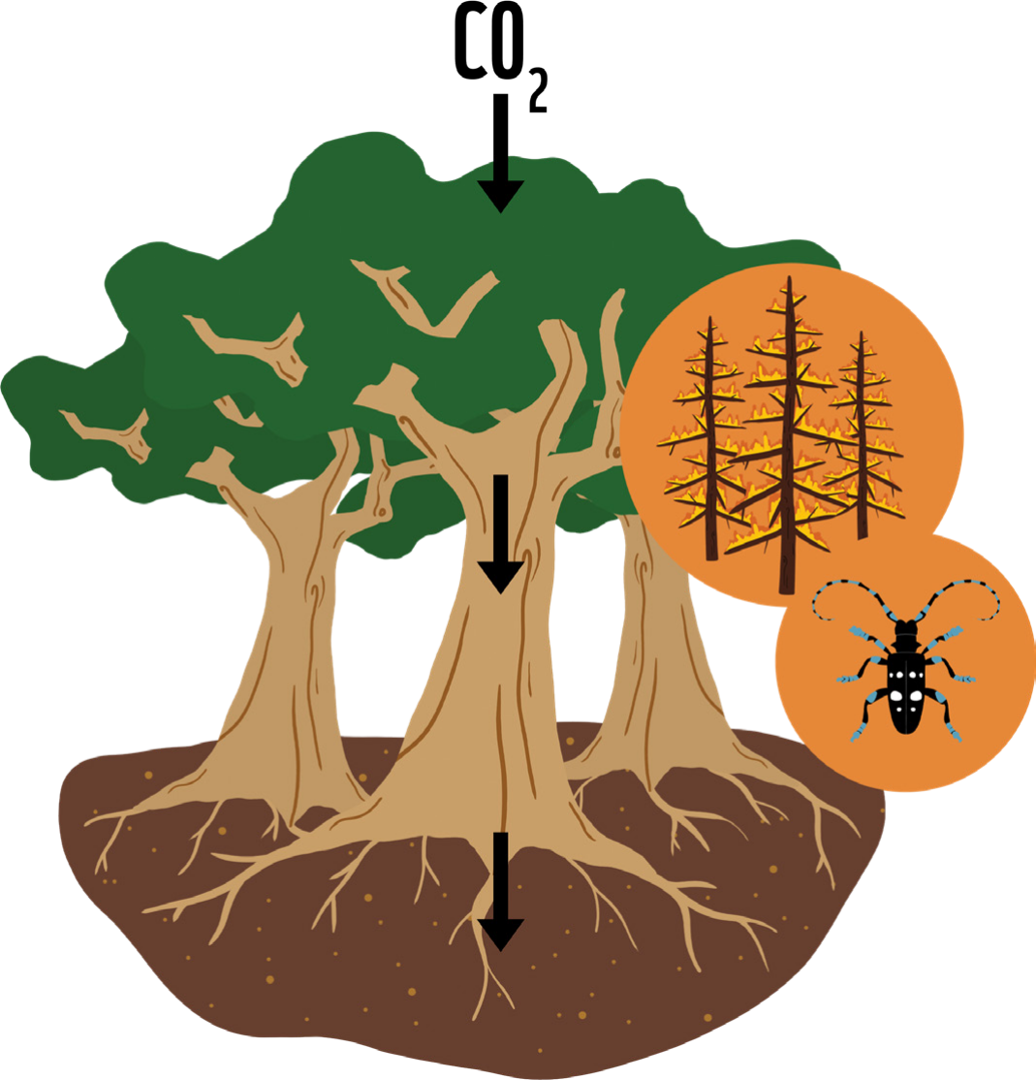
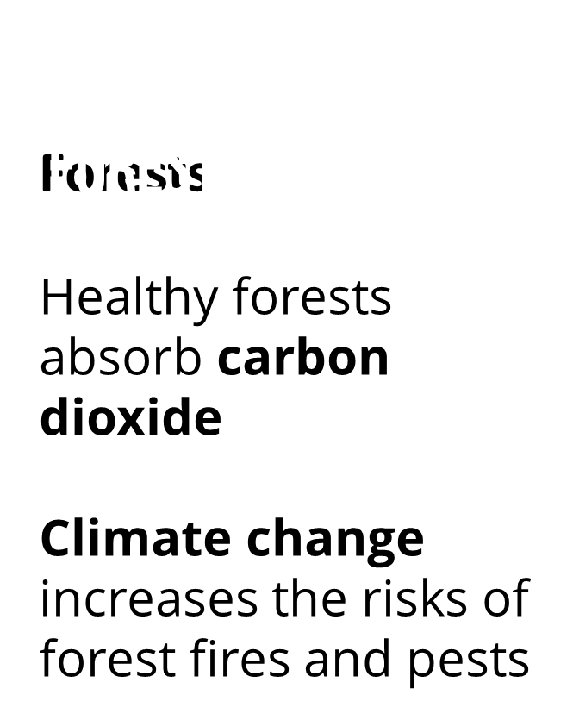
Notes:
Climate change is caused by there being too much carbon dioxide and other greenhouse gases in our atmosphere. This carbon dioxide comes from human activities like burning fossil fuels for energy and cutting down huge areas of forest around the world (known as deforestation).
Healthy forests can absorb carbon dioxide from the atmosphere (the bubble of gases around the Earth) and lock it into their roots, trunks and into the soil. That way they can help us in fighting climate change.
However, climate change increases the risks from forest fires and invasive pests, which are especially damaging for forests that are fragmented by human activities. If climate change damages our forests, they won’t be able to suck up carbon dioxide from the atmosphere.

Slide 8
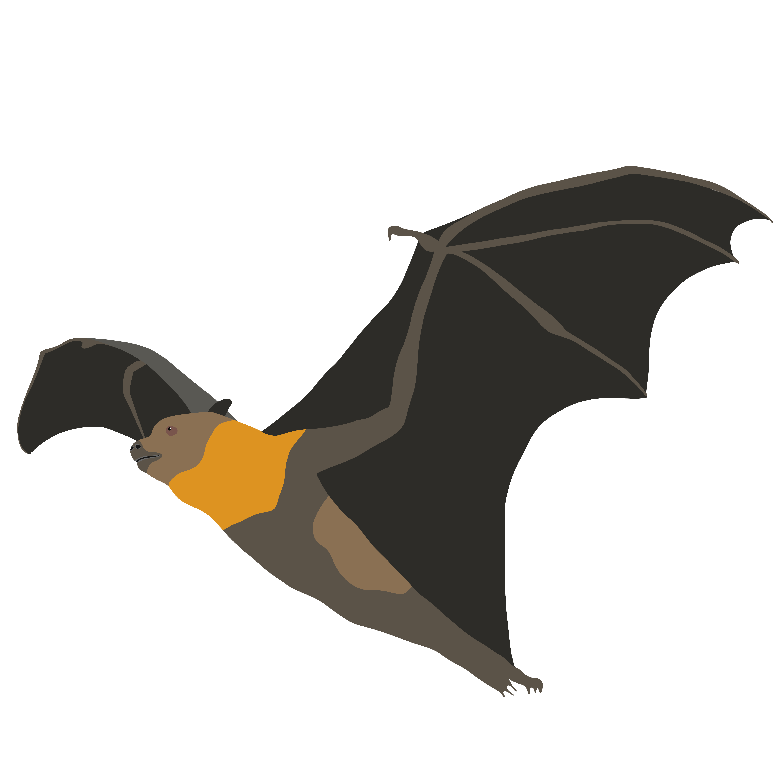
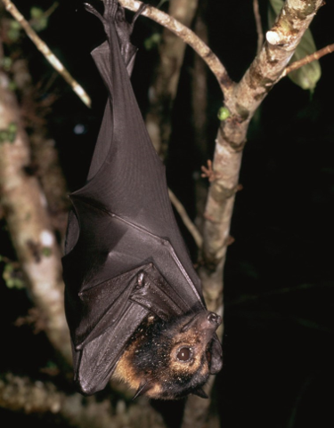
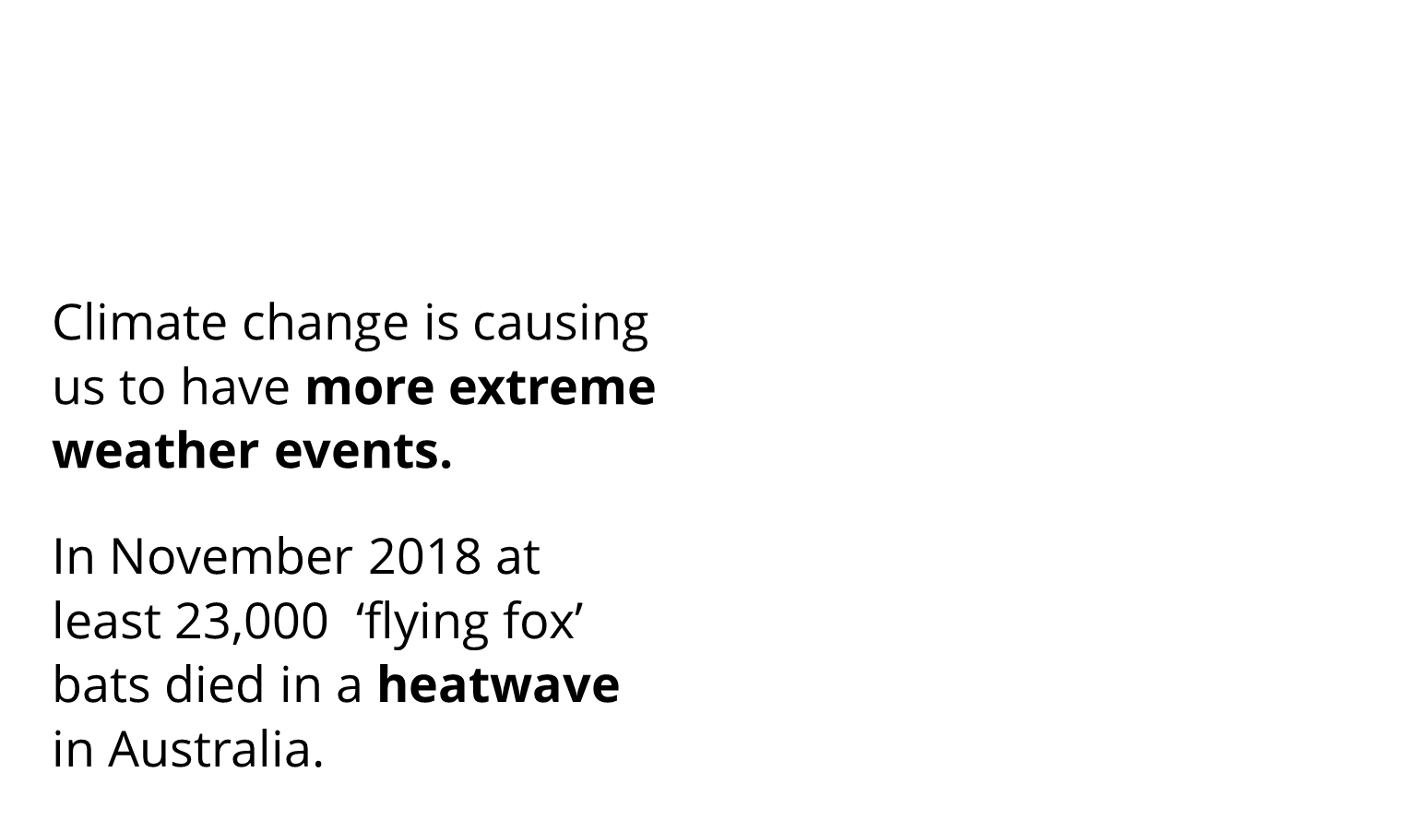
Notes:
Climate change is already causing us to have more extreme weather events like heatwaves, droughts, storms, floods and forest fires.
In November 2018 at least 23,000 ‘flying fox’ bats died over just two days in a heatwave in Australia. This event reduced the nation’s population of flying foxes by almost a third.​

Slide 9
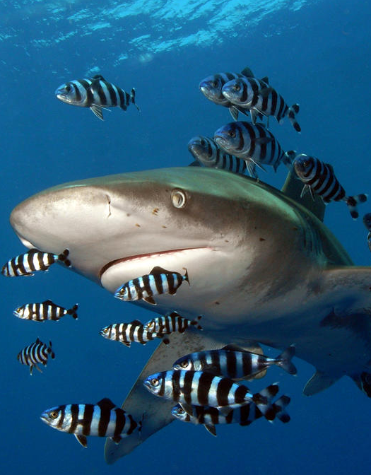

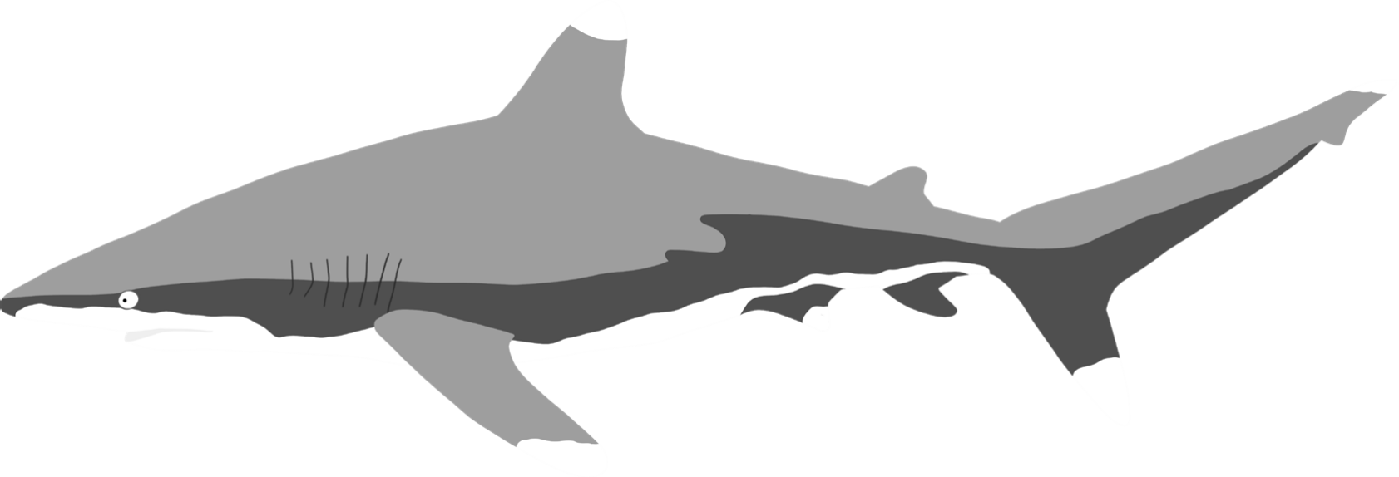
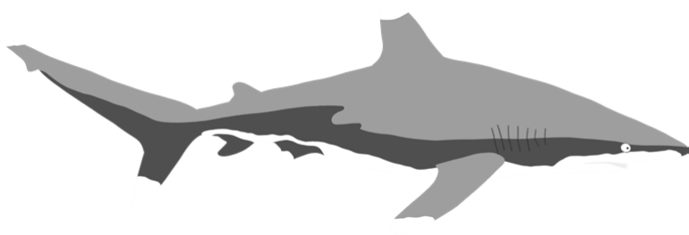
Notes:
The Living Planet Index shows an average decline in population sizes by 69%. But this is only an average – some species are affected more than others.
Populations of oceanic whitetip shark have declined by 95% globally, and this species is now classed as critically endangered on the IUCN Red List.
The population size of sharks and rays worldwide has dropped by over two thirds over the last 50 years, mainly due to fishing practices.
Sharks and rays are top predators in ocean food webs, and their loss can cause huge problems for other species when the ecosystem becomes unbalanced. For example oceanic whitetips spend most of their lives in deep water. They’re often accompanied by remora and pilot fishes (in the image). The whitetip sharks protect pilot fishes from other predators, and the pilot fish keep the sharks skin free of parasites. If there are less whitetip sharks in the ocean the pilot fish will no longer be protected from predators.

Slide 10

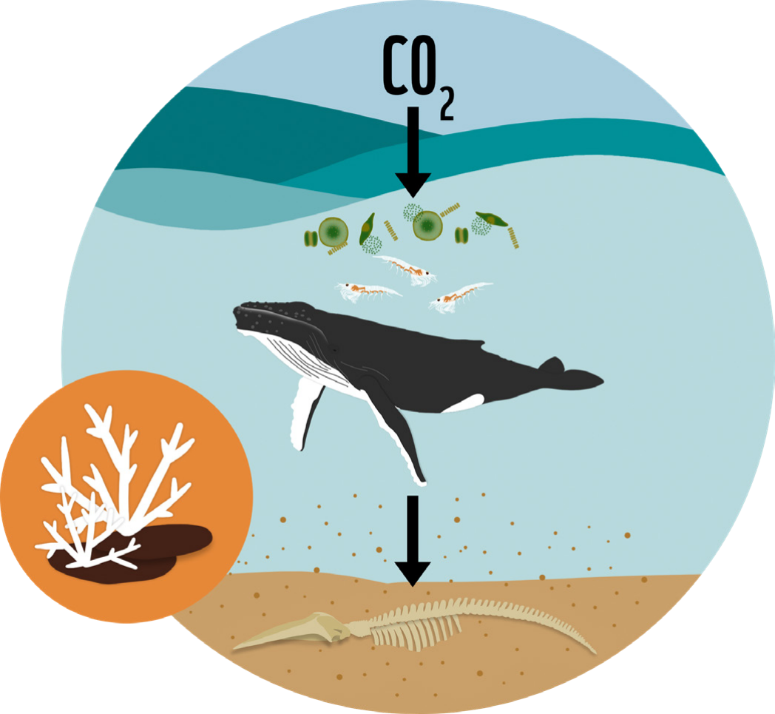
Notes:
Climate change is caused by there being too much carbon dioxide and other greenhouse gases in our atmosphere. This comes from human activities like burning fossil fuels for energy and cutting down huge areas of forest around the world (known as deforestation).
Tiny plants in the ocean absorb can carbon dioxide from the atmosphere. These microscopic plants (called phytoplankton) are eaten by animals and turned into poo or eventually just sink to the ocean floor as debris. Here they become stored in the sea floor mud and sediment and eventually turn into rock.
The ocean is important in tackling climate change, however climate change is already threatening key ocean habitats that are vital for wildlife – such as coral reefs.​

Slide 11
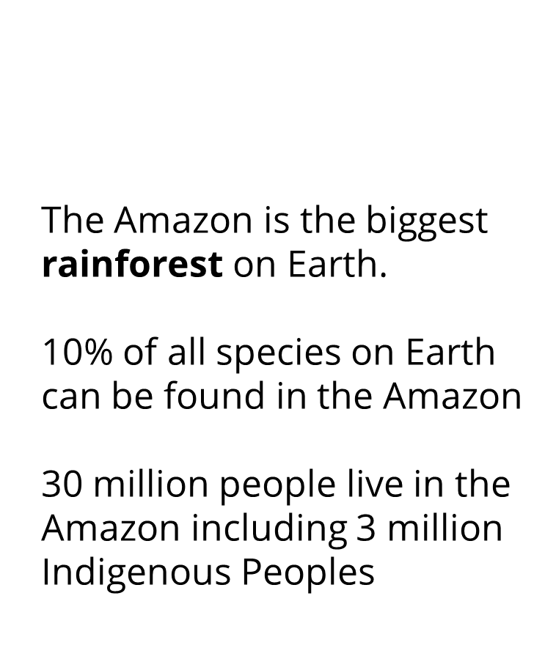
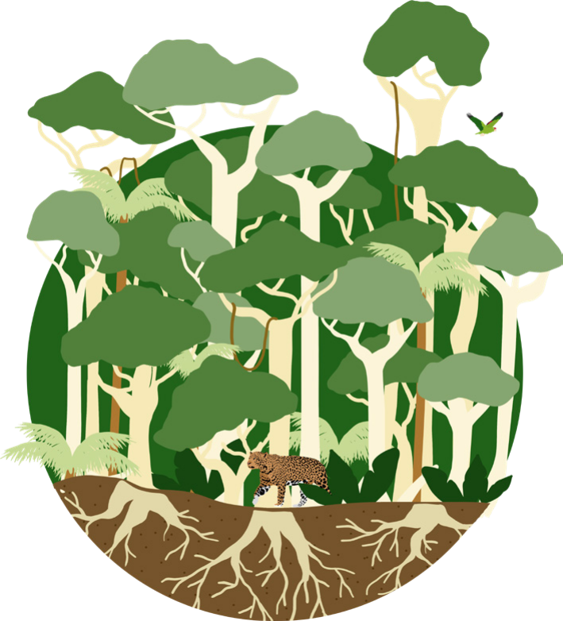
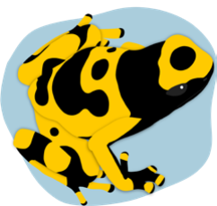
Notes:
The Amazon is the biggest rainforest on Earth and it is hugely important to nature and people.
Q: Where is the Amazon rainforest?​ A: South America
Q: What animals live in rainforests? Answers might include jaguars, frogs, birds, monkeys, insects, chameleons
10% of all species on Earth can be found in the Amazon and it is home to over 30 million people including 3 million Indigenous Peoples made from over 350 different groups.
Trees in the Amazon absorb huge amounts of carbon dioxide which gets locked up into their roots and trunks and into the soil. The Amazon also plays an important role in the world water cycle, releasing 20 billion tonnes of water into the atmosphere every day.
Q: What resources do we get from rainforests like the Amazon?
Answers include: wood, food, medicines, water, beauty products, metals, rubber
Q: What threats does the Amazon face?
Click to next slide for answers

Slide 12
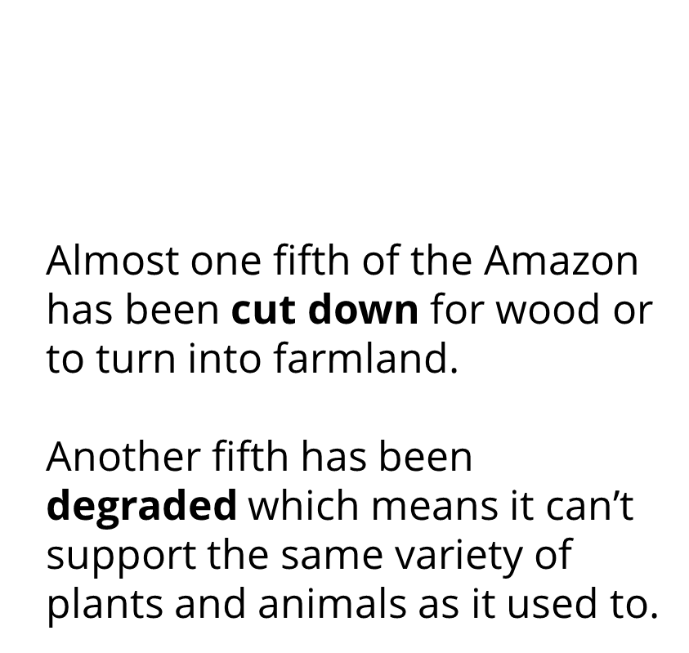
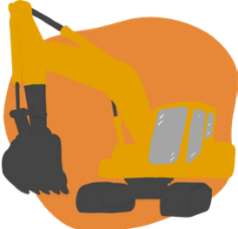
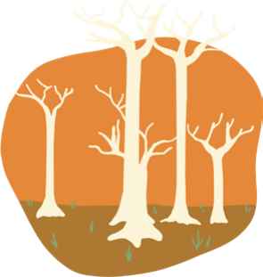
Notes:
We have lost 17% of the total forest cover in the Amazon due to felling of trees for timber or conversion of forest to farmland, and another 17% has been degraded. Land is described as ‘degraded’ when it is still got some trees left but it has been damaged and is no longer able to support same biodiversity as it used to.
Scientists say that if we continue to destroy the Amazon at this rate we will soon reach a point when the forest will no longer be able to work in the same way. It won’t be able to keep absorbing carbon dioxide and pumping out water into the atmosphere and this will have huge impacts on the planet’s ecosystems. The Amazon will gradually become drier and drier and become like a savannah – a grassy plan with few trees.

Slide 13
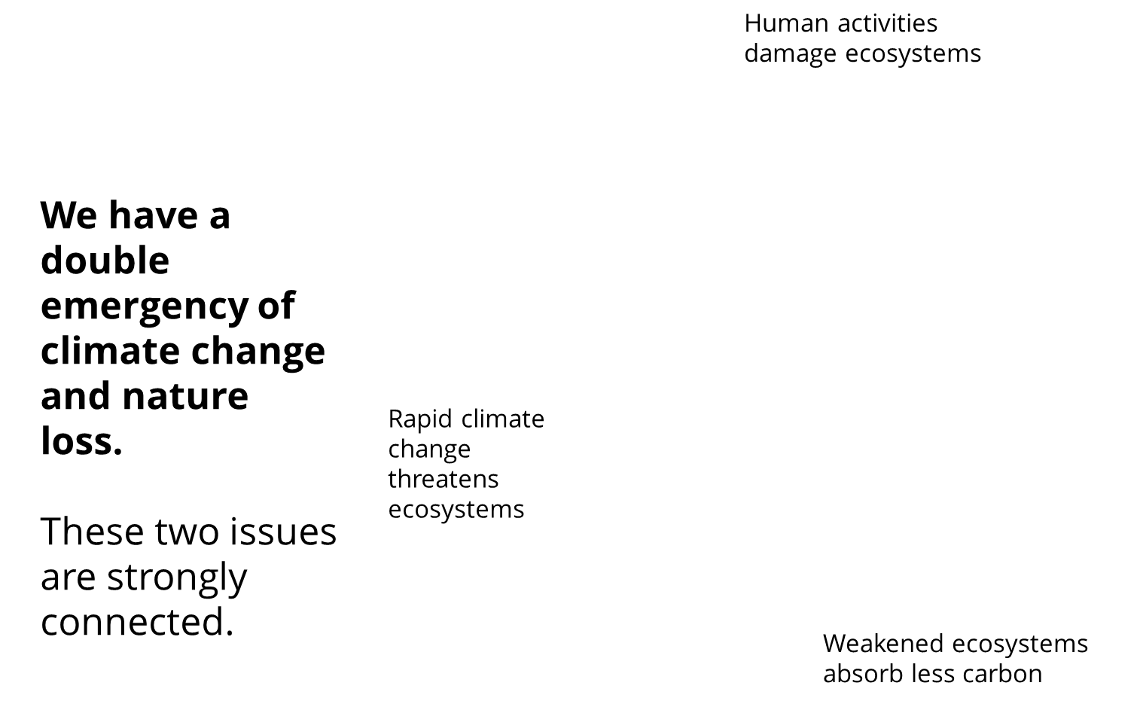
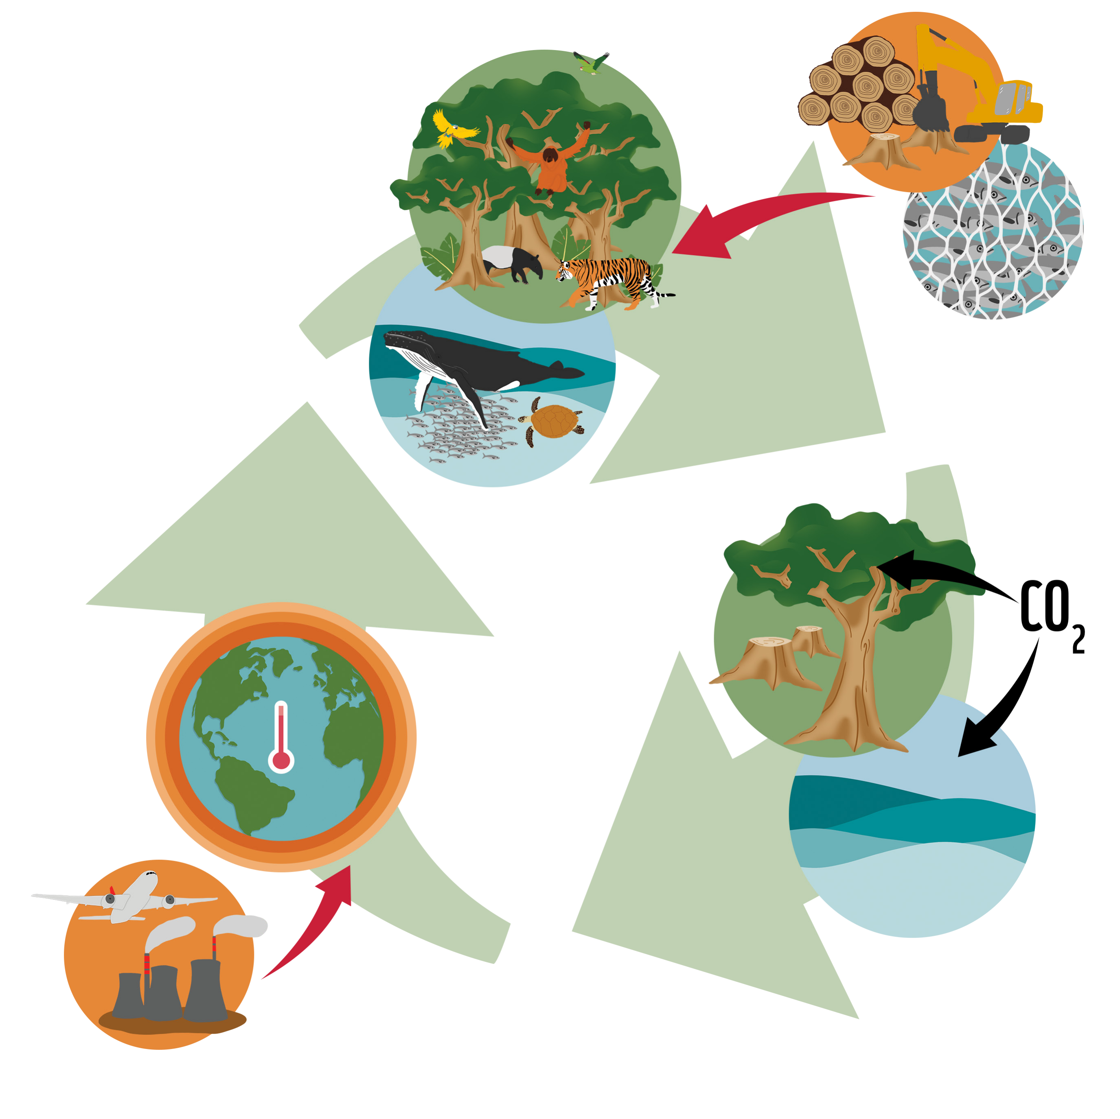
Notes:
Climate change is talked about more than loss of nature – but we need nature to stabilise the climate.
Forests and oceans cannot do their bit to absorb carbon if we destroy biodiversity.
The damage that is being caused to the natural world by habitat destruction is making our planet less able to absorb carbon dioxide from the atmosphere. In many cases human activities are causing the natural world to release even more carbon that was previously stored as wood or in the soil. This means that more carbon dioxide enters the atmosphere and speeds up global warming.
Climate change is already starting to have effects in the natural world, and if the average increase in global temperature is allowed to go above 1.5 degrees, climate change will become a greater and greater threat to wildlife.
We cannot solve either of these two problems unless we address both together.

Slide 14
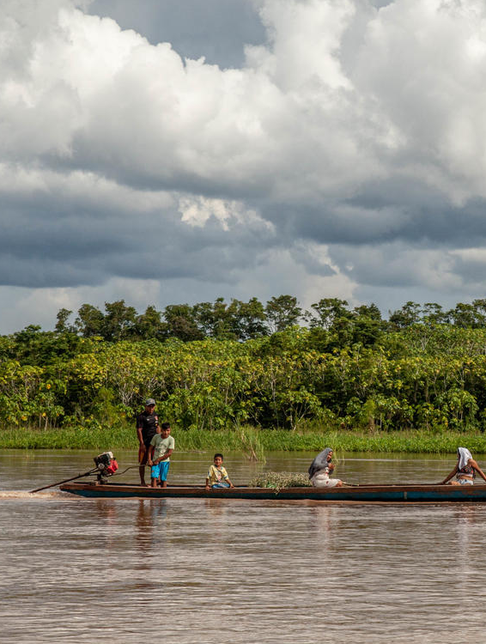
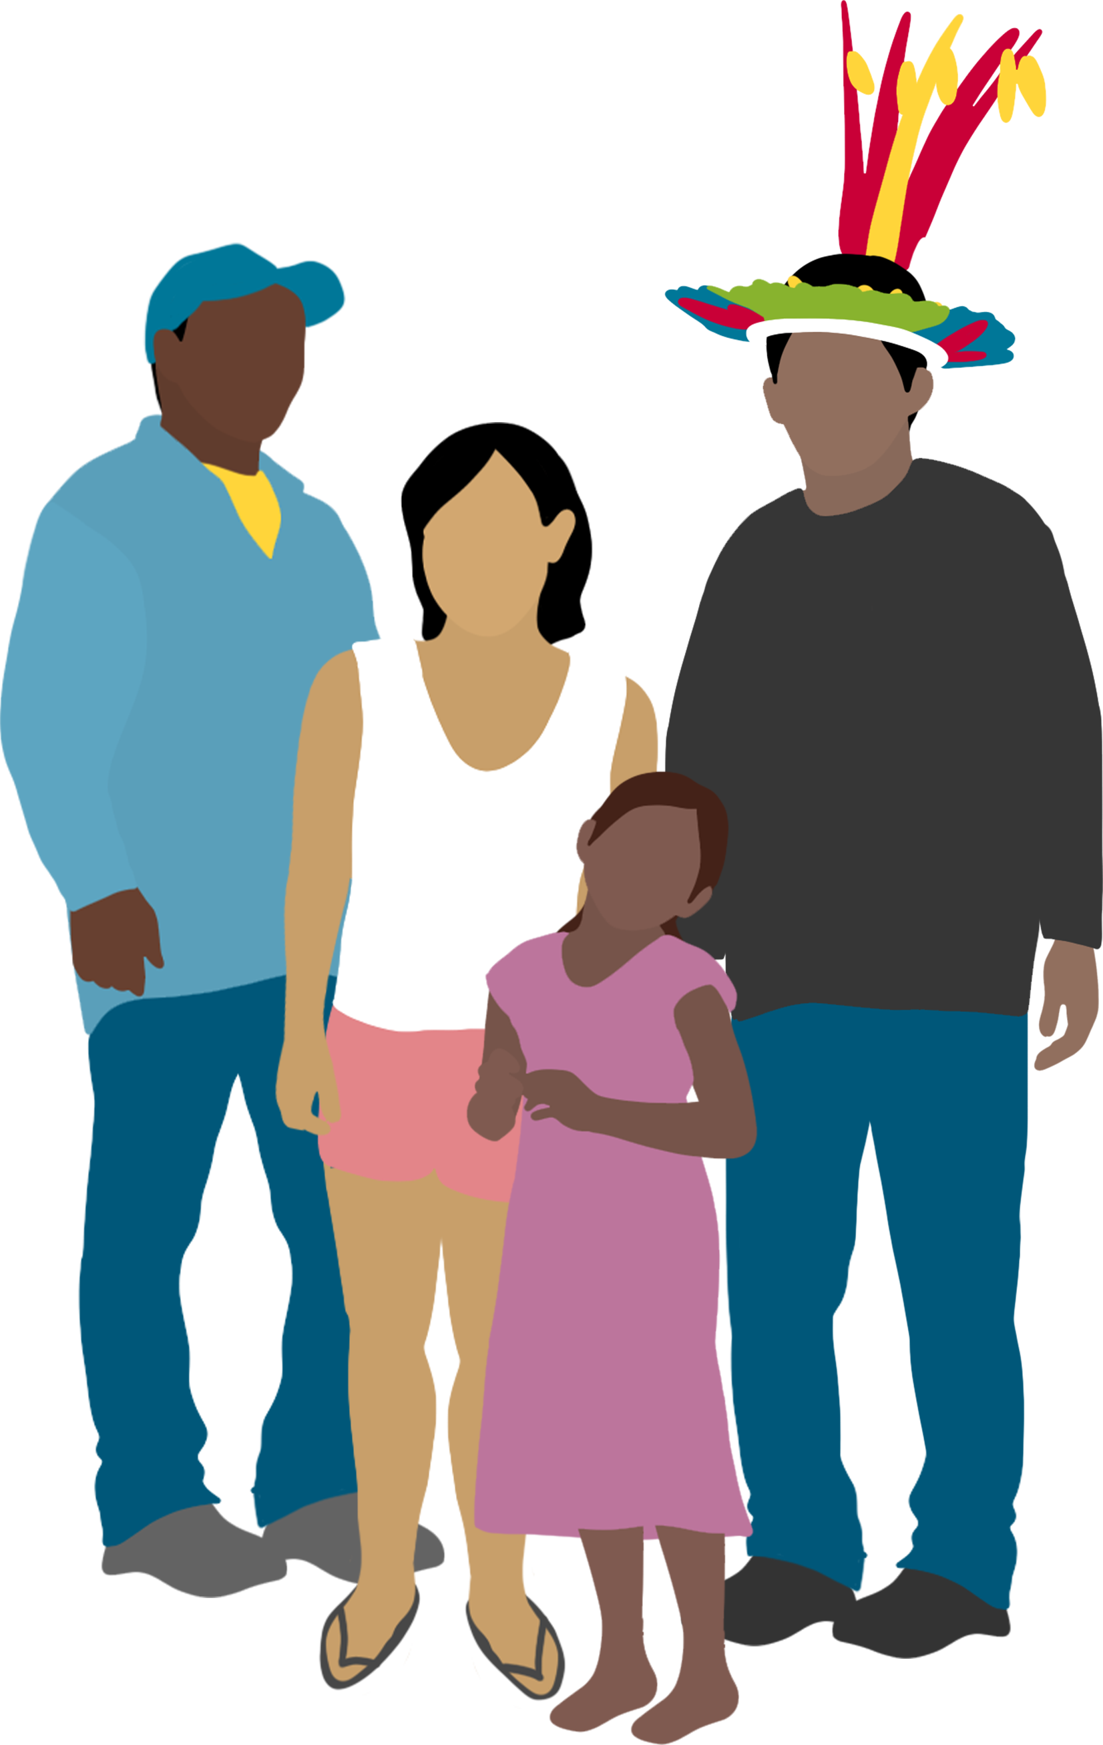
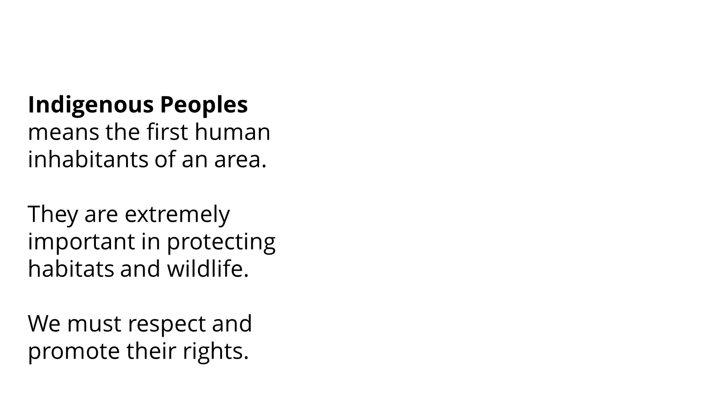
Notes:
Indigenous Peoples means the first human inhabitants of an area, who have traditions and culture associated with a landscape because they have generations of history there. We say ‘Peoples’ rather than ‘People’ because it refers to many different groups.
Indigenous peoples are very important to any effort to protect wildlife, because they often have the best understanding of the ecosystem and how to draw benefits from a habitat without breaking the natural balance. Often they are the most affected by issues caused by things like deforestation, pollution and climate change, despite not being to blame for these practices and the resulting problems. This means that as well as protecting wildlife in a landscape, we must respect and promote the rights of Indigenous Peoples.
Since 2007 more than 140 countries around the world have agreed to respect and protect the rights of Indigenous Peoples, set out in The UN Declaration on the Rights of Indigenous Peoples.

Slide 15

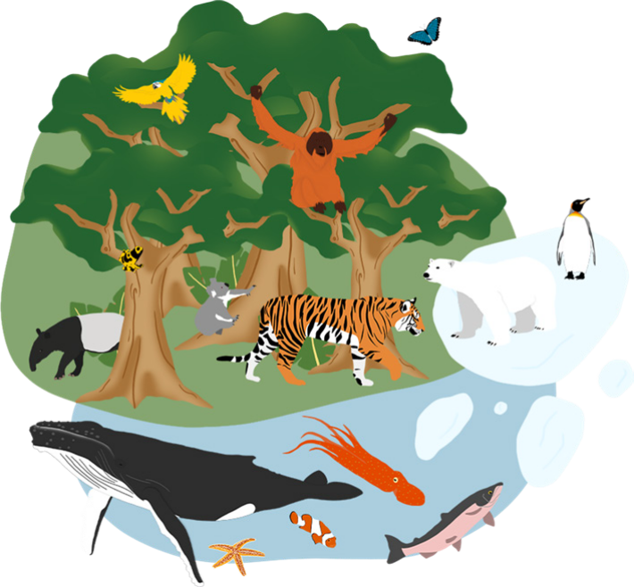
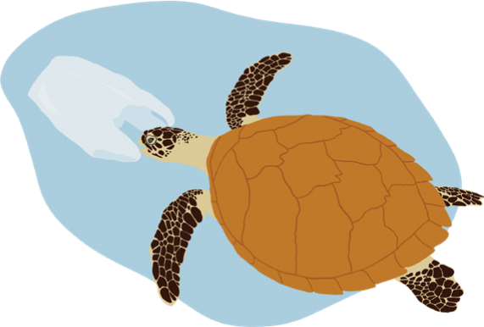
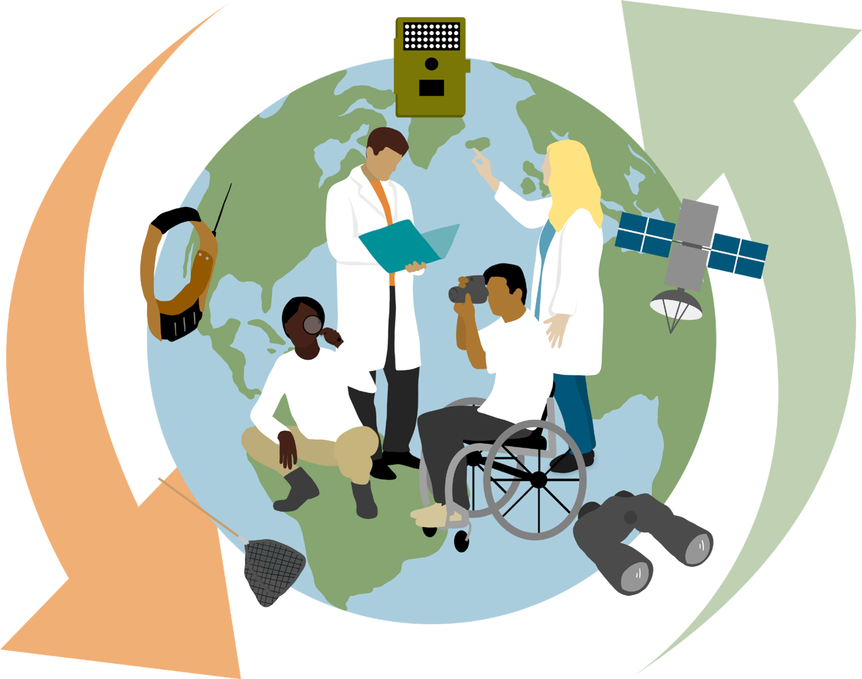
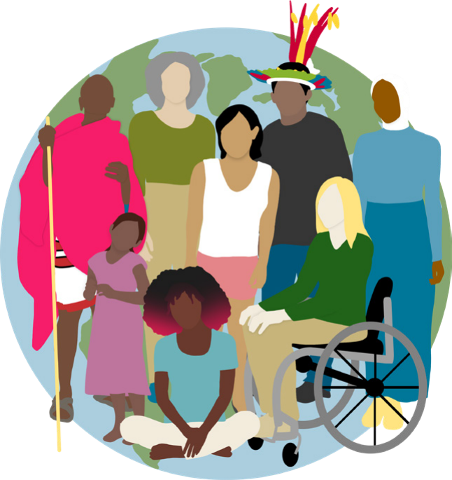
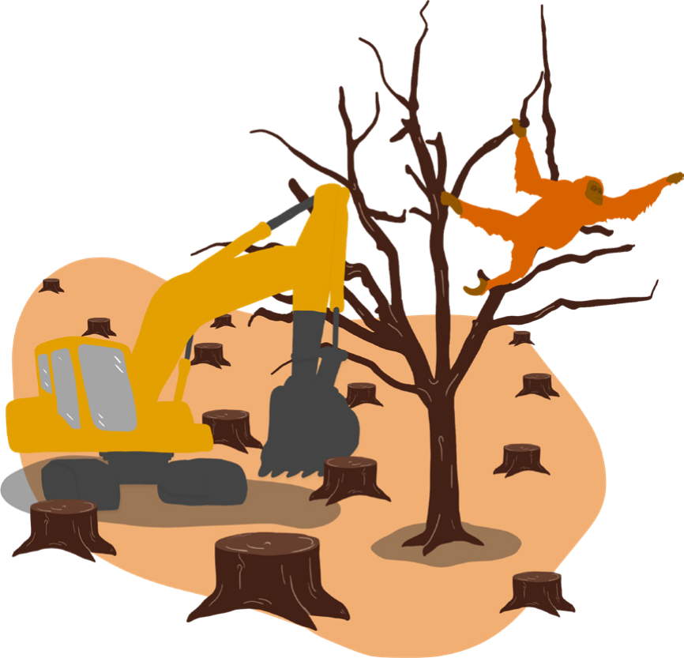
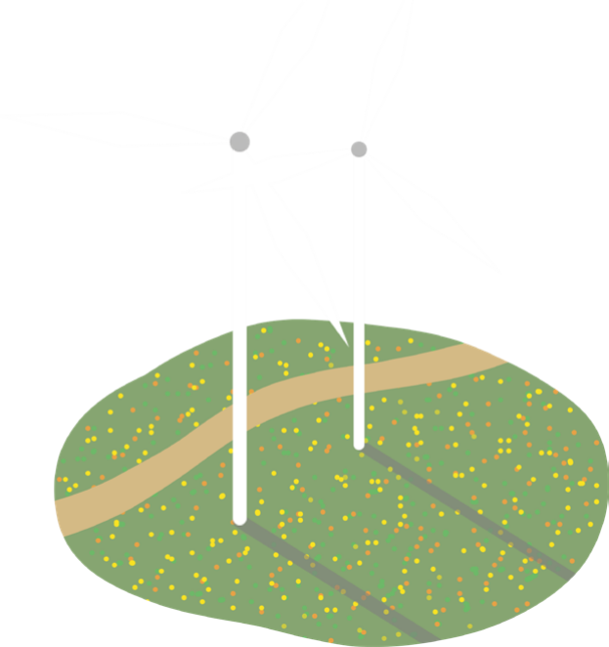
Notes:
We need to change our relationship with nature. We need to change from a world with declining nature, climate change, pollution, habitat loss and wildlife extinctions to a healthy living planet that works for nature, people and climate.
Nature: We need habitats to be restored and wildlife to be allowed to move freely across the landscape.
People: We need to manage natural resources fairly to ensure everyone has access to healthy food and a stable environment. We need to listen to Indigenous Peoples who are often the most knowledgeable about getting benefits from nature without upsetting the natural balance. We need to support communities most affected by climate change and nature loss and make sure they are involved in decisions that affect their lives, and support them to adapt.
Climate: We need to cut down our global carbon emissions and make sure we are using renewable energy and sustainable practices. We need to make sure our planet doesn’t warm up by more than 1.5 degrees above average.
Q: How can we help at home or at school?
Some suggestions on next slide

Slide 16
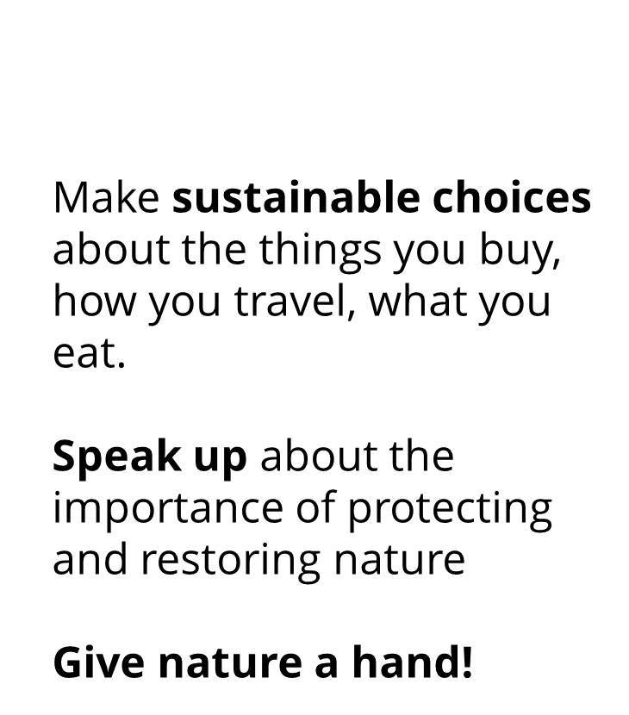

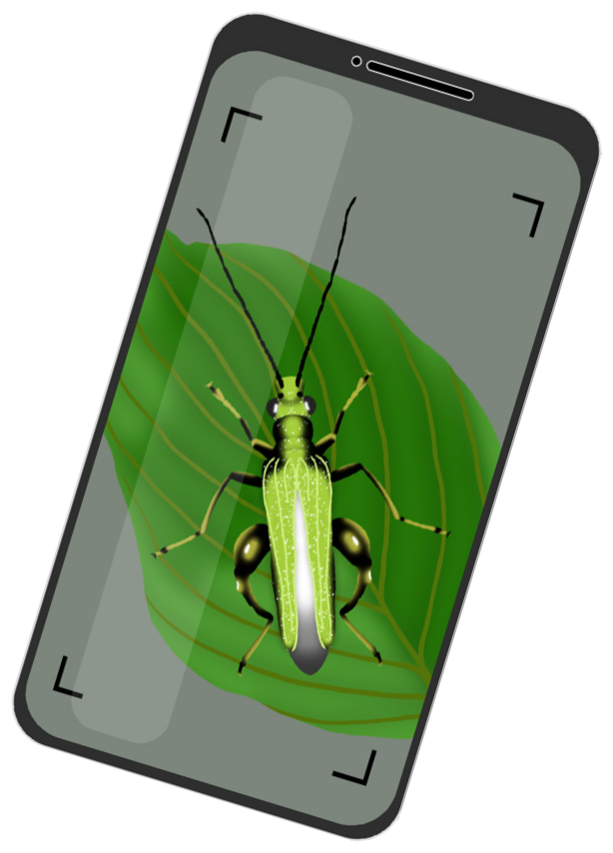
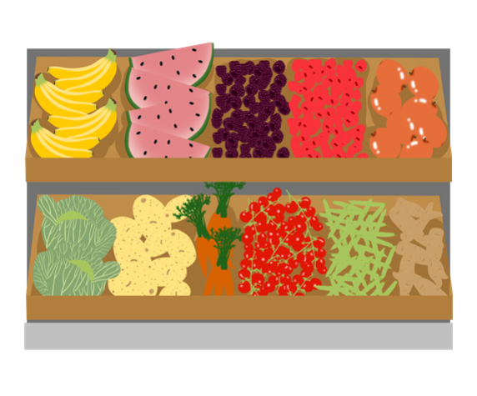
Notes:
Make informed choices about what you eat, the way you travel and the things you buy. If you don’t know what the impact on the planet might be, try to find out.#
Speak up about the importance of protecting and restoring nature through peaceful protest, blogging, writing for a local paper or sharing your thoughts with your school, local decision-makers and businesses. Remember that the people you influence may then be able to make have more impact through their choices and actions than you.
Give nature a hand. Whether you live in the heart of a city, on the seashore, or in the countryside, your local patch is part of a connected living landscape, and when it supports wildlife the whole world benefits. Get out and see what wildlife shares your local environment, record it to help scientists monitor the health of our living planet, and see what you can do to help local wildlife thrive. Could you plant more trees, or create new habitats such as a pond, woodpile or bird box?
Use the free Seek by iNaturalist app to identify, record and submit your wildlife sightings, and you can help scientists monitor global biodiversity.
Q: What could you do as a class to help?

Slide 17
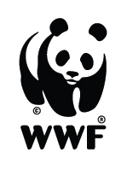
Notes:
Questions from students

