Slide 1
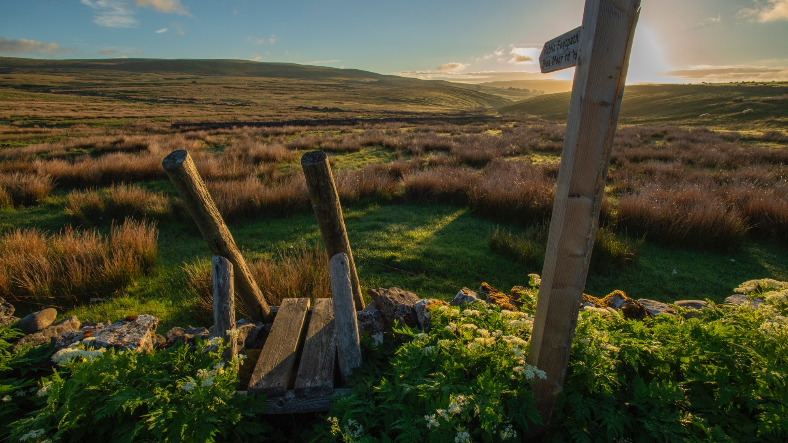
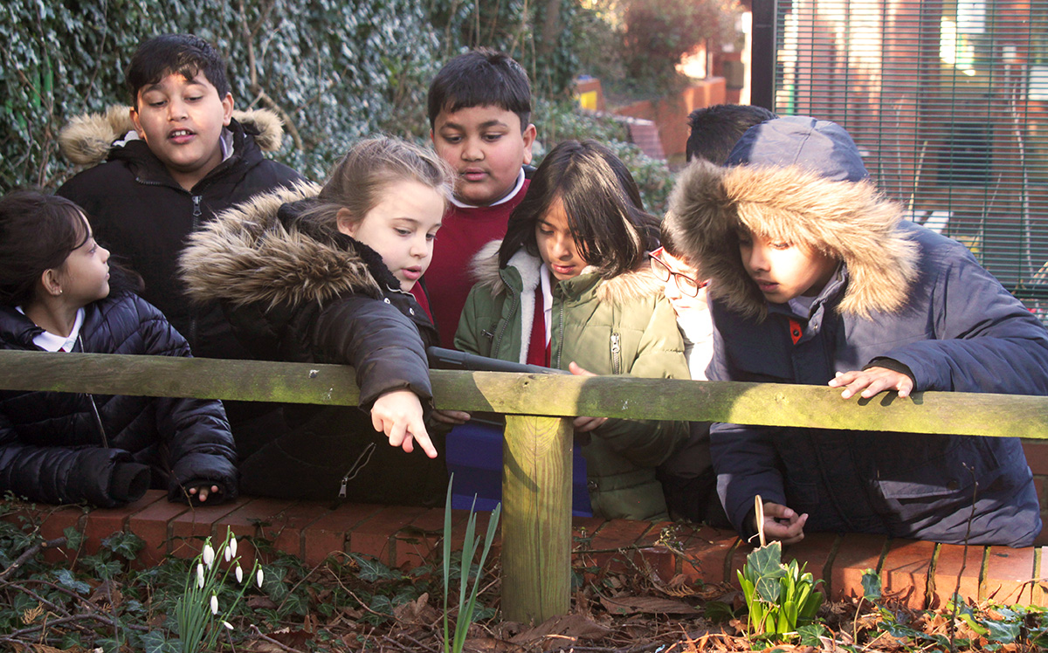



Schools
For Nature
© Matt Larsen-Daw/WWF
SCHOOLS
FOR NATURE
Teacher CPD
Vicki Allan & Caroline Howkins

Slide 2
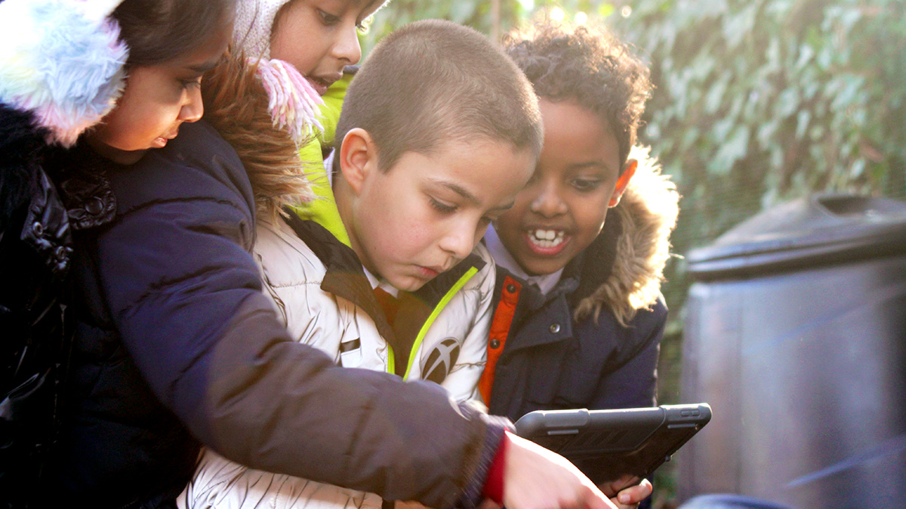
AGENDA
LEARNING OBJECTIVES
Why is nature important
How to start helping nature in your school grounds through connection activities
Resources
Schools For Nature
Greater awareness of the qualities and importance of four key biomes in the UK landscape, and the issues that threaten these key ecosystems.
Increased understanding and ability to communicate the importance of school grounds in improving the UK’s biodiversity.
Increased understanding on how to build nature experience into cross curricular lessons and connect students with nature to aid their learning and well-being.
Awareness of how to take part in Schools for Nature and the resources and support available.
© photo image credit
Notes:
Why is nature important
How to start helping nature in your school grounds through connection activities
Resources
Schools For Nature

Slide 3
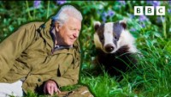
Notes:
Wild Isles is a new landmark natural history series, co-produced by WWF and RSPB, that will reveal a previously unseen wild side of the UK – and show why our isles are so important globally for nature.
The five-part series explores and celebrates the UK’s four key habitats – grasslands, woodlands, freshwater, and marine. Filmed over three years, the series uses the very latest technology to showcase dramatic new behaviour and previously unseen wildlife spectacles from across our wild isles – from battling butterflies to hunting sea eagles and killer whales.
It is available on BBC iplayer.

Slide 4
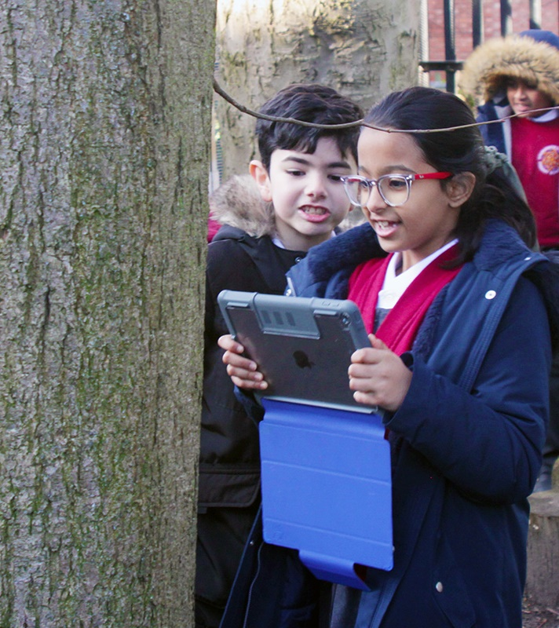

WHAT WE’RE DOING AND WHY WE’RE DOING IT
38 million birds have vanished from our skies in the last 50 years
97% of our wildflower meadows have been lost since the 1930s
A quarter of all our mammals are at
risk of extinction
© Matt Larsen-Daw/WWF
Notes:
The UK’s wildlife is amazing – but it’s in crisis. 38 million birds have vanished from our skies in the last 50 years, 97% of our wildflower meadows have been lost since the 1930s, and a quarter of all our mammals are at risk of extinction. We’ve lost so much, we’re now one of the 10% most nature-depleted countries in the world. Time has almost run out, but we have just enough of the natural world left to help it recover. We know what we need to do – and everyone has a part to play.
Nature is our life support system. It’s the web of life on which we all depend. When we work with nature and not against it, we have cleaner air to breathe, better water to drink, healthier food to eat. And science shows that time spent in nature makes us happier and healthier.

Slide 5

© Matt Larsen-Daw/WWF
What lessons do you teach outside?
© photo image credit
Notes:
Thinking about your answers to the question on the slide, think about whether during these lessons you were teaching:
About nature – facts and concepts explained in theory (classroom)
In nature – accessing benefits of nature through outdoor learning, though not necessarily using direct experience of the natural world for educational activities
Through nature – structured, guided experience of nature to see and feel concepts first hand.

Slide 6

ar
CONTACT V CONNECTION
Children who don’t connect with nature before the age of 12 are less likely as adults to connect with nature.
Children who express greater connection with nature are more likely to report taking action to care for nature.
Notes:
Contact v Connection.
There is a difference between being in nature and connecting with nature. It is a connection with nature that has the largest impact on whether an individual will take action to care for it.
Studies have shown that children who don’t connect with nature before the age of 12 are less likely as adults to connect with nature. We can’t guarantee that all children will have the same access to nature when outside of school, which is why it is so important to ensure that regular opportunities to connect with nature are built into our curriculums. In doing so, often common species will hold more engagement opportunities than something that is rare or fleeting. So, it is important to focus on the things children find themselves, as this gives a sense of pride and ownership and the opportunity for them to repeat the activity and discovery to deepen their connection to nature themselves.

Slide 7
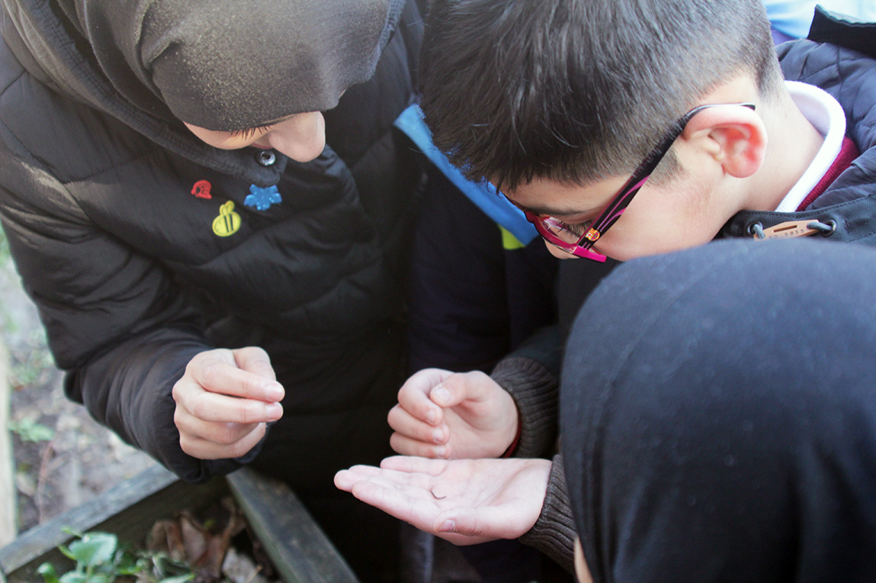

© Matt Larsen-Daw/WWF
Notice 3 good things
in nature
Connecting through the senses
50% more nature connection from noticing
Notes:
A study was carried out asking participants to notice and note 3 good things in nature each day for 5 days. Here there was a significant increase in connection. The 3 good things were not species or knowledge-based things, more about senses and the emotion things elicited e.g. sun warming the skin, the sound of the wind in the leaves etc.
50% more nature connection comes from noticing than time in nature.
The important thing to remember is there are ways of embedding opportunities for nature connectedness throughout your curriculum without having to plan a whole new topic. You can move the focus away from teaching whole lessons outdoors, to working in meaningful opportunities to connect which serve as inspiration for work back in the classroom.
Evidence
https://findingnature.org.uk/2017/12/04/nature-knowledge-or-nature-connection/
Richardson, M., Passmore, H. A., Barbett, L., Lumber, R., Thomas, R., & Hunt, A. (2020). The green care code: How nature connectedness and simple activities help explain pro-nature conservation behaviours. People and Nature.

Slide 8
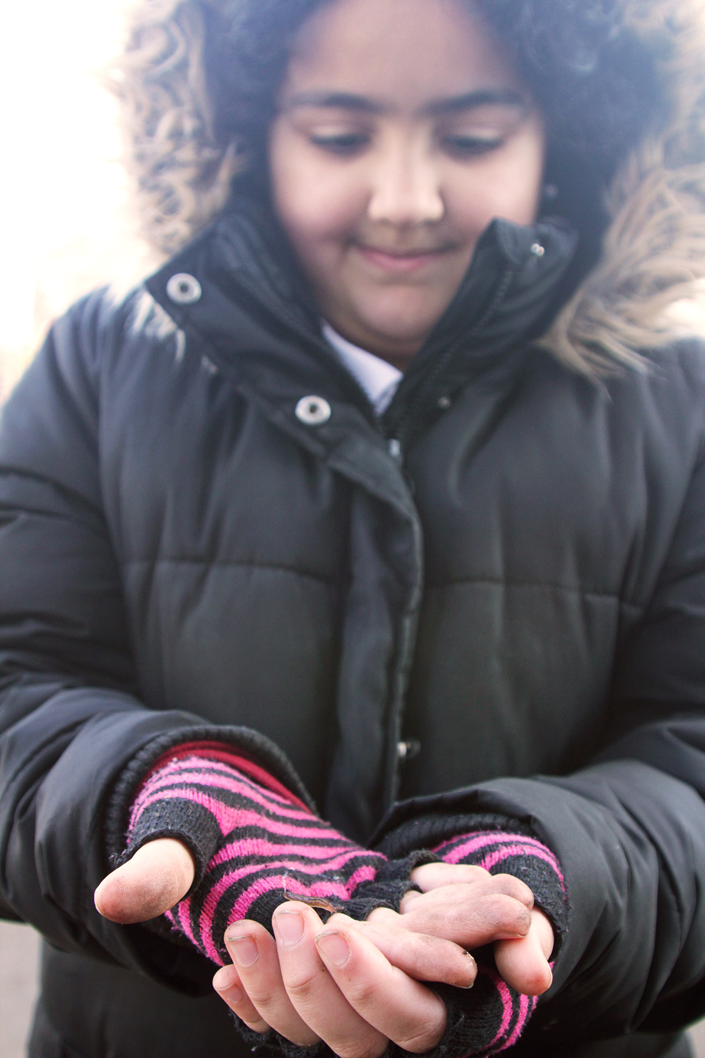
5 CONNECTION PATHWAYS
© Matt Larsen-Daw/WWF
Notes:
To start we can look at 5 types of positive relationship associated with nature connectedness which have been identified. These are the pathways to nature connectedness, activities in nature that involve:
Contact
Beauty
Meaning
Emotion
Compassion
As we walk through the pathways, we’ll be looking at the simplest ways to merge the experiences with what you may already have planned for the coming term. It is important to understand that a connection activity does not necessarily need to take up a whole lesson. You can use part of your lesson to go outside and connect with nature and use the experience to inspire different subjects across the curriculum.

Slide 9
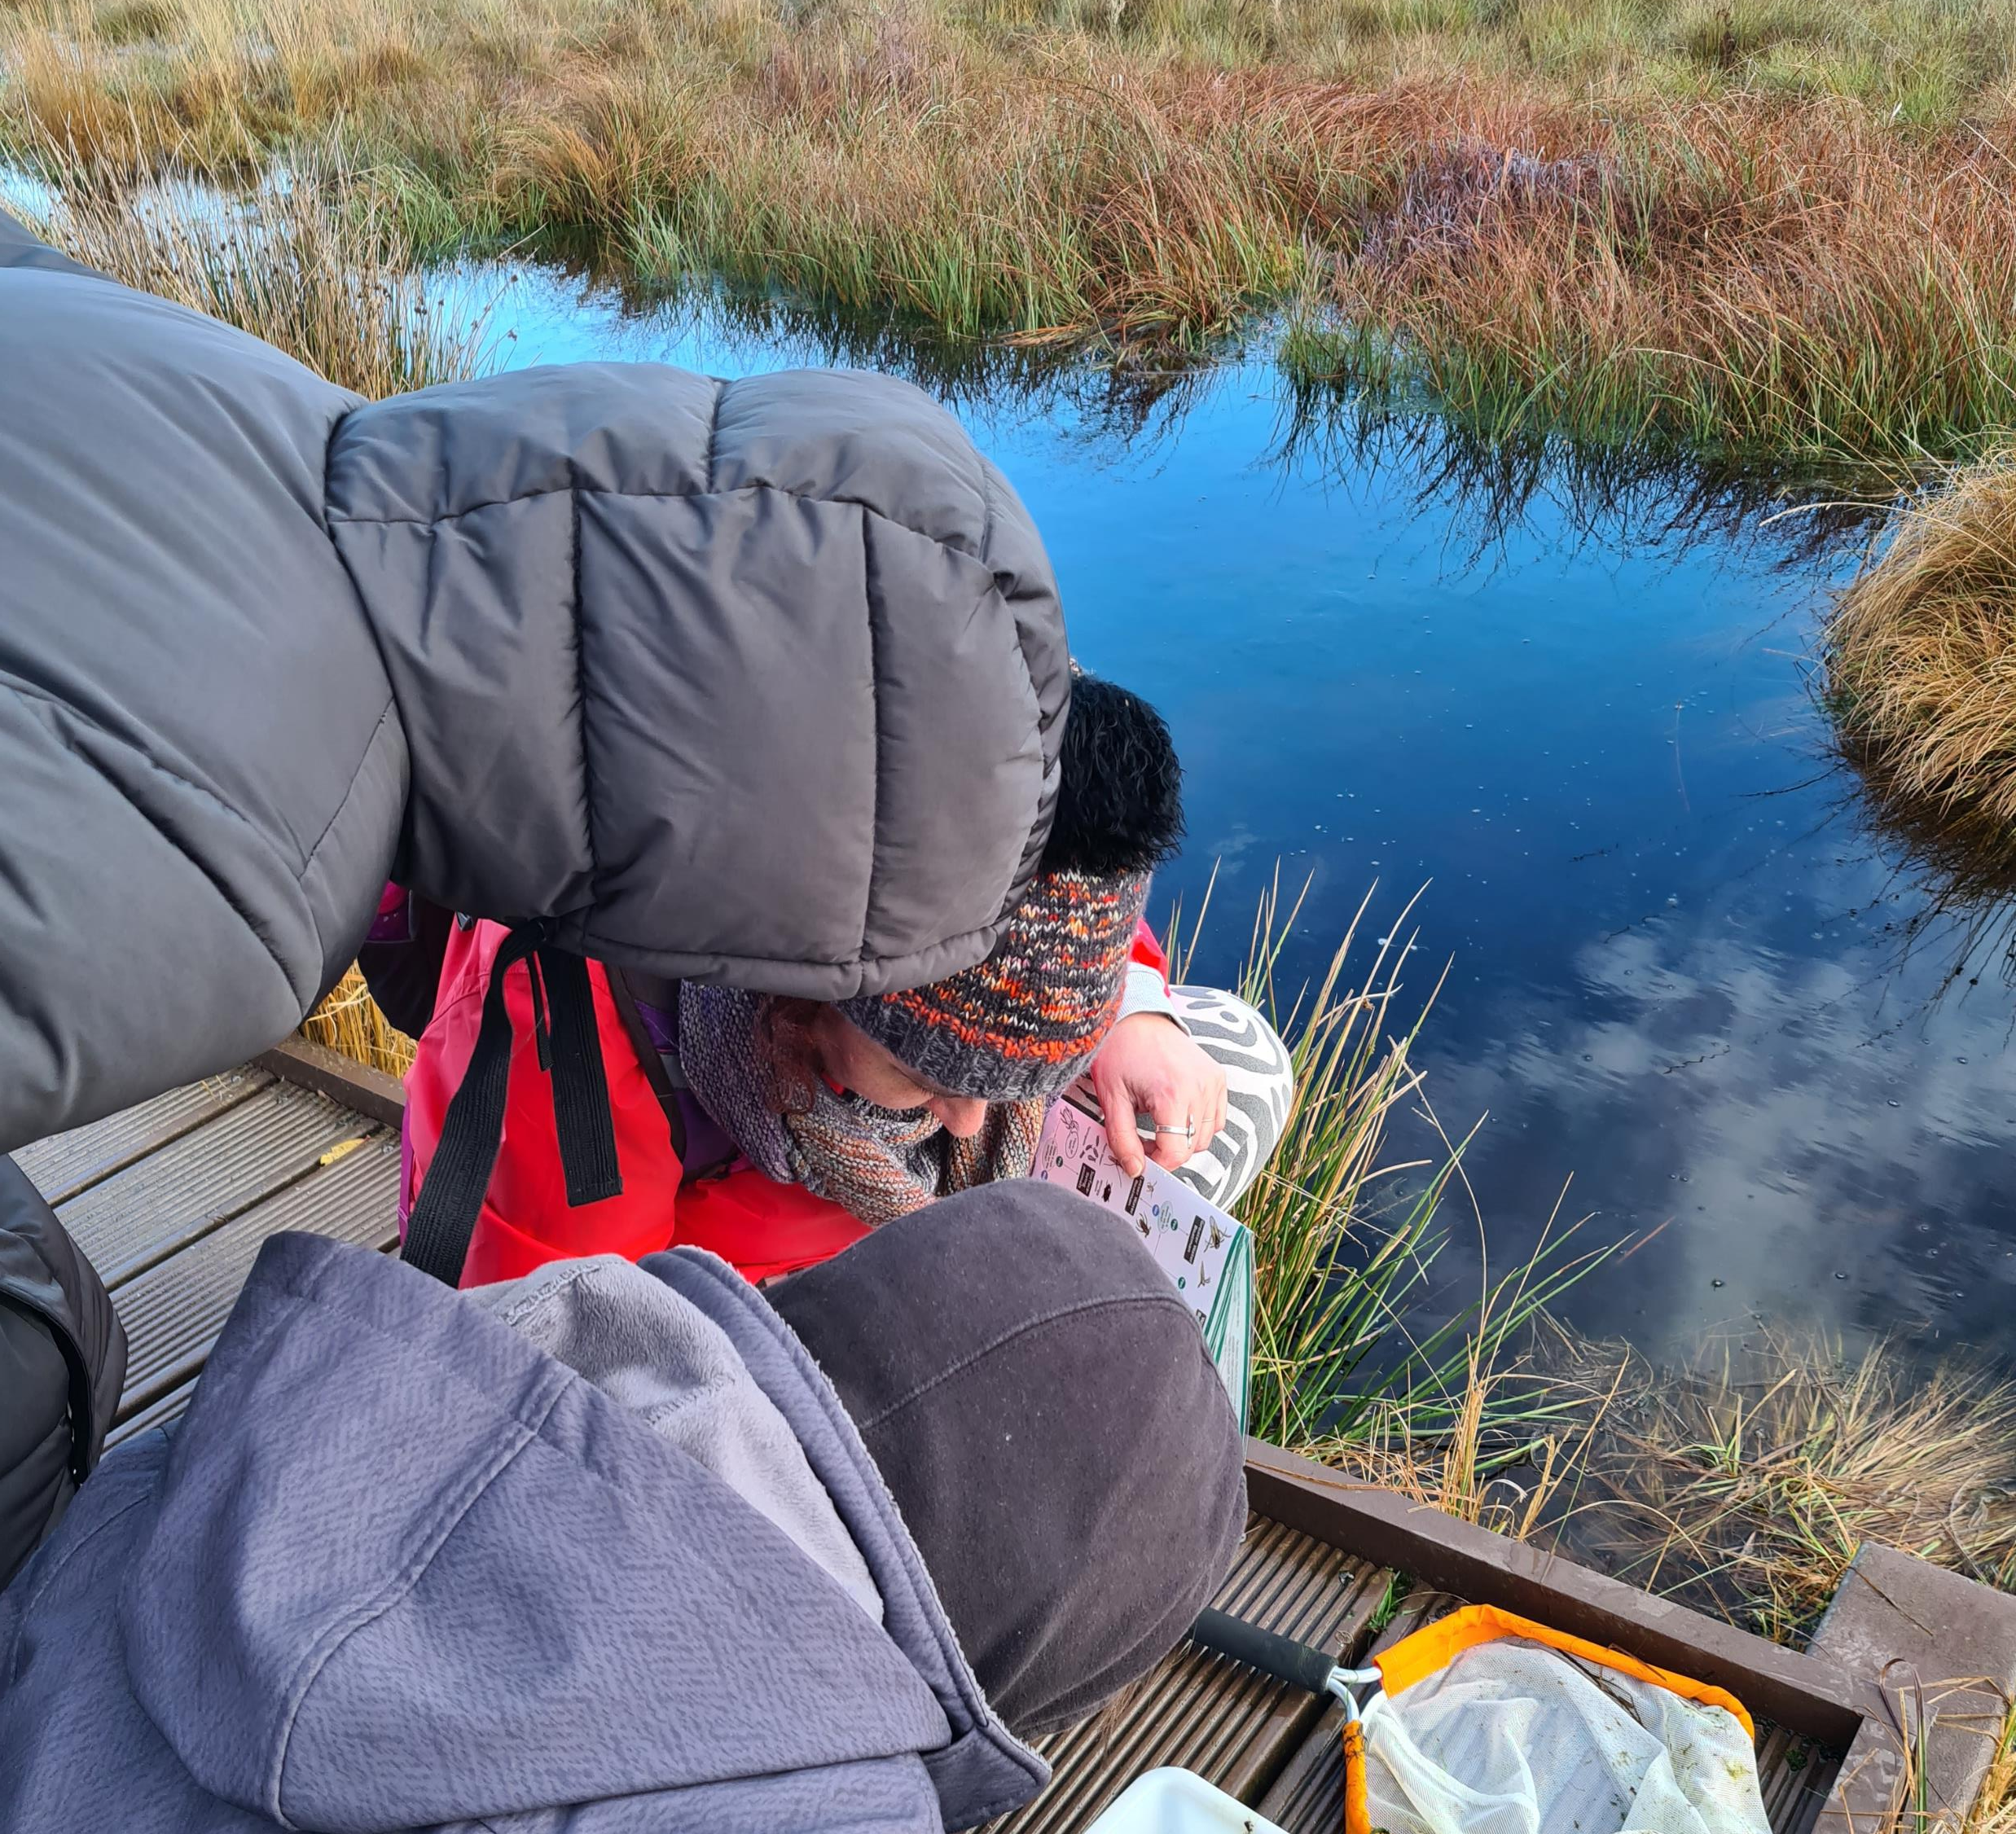
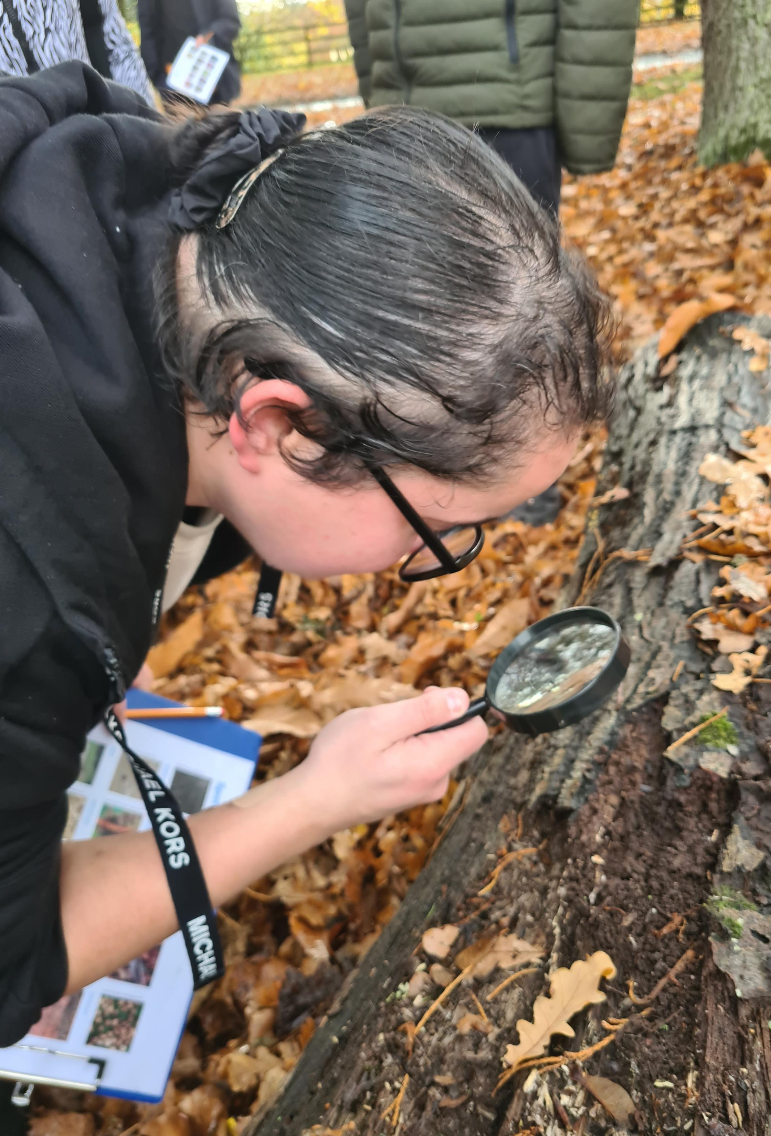

© RSPB Wild Challenge Submissions
CONTACT
Notes:
The first pathway we will look at is Contact. The act of engaging with nature through the senses for pleasure e.g. listening to birdsong, smelling wildflowers or watching the sunset.
People with good nature connectedness tend to be happier. Nature can generate many positive emotions, such as calmness, joy and creativity and can facilitate concentration.
By embedding connection to nature activities throughout your curriculum you will be providing your pupils with the opportunity to increase the amount of time they spend in nature. For some this will be very little outside of school, which is why it is so important for us to nurture their relationship with the natural world.
By expanding your pupils' experiences and giving them opportunities to experience how nature makes them feel, can be used as inspiration for work back in the classroom. The feeling of sun on their skin or how a gust of wind feels blowing through their hair. The memories triggered by certain smells could be used to inspire creative writing for example.

Slide 10
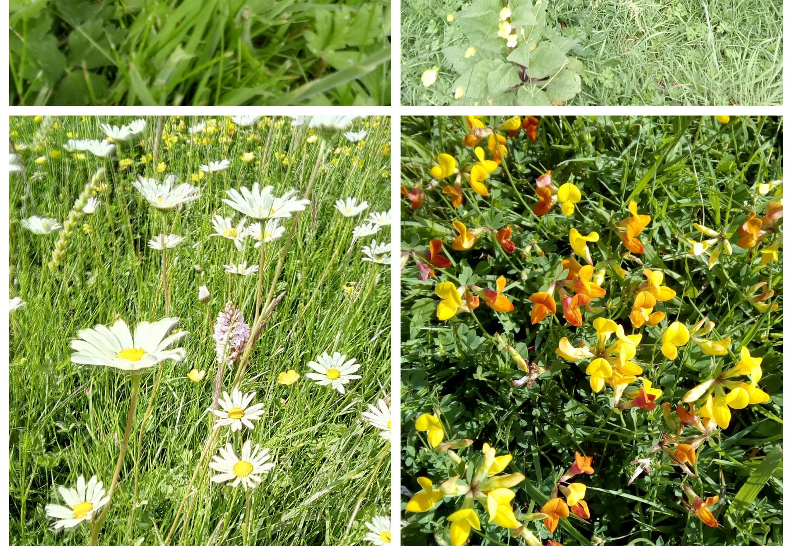
BEAUTY
© RSPB Wild Challenge Submissions
Notes:
The next is noticing natures beauty and engaging with the aesthetic qualities of nature, for example appreciating natural scenery or engaging with nature through the arts.
Practical examples might be Wild Art, painting the amazing colours of insects, taking photos of a flower or visiting somewhere with an amazing view.
While your pupils are noticing more about the nature around them, this is a great opportunity to start building a vocabulary bank that can be used for across different subjects. For example, pupils can use a list of describing words for something they have seen whilst exploring. Depending on the ability level and year group this could be for creative writing, or they could be describing a habitat for a particular animal linked to the Science curriculum. Children have to look at something inconspicuously so no one knows what they’re looking at. They then write down a list of words or phrases to describe what they’ve been looking at before swapping with a friend, and trying to find what their friend has described.

Slide 11
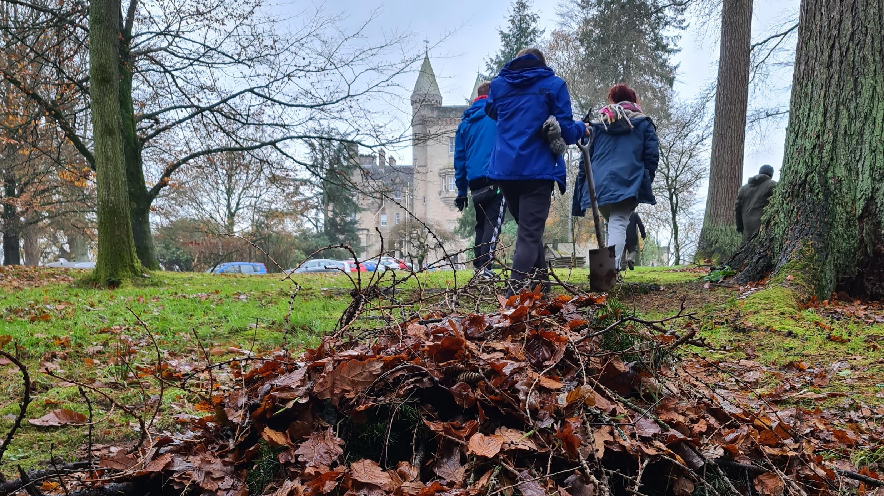

MEANING
© RSPB Wild Challenge Submissions
Notes:
Thirdly, allowing nature to bring meaning to our lives.
For this, explore and notice how nature appears in songs, stories, poetry and art. How special places are natural places. Celebrate the mystery, signs and cycles of nature.
Use nature or natural symbolism (e.g. language and metaphors) to represent an idea, enjoying the first swallow of summer, the first fall of leaves, create a story about a tree, map the journey of a bumblebee, celebrate the longest day.

Slide 12
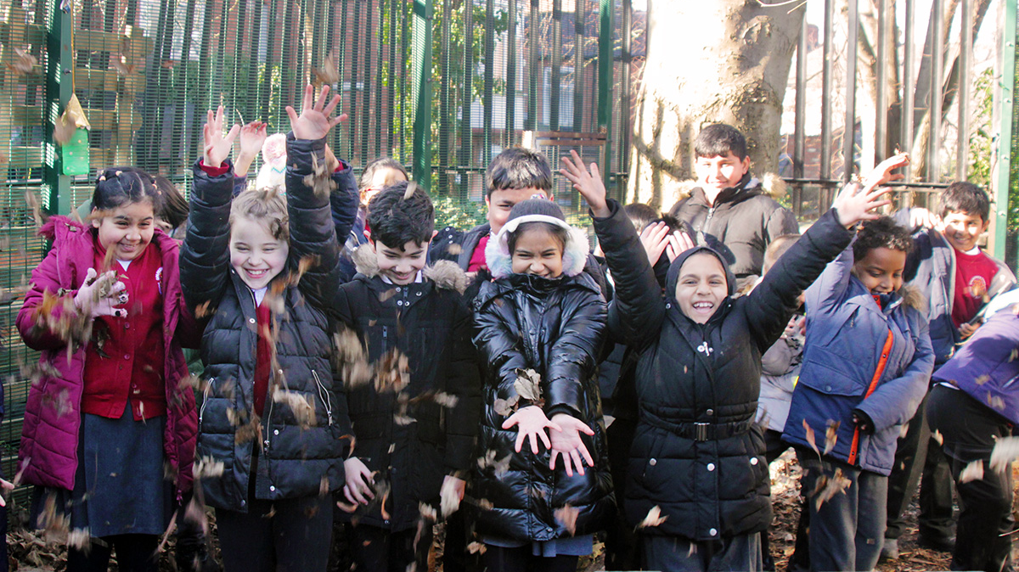
EMOTION
© Matt Larsen-Daw/WWF
Notes:
Fourth is emotion: Feeling alive through the emotions nature brings and fostering an emotional bond. There are many creative ways to achieve this, but it can include talking about, and reflecting on your feelings about nature. It might be finding happiness and wonder. Further guidance comes from the work on making note of the good things in nature, find joy in wildlife at play, take a moment to feel calm in nature.
https://findingnature.org.uk/2019/01/03/three-good-things-in-nature-3naturethings/

Slide 13
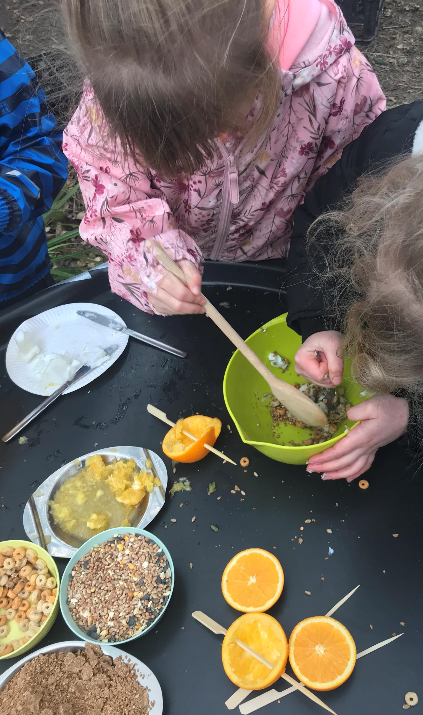
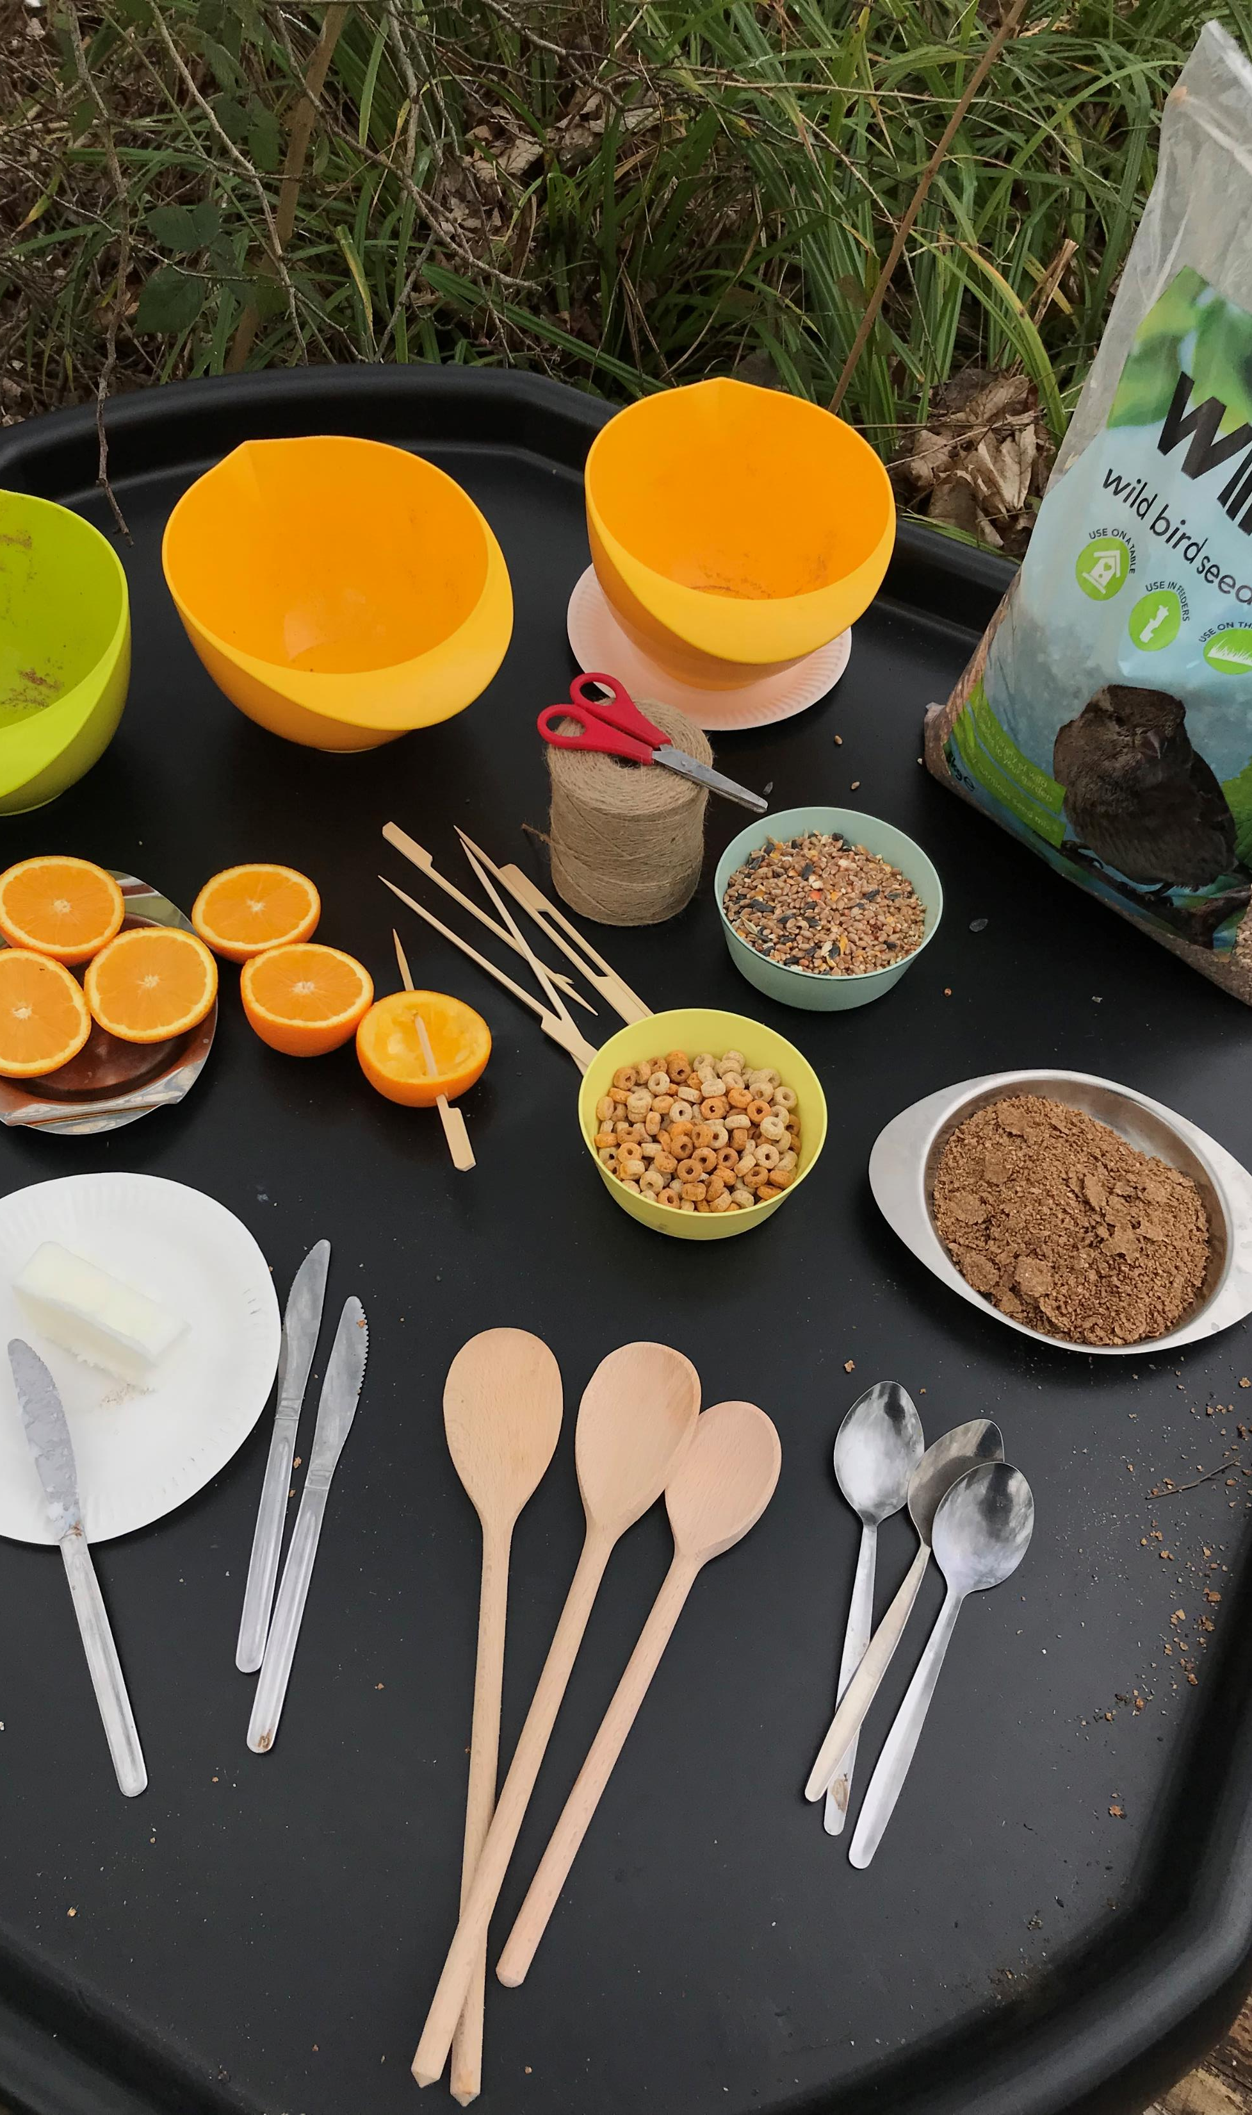
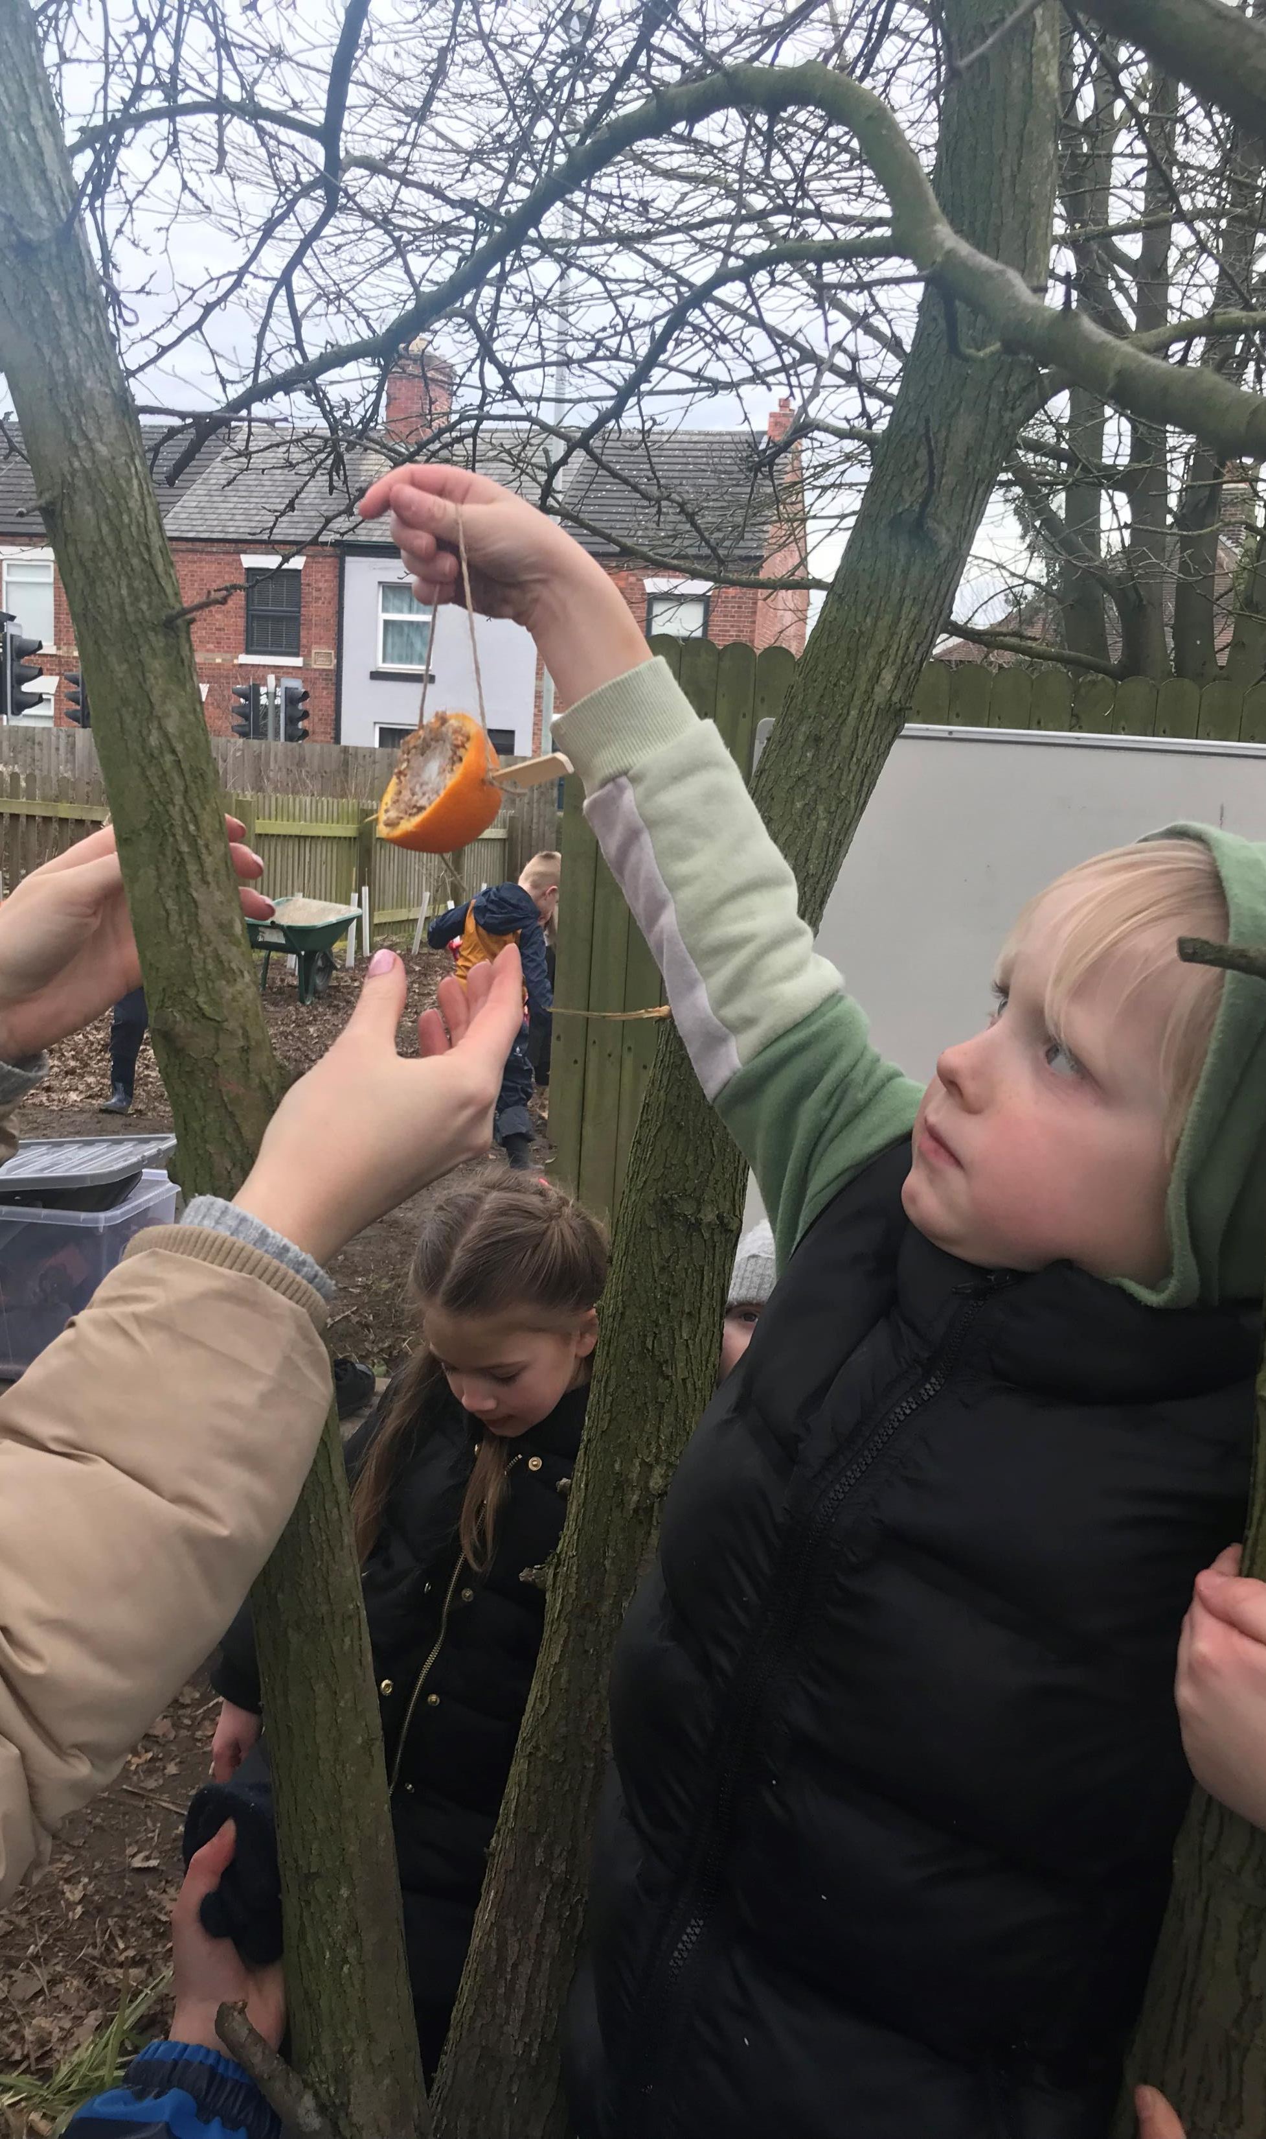
COMPASSION
© RSPB Wild Challenge Submissions
Notes:
And lastly compassion. When connected to nature our sense of self can be extended to include nature, it becomes something we notice every day and is part of our lives. As we build the awareness of how nature makes us feel, and the part it can play in our lives, it leads to a moral and ethical concern for nature as harming nature is harming ourselves. Compassion can range from making ethical product choices to being directly concerned with animal welfare. Feeling the need to take action to help nature, helping other people understand why that is important, and making these things feel like a natural process. Prompt people to consider what they could do for nature. Why not make a home for nature, show people how to take action for nature, plant wildflowers, and make bird feeders.

Slide 14
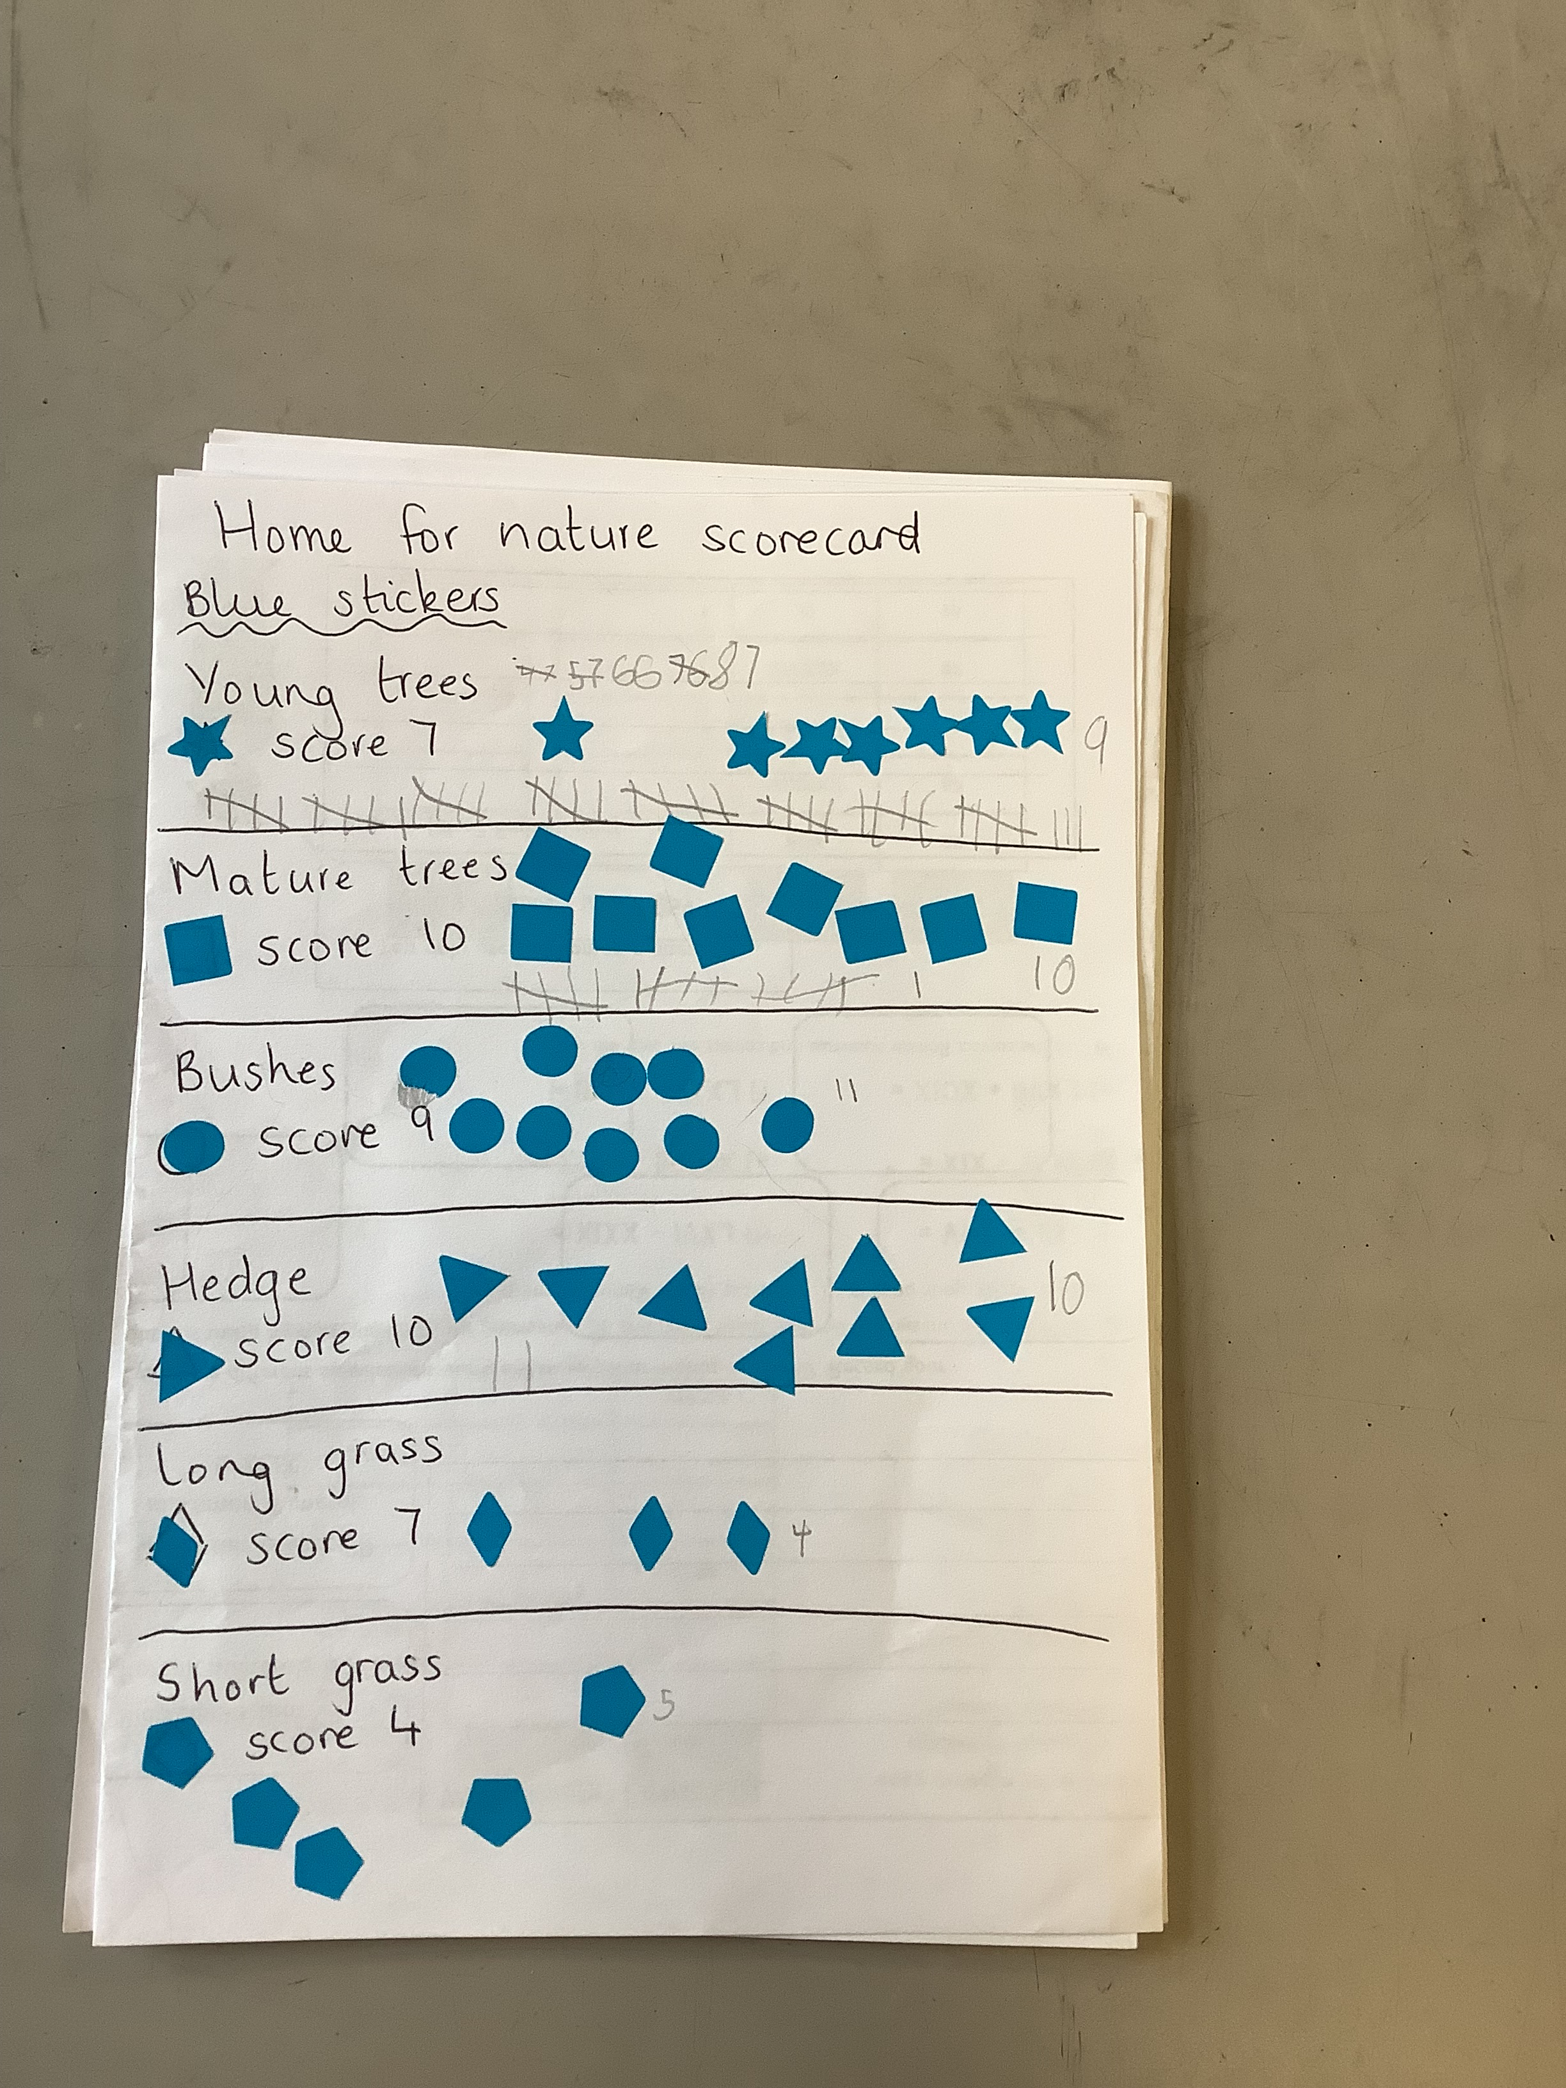
BIODIVERSITY ACTION PLAN
School grounds in England cover an area twice the size of Birmingham
School grounds can be used to explore local biodiversity and connect with nature
Actively improve UK biodiversity
© RSPB Curriculum for Nature Submission
Notes:
School grounds across England alone have a land mass which is twice the size of Birmingham. Not only will embedding opportunities to teach through and for nature have a positive impact on your pupils connectedness, and their pro-environmental behaviours, but it will develop your school grounds to be spaces for nature to thrive.
A great place to start is with your biodiversity action plan.

Slide 15
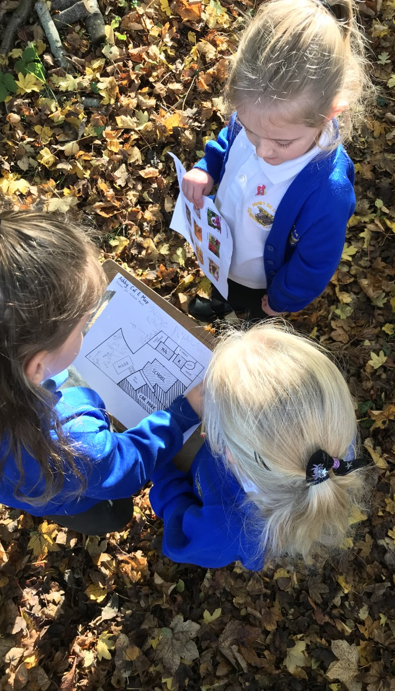
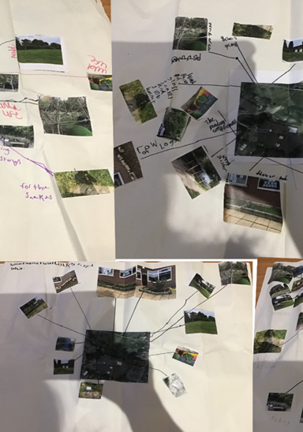
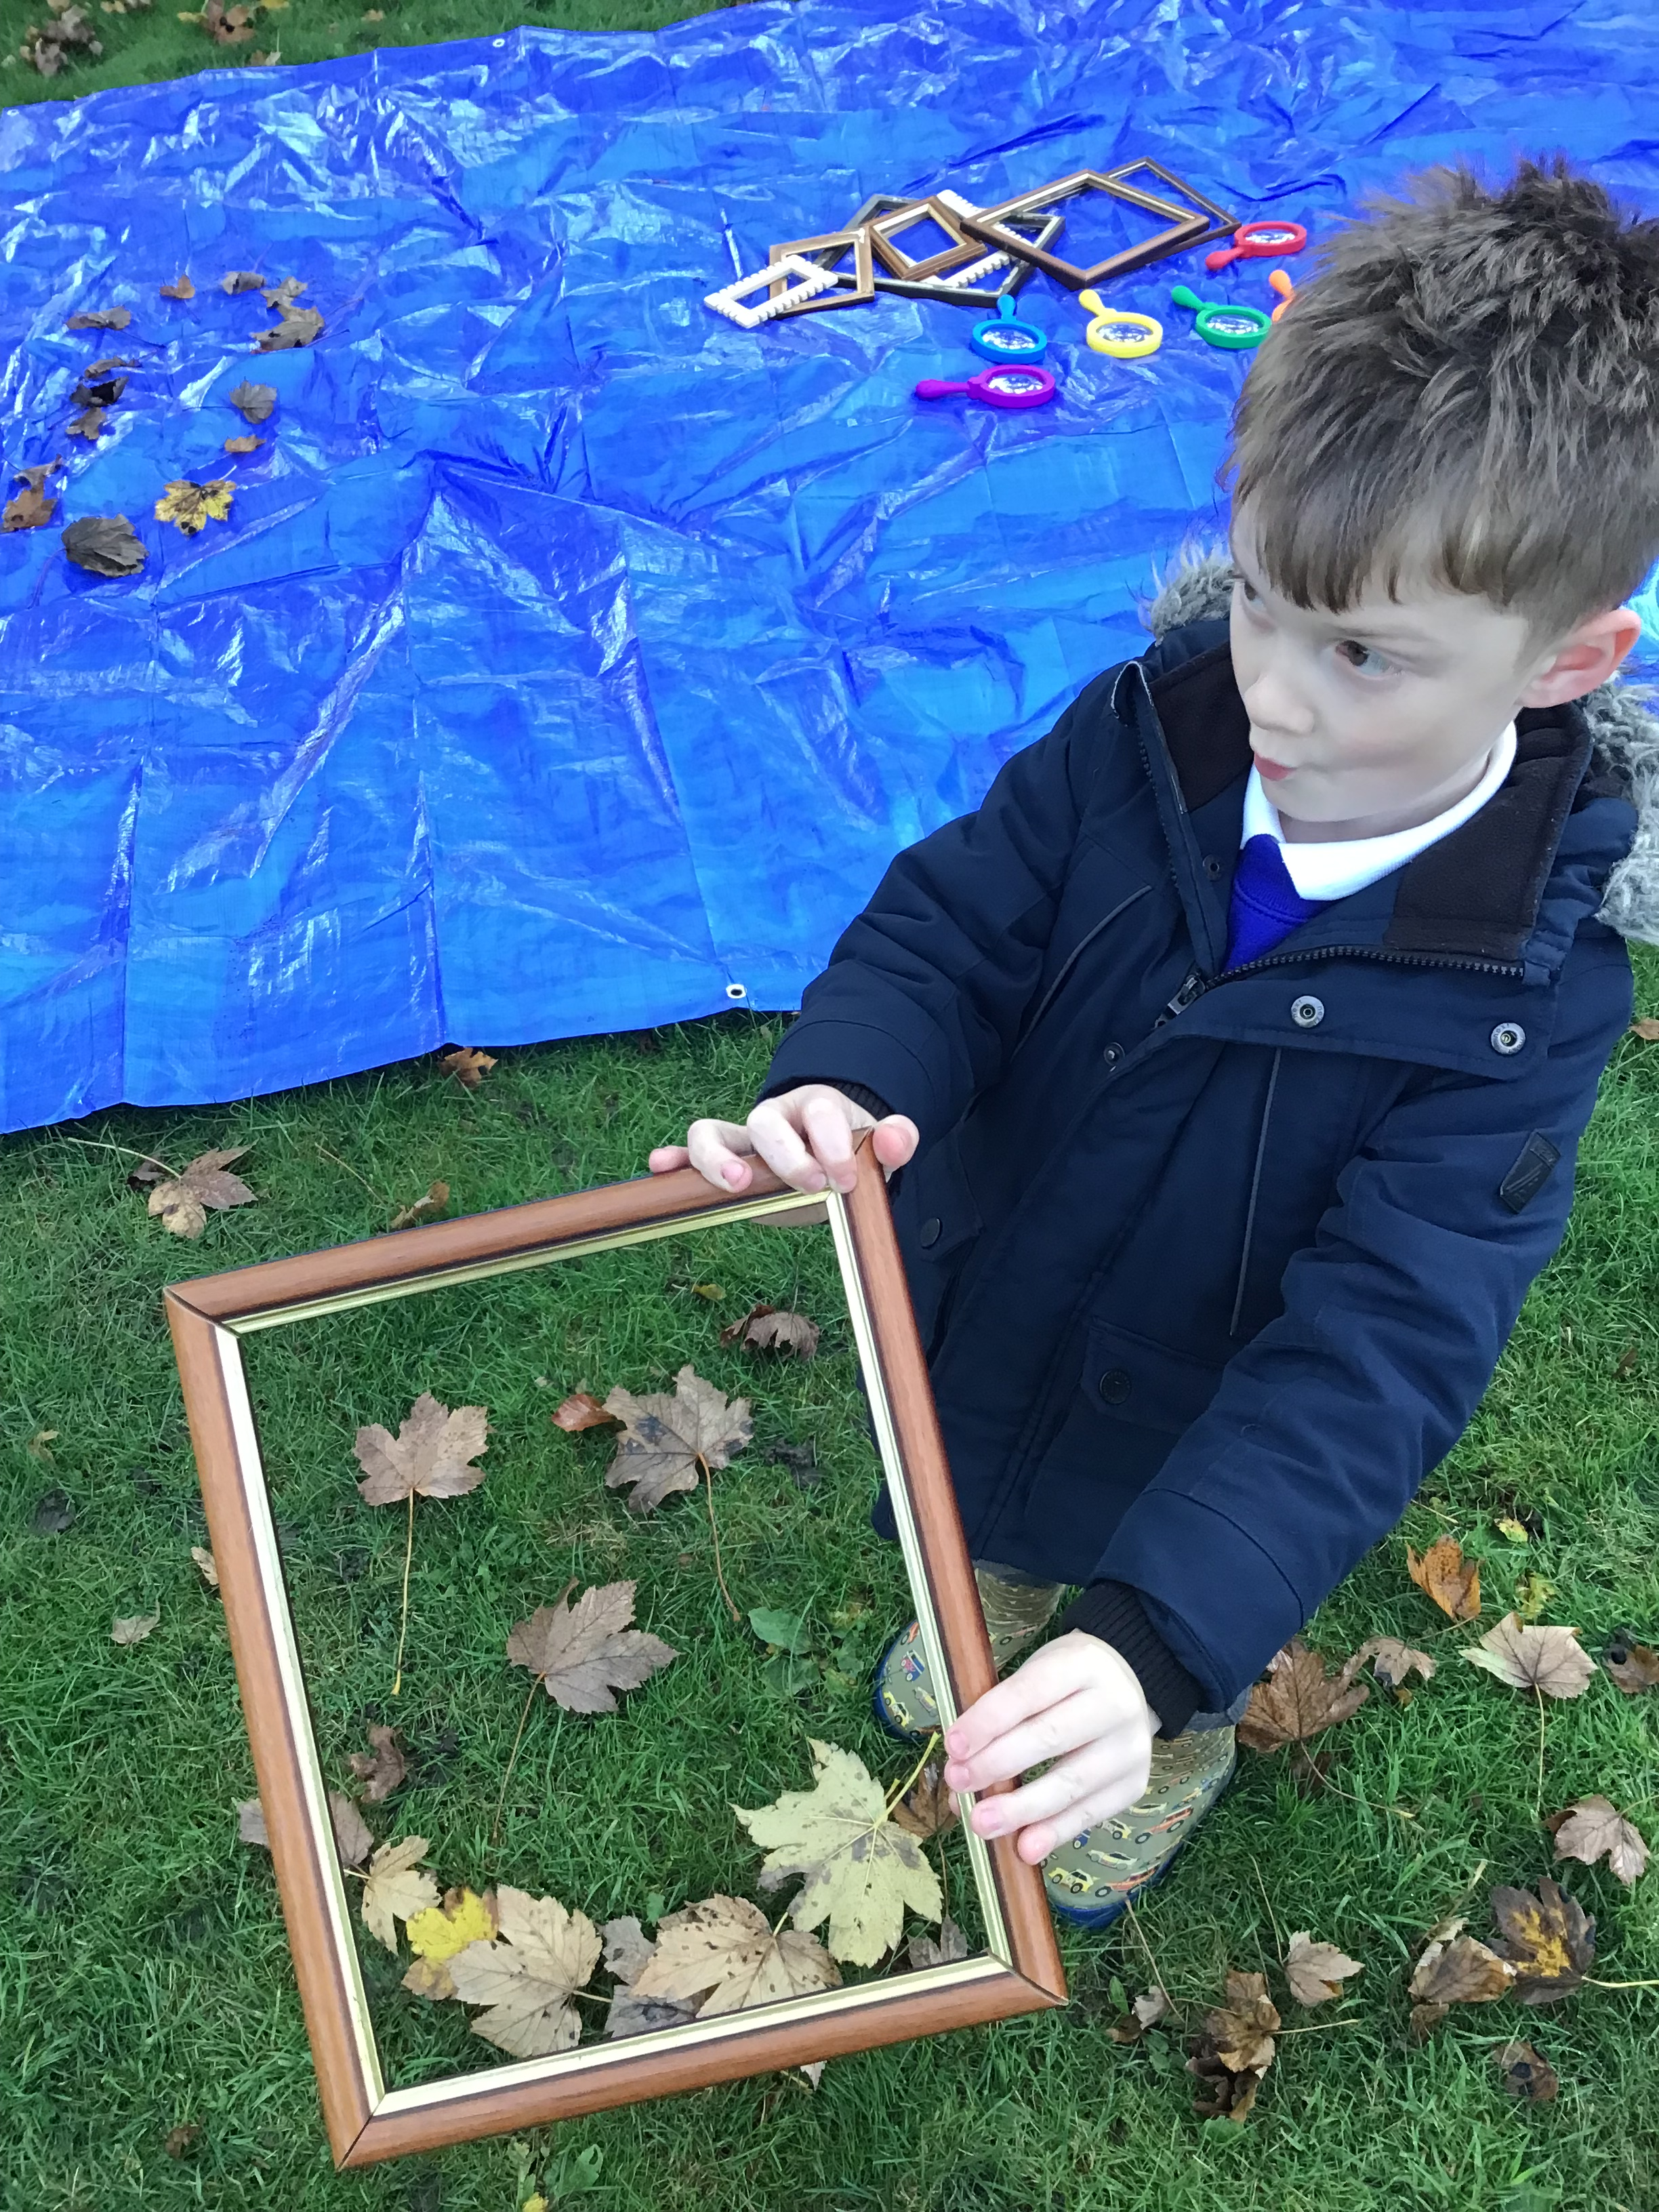
MAPPING
SURVEYING
PLANNING
RSPB Curriculum For Nature Submission
RSPB Curriculum For Nature Submission
RSPB Curriculum For Nature Submission
Notes:
This process can be led by your pupils, giving them an opportunity to map out the school grounds, noting all of the different types of areas you have. For example, shrubs, playing fields, tarmac yards etc. There are a range of ways you can do this from drawn maps to aerial images of your school grounds. This has great links to the Geography curriculum.
Surveying the different species you find using different techniques to survey each area. This is a great cross curricular activity as you can include identification, grouping, counting, charts, graphs etc.
Once you have a good picture of what your school grounds look like now and know which plants and animals call it home, you can begin to plan how the area could be improved. You could look at improving it for the wildlife that is already there, or you may want to develop an area to attract new species. In a project we ran, there was a school in central London which planted a wildflower meadow as part of the programme. The children noticed that they had started to see peacock butterflies in their wildflower garden, and they had never seen them in the school grounds before. They decided to do a bit of research and found out that peacock butterflies lay their eggs on stinging nettles. There was a large patch of stinging nettles on the other side of the school building. By planting the wildflowers they had created a nature corridor, which encourage the butterflies to fly over the school into their garden. The children were so happy not only that they had seen the butterflies, but they were proud that it was their actions that had made that happen.

Slide 16
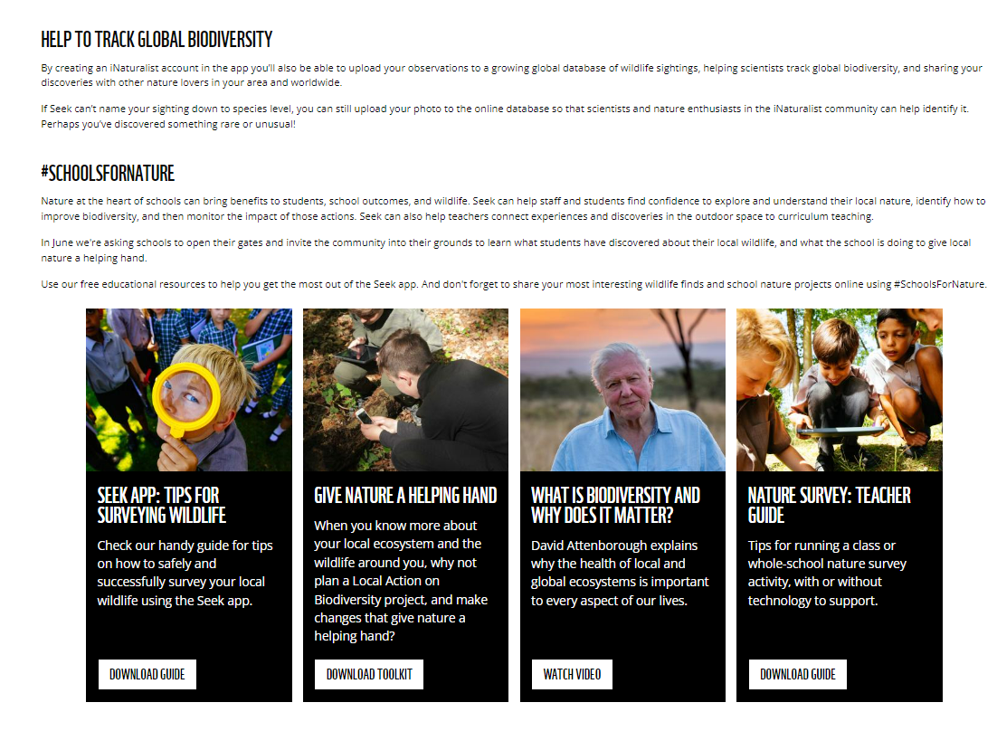
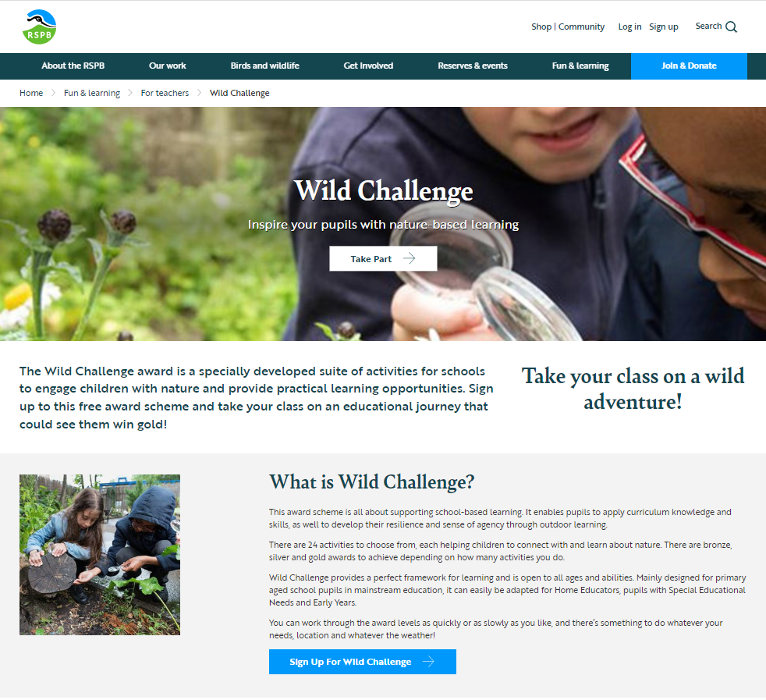
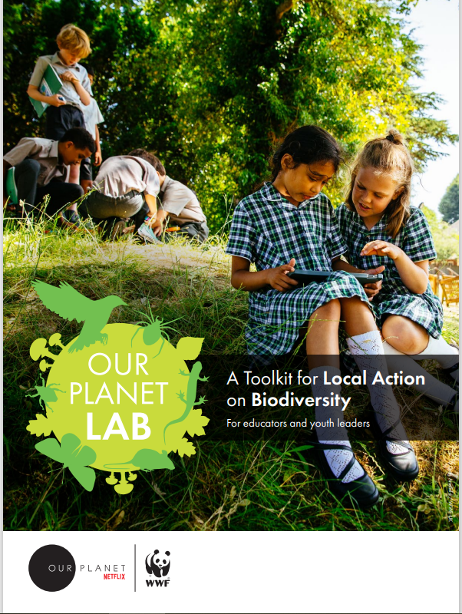

WHERE TO START
Free tools available from WWF
and RSPB
Survey your school grounds
Create your Biodiversity
Action Plan
Apply curriculum knowledge and skills, as well as developing resilience and sense of agency through outdoor learning
Notes:
Go to OurPlanetLAB_Toolkit.pdf (wwf.org.uk) to download the Local Action on Biodiversity toolkit from WWF to help you survey your schools grounds,
Sign up to RSPB’s Schools’ Wild Challenge where you can register your school, and upload evidence of how you are experiencing and helping nature, to gain a Wild Challenge Award. One of the Wild Challenge activities is a Biodiversity Action Plan. Schools' Wild Challenge - The RSPB

Slide 17

WILD ISLES RESOURCES
SCHOOLS FOR NATURE
Primary and secondary curriculum-linked
activity packs
  Exploring our Wild Isles presentation
  Woodlands
  Grassland
  Freshwater
  Marine
Spotter Guide
Reading Agency's Wild Isles reading list
www.saveourwildisles.com/schools
Take action for nature
Celebrate your actions for nature
w/c 12th June 2023
Download the Schools For Nature Celebration pack
Share on social media #SchoolsForNature
www.saveourwildisles.com/schools
Notes:
Wild Isles Resources
Primary and secondary curriculum-linked activity packs
Exploring our Wild Isles presentation
Woodlands
Grassland
Freshwater
Marine
Spotter Guide
Reading Agency's Wild Isles reading list
Schools For Nature
This June, we’re calling on schools and colleges to throw open their gates to families, local decision-makers and press to hold nature celebration events that raise awareness of the natural wonders in their local landscape, highlight the threats facing UK wildlife, and inspire action for nature in the community by showcasing the work of students and staff to make their school grounds wilder places. It will all help us contribute to the wider campaign to #SaveOurWildIsles.
The celebration is called Schools For Nature – and it’s your chance to celebrate your work to save nature in your school grounds. It’s all about celebrating work you’re already doing (we’re not asking you to do something brand new!)
How to take part:
You can celebrate by holding an event or open day, or an exhibition, in real-life, or on social media. However you choose to celebrate the work of your school, we hope you’ll add your voice to the celebration taking place across the UK. Post on social media using #SchoolsForNature and join us in highlighting the important contribution that schools can make to help nature.
Why celebrate?
Time and workload pressures in schools can leave you feeling stressed and less motivated. It’s important to build in time to celebrate your achievements. Celebration can become part of a whole school ethos that in turn promotes emotional and mental health. It’s also important to spend time with pupils celebrating the positive impact on them. This approach can reinforce essential resilience factors by:
● strengthening their experience of self-efficacy by valuing their participation
● helping them to recognise and value their experience of success
● developing their capacity to reflect
Equally important is the recognition that schools and pupils’ achievements are often supported by the local community. Celebrating with them enhances community spirit and can inspire them to take further action for nature.
To support this you will be able to down our Schools For Nature toolkit, with templates and ideas at www.saveourwildisles.com/schools
When you take part you will receive a certificate signed by Sir David Attenborough

Slide 18

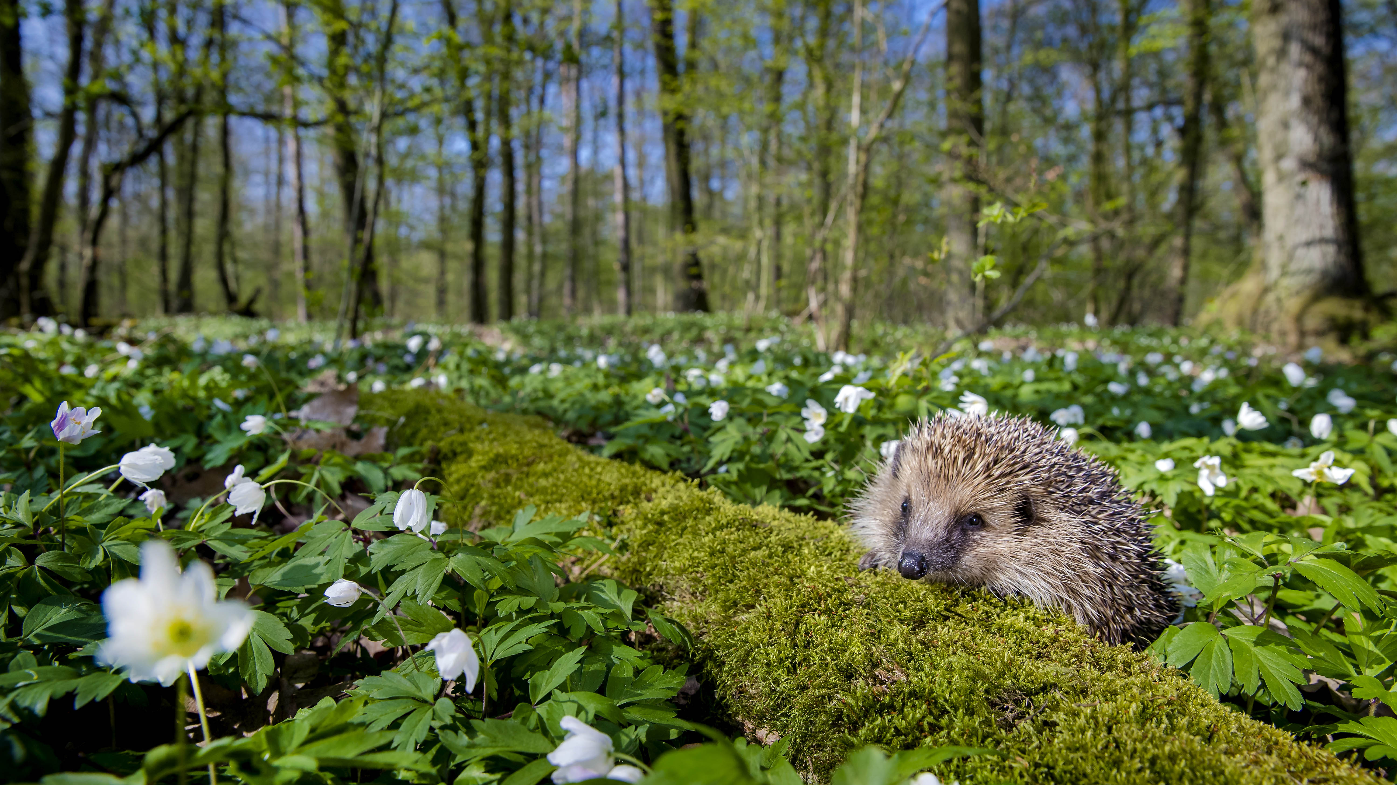

Though wild in some spaces, the UK is one of the most nature depleted places in the world. Because this is our home, it can only be our responsibility to protect and restore it. If schools across the UK could all become a little wilder, the benefits to nature - and to young people - would be huge. Take part in Schools For Nature and perhaps you can be the generation to pass these wild isles on in better shape than you inherited them.”
- Sir David Attenborough
"Though wild in some spaces, the UK is one of the most nature depleted places in the world. Because this is our home, it can only be our responsibility to protect and restore it. If schools across the UK could all become a little wilder, the benefits to nature - and to young people - would be huge. Take part in Schools For Nature and perhaps you can be the generation to pass these wild isles on in better shape than you inherited them.”
- Sir David Attenborough
© naturepl.com / Klein & Hubert / WWF
Notes:
"Though wild in some spaces, the UK is one of the most nature depleted places in the world. Because this is our home, it can only be our responsibility to protect and restore it. If schools across the UK could all become a little wilder, the benefits to nature - and to young people - would be huge. Take part in Schools For Nature and perhaps you can be the generation to pass these wild isles on in better shape than you inherited them.” – Sir David Attenborough

Slide 19
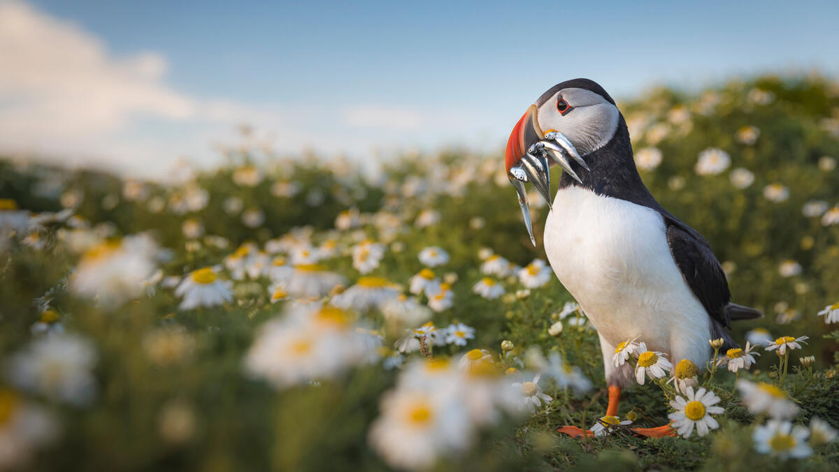


© Drew Buckley (rspb-images.com)

